Slide 1
Day Care
Management System
Jianwei Hu, Hongji Luo, Juan Wu, Yucheng Qu, Jing Zhang

Slide 2

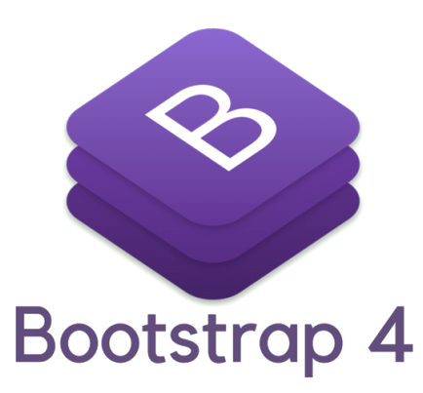


Technology
Backend: Java, Spring Boot
Database: MySQL
Frontend: Bootstrap 4, Javascript

Slide 3
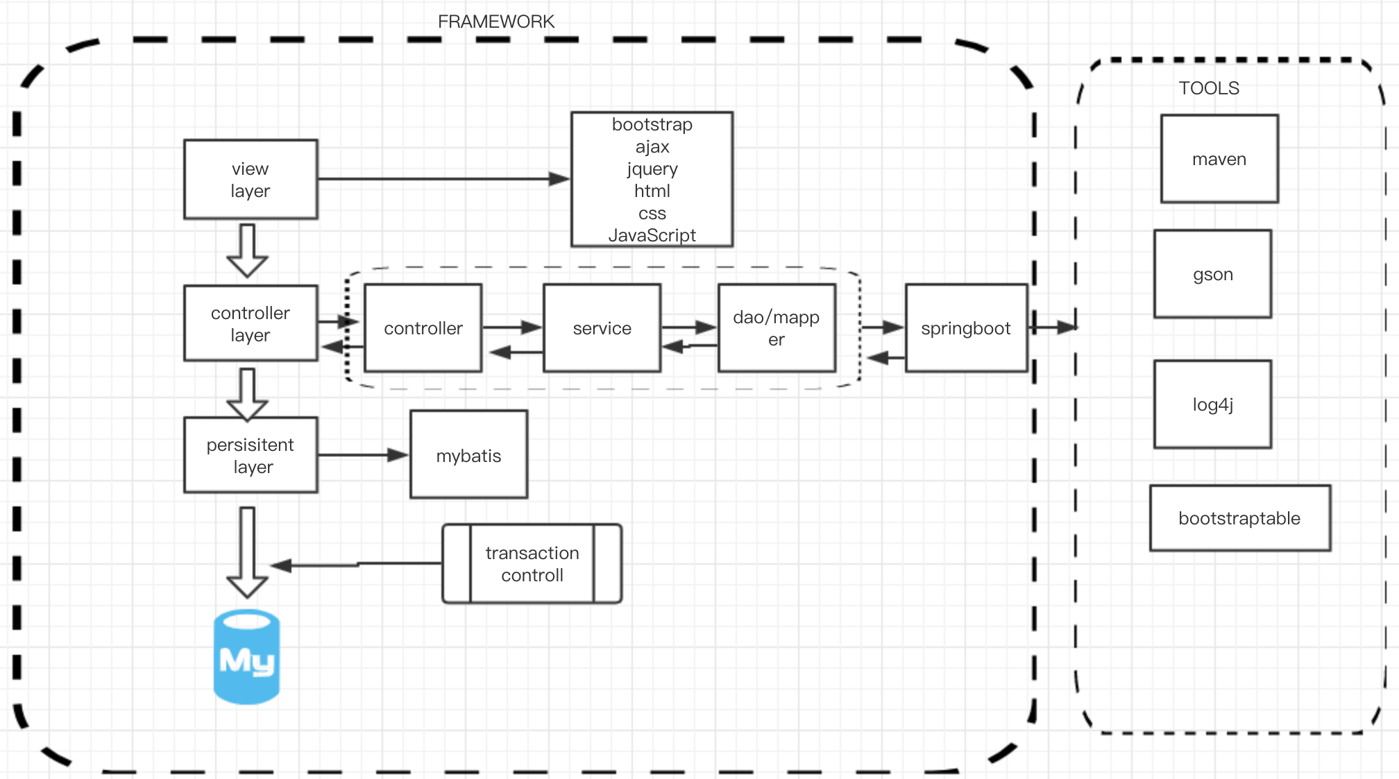
Project Structure

Slide 4
Demo

Slide 5
Features
Easy to use Information panel for day care manager
Easy to enroll students and teachers and capture the data
Easy to track the students and teachers annual registration renewal
Easy to track immunization anniversaries
Assign students to teacher according the the state regulations
Assign student/teacher groups to classrooms according to state regulations

Slide 6
Object Oriented Design
Encapsulation
Abstraction
Inheritance
Polymorphism

Slide 7
SOLID
Single Responsibility
Open-Closed
Liskov Substitution
Interface Segregation
Dependency Inversion

Slide 8
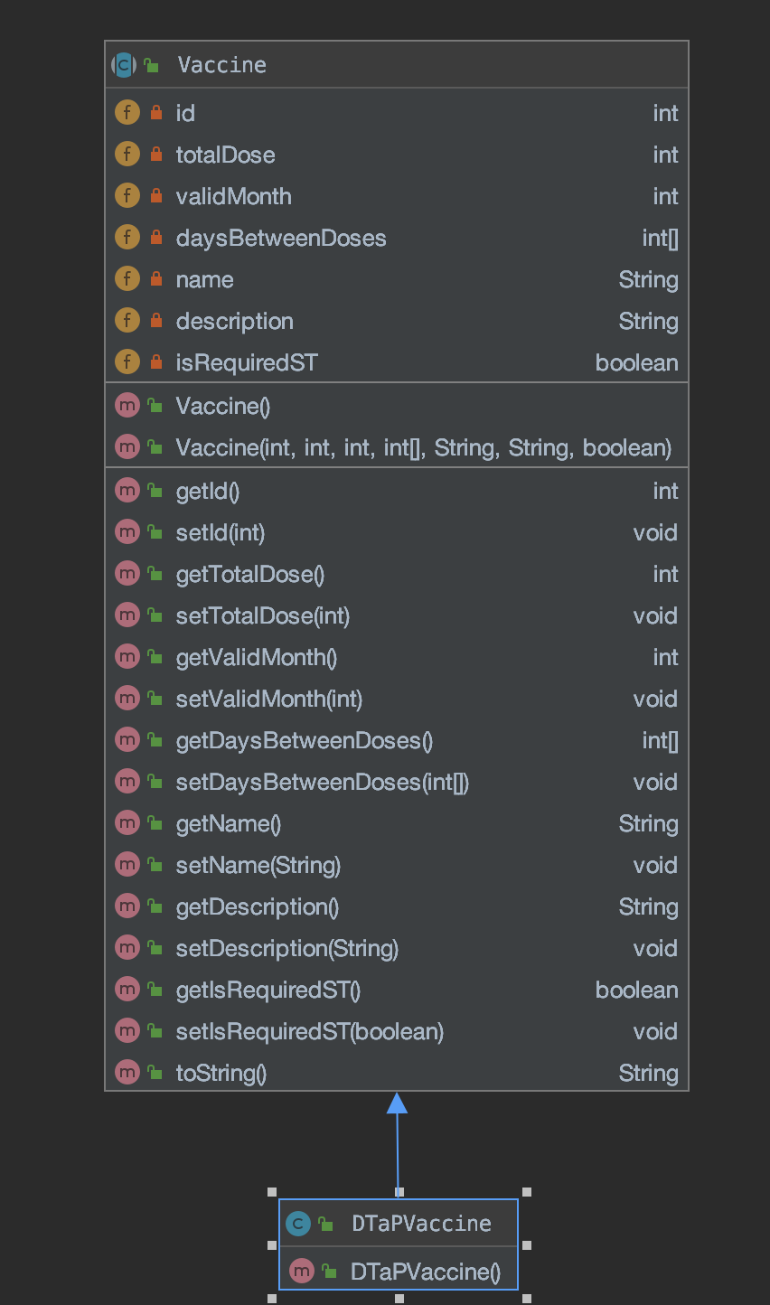
Single Responsibility
Vaccine class contains only variables and methods that is related to the vaccine.
Notes:
Vaccine class only do the single responsibility, contains the attributes of the vaccine

Slide 9
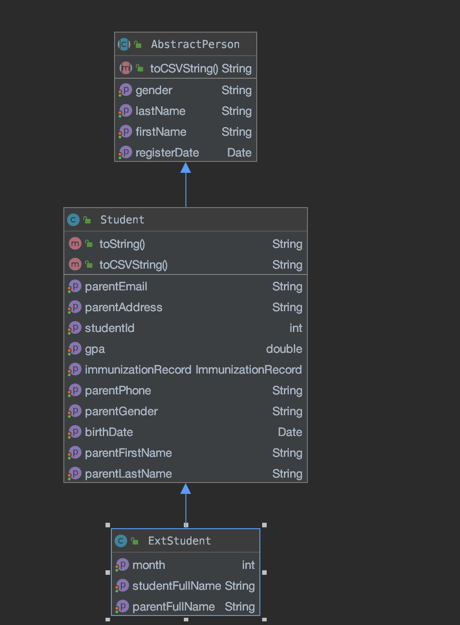
Open-Closed
Student class extends from AbstractPerson class instead of modifying the parent class.
Notes:
Class is open to extension, closed to modification

Slide 10
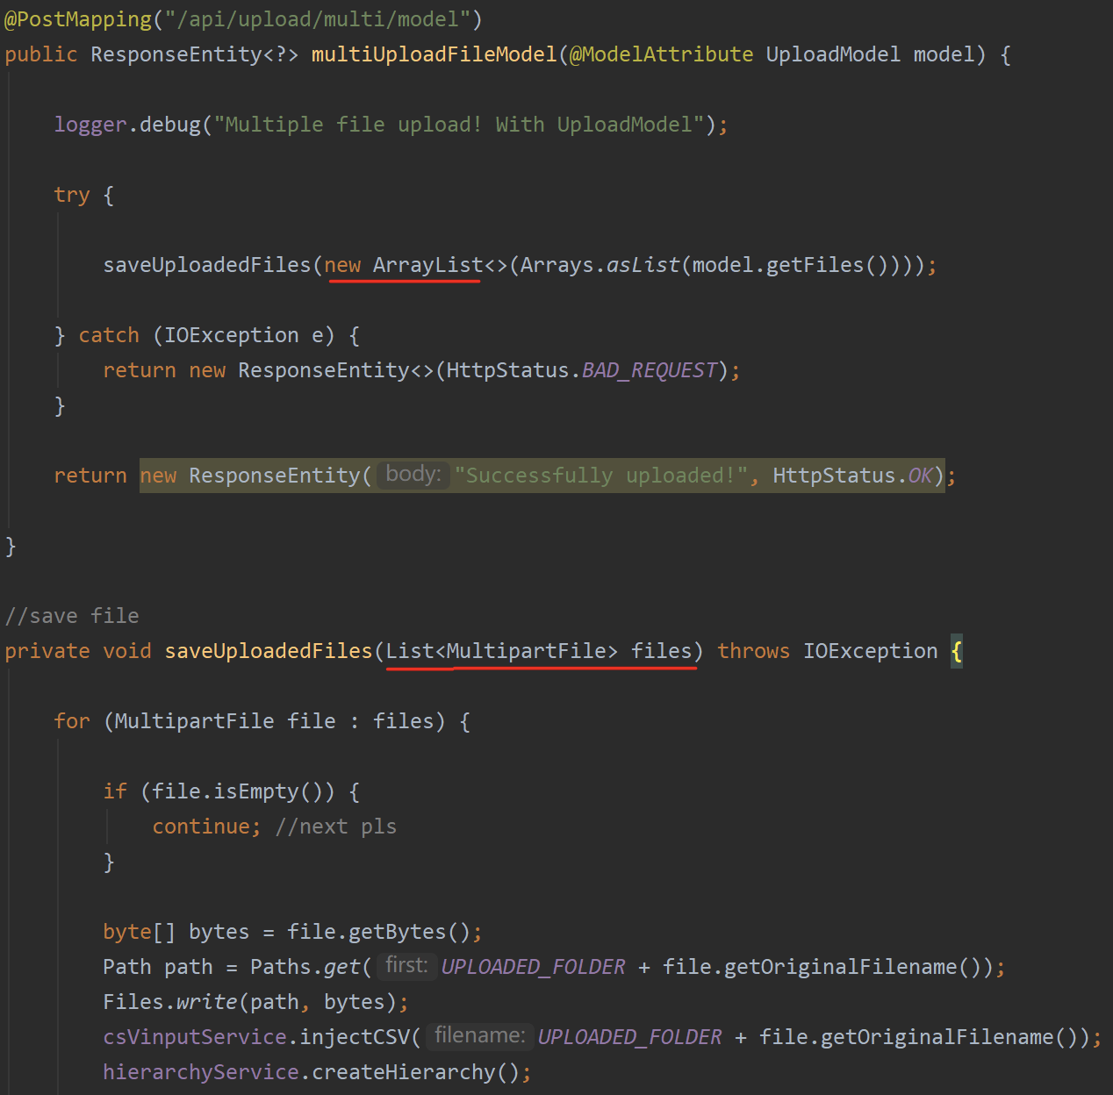
Liskov Substitution
Implement List instead of ArrayList
Notes:
•IS-A Relationship: Any subclass may be Substituted for its Super class; •Run-time Polymorphism;
•Employ Strong subtyping by implementing specific interfaces in subclass; –Used to differentiate subclasses;

Slide 11
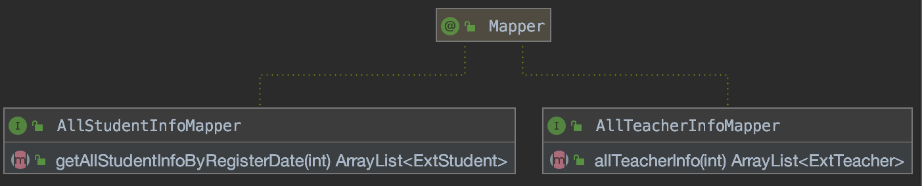
Interface Segregation
Mapper interface only contains what is for mapping.
Only focus on getting all students/teachers information.
Notes:
Interface: •Small granularity Very focused and Specific purpose;

Slide 12
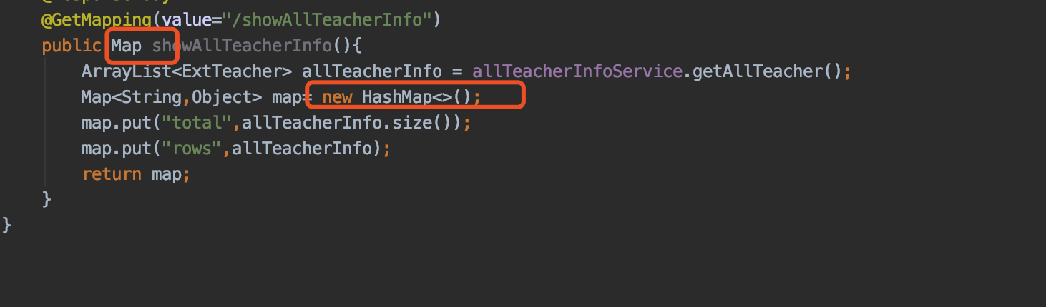
Dependency Inversion
Depend on Map interface instead of a specific Map.
Functionality hiding, subclass hashmap is never named
Notes:
•Loosely coupled Design; •Depend on abstractions.

Slide 13
Factory Pattern Method
There are two kinds of beans in the Spring bean container: ordinary beans and factory beans.
Spring-Boot annotation @Autowired to implement factory method pattern
E.g.
Service is a bean, and use autowired to go to beanfactory and get a service object

Slide 14
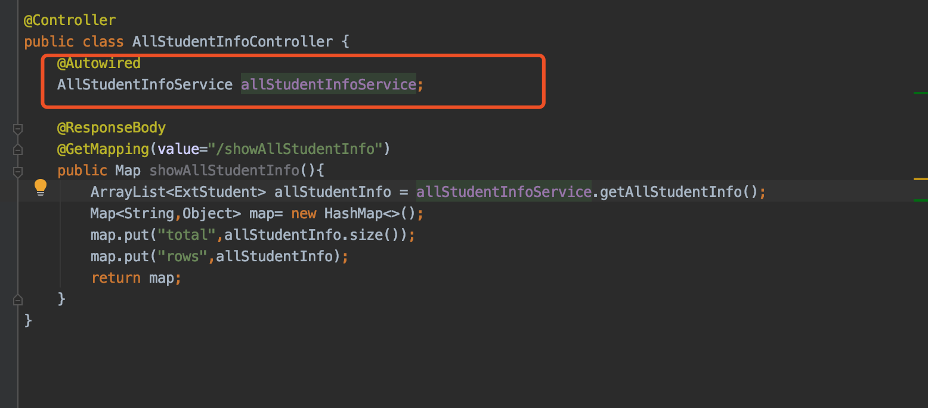
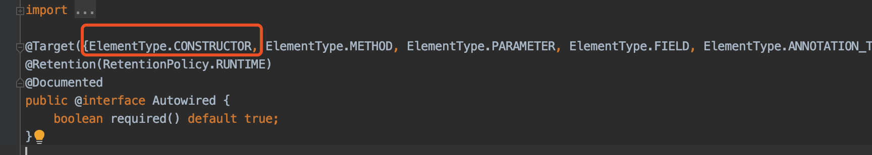
Notes:
Service is a bean, and use autowired to go to beanfactory and get a service object

Slide 15
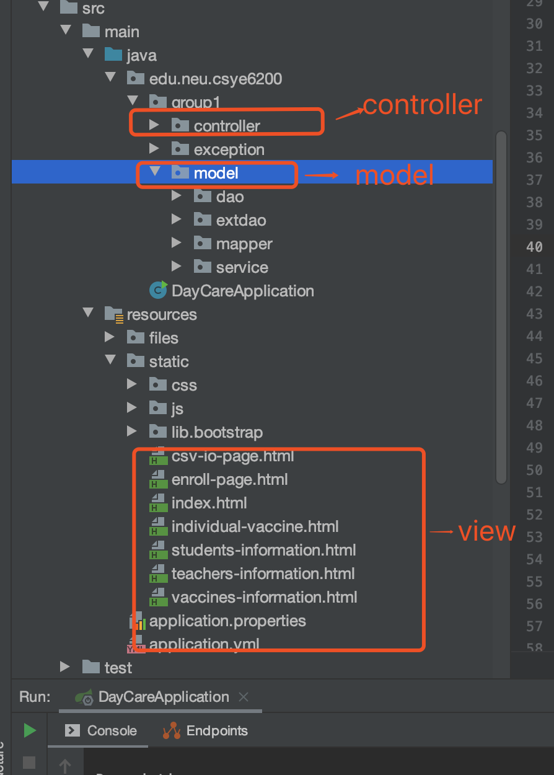
MVC Design Pattern
Model: mapper and dao contains the pure application data
View: present the data to user, the html page
Controller: listens to events triggered by view, between view and module, use json and api to communication. In most cases, the reaction is to call a method on the model.

Slide 16
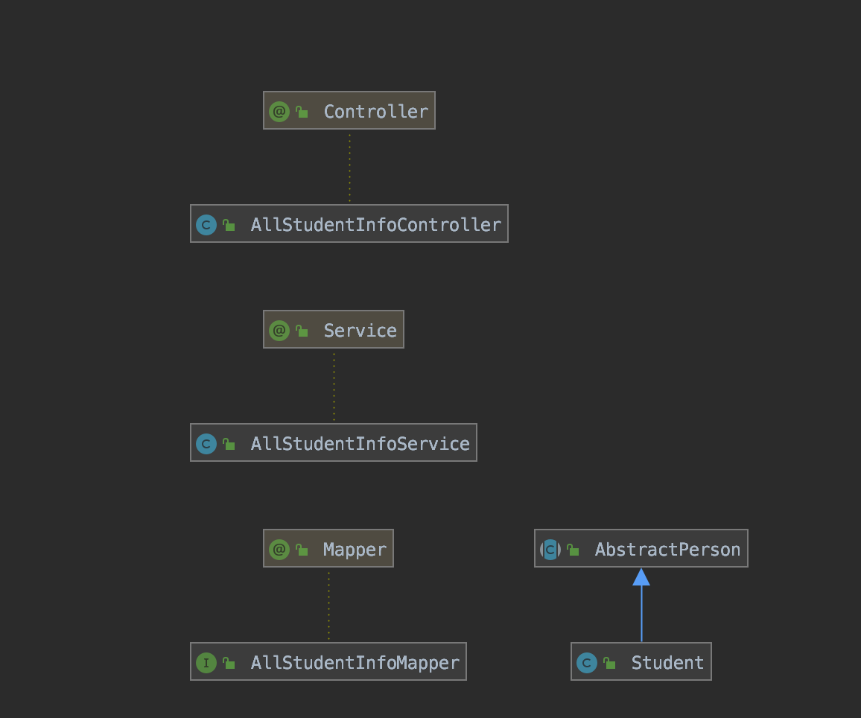
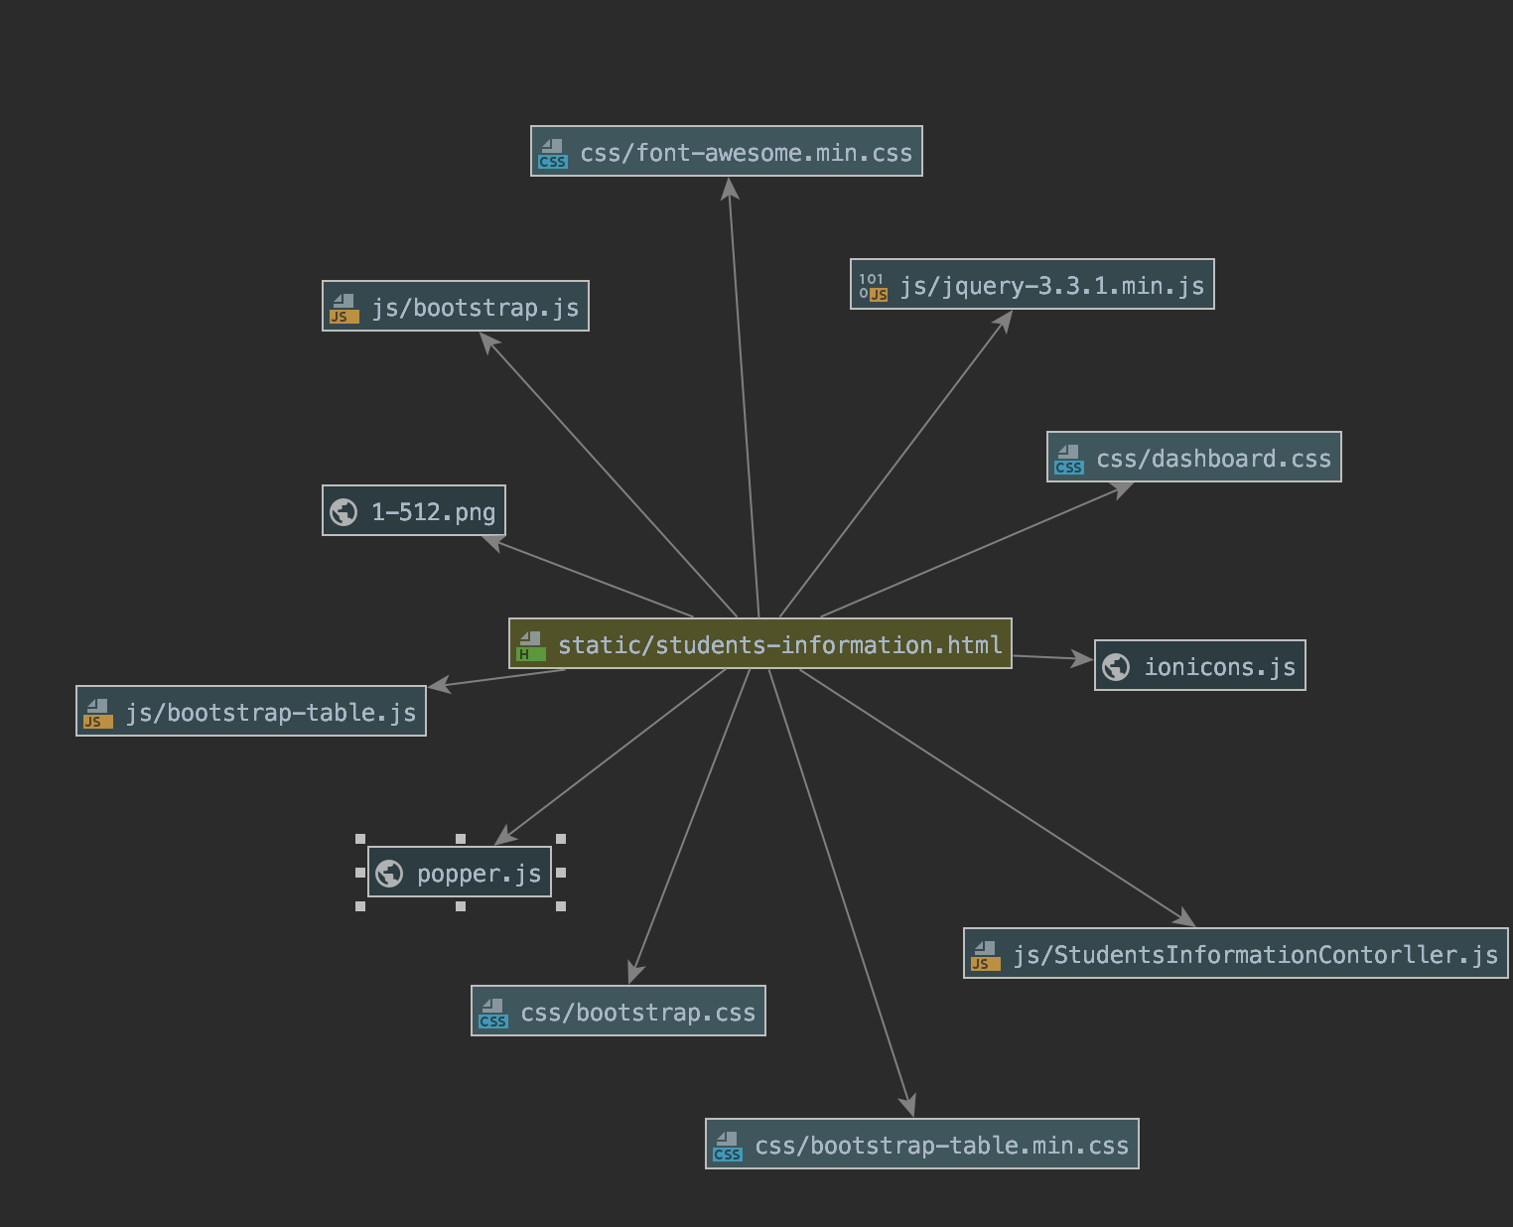
controller
view
model

Slide 17
Thank You

