Slide 1
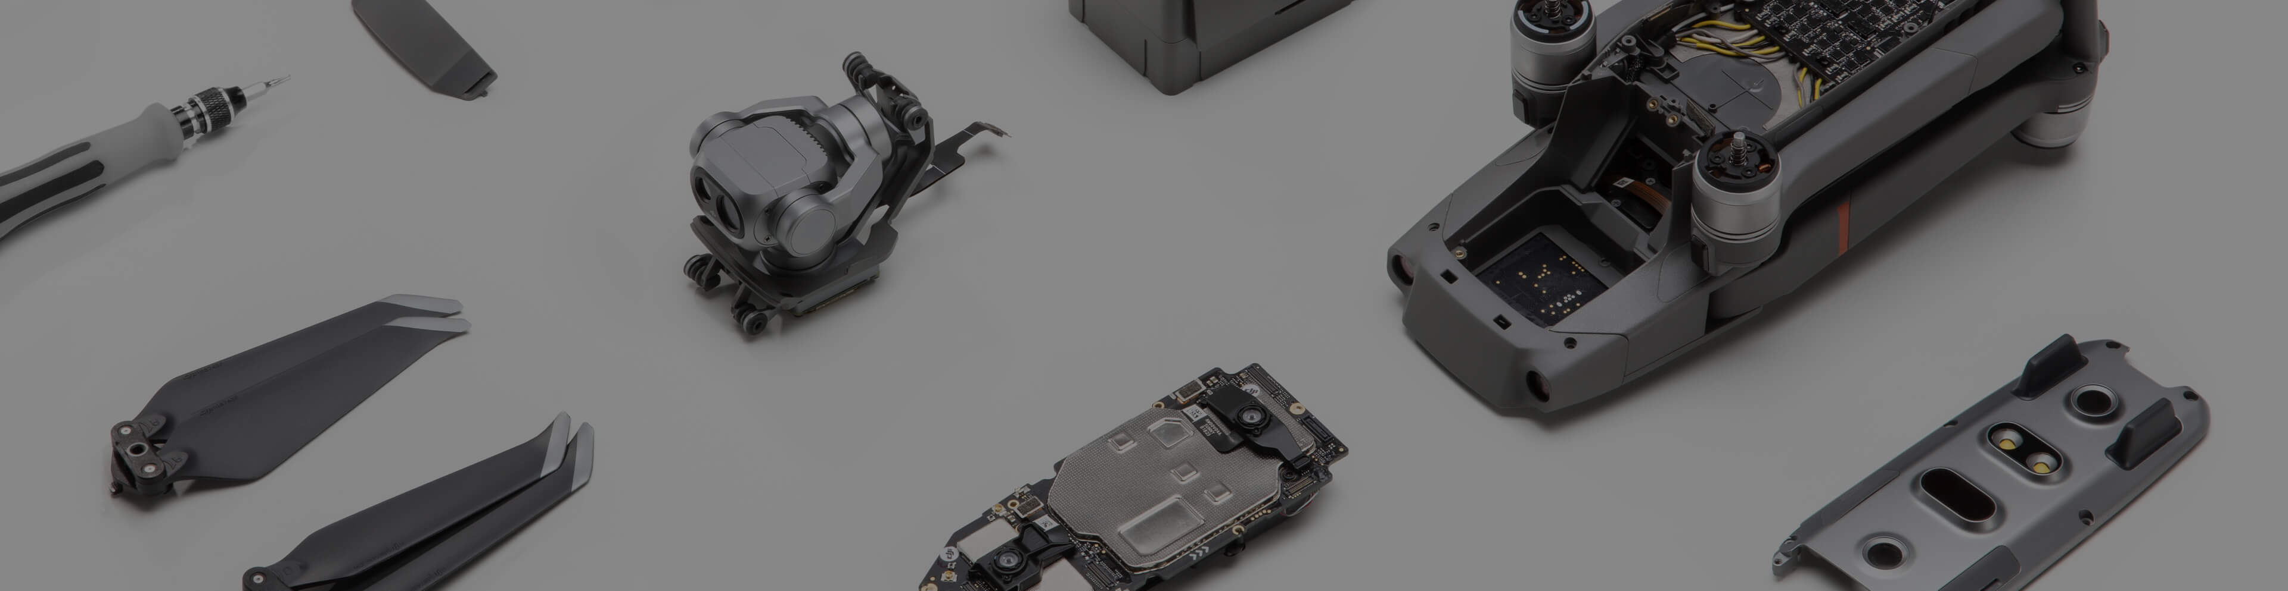
Crowd Surveillance
Object Detection Application Designed for DJI Smart Drone
2019 Design & Build Winter Hack
Team 3

Slide 2
01
Design Architecture
02
Technology Inside
Content
03
Problems
04
Future Works
05
Future Applications

Slide 3

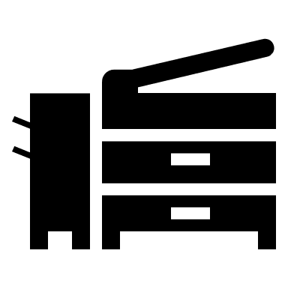

1
Design Architecture
Drone
Control the drone
Video Streaming (RTMP)
Controller
RTMP Server
Client: laptop or mobile
Send back results
Process the video streaming and generate web/mobile
Access the results via http

Slide 4
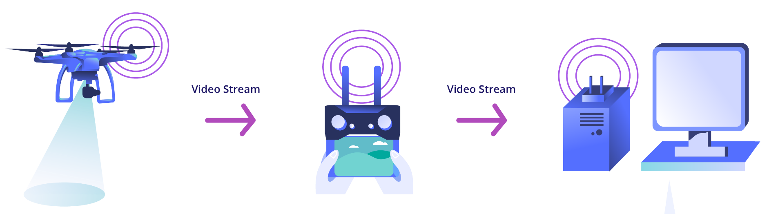
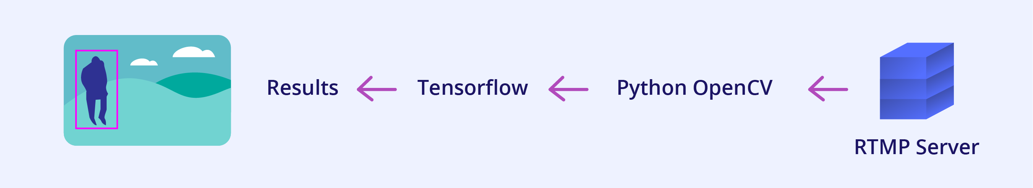
2
Technology Inside
Real-time Video Transfer: Real-Time Messaging Protocol (RTMP)
Step 1:
Step 2:

Slide 5
3
Problems
Interface problem of package ml5js/tensorflow/opencv
Ml5js: A Collection of JavaScript based computer vision libraries (includes PoseNet, YOLO, Style Transfer, etc).
We try to find some functions or related packages that let it receives RMPT video streaming as input, rather than the video devices of the client computer.
Latency of 30 seconds
To create a mobile application integrating all of the above.
To be continued~~~

Slide 6
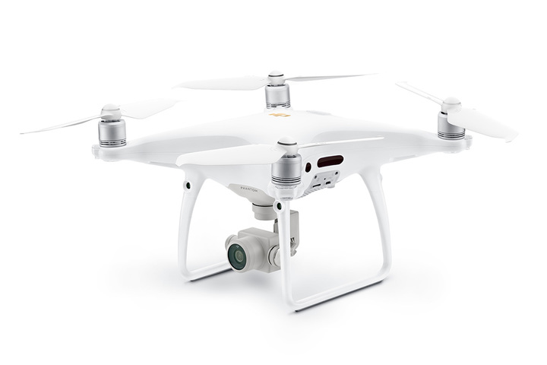
4
Future Works
Future Works: Training our own detection model
DJI smart drone:
Train own models to generate application specific object detection.
Broadcast the stream to multiple clients simultaneously.
Better architecture to reduce the stream latency.
To be continued~~~

Slide 7
5
Future Applications
In Shopping Mall, Museums, Playground, etc.
We can have crown monitoring and counting. Or even set up a virtual parameter
In the play grounds to monitor and detect kids when they go beyond the boundary.
To be continued~~~

Slide 8
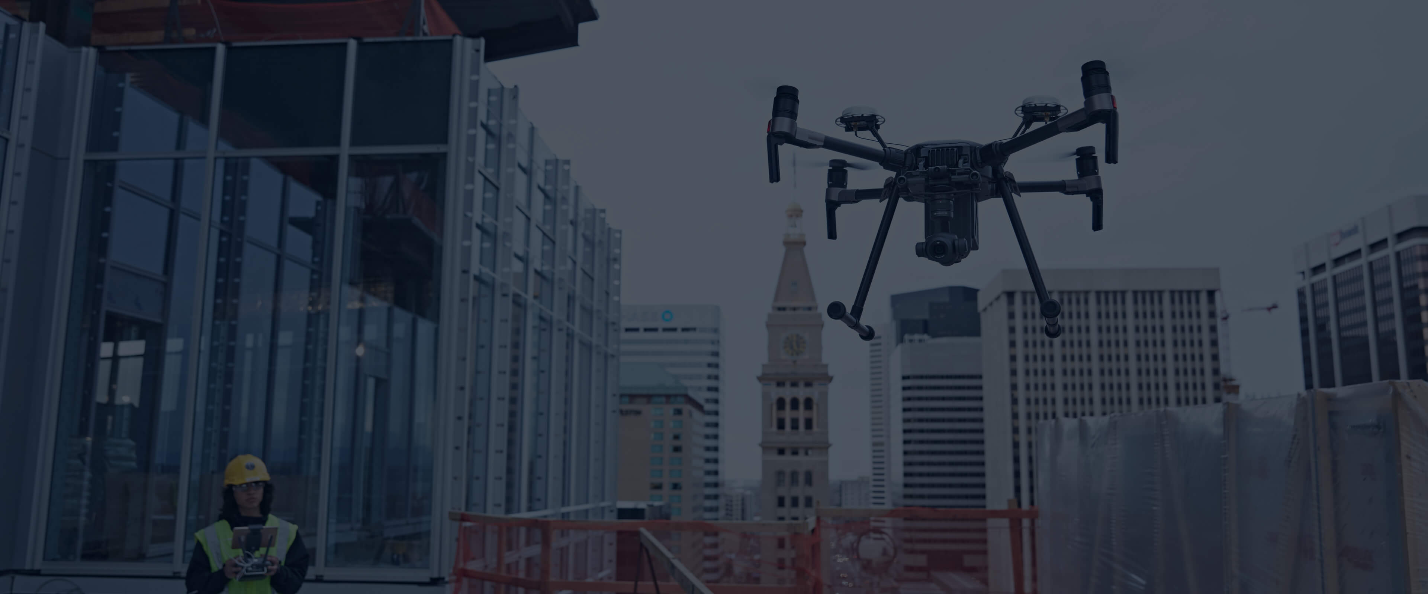
Thanks for listening!

