Slide 1
[CS 584] Data Mining
Text Classification
Carlotta Domeniconi

Slide 2
Topics
Common scenarios in text classification
Representation of text: bag-of-words
Feature selection/construction methods
K-Nearest Neighbor classifier
Criteria for evaluating predictive performance

Slide 3
Why text classification?
Key method for organizing online information;
Basic building block in a wide range of applications:
  Yahoo! directories categorize Web pages by topic;
  Online newspapers customize themselves to users’ preferences;
  Routing agents at service hotlines forward incoming emails to the appropriate expert by content;
  …

Slide 4
Challenges
Large input space: A word level representation easily leads 30,000 or more dimensions;
Little training data: Fewer training examples than dimensions;
Noise: Natural language documents contain mistakes. Mislabeled examples;
Complex learning tasks: The classes of text classification tasks are often based on the semantic of natural language;
Computational efficiency: Training algorithms must handle the large number of features efficiently.

Slide 5
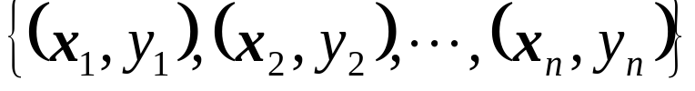
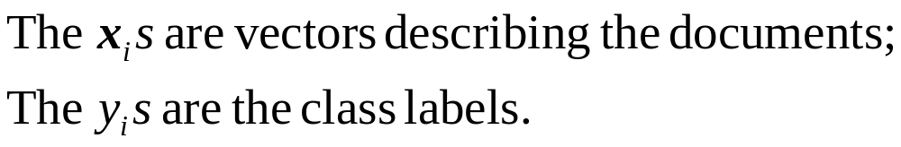
Learning from Examples
Goal: Infer a classification rule from a sample of labeled training documents so that it classifies new examples with high accuracy.

Slide 6
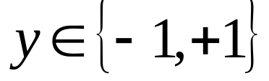
Binary Setting
There are exactly two classes;
  E.g., “relevant” and “non-relevant” in an information retrieval application;
  E.g., “spam” and “non-spam” messages in an email filter.

Slide 7
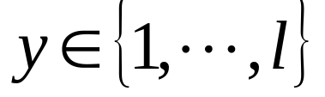
Multi-Class Setting
There are more than two classes;
  E.g., an email routing agent might need to forward an incoming email to one out of ten (l=10) customer representatives;

Slide 8
Multi-Label Setting
A document can have multiple labels;
  E.g., indexing of news articles: a single story could be in the categories soccer and Italy;

Slide 9
Representing Text
The representation of sample documents has a crucial influence on how well the learning algorithm can generalize;
Most machine learning algorithms require that each example is described by a vector of fixed dimensionality;
By far, the most common way to represent text for text classification is the word-based representation (lexical level representation).

Slide 10

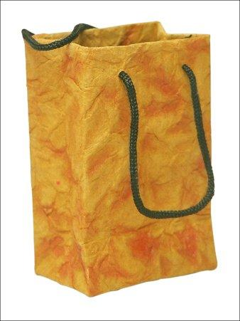
Representing Text
Of all the sensory impressions proceeding to the brain, the visual experiences are the dominant ones. Our perception of the world around us is based essentially on the messages that reach the brain from our eyes. For a long time it was thought that the retinal image was transmitted point by point to visual centers in the brain; the cerebral cortex was a movie screen, so to speak, upon which the image in the eye was projected. Through the discoveries of Hubel and Wiesel we now know that behind the origin of the visual perception in the brain there is a considerably more complicated course of events. By following the visual impulses along their path to the various cell layers of the optical cortex, Hubel and Wiesel have been able to demonstrate that the message about the image falling on the retina undergoes a step-wise analysis in a system of nerve cells stored in columns. In this system each cell has its specific function and is responsible for a specific detail in the pattern of the retinal image.
sensory, brain,
visual, perception,
retinal, cerebral cortex,
eye, cell, optical
nerve, image
Hubel, Wiesel
perception
sensory
retinal
Cerebral cortex
Wiesel
optical
nerve
cell
brain
visual
eye
Bag-of-words representation of a document

Slide 11
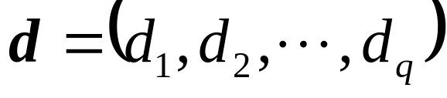
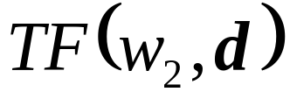
Of all the sensory impressions proceeding to the brain, the visual experiences are the dominant ones. Our perception of the world around us is based essentially on the messages that reach the brain from our eyes. For a long time it was thought that the retinal image was transmitted point by point to visual centers in the brain; the cerebral cortex was a movie screen, so to speak, upon which the image in the eye was projected. Through the discoveries of Hubel and Wiesel we
Of all the sensory impressions proceeding to the brain, the visual experiences are the dominant ones. Our perception of the world around us is based essentially on the messages that reach the brain from our eyes. For a long time it was thought that the retinal image was transmitted point by point to visual centers in the brain; the cerebral cortex was a movie screen, so to speak, upon which the image in the eye was projected. Through the discoveries of Hubel and Wiesel we
Of all the sensory impressions proceeding to the brain, the visual experiences are the dominant ones. Our perception of the world around us is based essentially on the messages that reach the brain from our eyes. For a long time it was thought that the retinal image was transmitted point by point to visual centers in the brain; the cerebral cortex was a movie screen, so to speak, upon which the image in the eye was projected. Through the discoveries of Hubel and Wiesel we
Of all the sensory impressions proceeding to the brain, the visual experiences are the dominant ones. Our perception of the world around us is based essentially on the messages that reach the brain from our eyes. For a long time it was thought that the retinal image was transmitted point by point to visual centers in the brain; the cerebral cortex was a movie screen, so to speak, upon which the image in the eye was projected. Through the discoveries of Hubel and Wiesel we
perception
sensory
retinal
Cerebral cortex
Wiesel
dictionary
optical
nerve
cell
w1 w2 …. wq
brain
visual
eye
Term Frequency

Slide 12
Word-Based representation
Bag-Of-Words: Using words as indexing terms, a document is transformed into a sequence of words. The ordering of words is ignored. Thus the sequence of words becomes a “bag” of words.
Each document is then represented as a vector:
  Each component is indexed by a word;
  The value of the component can be the number of times the word appears in the document (Term Frequency).

Slide 13
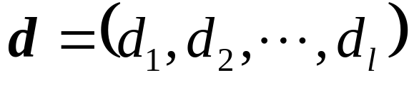
Bag-Of-Words
dictionary
w1 w2 …. wl
Term Frequency
TF(w,d) = number of times the word w occurs in document d

Slide 14
Bag-Of-Words
Very effective in information retrieval and text classification;
It is simple;
Leads to a loss of information (ambiguities at word level cannot be resolved, e.g. book, bank);
Seams to capture enough meaning of the document, while keeping the representation simple.

Slide 15
BOW: Why does it work?
A language continuously adapts to the distribution of tasks, e.g., by introducing new words;
The dictionary of a language reflects what we deem as important;
The same notion of importance also drives the text-classification tasks.

Slide 16
BOW: Why does it work?
Example: For an Eskimo, classifying weather reports by the type of expected snowfall might be an important text-classification task;
The Eskimo language is said to have many words differentiating between different types of snow; e.g.: 49 words for snow and ice from a West Greenlandic grammar book were found (the list is not comprehensive!)
A BOW approach will most likely be successful.

Slide 17
BOW: Why does it work?
Words are the fundamental building blocks of a language where syntax and semantic meet.

Slide 18
Feature Selection
The dimensionality l can be very large;
It is common practice to preprocess the vectors to reduce the dimensionality by removing irrelevant attributes.
Feature selection is twofold:
  accuracy and efficiency.

Slide 19
Feature Selection
Feature Subset Selection: The new representation consists of a subset of the original attributes;
Feature Construction: The new representation consists of new features obtained by combining the original attributes;

Slide 20
Feature Subset Selection
Stop-word elimination: Words like “the” or “and” are irrelevant and independent of the classification task (removes particularly frequent words);
Document frequency thresholding: All words that occur in less than m documents of the training corpus are not considered as features (removes particularly infrequent words);

Slide 21
Feature Construction
Stemming: different word forms based on the same stem are equivalent with respect to the classification task. Thus they are collapsed to their common stem;
  E.g.: “computing”, “computability”, “computer” are projected to the same attribute “comput”.
  Fails in some cases: “probate” is stemmed to “probe”; “relativity” is stemmed to “relate”
A simple rule-based algorithm for stemming English words is the Porter algorithm (1980).

Slide 22
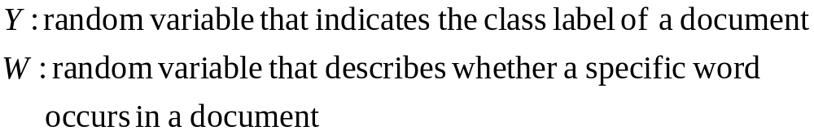
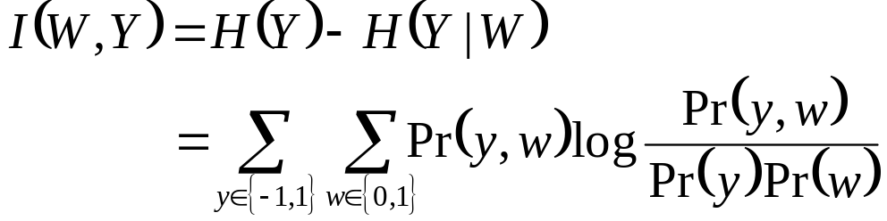
Feature Subset Selection (cont.)
Mutual information (or Information Gain):
Describes the information that a word contributes in encoding the class label Y

Slide 23
Feature Subset Selection (cont.)
Mutual information (or Information Gain):
The words with the highest empirical mutual information are selected as features.

Slide 24
Feature Construction (cont.)
Feature subset selection may not reveal clustering structure in the best way possible;
The clusters may be formed by multiple correlated features;
In the BOW model, a distinct dimension is allocated for each word;
There is no need for so many (tens of thousands) dimensions, since there are all sorts of latent relationships between the words;

Slide 25
Feature Construction (cont.)
E.g.: car and automobile; cows and sheeps are likely to occur in similar documents;
Thus: documents, seen as points of the BOW space, are not likely to nearly “use up” all possible regions but are likely to occupy semantically meaningful subspaces of it;

Slide 26
Feature Construction (cont.)
x₂
x₁
Notes:
The maximum vairance is captured along the first dimension. PCA rotates the data PCA rotates the data (centered at the origin) in (centered at the origin) in such a way that the maximum such a way that the maximum variability is visible (i.e., variability is visible (i.e., aligned with the axes.) aligned with the axes.)

Slide 27
Principal Component Analysis
Goal of PCA
  To reduce the number of dimensions.
  Transforms interdependent variables into single and independent components.
What does PCA achieve its goal?
  Transforms the data into a lower dimensional space, by constructing dimensions that are linear combinations of the input dimensions/features.
  Find independent dimensions along which data have the largest variance.

Slide 28
Dimensionality Reduction: PCA
Goal is to find a projection that captures the largest amount of variation in data
x₂
e
x₁
Notes:
The maximum vairance is captured along the first dimension. PCA rotates the data PCA rotates the data (centered at the origin) in (centered at the origin) in such a way that the maximum such a way that the maximum variability is visible (i.e., variability is visible (i.e., aligned with the axes.) aligned with the axes.)

Slide 29
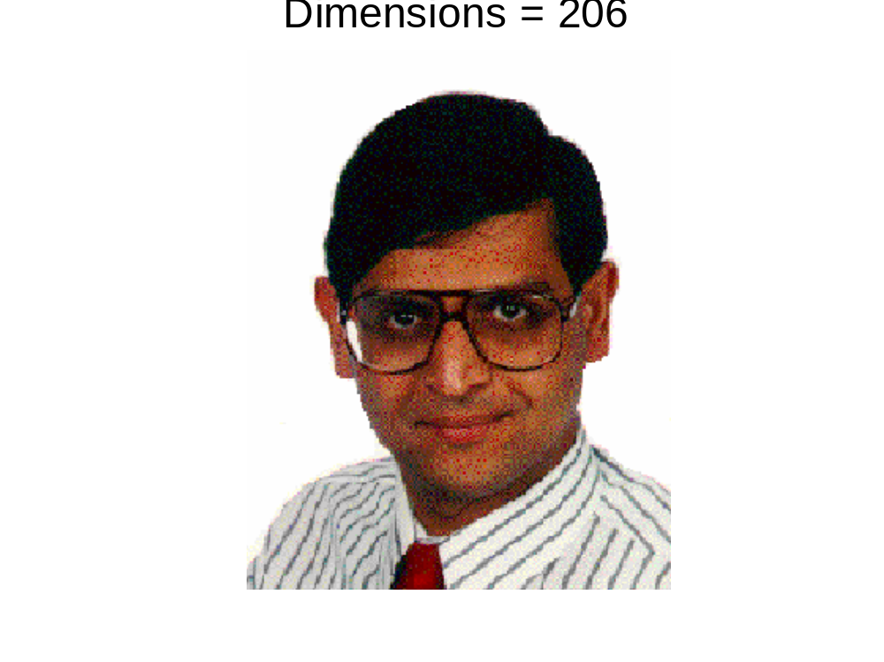
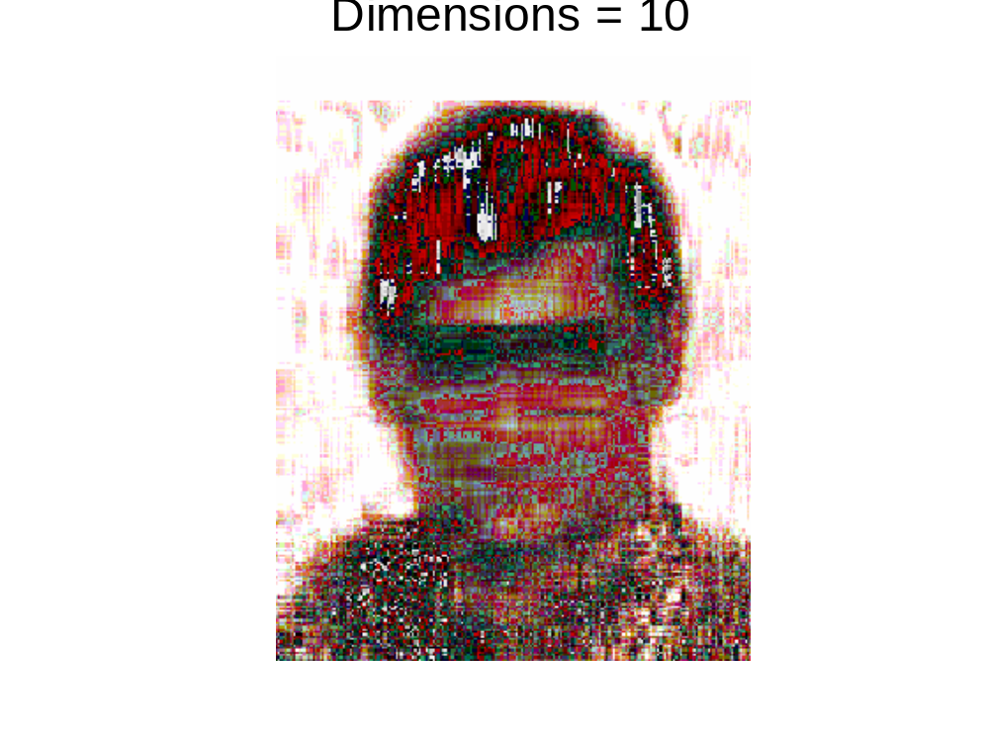
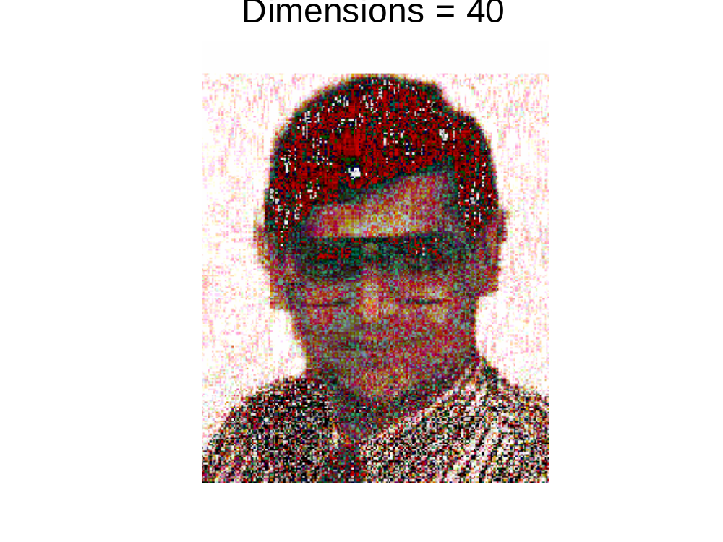
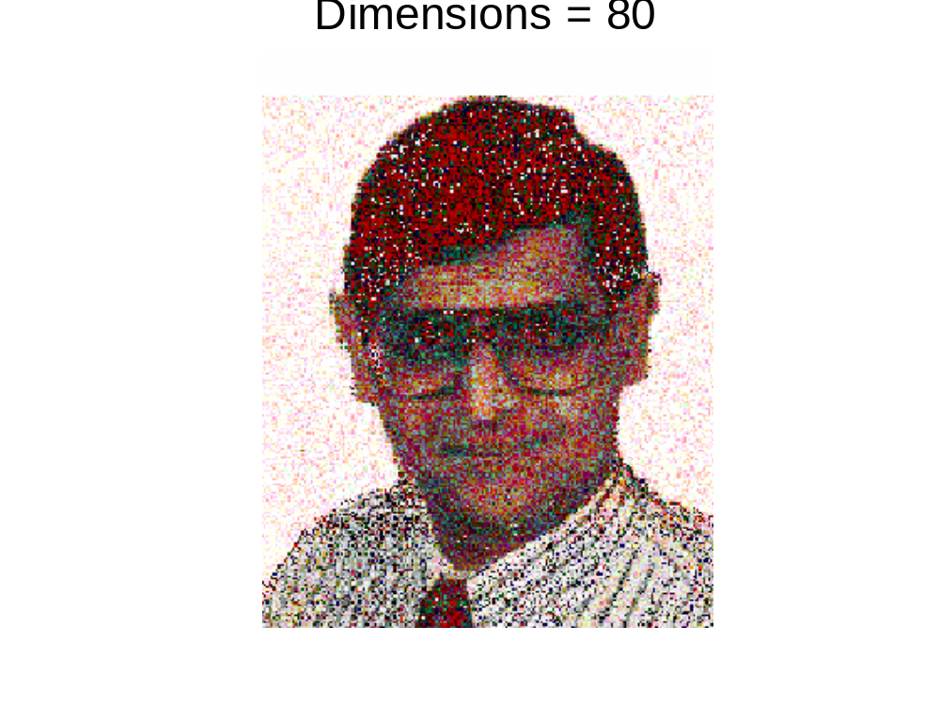
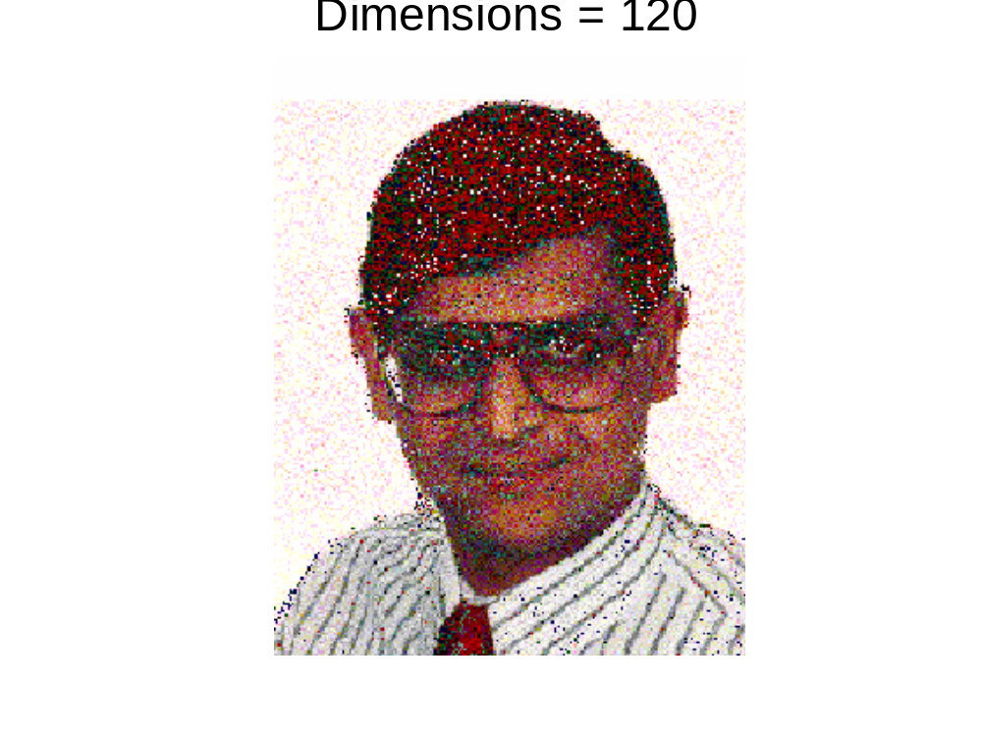
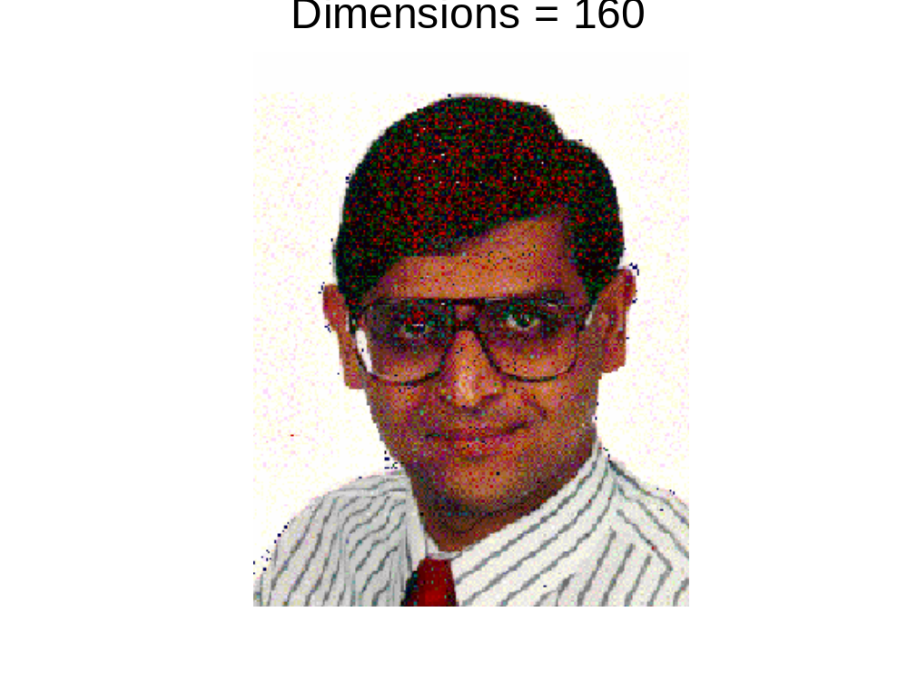
Dimensionality Reduction: PCA

Slide 30
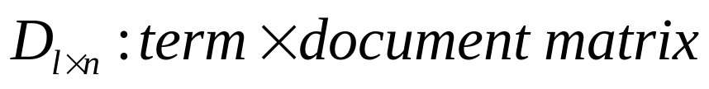
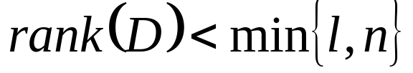
Feature Construction (cont.)
Formally stated:

Slide 31


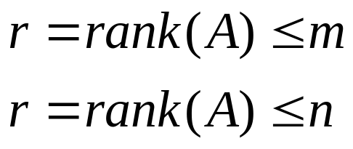
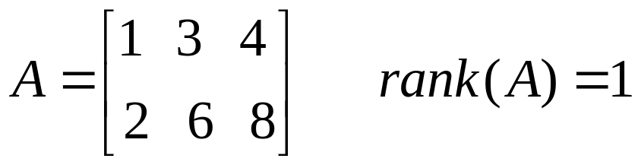
Notes on the Rank of a matrix
A square invertible (non-singular) matrix has rank n. It has n independent rows and columns.
For a rectangular matrix :
A has r independent rows, and r independent columns.
Example:

Slide 32

Notes on the Rank of a matrix
The definition or rank relevant to us deals with spaces of vectors.
The rank r is the dimensionality of the column space, as well as the dimensionality of the row space.
This means that any vector in the column space (e.g. document) can be written as a linear combination of r basis vectors.
By diagonalizing the matrix, we are going to choose orthonormal bases for these spaces.

Slide 33
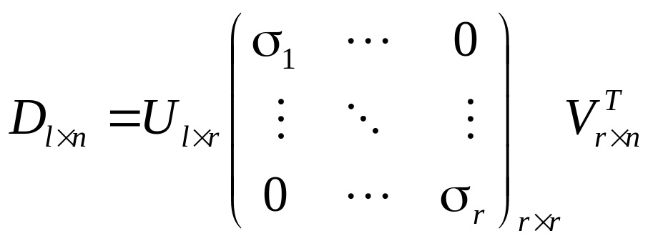


Feature Construction (cont.)
One way to reveal the rank of D is to compute its Singular Value Decomposition (SVD):
Singular values

Slide 34
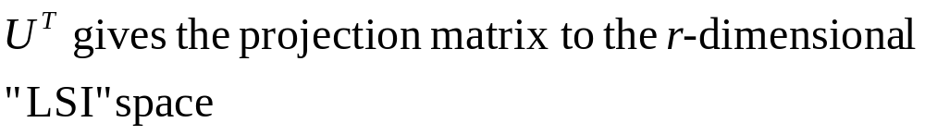
Feature Construction (cont.)
The r columns of U are the singular vectors

Slide 35
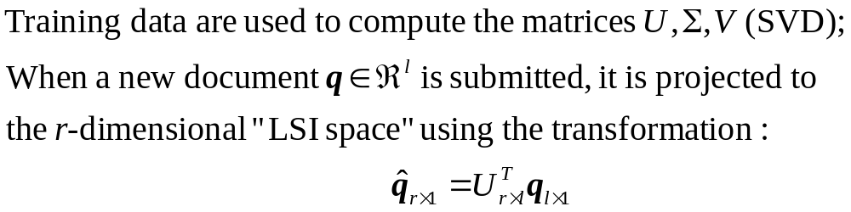
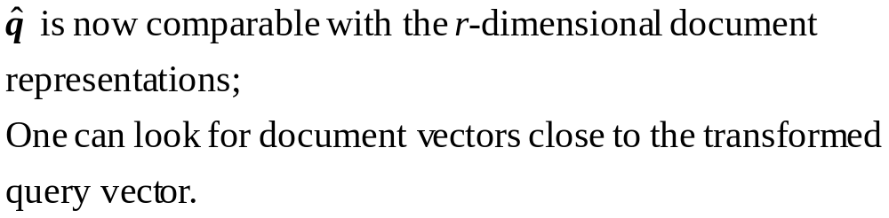
Overall LSI procedure

Slide 36
LSI
In practice, not all r singular values are retained;
A smaller number k of the top singular values are retained;
Dominating singular values capture the “signal” in D, leaving the smaller singular values to account for the noise;
LSI maps synonymous and related words to similar directions.

Slide 37
Latent Semantic Indexing
Latent Semantic Indexing (LSI): Principal Component Analysis applied to text.
Projects the document vectors into a lower dimensional space of orthogonal coordinates (“semantic space”).
The mapping identifies highly correlated dimensions: words that co-occur often in the same documents are merged into a single dimension of the new space.

Slide 38
Term Weighting
“Soft” form of feature selection;
Three components:
  Document component
  Collection component
  Normalization component
Final weight:

Slide 39
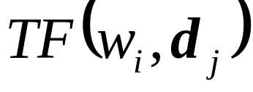
Term Weighting
Document component : captures the statistics about a particular term in a particular document.
Basic measure is Term Frequency:
Or binary weight: equal to 1 for terms present in the document.

Slide 40
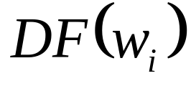
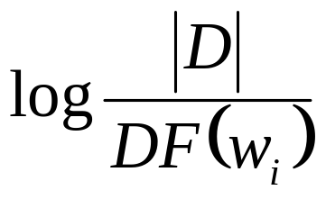
Term Weighting
Collection component : assigns lower weight to those terms that are frequent in almost any document.
Basic measure is Document Frequency:
If the document frequency is high, the weight of the term is reduced:
Inverse Document Frequency (IDF)

Slide 41
Normalization component : adjusts the weights so that small and large documents can be compared on the same scale.
Term Weighting

Slide 42
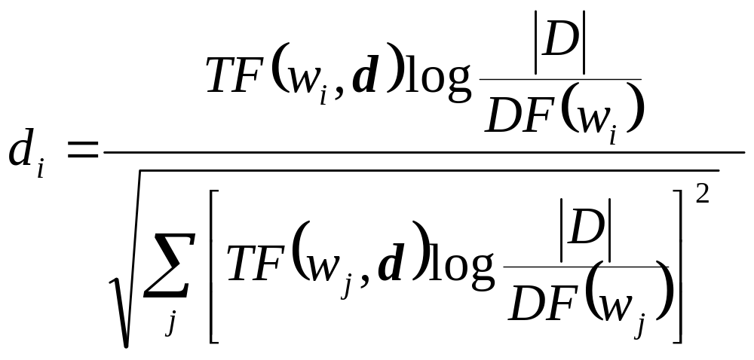
TFIDF
Popular TFIDF representation with Euclidean length normalization:

Slide 43
Similarity and Dissimilarity
Similarity
  Numerical measure of how alike two data objects are
  Is higher when objects are more alike
  Often falls in the range [0,1]
Dissimilarity
  Numerical measure of how different two data objects are
  Lower when objects are more alike
  Minimum dissimilarity is often 0
  Upper limit varies
Notes:
Think Point (Can we come up with similarity metrics)

Slide 44
Defining Distance Measures
Let A and B be two objects from the universe of possible objects. The distance (dissimilarity) is denoted by d(A,B)
What properties should a distance measure have?
d(A,B) >= 0 [non-negativity]
d(A,B) = 0 if and only if A = B [identity]
d(A,B) = d(B,A) [Symmetry]
d(A,B) ≤ d(A,C) + d(B,C) [Triangular Inequality]
      When the last one holds, we call the measure a metric
Notes:
EXERCISE!

Slide 45
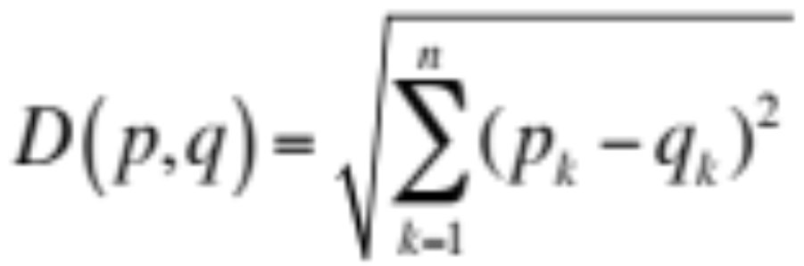
Euclidean Distance
  where n is the number of dimensions (attributes) and p_{k} and q_{k} are, respectively, the k^{th} attributes (components) of data objects p and q.
Standardization is necessary, if scales differ.

Slide 46
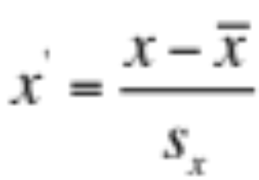
Feature Transformation
A function that maps the entire set of values of a given attribute to a new set of replacement values such that each old value can be identified with one of the new values.
  Standardization or Normalization:

Slide 47
Common Properties of a Similarity
Similarities also have some well known properties.
Let s(p, q) be the similarity between points (data objects), p and q:
  s(p, q) = 1 (or maximum similarity) only if p = q
  s(p, q) = s(q, p) for all p and q. (Symmetry)

Slide 48
Similarity Between Binary Vectors
It is common for objects p and q to have only binary attributes
Compute similarities using the following quantities
M₀₁ = the number of attributes where p was 0 and q was 1
M₁₀ = the number of attributes where p was 1 and q was 0
M₀₀ = the number of attributes where p was 0 and q was 0
M₁₁ = the number of attributes where p was 1 and q was 1
Simple Matching and Jaccard Coefficients
SMC = number of matches / number of attributes
= (M₁₁ + M₀₀) / (M₀₁ + M₁₀ + M₁₁ + M₀₀)
J = number of 11 matches / number of not-both-zero attributes values
= (M₁₁) / (M₀₁ + M₁₀ + M₁₁)

Slide 49
SMC versus Jaccard: Example
p = 1 0 0 0 0 0 0 0 0 0
q = 0 0 0 0 0 0 1 0 0 1
M₀₁ = 2 (the number of attributes where p was 0 and q was 1)
M₁₀ = 1 (the number of attributes where p was 1 and q was 0)
M₀₀ = 7 (the number of attributes where p was 0 and q was 0)
M₁₁ = 0 (the number of attributes where p was 1 and q was 1)
SMC = (M₁₁ + M₀₀)/(M₀₁ + M₁₀ + M₁₁ + M₀₀) = (0+7) / (2+1+0+7) = 0.7
J = (M₁₁) / (M₀₁ + M₁₀ + M₁₁) = 0 / (2 + 1 + 0) = 0

Slide 50
Cosine Similarity
If d₁ and d₂ are two document vectors, then
cos( d₁, d₂ ) = (d₁ • d₂) / ||d₁|| ||d₂|| ,
where • indicates vector dot product and || d || is the length of vector d.
Example:
d₁ = 3 2 0 5 0 0 0 2 0 0
d₂ = 1 0 0 0 0 0 0 1 0 2
d₁ • d₂= 3*1 + 2*0 + 0*0 + 5*0 + 0*0 + 0*0 + 0*0 + 2*1 + 0*0 + 0*2 = 5
||d₁|| = (3*3+2*2+0*0+5*5+0*0+0*0+0*0+2*2+0*0+0*0)^{0.5} = (42) ^{0.5} = 6.481
||d₂|| = (1*1+0*0+0*0+0*0+0*0+0*0+0*0+1*1+0*0+2*2) ^{0.5} = (6) ^{0.5} = 2.245
cos( d₁, d₂ ) = .3150

Slide 51






Nearest Neighbor Classifiers
Basic idea:
  If it walks like a duck, quacks like a duck, then it’s probably a duck
Compute Distance
Test Record
Choose k of the “nearest” records
Training Records

Slide 52
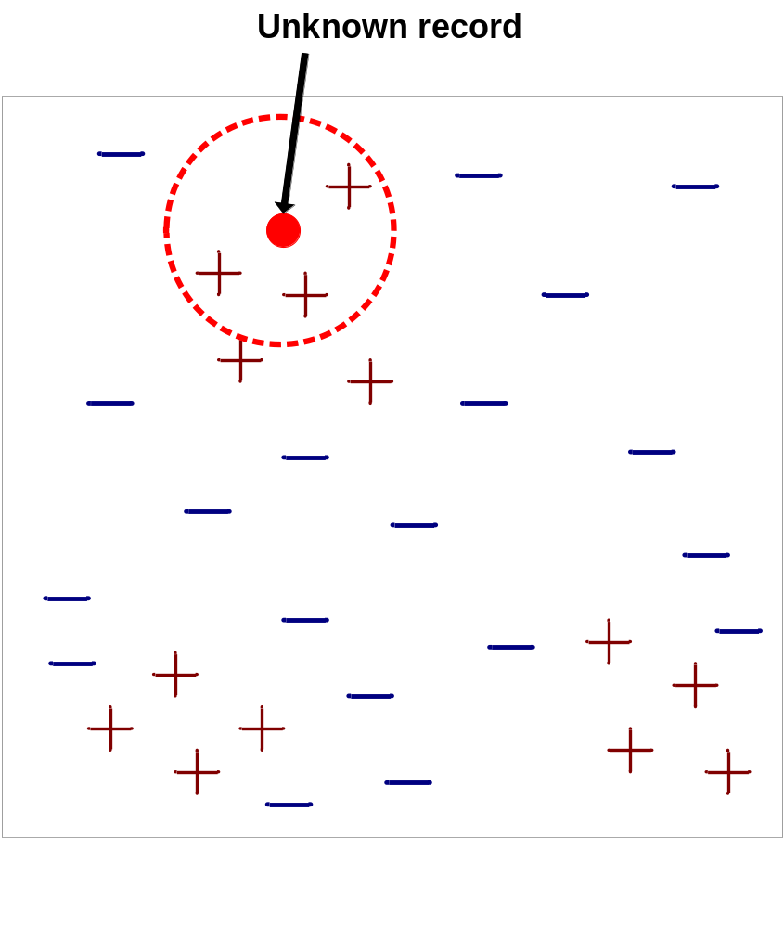
Nearest-Neighbor Classifiers
Requires three things
  The set of stored records
  Distance Metric to compute distance between records
  The value of k, the number of nearest neighbors to retrieve
To classify an unknown record:
  Compute distance to other training records
  Identify k nearest neighbors
  Use class labels of nearest neighbors to determine the class label of unknown record (e.g., by taking majority vote)

Slide 53

Definition of Nearest Neighbor
K-nearest neighbors of a record x are data points that have the k smallest distance to x

Slide 54
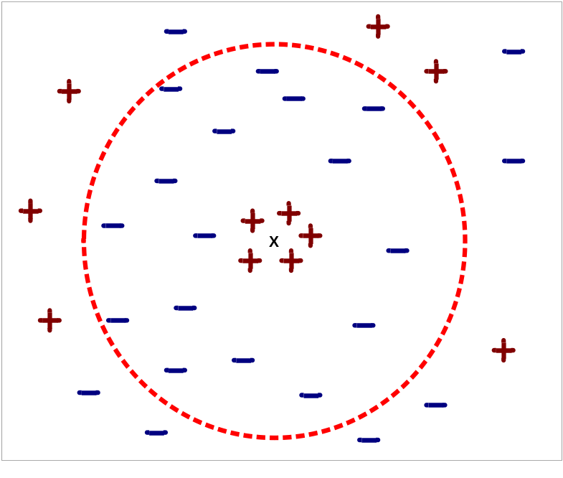
Nearest Neighbor Classification…
Choosing the value of k:
  If k is too small, sensitive to noisy points
  If k is too large, neighborhood may include points from other classes

Slide 55
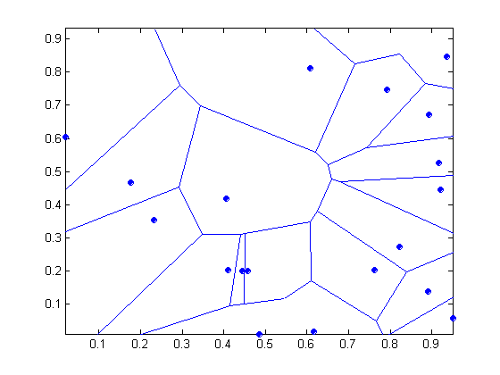
1 nearest-neighbor
Voronoi Diagram

Slide 56
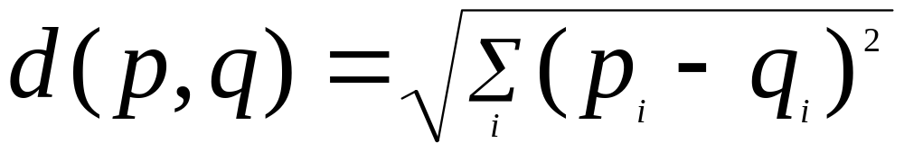
Nearest Neighbor Classification
Compute distance between two points:
  Euclidean distance
Determine the class from nearest neighbor list
  take the majority vote of class labels among the k-nearest neighbors
  Weigh the vote according to distance
    weight factor, w = 1/d²

Slide 57
Nearest Neighbor Classification…
Scaling issues
  Attributes may have to be scaled to prevent distance measures from being dominated by one of the attributes
  Example:
    height of a person may vary from 1.5m to 1.8m
    weight of a person may vary from 90lb to 300lb
    income of a person may vary from $10K to $1M

Slide 58
Nearest Neighbor Classification…
Problem with Euclidean measure:
  High dimensional data
    curse of dimensionality
  Can produce counter-intuitive results
1 1 1 1 1 1 1 1 1 1 1 0
1 0 0 0 0 0 0 0 0 0 0 0
vs
0 1 1 1 1 1 1 1 1 1 1 1
0 0 0 0 0 0 0 0 0 0 0 1
d = 1.4142
d = 1.4142
    Solution: Normalize the vectors to unit length

Slide 59
Nearest neighbor Classification…
k-NN classifiers are lazy learners
  They don’t build models explicitly
  Classifying unknown records is relatively expensive

Slide 60








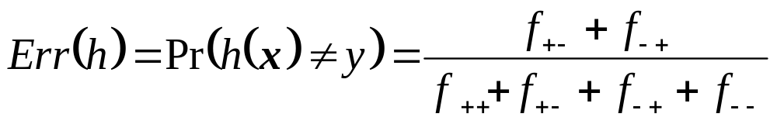
Performance Measures
label
label
prediction
prediction
Contingency Table
Error rate

Slide 61




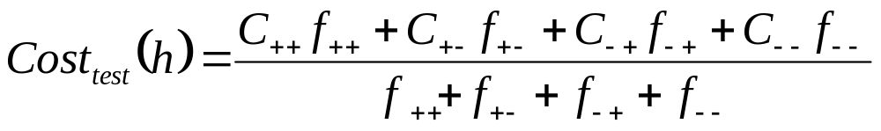
Performance Measures
label
label
prediction
prediction
Cost Matrix
Cost function

Slide 62

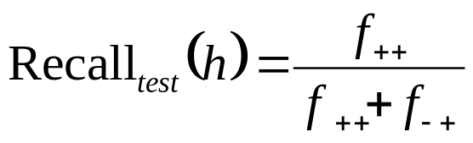
Recall
Is the probability that a document with label y=1 is classified correctly:
Estimation of the recall:
Total number of documents with label y = 1

Slide 63

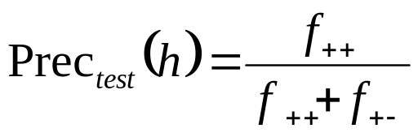
Precision
Is the probability that a document classified as 1 is classified correctly:
Estimation of the precision:
Total number of documents predicted as positives

Slide 64
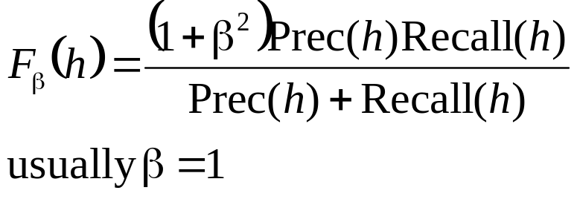
Precision and Recall combined
Between high precision and high recall exists a trade-off;
Single performance measure:

