Slide 1

PROBLEM STATEMENT : AUTOMATIC ACCIDENT DETECTION AND AMBULANCE RESCUE SYSTEM..
Nowadays the road accidents in modern urban areas are increased to uncertain level. The loss of human life due to accident is to be avoided.
Traffic congestion is a major fact that causes delay to ambulance. The idea behind this is to implement a system which would control mechanically the traffic lights in the path of the ambulance.
Students can build a controller that identifies the location of the accident spot through the sensor systems in the vehicle which determined the accident and thus the controller walks through the ambulance to the spot.
TEAM LEADER NAME : Abhishek Gupta
TEAM CODE : C17
TEAM NAME : Impulse.
IMPULSE is an efficient and practical system that caters to medical emergencies and provides quick ambulance service by detecting accidents on the roads. It also provides assistance to any emergency from any location. With the traffic clearance mechanism implemented, it ensures the reliability and swift succour to the ones in need.
IMPULSE

Slide 2
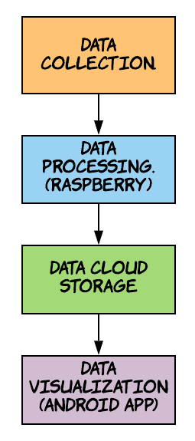
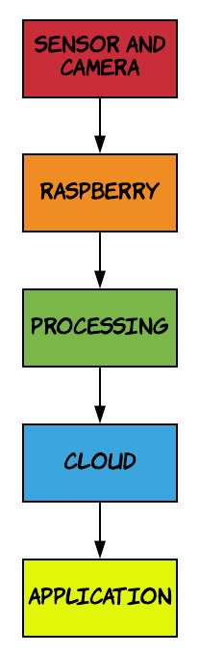
Solution/Prototype :-
Data Collections
At the gate , when IR sensor gets activated the camera module will be triggered and that specific data will be fed into Processing layer .
At the parking area the camera module will continously observe atleast 4 parking spaces and send the data to the processing layer.
Data Processing
At the gate, the number plate , vehicle type (Car , Bike , Truck ) and the entry-exit time is saved to the cloud using KNN algorithm and Conventional Neural Networks .
At the parking area, which vehicle (number plate) is parked in which slot is detected using vehicle classifier and the image of it is passed to number plate detection module.
Data Cloud Storage
The Output of data processing layer is saved into cloud that is vehicle type , entry-exit time , number plate , slot occupied and payment details .
Prototye Flow
System Flow

Slide 3
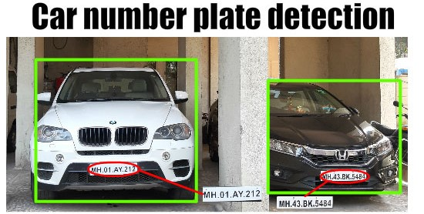
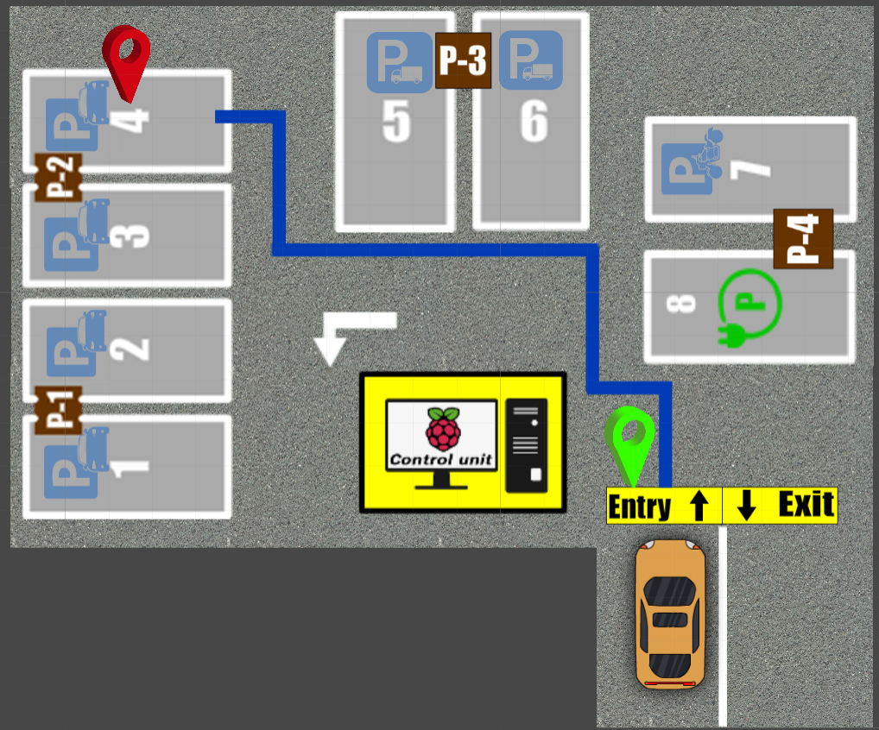
Data Visualizations (Android app)
The current vacant parking spots in each floor will be made visible on site and on the app after which he can move toward his desired floor and parking slot .
The user will be automatically shown shortest path to nearest free space available , once he clicks on map he also has the option to choose any free space available on the map and when he parks the slot number is made visible to him on the app.
When the user pulls out his vehicle for exiting, he will be notified on his app and this helps in preventing malpractices (stealing).
Additional Features
The user can pay at the cash counter on exit, or use Paytm.
If he loses track, he can opt for the “LOST” option, which will detect his location on certain parameters and redirect him.
Register User Benefits
The staff will have fixed parking spot .
Monthly payment. (For the time, the parking slot was used) .
Net banking. (Automatically montly money deducted).
All the visit details (entry and exit time) will be visible to him at all times.
If his slot gets occupied by someone else, the admin will be notified immediately.
Data Processing
Data Visualization

Slide 4
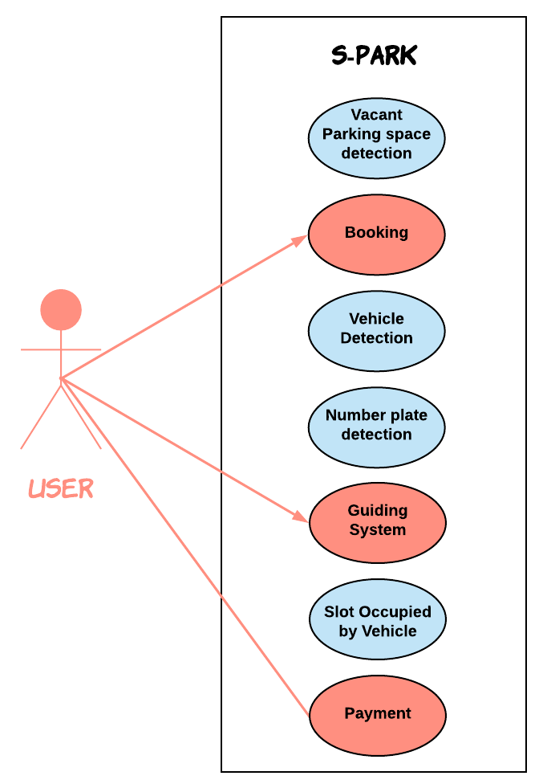
Technology Stack
Modern Technology :- Machine learning, Deep learning, IOT.
Mobile Development :- Android Studio, Android SDK .
Backend Development :- Firebase.
Hardware Components :- Arduino, MEMS and Vibration
Sensors, LCD, Buzzer, GSM and GPS module.
Dependencies
Requires Android version Jellybean and higher .
Hardware components and their installation and power supply .
Use Case

Slide 5
VEHICLE ACCIDENT DETECTION
The system will automatically detect vehicle accidents on the roads and a ambulance will be allotted for the same.
TRAFFIC CLEARANCE
When the sire sound of ambulance is detected on the road, the traffic signal for that lane will be turned green involuntarily. It will remain green for a specific time.
SHOWSTOPPERS
NEAREST HOSPITAL ALLOCATION.
On the basis of location of the patient, the nearest hospital will be alerted and ambulance will be sent to the patient. If the hospital doesn’t have ambulance, the next nearest hospital will be alerted
AI CHAT BOT
This bot will commune with the patient or the acquaintance and predict the disease. It will provide precautionary measures too for the predicted disease too.

