Slide 1

PROBLEM STATEMENT : AUTOMATIC ACCIDENT DETECTION AND AMBULANCE RESCUE SYSTEM..
Nowadays the road accidents in modern urban areas are increased to uncertain level. The loss of human life due to accident is to be avoided.
Traffic congestion is a major fact that causes delay to ambulance. The idea behind this is to implement a system which would control mechanically the traffic lights in the path of the ambulance.
Students can build a controller that identifies the location of the accident spot through the sensor systems in the vehicle which determined the accident and thus the controller walks through the ambulance to the spot.
TEAM LEADER NAME : Abhishek Gupta
TEAM CODE : C17
TEAM NAME : Impulse.
IMPULSE is an efficient and practical system that caters to medical emergencies and provides quick ambulance service by detecting accidents on the roads. It also provides assistance to any emergency from any location. With the traffic clearance mechanism implemented, it ensures the reliability and swift succour to the ones in need.
IMPULSE

Slide 2
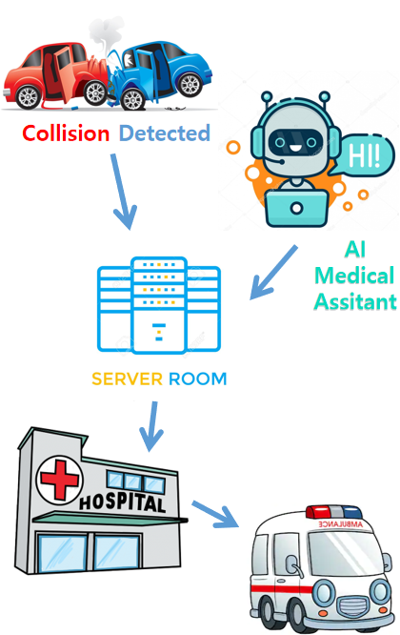
Solution/Prototype :-
AUTOMATIC VEHICLE ACCIDENT DETECTION
The sensor modules in Arduino can detect an accident and a buzzer will be triggered. If it was due to some error, the user can manually switch it off.
If the buzzer perpetuates, accident will be confirmed, and the location (GPS) will be automatically sent to the server (SMS) which dispatches an ambulance to the said location.
MEDICAL EMERGENCY AT ANY LOCATION
(ANDROID APP)
The user has to only click a button on the app, which sends his location to the server using GPS and the ambulance is dispatched.
The app further provides an AI Bot system (Medical Assistant) which helps in providing assistance before the ambulance arrives.
NEAREST HOSPITAL ALLOCATON
Considering the location of the emergency, the nearest registered hospital will be notified and they will dispatch the ambulance.
All hospitals will automatically update the server about the availability of their ambulance services.
If any hospital has exhausted its ambulance services, the next nearest hospital will be allocated.
System Flow

Slide 3
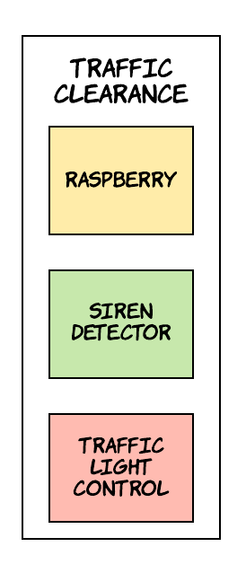
TRAFFIC CLEARANCE
A trained neural network will detect the siren sound and this signal will be passed to the traffic signal and will make it green.
It will remain green for a specific time even after the siren sound fades.
INTERFACES
The users(optional) and hospitals have to register.
The ambulance driver will be shown the shortest path to the medical emergency location.
It is a cross platform system, working on iOS, Android and Desktop.
Technology Stack
Modern Technology :- Machine learning, Deep learning, IOT.
Server Side :- Android Studio, Android SDK ,Python , Firebase .
Hardware Components :- Raspberry pi , Raspberry Mic ,Arduino, MEMS and Vibration Sensors, LCD, Buzzer, GSM and GPS module.
Languages : - Arduino
Dependencies
Requires atleast Android version Jellybean and higher , IOS 4.3.
Hardware components and their installation and power supply

Slide 4
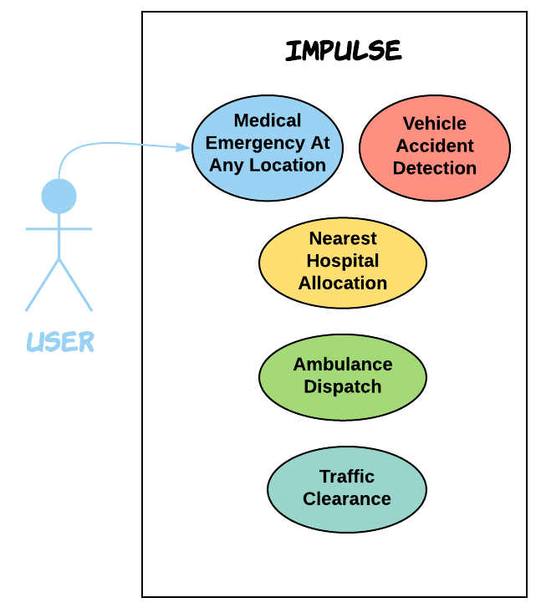
Use Case
SHOWSTOPPER
AI MEDICAL ASSITANT BOT
This mechanism becomes active when an ambulance is referenced and communes with the user even before the ambulance arrives.
This feature enables the user to input his symptoms and the trained DNN model predicts the medical condition in accordance with the symptoms.
It also provides precautionary measures for the same, which helps in giving apt assistance to the user before reaching the hospital.
The user can speak to the bot and all the necessary details will be sent to the hospital.

