Slide 1
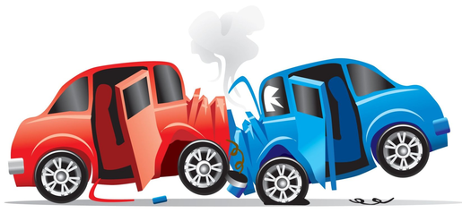




Collision Detected
AI Medical Assitant

