Slide 1
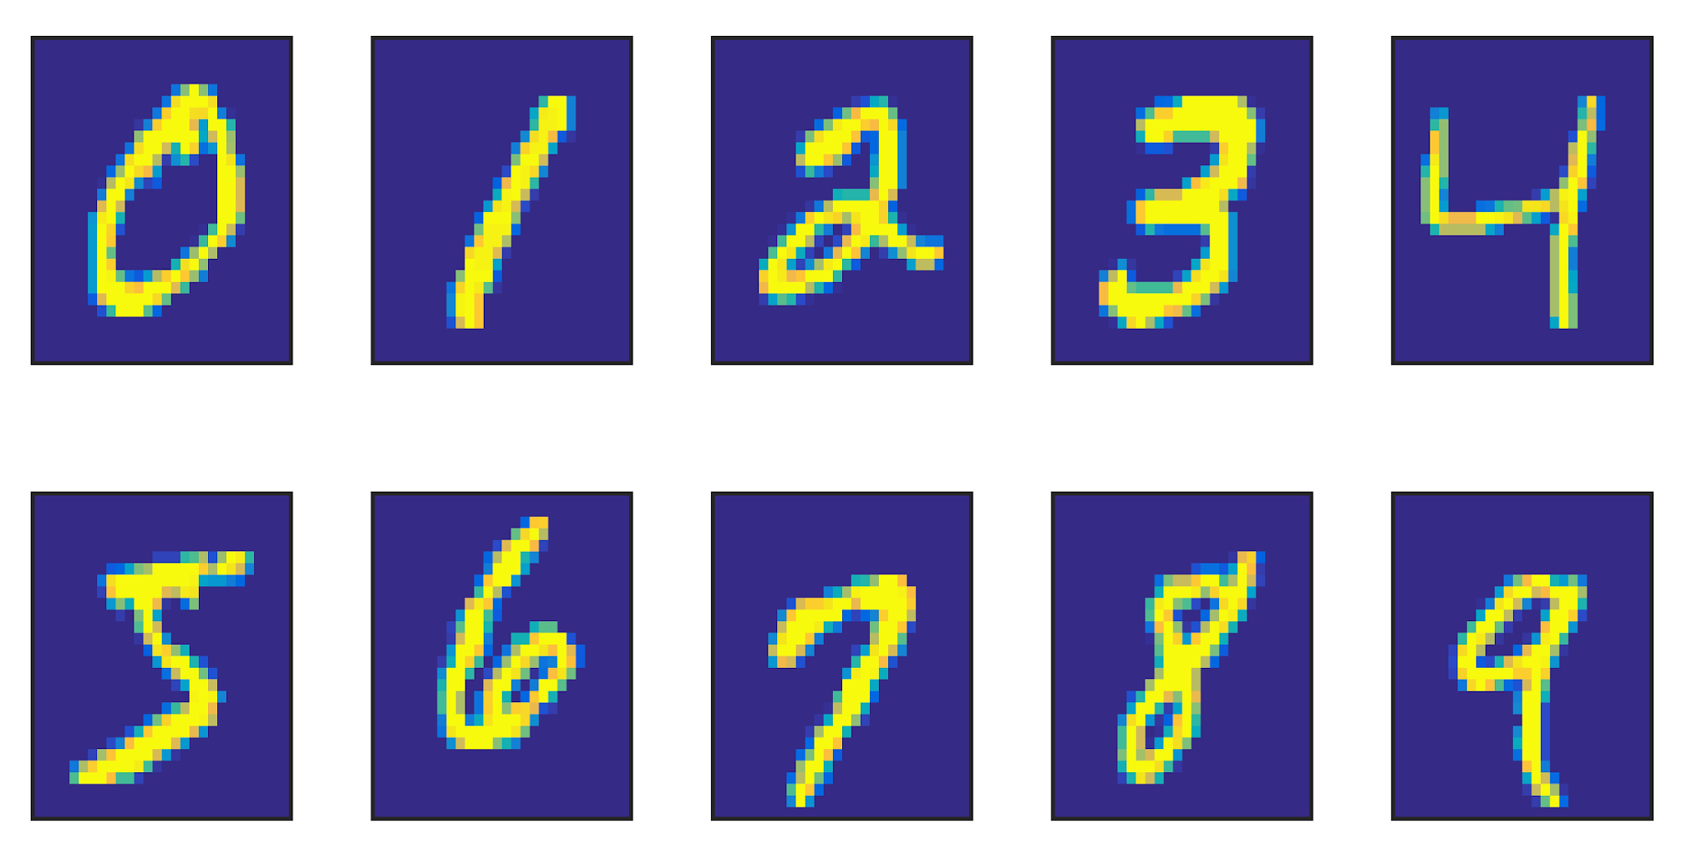
















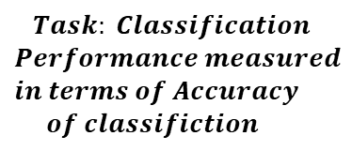












$$U_{0}$$
Source Node
$${(1−U}_{0})$$
$$∆Weights of$$
$$Vascular Tree$$
Root Node
$$U_{3,1}$$
Reservoir
$$U_{2,1}$$
Vascular Network
2
3
$$U_{4,2}$$
$$U_{5,2}$$
$$U_{6,3}$$
$$U_{7,3}$$
$$Forwar Energy d Pass$$
$$∆Energy$$
4
5
6
7
$$∆Energy Back Propagation$$
$$U_{8,4}$$
$$U_{9,4}$$
$$U_{10,5}$$
$$U_{11,5}$$
$$U_{12,6}$$
$$U_{13,6}$$
$$U_{14,7}$$
$$U_{15,7}$$
Terminal Leaf Nodes
10
12
13
14
15
8
9
11
$$∆Bias$$
$$Less$$
$$Energy$$
$$More$$
$$Energy$$
Neural
Network
$$Task: Classification$$
$$Performance measured$$
$$in terms of Accuracy$$
$$of classifiction$$
$$High Bias$$
$$Less Bias$$
$$Input$$
$$MNIST Data$$
$$Less Activity$$
$$High Activity$$

