Slide 1
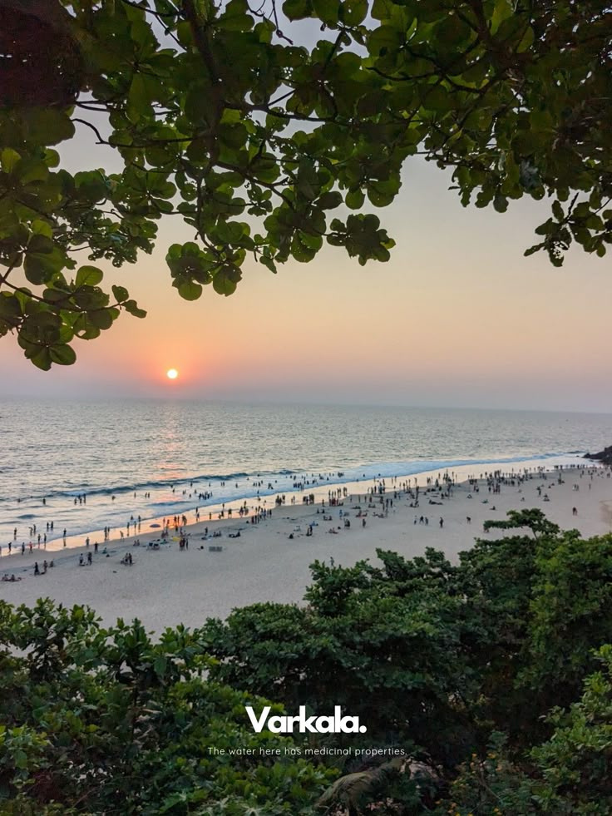
THYNK UNLIMITED
Tourism Resource Mapping
-

Slide 2
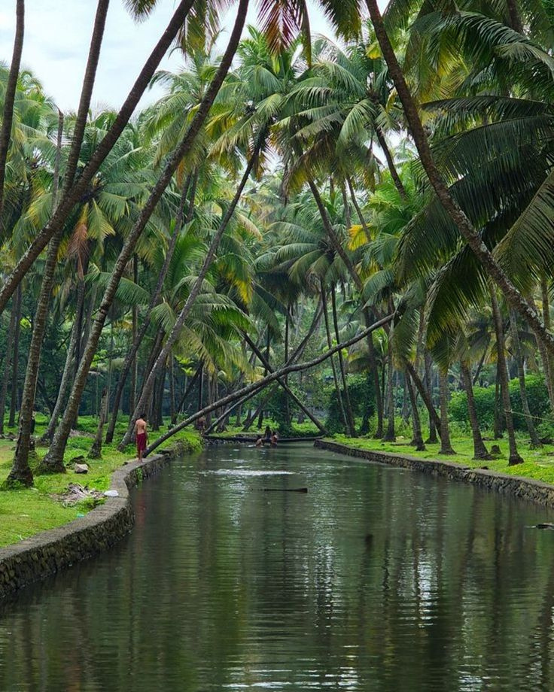

Home
About
Content
Others
Thiruvananthapuram
Thiruvananthapuram, located at the southern tip of Kerala (8.5241° N, 76.9366° E), features diverse geographical elements including coastal beaches, hilly terrains, and river networks. The district is rich in tourist resources such as cultural and religious sites, wildlife sanctuaries, and hill stations.
Key factors supporting tourism include well-developed road and rail networks, proximity to the international airport, and availability of hotels and restaurants near major attractions, making it an important hub for both domestic and international visitors.”

Slide 3
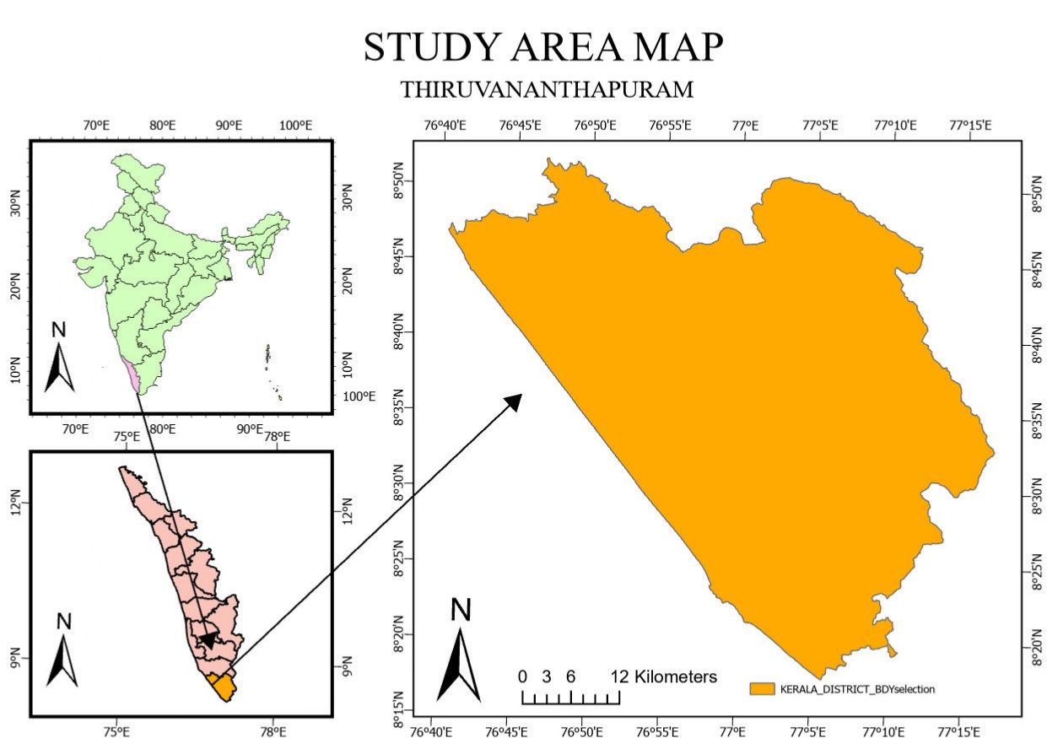

Slide 4
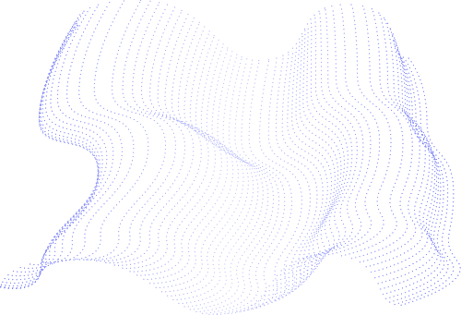
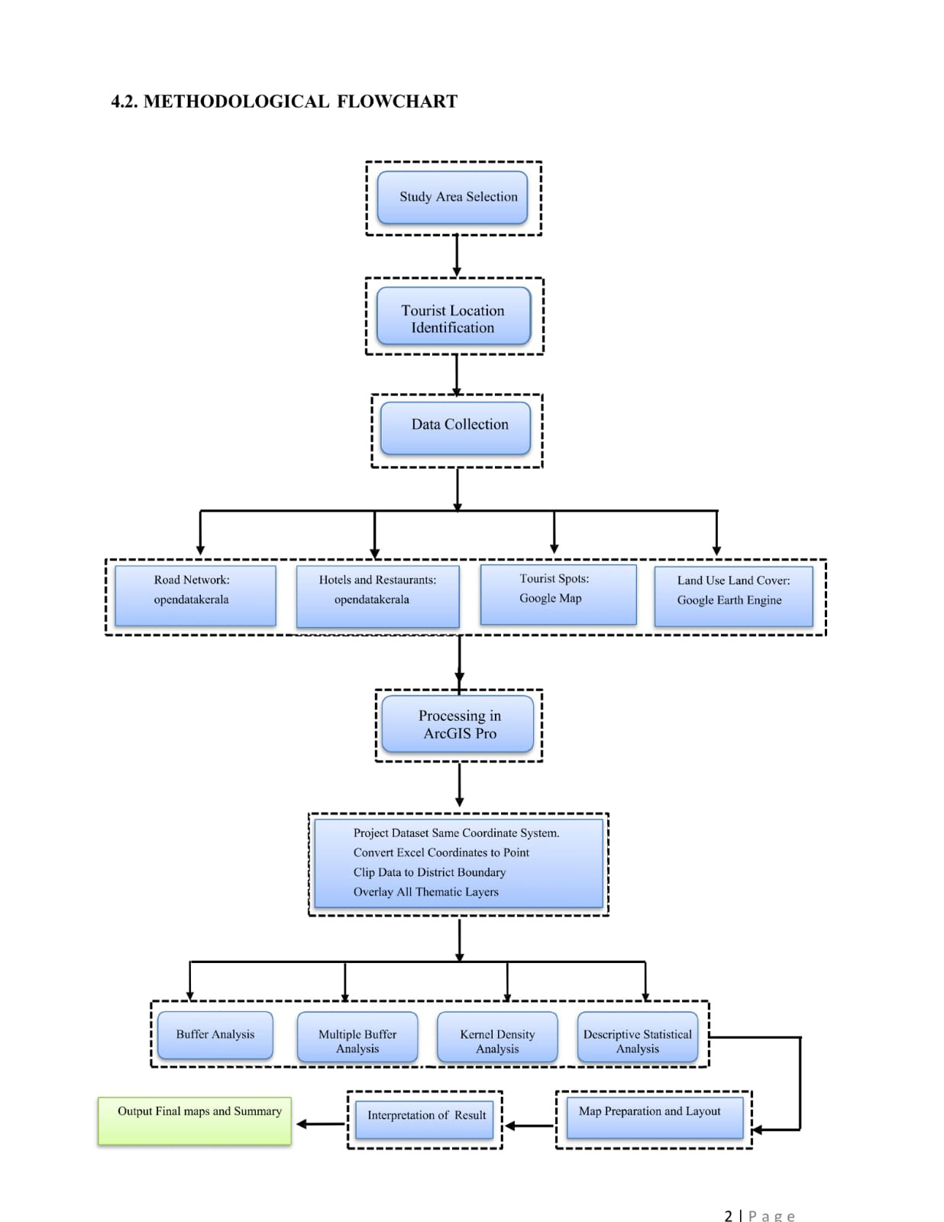
Methodology

Slide 5
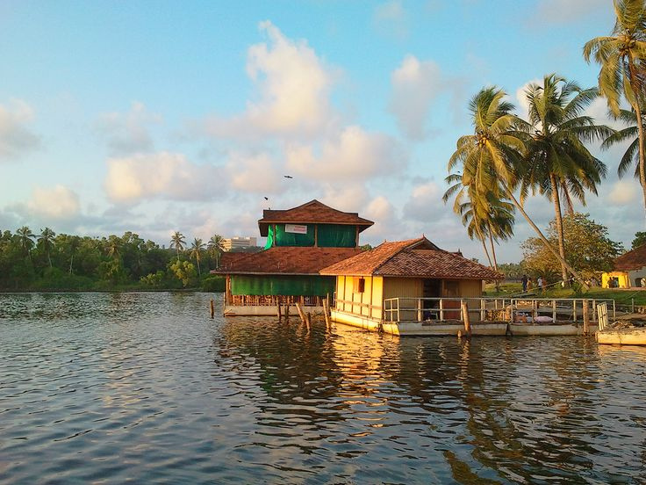
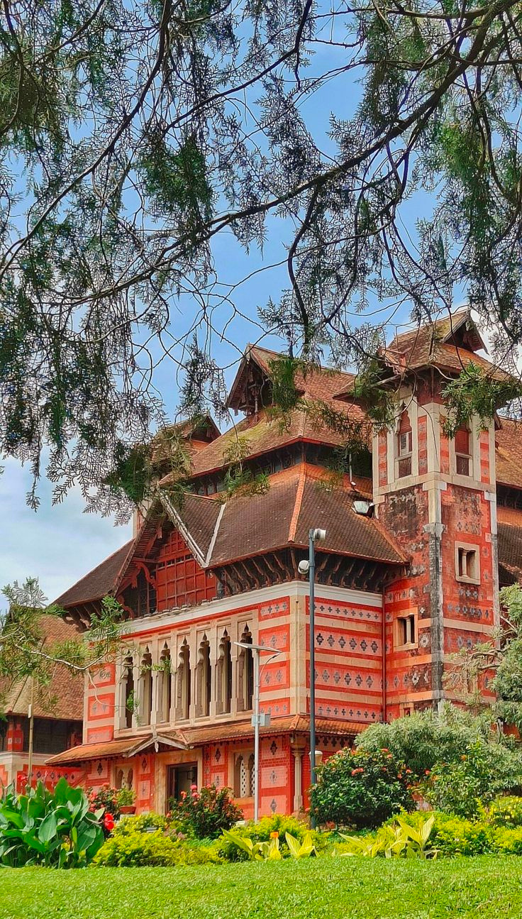
Padmanabhaswamy Temple
Kovalam Beach
Varkala Beach & Cliff
Neyyar Wildlife Sanctuary
Sree Chitra Art Gallery
Ponmudi Hill Station
Shankumugham Beach
Kuthiramalika (Palace)
Major Attractions

Slide 6
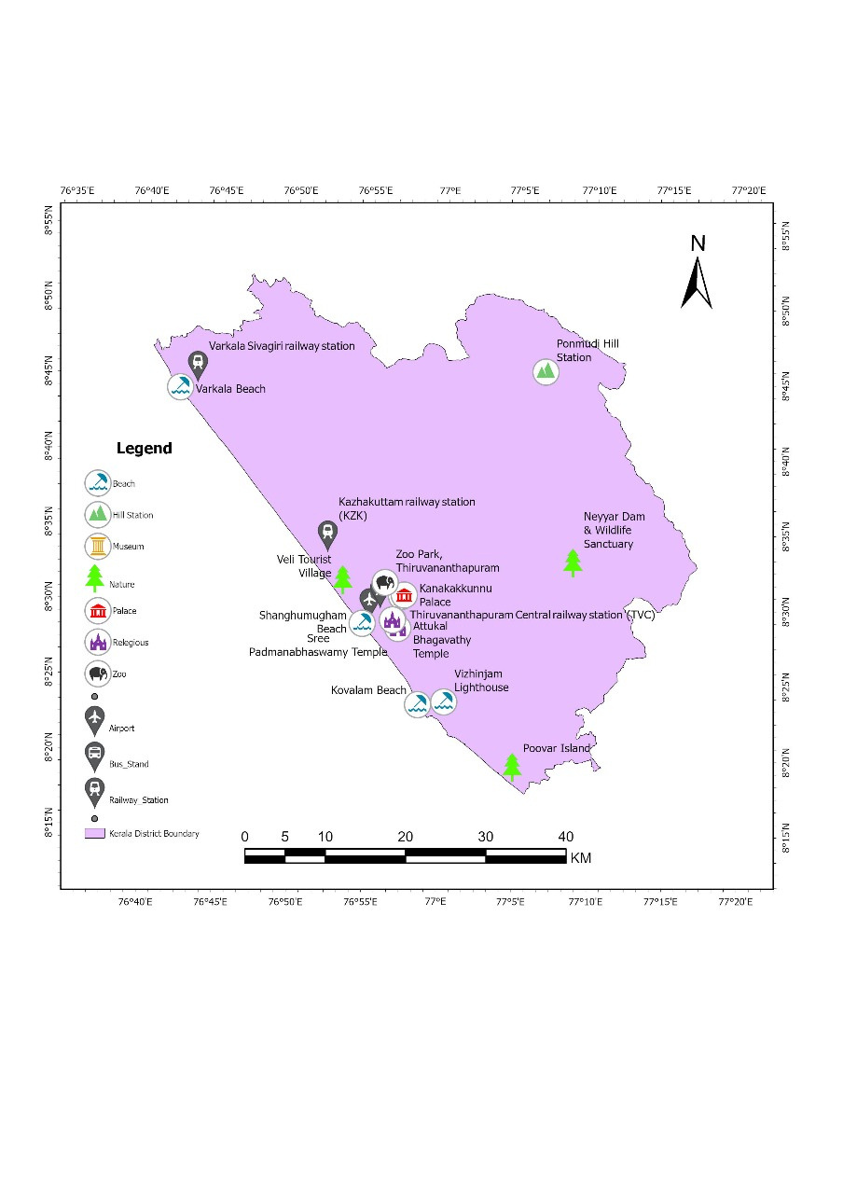
The tourist sites and hub map of Thiruvananthapuram district was created using GIS by plotting shapefiles for major tourist attractions, including beaches, temples, hill stations, and wildlife areas. Each tourist spot is represented as a point on the map, and key tourist hubs—areas with a high concentration of amenities such as hotels, restaurants, and transport facilities—are highlighted.
This map visually represents the spatial distribution of tourism resources, helping to identify popular clusters, plan infrastructure, and support sustainable tourism development by showing where services are concentrated and where gaps exist

Slide 7
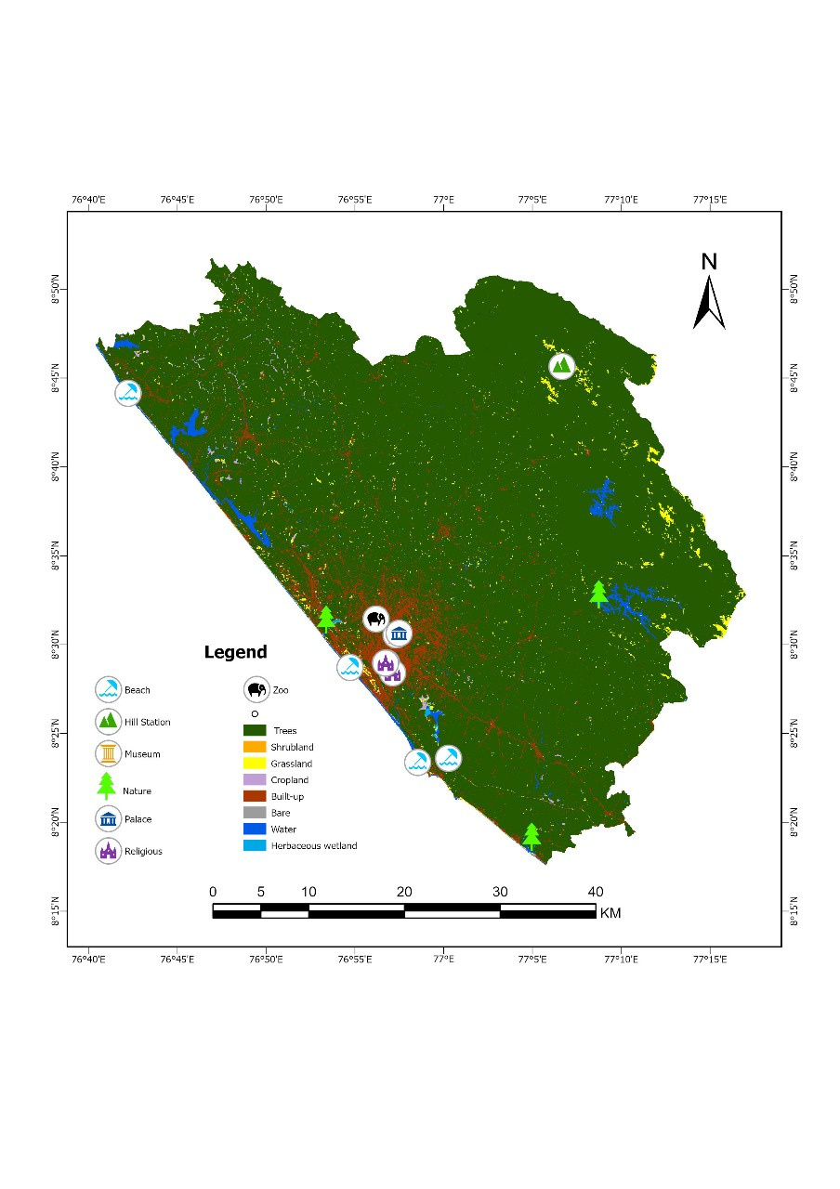

The majority of built-up areas (red/orange) align with the coast and the southwest quadrant, coinciding with highly concentrated tourist activity.
Many tourist destinations (palaces, temples, museums) are located in or near built-up areas, highlighting the link between urbanization and tourism.
Land Use Land Cover
Home
About
Content
Others
Urban-Tourism Nexus
Natural Appeal vs. Urban Threat
Nature-based spots (Ponmudi, Varkala) are in less developed landscapes (forests, wetlands).Proximity to urban growth threatens natural locations, requiring
proper planning for sustainable infrastructure and environmental protection.

Slide 8
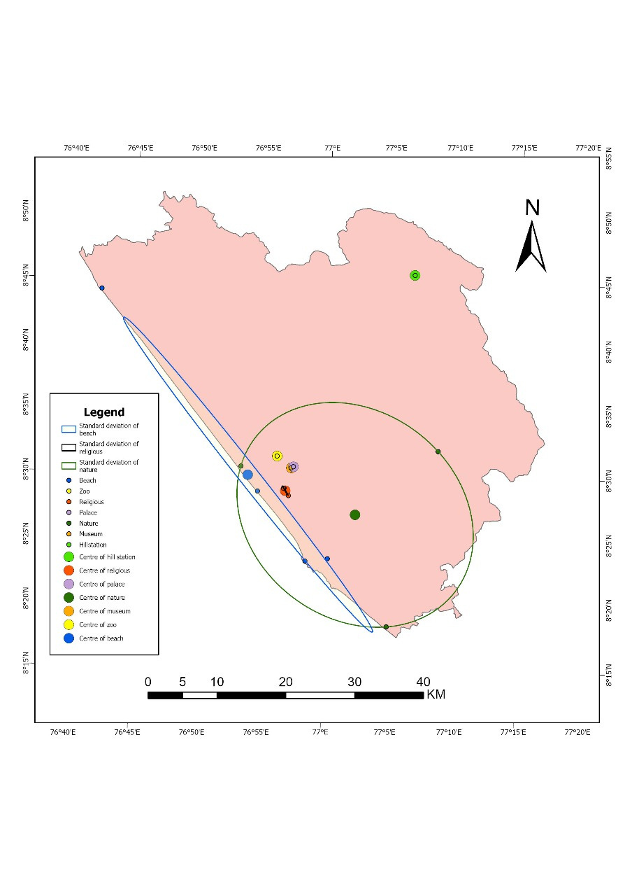
Descriptive Analysis of POI
The descriptive analysis of Points of Interest (POIs) in Thiruvananthapuram examines the spatial distribution of key tourist resources such as temples, beaches, hill stations, wildlife areas, hotels, and restaurants.
By analyzing the mean, standard deviation, and patterns of these POIs, we can identify areas with high tourist concentration, clusters of amenities, and gaps in infrastructure. This analysis helps in understanding tourism density, planning for visitor services, and prioritizing zones for sustainable tourism development.”

Slide 9
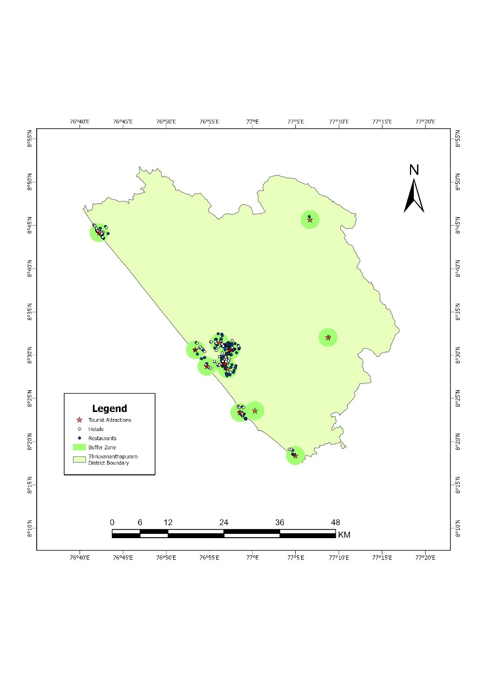
Buffer Analysis (Service Availability)
The buffer analysis around the tourist attractions identies the availability and concentration of the hotels and restaurants, determing visitor convince.
High Service Zone
Includes Padmanabhaswamy Temple, Napier Museum, Kovalam, and Varkala areas where hotel and restaurant density is high, indicating strong tourist infrastructures.
Covers Veli, Shankumugham, and nearby regions with a fair number of facilities and moderate accessibility for tourists.
Comprises Neyyar Dam, Nipunmudi Hills, and adjoining hilly areas with limited hotel services and low tourism development.
Moderate Service Zone
Low Service Zone

Slide 10
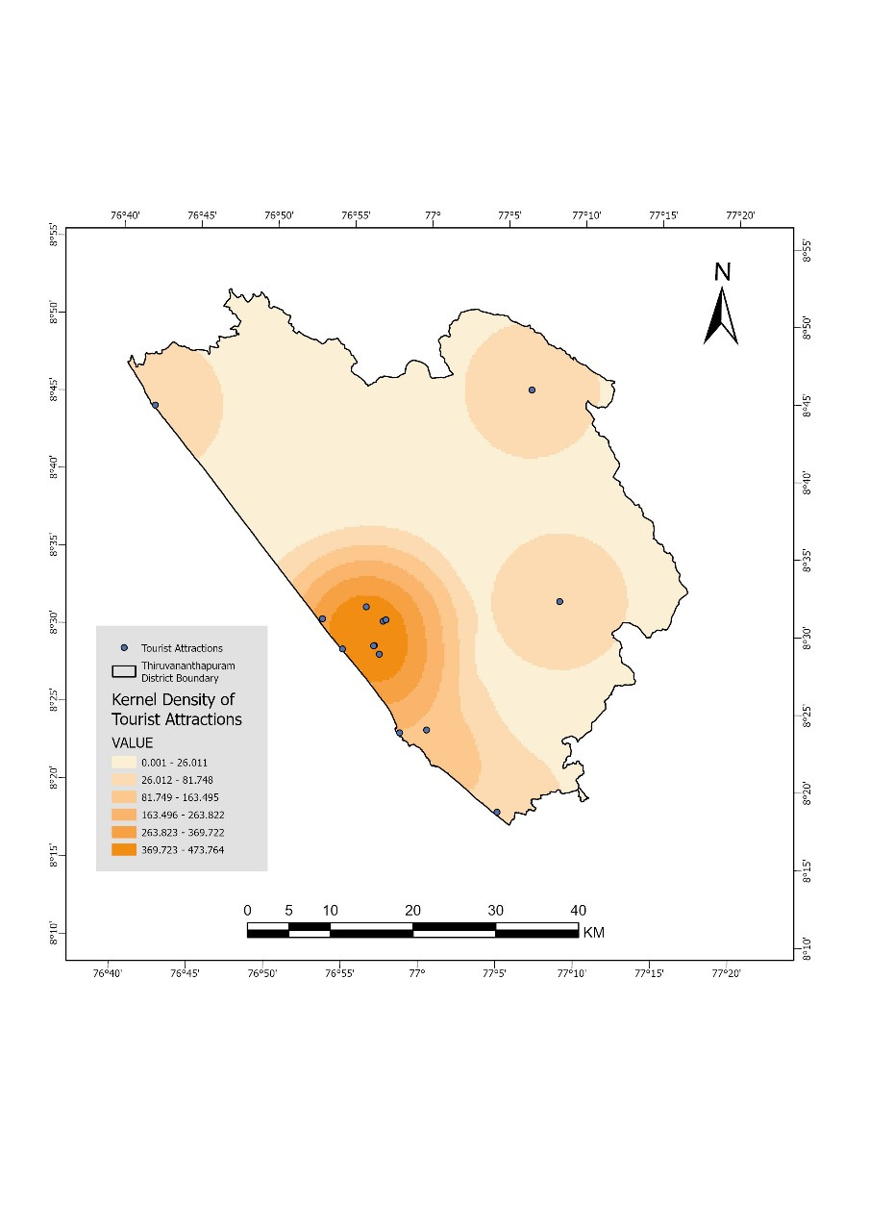
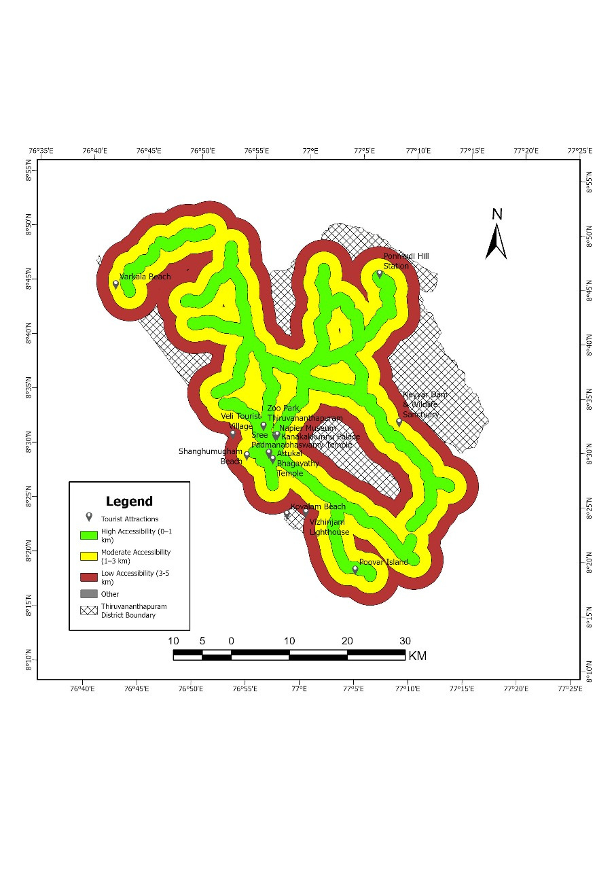
Hotspot and Accessibility Analysis
About
Content
Others
Kernel density: Identifying the Hotspots
Accessibility:Road Connectivity

Slide 11

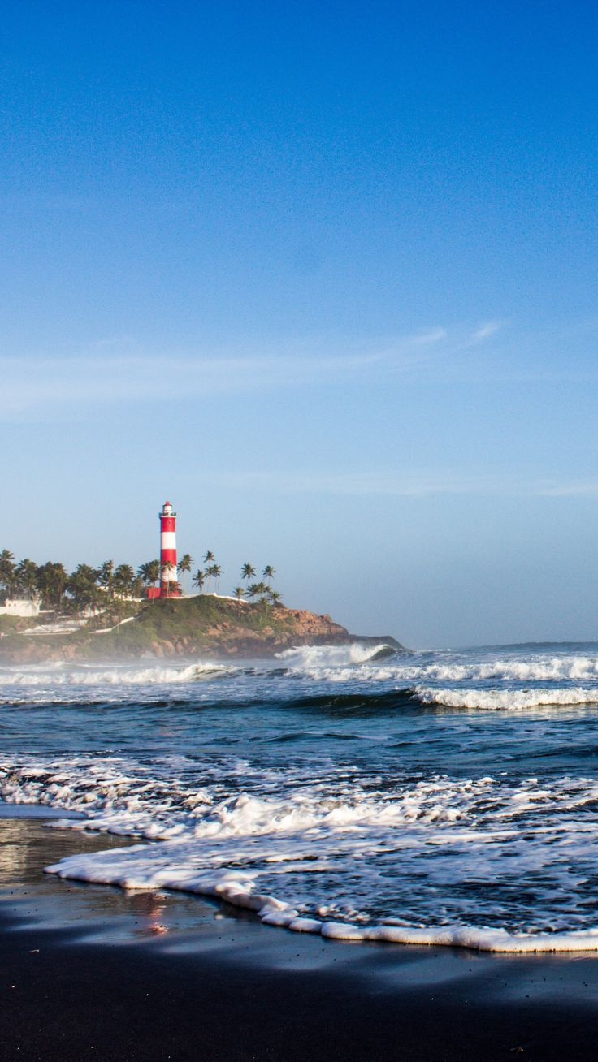
The Kernel Density Analysis was carried out to identify the major tourist hotspots in Thiruvananthapuram District. The results show a high concentration of tourist points around Padmanabhaswamy Temple, Napier Museum, Kovalam, and Varkala, indicating these as the most active tourist hubs with better supporting facilities and services. Moderate hotspots were observed in regions like Veli and Shankumugham, while low-density areas such as Neyyar Dam and Nipunmudi Hills indicate limited tourist activity and infrastructure.
The Multi-buffer Analysis was performed from the primary road network with buffer distances of 0–2 km, 2–3 km, and greater than 3 km to assess accessibility. Areas within 0–2 km show high accessibility with easy approach to major tourist sites, 2–3 km zones represent moderate accessibility, and regions beyond 3 km are categorized as low accessibility zones due to their remoteness and weaker transport connections. Together, these analyses reveal the spatial distribution of tourism activity and accessibility across the district.

Slide 12
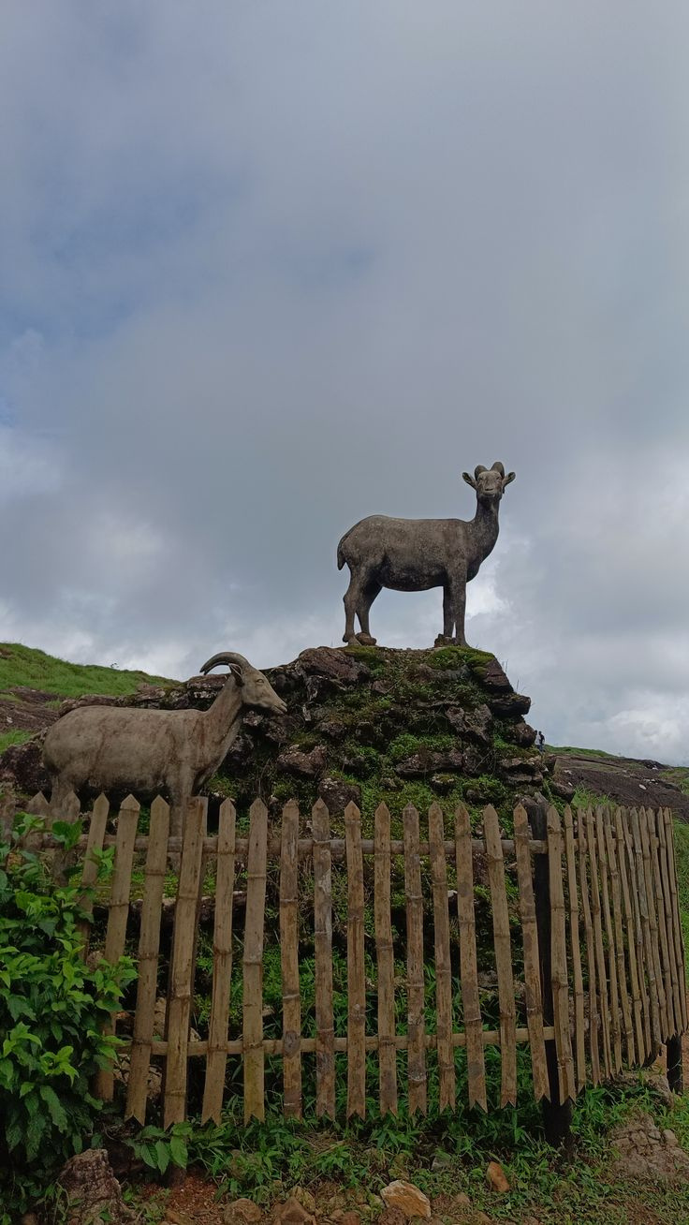
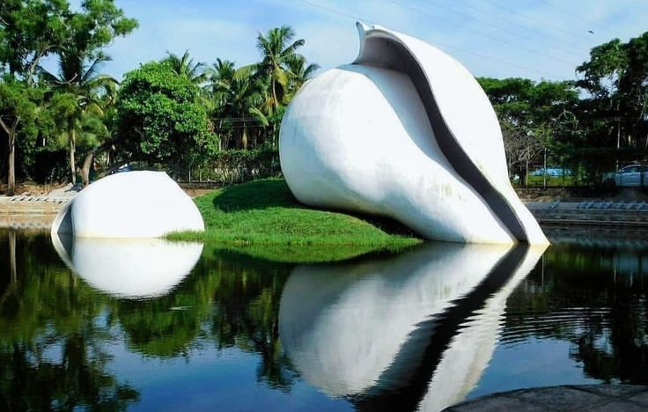
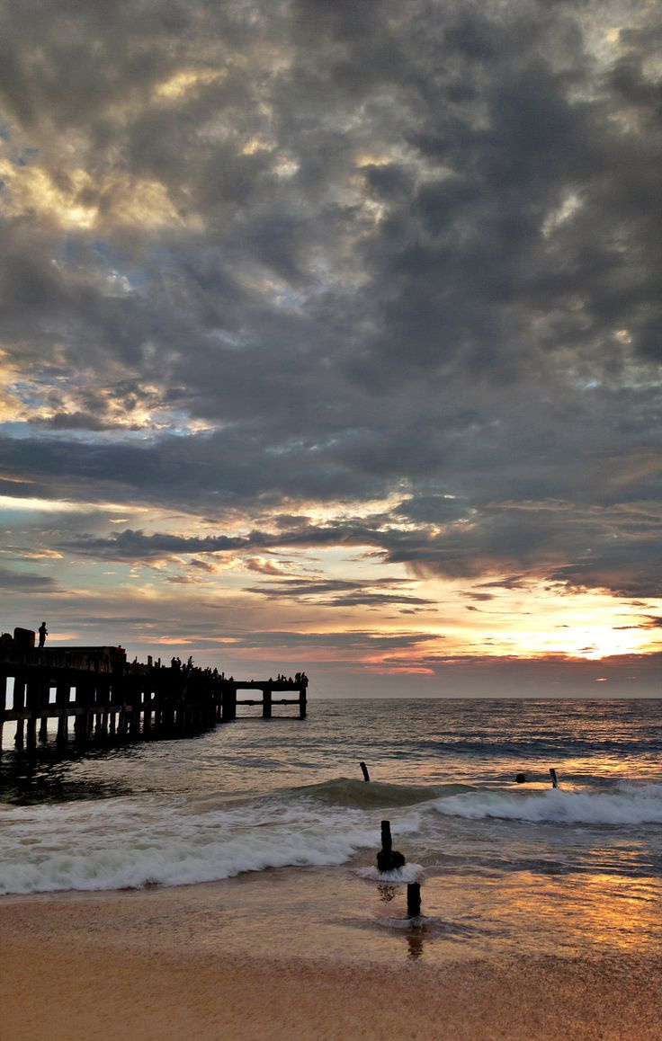
Conclusion
Spatial Disparity
Tourism is concentrated in coastal and urban areas, showing uneven regional development.
Infrastructure Gaps
Remote and hilly areas have limited service availability, affecting tourist convenience.
Accessibility Matters
Well-connected sites attract more visitors; improving road access can promote balanced growth.
Balanced Growth Needed
Expanding infrastructure to interior regions can reduce pressure on coastal hotspots.
GIS for Planning
GIS analysis helps identify gaps and guide sustainable tourism development across the district.

Slide 13
Thank You
-

