Slide 1






Enterprise HR Analytics:
A Strategic Solution
Excel
Transforming Raw Payroll & Performance Data into Actionable Business Intelligence
Bhagabata Brahma
Data Analyst | Excel | Power BI | SQL | Python

Slide 2





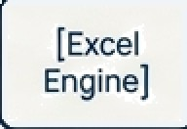
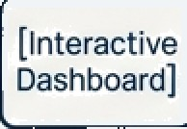







The Project at a Glance: From Challenge to Impact
The Business Challenge
The Strategic Solution
Ouantifiable Business Impact
HR and Finance teams lacked a unified view of workforce data across different geographies (New Zealand 6 India).
Manual, disparate reporting processes hindered the ability to monitor key metrics, ensure pay equity, and make strategic
workforce decisions.
An end-to-end HR data analytics model built entirely within Microsoft Excel. The solution automates the workflow from raw data ingestion ingestion and cleaning through to advanced analysis and interactive executive dashboarding.
Enabled data-driven monitoring of compensation fairness and gender pay equity.
Provided clear evaluation of performance-to-pay alignment.
Streamlined planning and simulation for bonus distribution.
Established benchmarks for workforce metrics across geographies.
[Raw Data]

Slide 3

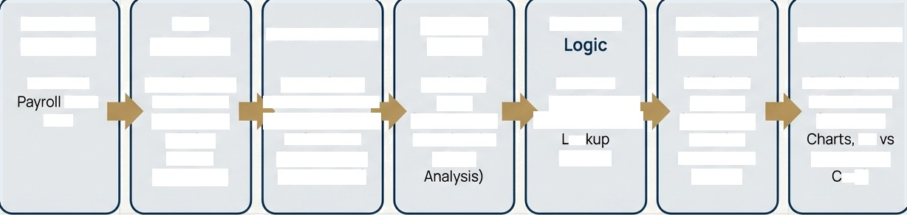
Disciplined Architecture for Transforming Data into Decisions
Raw Data Ingestion | Data Cleansing | Transformation | Analysis Engine | Business | Statistical Modelling | Visualisation
Raw HR s | Data Cleaning | Power Ouery | Analytical | Business | Statistical | Visualization 6
Excel | & Validation | ' Transformation- | Layer | Logic Layer | Analysis | 6 Dashboard
Files | (Duplicates, | ,• (Combine Files, - | (Pivot Tables. | (Bonus Rules, — | (Histogram. | (Executive
 | Missing | Define Data | KPIs, Gender | oo | Box Plot, | NZ
 | Values, | Types. Create | & Dept | Models) | Correlation, | India Report
 | Formatting) | Master Table) |  |  | Trends) | ard)
This improjent replicates a real-world corporate analytics This project replicates a real-world, ensuring a governed and repeatable process from source files to final decision support.

Slide 4
Laying the Foundation: Data Preparation and Integration
Creating a single source of truth from multi-country raw data.
Key Activities The Outcome
Data Cleaning & Validation
Systematically removed duplicate and invalid employee records.
Standardised critical data fields including salary, date, and text formats for consistency.
A Governed Master Employee Table
The result is a single, clean, and reliable master dataset that serves as tne foundation for all subsequent analysis and reporting.
Before After
Data Integration with Power Query
Combined disparate Excel files from New Zealand and India into a unified dataset.
Applied robust transformation logic and data validation rules.
Da te
Date
15/03/2023 | $55,000 | 2023-03-15 | SSOOD
Mar—16—23 | 56000 | 2023—03-16 | 56000
Before
After

Slide 5

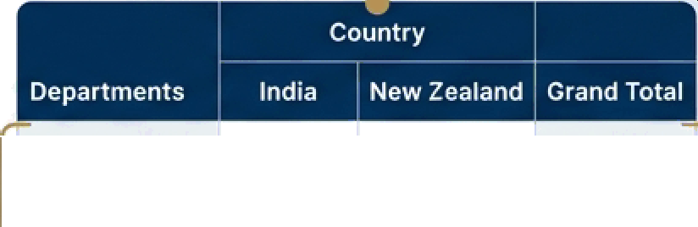
Building the Analytical Engine with Pivot Tables
Deriving core descriptive analytics and Key Performance Indicators.
With a clean master table, Pivot Tables and Pivot Charts were used as the primary engine for analysis. This allowed for rapid, flexible aggregation of data to answer key business questions.
 |  | Engineering | 55.000 | 58,000 | 55,000
 |  | Saes | 60,000 | 6S,OO0 | 60,000
(Departments) | ” | HR | 45,000 | 48,000 | 45,000
 |  | Marketing | 50,000 | 53,000 | 5O,00O
 |  | Finance | 52000 | 55,000 | 52,000
Key KPIs Calculated:
Total Headcount
Average & Median Salary
Department-wise Cost Analysis
Country-wise Workforce Metrics (NZ vs. India)
(Average of Salary)

Slide 6


Spotlight: Analysing Compensation Fairness and the Gender Pay Gap
Problem Statement
A key objective was to provide a clear, data-driven view into salary distribution between male and female employees to support pay equity initiatives.
Average Salary Comparison: Male vs. Female
$8
$7
Identified Pay Gap
$6
$60,000
S5
Methodology
A dedicated Pivot Table was constructed to compare key salary metrics (Average, Median) segmented by gender. This provides an unambiguous starting point for deeper investigation.
ss
$2
$1
Male
Female
GendE'F

Slide 7



Spotlight: Automating Complex Business Logic for Bonus Calculation
Business Need
The finance and HR teams required a transparent and repeatable method for calculating performance- based bonuses according to established business rules.
Technical Solution
Advanced IF logic was nested to create a formula- based bonus calculation engine.
The structure is fully transparent and audit-ready, with each step of the calculation clearly laid out.
B2
A
B
D
E
F
H
John Doe |  |  | High |  |  |  |  | 580,000 |  | Tierl |  |  |  |  | $12,000
Jane Smith |  |  | Medium |  |  |  |  | 575,000 |  | Tier 2 |  |  |  |  | $7,500
Bob Johnson |  |  | Low |  |  |  |  | $60,000 |  | Tier 3 |  |  |  |  | $3,000 '
Alice Williams |  |  | High |  |  |  |  | 590,000 |  | Tiers |  |  |  |  | 513,500
Charlie Brown |  |  | Medium |  |  |  |  | 565,000 |  | Tier 2 |  |  |  |  | 56,500
2
3
k S 6
7
=IF(B2=“High", C2*15%,
IF(B2-“Medium”, C2*10%,
C2*5y"o))
4
8

Slide 8
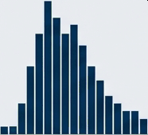
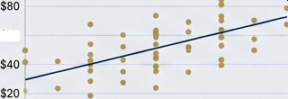
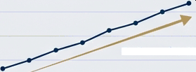
Uncovering Deeper Insights with Statistical Analysis
Moving beyond KPIs to understand distributions, correlations, and trends.
1. Salary Distribution
Method: Histogram & Box Plots.
2. Performance & Pay Correlation
Method: Scatter Plot & CORREL
function.
Purpose: To statistically evaluate the alignment between employee performance ratings and their corresponding salaries.
3. Workforce Trends
Method: Line Charts.
Purpose: To visualise the spread of salaries, identify outliers, and understand the overall compensation structure.
Purpose: To analyse employee headcount and salary trends over time.
Salary Distribution Histogram
Performance vs. Pay
Employee Headcount Trend
$100
100
80
$60
i
60
40
Continuous Growth
C0R9EL = 0.45
20
$00
0
$40k
S60k
$80k
g 0
G120k
'
1
4
5
01 02 03 O4 O\ O2 03 Q4
2023 2023
Performance I2eting (J-5)

Slide 9


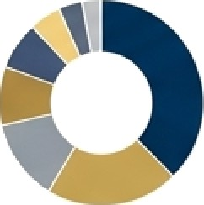







The Result: An Interactive HR & Payroll Executive Dashboard
At-a-glance KPI Cards for critical metrics.
. .
,
* “
Total HeadcoMnt:
YTD Bonus Payout:
.296
250
$85 000
+ TIier in
Employee Information kinder
$.2R
$4.5M
0.2°A
Dynamic charts visualising department and country-level performance.
•SaIes
e Engineering
e Marketing
Headcount
\,250
750
MTOQO
Avg. Salary
$85,000
585,000
Avg. Salary
10.0a
1e.Ok
India
Etc
Bonus 96
18.5%
24.5%
Growth Rate
5.7B
O.5%
Growth Rete
0.2%
3.2k
Integrated Information Finder for quick employee lookups.
Geographic comparison scorecard (NZ vs. India).

Slide 10
A Global View: The New Zealand vs. India
Executive Scorecard
Objective
To provide leadership with a direct,
side-by-side comparison of workforce metrics across the two key operating countries.
Geographic Scorecard: NZ vs. India
Metric New Zealand India
Features
, • Summarises key KPIs including Headcount, Average Salary, and Gender Ratio for each country.
Headcount
1,250
750
Avg. Salary
$85,000
$78,000
@ • Utilises conditional formatting (e.g., colour scales, icons) to instantly highlight performance differences and areas requiring attention.
Gender Ratio
55% 45%
60@o : 40%

Slide 11





Delivering Tangible Business Value and Decision Support
This analytics solution empowers HR and Finance leaders to move from reactive reporting to
proactive, data-driven strategic planning.
Monitor Fairness | Evaluate Alignment | Plan & Simulate | Benchmark Performance | Drive Strategy
Proactively monitor | Objectively assess the | Efficiently plan, model, | Benchmark key | Make informed, data-
compensation fairness | alignment of employee | and simulate bonus | workforce metrics and | driven decisions on
and gender pay equity | performance with | distribution scenarios. | costs across different | workforce planning,
across the organisation. | compensation. |  | geographies. | talent management, and budgeting.

Slide 12
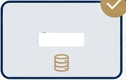
A Showcase of End-to-End Analytics Capability
Data Value Chain
Ingest
Integrate
Process
Store
Analyze
Visualize
Consume
Technology & Toolkit Platform: Microsoft Excel ETL: Power Query
Analysis: Pivot Tables, Advanced Formulas (XLOOKUP, INDEX-MATCH)
Statistics: CORREL, MEDIAN, PERCENTILE functions
Visualisation: Pivot Charts, Histograms, Box Plots,
Conditional Formatting
Professional Project Structure
The project was managed with a clear and organised
repository structure, separating raw data, cleaned data, analysis
models, and documentation for clarity and maintainability.
project name
/data_raw
/data_cIean
/analysis
/visuaIs
"1 /docs

