Slide 1
From Raw Data to Strategic Insight
A Blueprint for an End-to-End Data Analysis Workflow
Swiggy: Data Analysis

Slide 2















The Daily Challenge: Turning Disparate Data into Business Intelligence
Source:
Daily and weekly Excel files arrive via email from Safes, Marketing, and Operations teams.
Sales
Role:
You are the Data Analyst responsible for the entire data lifecycle.
Marketing
Business
Intelligence
Objective:
Validate, clean, integrate, and analyse this data to provide actionable insights to senior leadership (CEO, Directors).
Operations

Slide 3
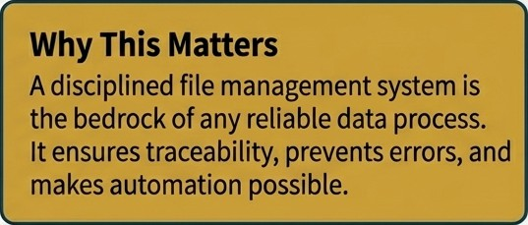



Establishing Order: The Foundation of a Trustworthy Data Pipeline
Systematic Data Receipt
Action: Daily monitoring of the sales mailbox to
identify and retrieve new data files.
Source Teams: Sales, Marketing, Operations.
Structured File Management
Action: Download all Excel files and save them into a predefined, logical folder system. This prevents data loss and ensures process integrity.
Raw Data
Data_Ana1ys1s/
Raw_Data/
SaIes_2024_01. xlsx
Cleaned Data
Sa tes_2024_02. xlsx
CIeaned_Data/ Processed_Data/
Processed Data

Slide 4




The First Line of Defence: Initial Validation and Cleaning in Excel
File Validation Checks (Before Loading)
File Format: Is it the correct‘.xtsx’ format?
Column Integrity: Are all expected columns present?
Data Types: Do columns contain the correct data types (date, number, text)?
File Health: Is the file free from corruption or errors?
Data Cleaning Activities
Remove extraneous rows (e.g„ repeated headers, totals).
Correct spelling inconsistencies (e.g., Country names, Product names).
Standardise formats for consistency (e.g., uniform date format, proper text case).
Country | Date | Sales
london | 01/03/24 | 1000
Country
Date
Sales
 |  |  | London | 2024-03-01 | 1000
London | Mar-02-2024 | 1500 | London | 202403-02 | 1500
Total | 03-03-24 | 2000 4S00 | London | 2024-03-03 | 2000
Before
After
G NotebookLtVi

Slide 5






Profiling and Mapping: Understanding the Data's DNA
Data Profiling - What Does the Data Tell Us? Data Mapping -Aligning Source to Target
Count number of rows and columns.
Purpose: Ensures consistency before loading into the database by aligning source column names with the standardised target schema.
Identify unique values per column.
Determine Min/Ivlax values for numerical fields.
Analyse the overall distribution of data.
Key questions answered by profiling:
Is the data usable? Is anything missing? Are there abnormal values?
Source Column | Target Column
City | City_Narne
Or Date | Order Date
Rest Name | Restaurant Name

Slide 6



The Quality Gate: A Zero-Tolerance Approach to Data Issues
Duplicate Records
Implement checks to detect and remove duplicate entries to ensure data integrity.
MissingVa!ues (Nu!ls)
@ Identify empty cells in mandatory
fields (State, City, Order_Date).
@ Decide whether to fill with a default, remove the record, or permit NULL.
Blank/Empty Strings
Detect records where crucial fields contain empty text rather than NULL values.

Slide 7


Centralising a Single Source of Truth: The ETL Process
EXTRACT
Sourcing raw data from the initial Excel files received via email.
TRANSFORM
Applying al validation, cleaning, profiling, and mapping rules from the previous steps.
LOAD
Importing the fully cleaned and structured data into target SQL database tables (e.g., Order_Name, Food_items, Sales).
Strategic fJutromc The ETL process creates a centralized and trusted data repository.
This is the singte source of truth for all subsequent analysis and business intelligence.

Slide 8






Designing for Performance and Clarity: The Star Schema
dim_date
@ | Year Ivlonth quarter
dim_restaurant
 | Restauran\_Name
fact_swiggy_orders '
Dimensional modelling organises data to make analysis simple, consistent, and efficient. It separates descriptive information (Dimensions) from measurable values (Facts), reducing data duplication and improving query performance.
$ Price_lNR ”I Rating
date_key
location_key
restaurant_key
dim_Iocation
@ | State
category_key
dim_category
 | Cuisine
dish_key
Most BI tools are optimised for this structure, ensuring a scalable and reliable foundation for analytics.
dim_dish
 | Dish_Name

Slide 9




Ensuring Database Integrity and Data Privacy
Post-Load S§L Validation
Even after loading, a final layer of checks is performed in SQL to guarantee integrity.
Row Count Verification: Does the table row count match the source?
Foreign Key Validation: Are all
relationships intact?
Null Checks: Re-verify critical columns ( SELECT C0UNT(•) FR0ñ sales hiHERE custoner_td IS NULL; ).
Responsible Data Masking
Management needs insights, not sensitive personal data. Data masking is essential for privacy and compliance.
Mask sensitive fields like Email ID, Customer Name, and Phone Number.
Before: "john.doeggnat1.con" After basking: "jXXXXgXXXX. con"

Slide 10




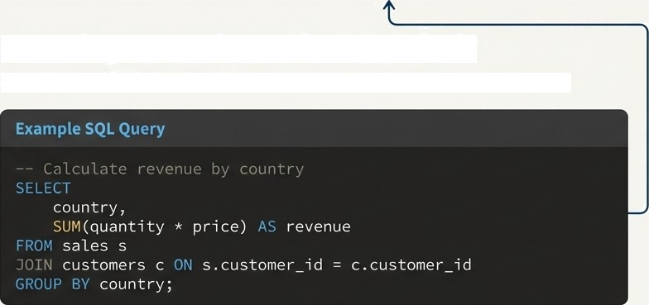
From Data to Decisions: Unleashing SQL for Analysis
Developing Key Performance Indicators (KPIs)
Total orders Total Revenue
1.2M Z450M
Average Dish Price Average Rating
Z285
4.16
Powering Deep-Dive Business Analysis
Move beyond high-level metrics to answer complex business questions.

Slide 11




A Multi-Dimensional View of Business Performance
Date-Based Analysis
Monthly & quarterly order trends
Year-wise growth patterns
Day-of-week performance analysis
Food & Restaurant
Performance
Top 10 restaurants by orders
Most ordered dishes and categories
Cuisine performance (Orders vs. Average Rating)
Location-Based Analysis
Top 10 cities by order volume
Revenue contribution by state
Customer Spending Insights
Distribution of orders across spending buckets:
- Under100,100-199,200-299, 300-499,500+

Slide 12



Bridging the Gap: Transtating SQL Analysis for
Business Users
SQL
S§L §uery Export
Why Excel?
Empowers stakeholders with a familiar tool.
Enables rapid ad-hoc analysis via Pivot Tables.
Facilitates the creation of Summary Sheets and Charts for reporting.
Business Analysis
This step transforms technical output into a flexible asset for the entire business.
G NotebookLM

Slide 13
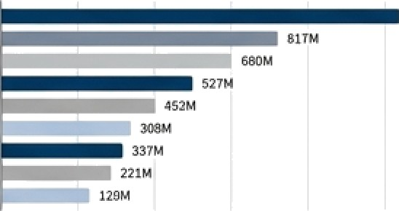
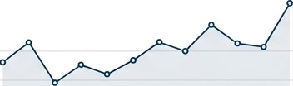
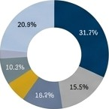
Visualising the Narrative: The Excel Dashboard
Total Safes:
Z450M
!
ToaloMem:
1.2M
Active Customers:
85K
monthly Sales Trend
Top 10 Restaurants by Orders
Jan
Feb Mer
Mgy /n
Jul
Sep Out Nov
Category-wise Sales Contribution
aa
”
The linal dashboard provides at-a-glance insights, allowing stakeholders to quickly understand performance and identify trends.
”” ” ”* ” ” ” ”
”

Slide 14







Delivering Actionable Insights to Leadership
The Final Package:
The Excel Dashboard: The primary visual tool for exploration.
Summary Insights: A concise list of key findings, written in clear business language (bullet points).
Strategic Recommendations: Actionable suggestions based on the data-driven insights.
The Audience:
CEO
Director Sales Head

Slide 15
The Analyst's Contribution:
The Complete Data Value Chain
„ .. ,
Data Receipt
Cleaning & Validation
ETL &
Modelling
SQL
Analysis
Visualisation
Strategic Insight
I handle end-to-end data management from receiving raw Excel files via email, validating and cleaning data, performing ETL, integrating data into SQL databases, running analysis queries, creating Excel dashboards, and finally sharing actionable insights with stakeholders.'

