Slide 1
Data reveals where retail planning must differ
Demand analysis and forecasting for grocery operations
MBA Year 1 · Operations Management
Student: [Name] · Institution: [Institution] · [Presentation Date]
Notes:
This project examines how retail sales history and operational context can support demand planning. The emphasis is on business interpretation and operating decisions, with forecasting used as one supporting stage rather than as a model leaderboard.

Slide 2
EXECUTIVE VERDICT
Concentration and peaks demand differentiated planning
72.7%
825.2k
+19.1%
414.4
sales from four families
Sunday mixed units
holiday store-day sales
best average forecast MAE
One rule cannot fit every store, family, and operating period.
Stable high-volume flows need routines; volatile and peak periods need flexibility.
Source: project analysis of Kaggle Store Sales data
2
Notes:
The analysis supports differentiated planning. Stable high-volume categories can use regular routines. Volatile important categories, weekend peaks, holidays, promotion periods, and high-variability stores need shorter review cycles and more operating flexibility.

Slide 3
BUSINESS QUESTION
Historical evidence can sharpen retail planning choices
How can sales history and operational factors support better planning?
01
02
03
04
05
Map demand patterns
Compare stores and families
Assess operating factors
Test forecast support
Translate evidence into action
Boundary: the dataset supports planning insight—not inventory optimization.
3
Notes:
The business question stays broad enough to follow the evidence. The project examines demand patterns, operating associations, store and family differences, and forecast usefulness. It does not claim direct inventory optimization because stock, lead-time, service, and cost data are unavailable.

Slide 4
DATA FOUNDATION
A complete panel anchors the analysis at daily family level
3,000,888
1,684
54 × 33
date × store × family
unique sales rows
observed dates
stores × families
Source | Rows | Role
Sales | 3,000,888 | Demand + promotions
Transactions | 83,488 | Traffic proxy
Stores | 54 | Format + geography
Holidays | 350 | Event scope
Oil | 1,218 | Economic context
Coverage: 1 Jan 2013–15 Aug 2017 · Kaggle Store Sales
4
Notes:
The source files operate at different grains. Stores are static; transactions are daily by store; oil is daily; and holidays can overlap by geographic scope. Join validation is essential because an incorrect merge could duplicate sales or apply local events to every store.

Slide 5
METHOD
The workflow keeps business decisions ahead of model complexity
Question
→
Audit
→
Prepare
→
Explore
→
Diagnose
→
Forecast
→
Act
Full panel for network patterns · transparent subset for detail · chronological forecast validation
5
Notes:
The workflow starts with a business question and ends with operating choices. Data-quality checks protect the analysis. Forecasts are evaluated only after patterns and operational differences are understood, and only by whether they add useful information beyond transparent baselines.

Slide 6
DATA QUALITY
Preparation preserves signals instead of deleting inconvenient variation
31.30%
8.19%
43
rows with zero sales—retained
store-dates missing transactions
missing oil observations—flagged
● No duplicate sales keys or negative sales
● Holiday scope matched to relevant stores
● Every join preserved all 3,000,888 rows
● Retail spikes remained visible for investigation
Quality principle: preserve uncertainty and validate every merge
6
Notes:
Blind deletion would remove operationally meaningful variation. Zeros can reflect genuine low demand, closures, or store lifecycle. Missing transactions remain missing rather than becoming zero traffic. Oil values are filled over a daily index and flagged, while holiday scope is matched before joining.

Slide 7
ANALYTICAL SCOPE
A transparent subset makes detailed comparisons credible
16 Aug 2015
Two-year analytical window
15 Aug 2017
5 stores
5 families
≥90%
44 · 45 · 17 · 32 · 25
Grocery I · Beverages · Produce · Cleaning · Frozen
transaction + active-sales coverage
Selection spans high, median, low, and volatile mature stores.
Lifecycle rules prevent pre-opening zeros from masquerading as volatility.
7
Notes:
The full dataset still supports network findings. The subset makes detailed comparisons manageable without choosing cases arbitrarily. Lifecycle eligibility prevents late-opening stores from appearing artificially volatile because of pre-opening zero rows.

Slide 8
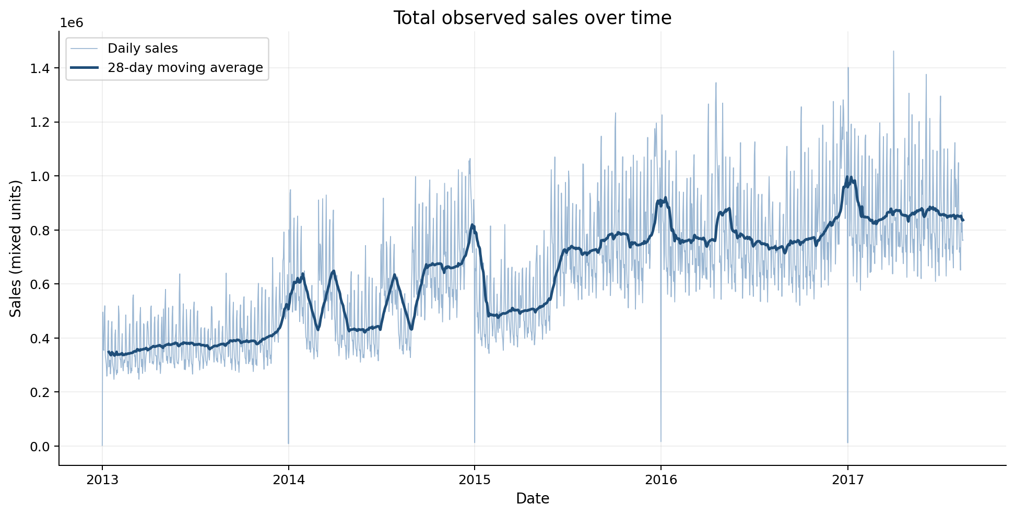
DEMAND PATTERNS
Average daily network sales doubled before 2017
385.8k → 790.8k
Observed network sales; 2017 is partial through 15 August
8
Notes:
Average daily observed network sales rose from about 385.8 thousand mixed units in 2013 to 790.8 thousand in 2016. This is not confirmed same-store growth; store openings, assortment changes, promotions, and other factors may contribute.

Slide 9
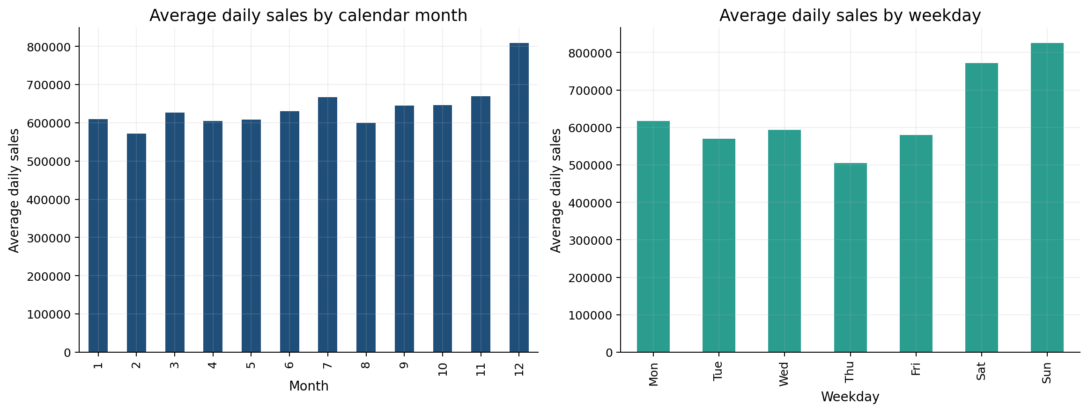
CALENDAR EFFECTS
Weekends and December create recurring operating pressure
Sunday 825.2k
December 808.6k
Review staffing, checkout, receiving, and shelf replenishment before peaks.
Values are network averages in mixed units
9
Notes:
Sunday and Saturday have the highest weekday averages, while December has the highest monthly average. These network patterns support advance peak reviews, but store and family histories should refine the final operating plan rather than applying one universal multiplier.

Slide 10
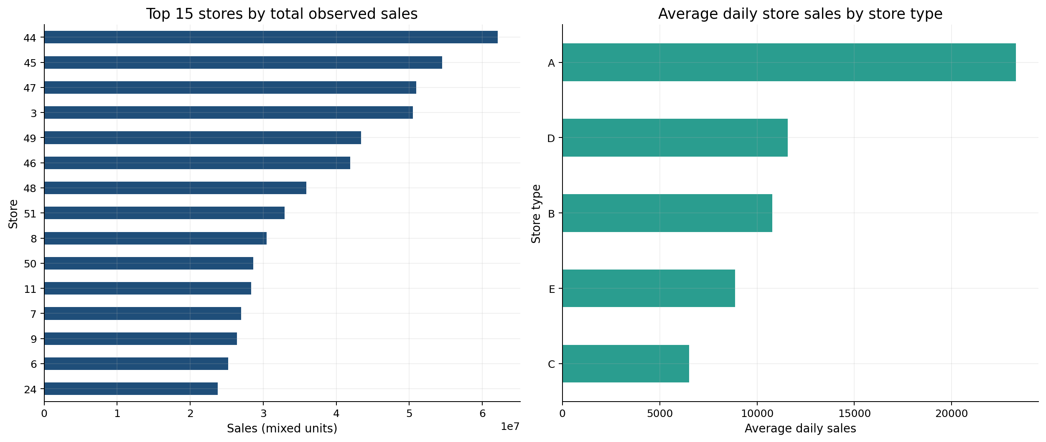
STORE DIFFERENCES
Store scale and mature-store variability require local rules
62.1M
Store 44 mixed units
0.702
Store 25 mature CV
7 stores stay outside mature-store variability comparisons.
Lifecycle context prevents false underperformance or volatility labels
10
Notes:
Store 44 has the highest observed sales. Among mature stores with adequate transaction and active-sales coverage, Store 25 has the highest daily-demand coefficient of variation. Newer or incompletely covered stores remain separate from mature-store comparisons.

Slide 11
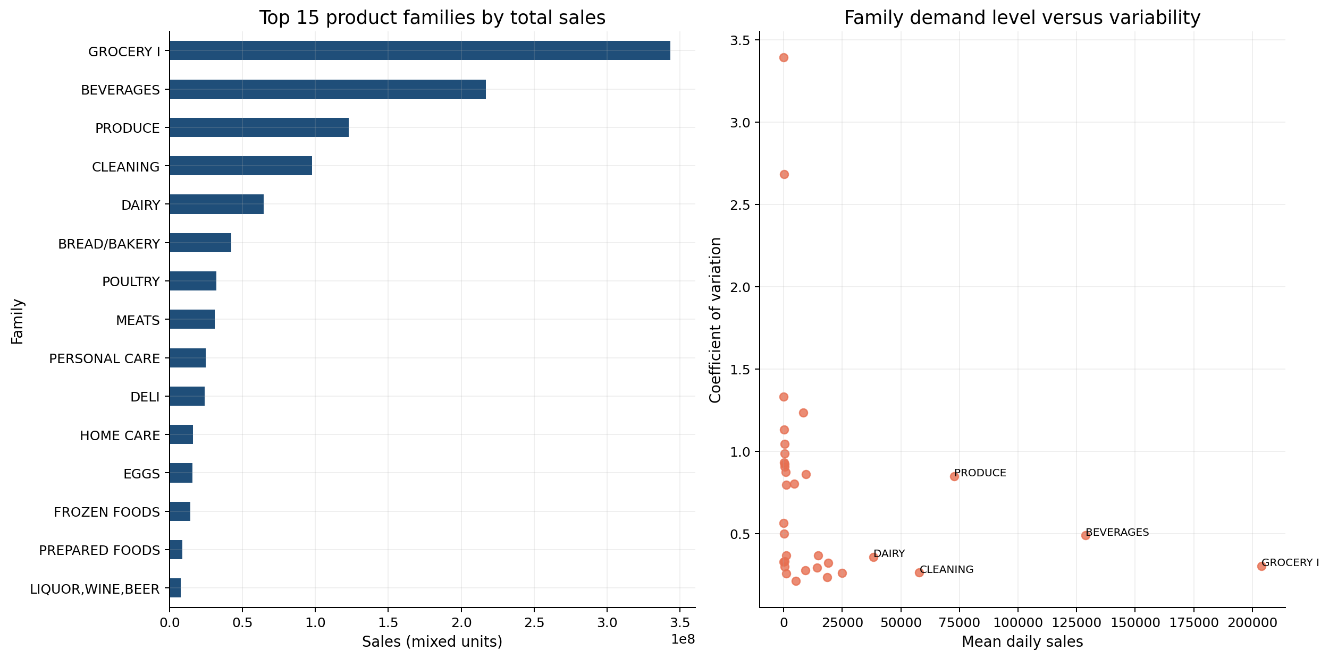
FAMILY PORTFOLIO
Four families contribute nearly three quarters of sales
31.99%
Grocery I
Produce
high-volume + volatile
Monitor closer; plan flexibly.
Sales shares and daily-demand CV use the full historical panel
11
Notes:
Grocery I, Beverages, Produce, and Cleaning contribute 72.7 percent of observed family-level sales. Grocery I and Cleaning combine scale with relative stability. Produce combines commercial importance with much greater variability and therefore merits closer monitoring.

Slide 12
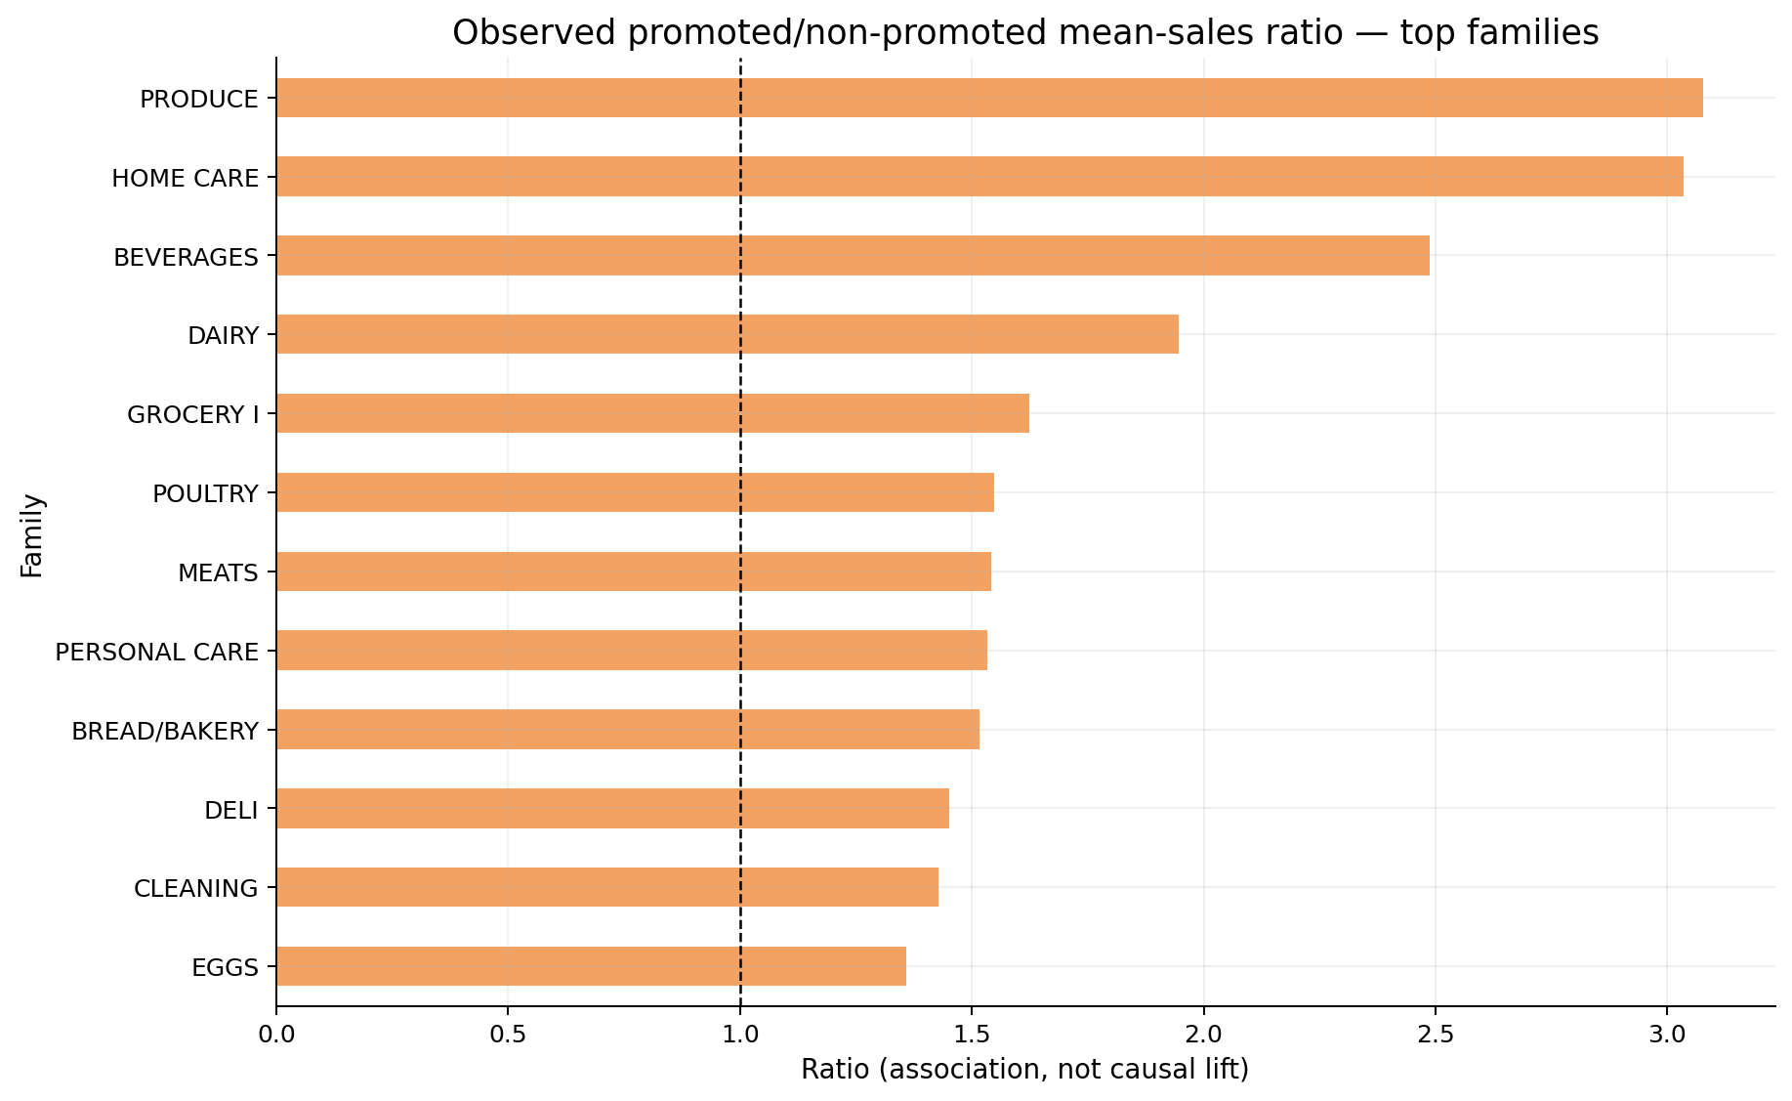
DEMAND DRIVERS
Promotion and holiday associations vary across operating contexts
3.08×
Produce promotion ratio
+19.1%
holiday store-day sales
Coordinate campaigns and events with supply, shelf space, receiving, and labor.
Associations, not causal lift; timing and targeting may confound comparisons
12
Notes:
Promotion ratios indicate where operating pressure may be stronger, but they do not estimate incremental lift because promotions were not randomly assigned. Holiday store-days also differ by month, weekday, promotion mix, and location.

Slide 13
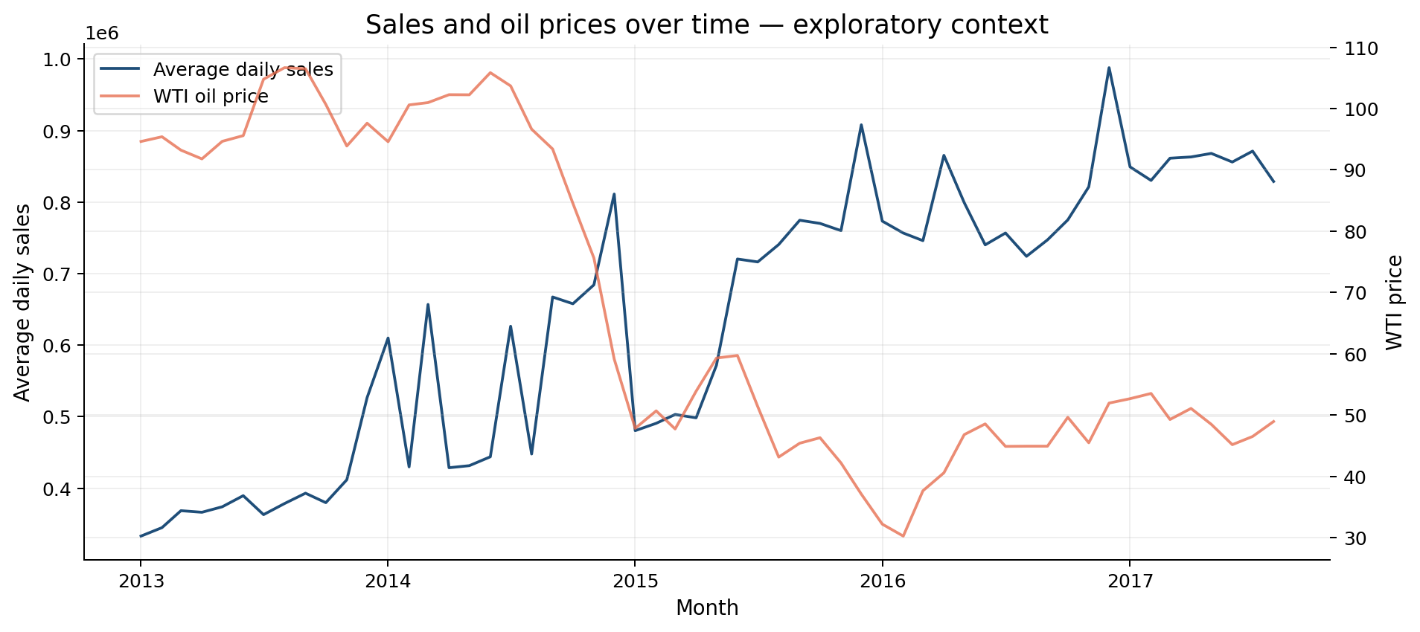
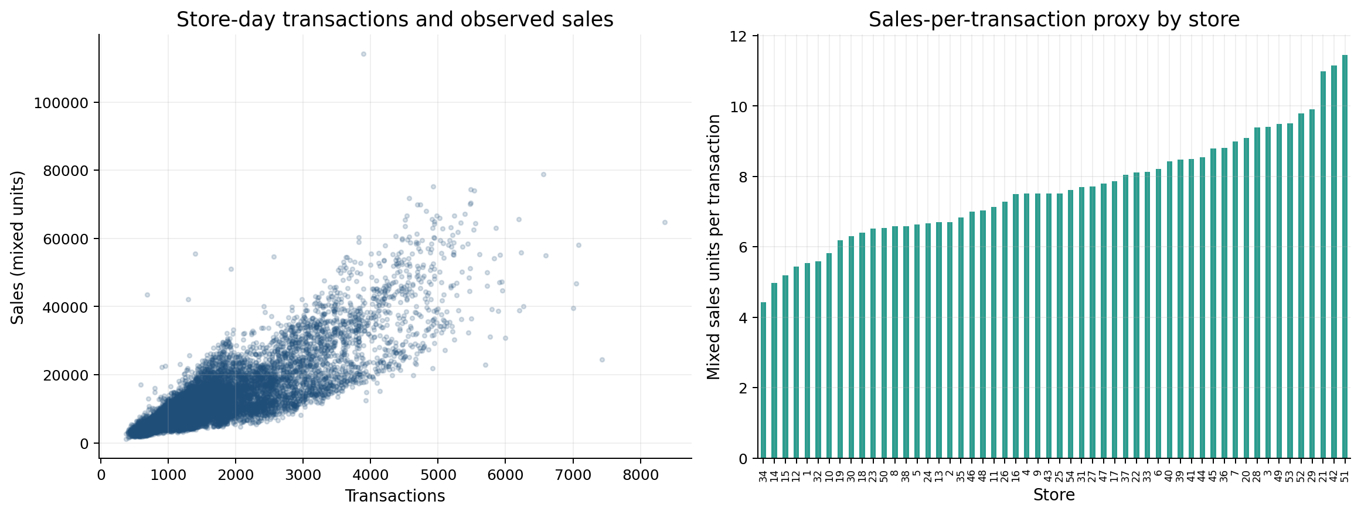
OPERATIONAL CONTEXT
Transactions inform workload; oil remains exploratory context
0.837
sales–transaction correlation
Oil correlation −0.788 may reflect shared trends and omitted factors.
Correlation supports investigation—not causation
13
Notes:
Transactions provide a useful traffic proxy for staffing and checkout planning. Sales divided by transactions is still a mixed-unit basket proxy, not revenue per transaction. The oil relationship is exploratory because time trends and omitted variables can create strong contemporaneous correlation.

Slide 14
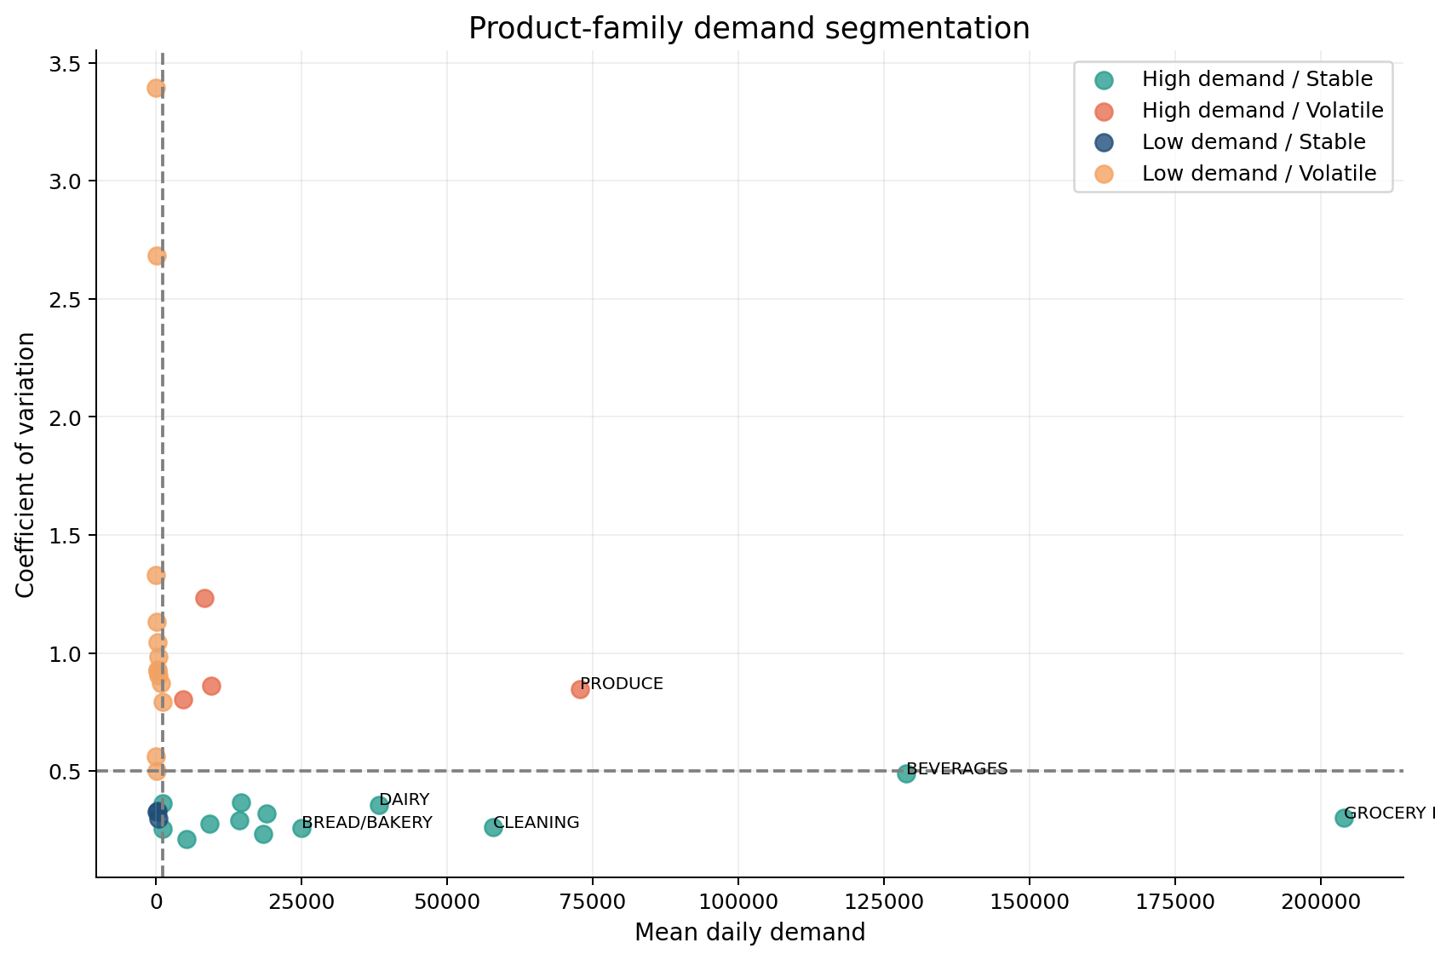
OPERATIONS SEGMENTATION
Demand level and variability define four planning postures
Segment | Families
High / stable | 13
High / volatile | 4
Low / stable | 3
Low / volatile | 13
Produce deserves shorter reviews: scale and volatility compound operating risk.
Median demand and median CV are transparent portfolio cutoffs
14
Notes:
The segmentation uses median daily demand and median coefficient of variation. It is a practical framework for differentiated review cadence, not a universal retail classification or an inventory-policy prescription.

Slide 15
FORECAST DESIGN
Forecasting tests value beyond transparent operating baselines
Target
Validation
Models
Metrics
3 daily store–family series
Final 60 days held out
Naive · seasonal · Holt-Winters · RF
MAE · RMSE · RMSLE
Shifted lags + chronological split + no future transactions
No confusion matrix: continuous sales require regression errors and forecast plots.
15
Notes:
Forecasts use chronological validation rather than a random split. Lag and rolling features are shifted to avoid leakage, and future realized transactions are excluded. MAE measures average unit error, RMSE emphasizes large misses, and RMSLE emphasizes proportional error.

Slide 16
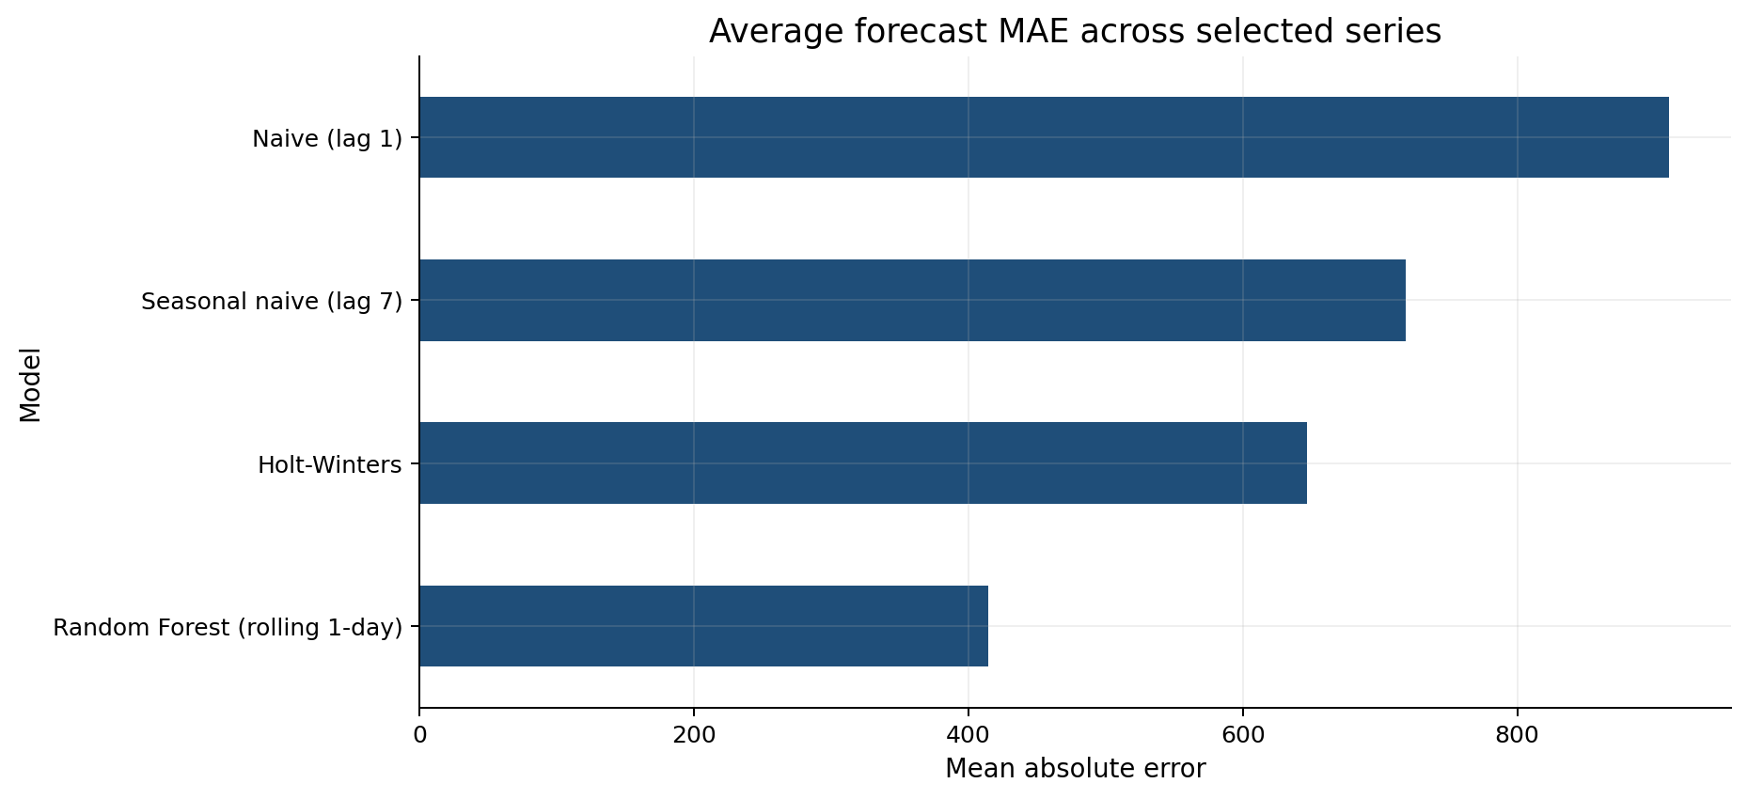
FORECAST RESULTS
Random Forest leads on average, but winners vary
414.41
Random Forest average MAE
−42.3%
vs weekly seasonal baseline
Holt-Winters wins Store 32 · Frozen Foods
60-day holdout · rolling RF and fixed-path Holt-Winters differ operationally
16
Notes:
Random Forest has the best average errors and a 42.3 percent lower average MAE than the weekly seasonal baseline. Holt-Winters still wins one series, so the operational conclusion is to retain a transparent baseline and monitor errors by store-family series.

Slide 17
MANAGERIAL ACTIONS
Evidence supports differentiated operating policies
Protect core flow
Flex for volatility
Prepare recurring peaks
Routine cycles for stable, high-volume families
Shorter reviews for Produce and volatile stores
Roster and receive ahead of weekends and December
Coordinate promotions
Benchmark forecasts
Separate lifecycle effects
Link campaigns to supply, shelf space, and labor
Track each model against seasonal naive
Treat new and mature stores differently
Actions are planning routines—not precise inventory prescriptions
17
Notes:
These actions translate observed patterns into practical planning routines. They remain intentionally non-prescriptive because the dataset lacks stock positions, labor productivity, shelf capacity, lead times, supplier constraints, costs, and service targets.

Slide 18
CONCLUSION
Better choices emerge when uncertainty stays visible
Plan differently where the evidence differs.
What remains unknown
● Unconstrained demand
● Inventory and stockouts
● Lead times and service targets
● Costs, margins, and capacity
● Prioritize volume without assuming equal predictability
● Prepare for calendar and promotion pressure
● Benchmark forecasts by store–family series
● Separate mature stores from lifecycle effects
Next step: pilot forecasts beside seasonal baselines and monitor errors.
Project conclusion: trustworthy evidence supports planning without overstating causality
18
Notes:
The main contribution is not one best model. It is a structured way to distinguish scale, variability, calendar peaks, store lifecycle, and forecast uncertainty so managers can apply different planning responses where the evidence justifies them.

