Slide 1
PromptlyAI

Slide 2
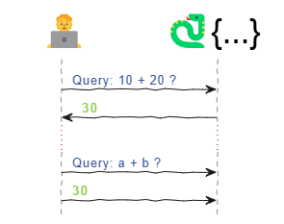
Deterministic Functions
Deterministic Function Call

Slide 3
Deterministic Functions
Deterministic Function Call
def add_numbers(a, b):
return a+b

Slide 4
Deterministic Functions
Deterministic Function Call

Slide 5
Deterministic Functions
Deterministic Function Call
Consistent Results: Same input always produces the same output
Easily Testable: Simple to debug, validate, and trust
Composable: Can be safely reused and combined in larger workflows

Slide 6
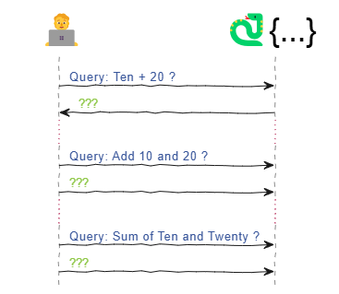
Functions & Its Limitations
Deterministic Function Call
Functions & Limitations
Consistent Results: Same input always produces the same output
Easily Testable: Simple to debug, validate, and trust
Composable: Can be safely reused and combined in larger workflows

Slide 7
Functions & Its Limitations
Deterministic Function Call
Functions & Limitations
Consistent Results: Same input always produces the same output
Easily Testable: Simple to debug, validate, and trust
Composable: Can be safely reused and combined in larger workflows
Cannot handle natural or unstructured language.
Requires exact syntax; no room for interpretation.
Cannot adapt dynamically without manual updates.

Slide 8
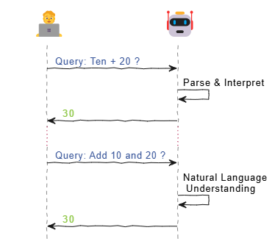
LLM - Natural Language Processing
LLM Capabilities

Slide 9
LLM - Natural Language Processing
LLM Capabilities
Understands natural language queries
Handles ambiguity with reasoning
Needs tools for real-time/external data

Slide 10
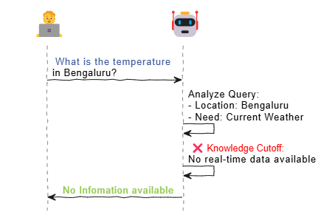
LLM - Natural Language Processing & Limitations
LLM Capabilities
LLM - Limitations
Understands natural language queries
Handles ambiguity with reasoning
Needs tools for real-time/external data

Slide 11
LLM - Natural Language Processing & Limitations
LLM Capabilities
LLM - Limitations
Responses are limited to training cutoff (no real-time info).
Cannot fetch live data like weather or stock prices.
Analyzes queries well but can’t complete actions needing up-to-date information.
Understands natural language queries
Handles ambiguity with reasoning
Needs tools for real-time/external data

Slide 12
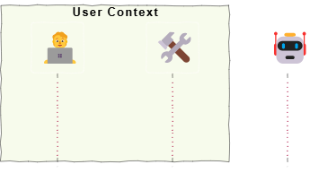
LLM & Function Tools
User With Function Tools

Slide 13
LLM & Function Tools
User With Function Tools
Tools component added under the User context to extend interaction scope.
Provides a set of callable functions for specialized tasks (e.g., weather, calculator)

Slide 14
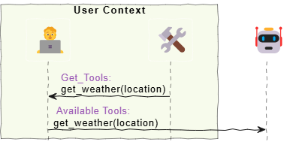
LLM & Function Tools
User With Function Tools
LLM Enabled with Tools
Tools component added under the User context to extend interaction scope.
Provides a set of callable functions for specialized tasks (e.g., weather, calculator)

Slide 15
LLM & Function Tools
User With Function Tools
LLM Enabled with Tools
Tools component added under the User context to extend interaction scope.
Provides a set of callable functions for specialized tasks (e.g., weather, calculator)
Tools are now connected to the LLM for handling specific tasks.
The LLM knows which tools it can use, such as get_weather(location).
This setup helps the LLM perform actions beyond just generating text.

Slide 16
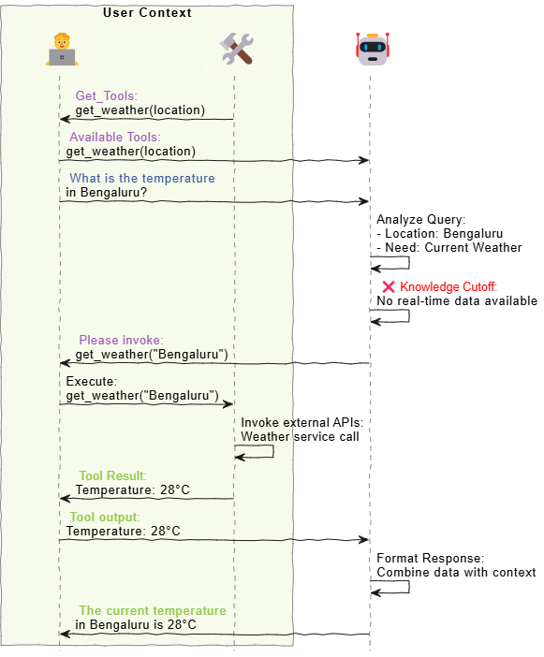
LLM & Function Tools In Action…

Slide 17
LLM & Function Tools In Action…
LLM understands the user's request and identifies what information is needed
It uses connected tools (like get_weather) to gather real-time data.
With the tool results, LLM builds a meaningful response and delivers the final answer.

Slide 18
LLM & Function Tools In Action.
LLM understands the user's request and identifies what information is needed
It uses connected tools (like get_weather) to gather real-time data.
With the tool results, LLM builds a meaningful response and delivers the final answer.
❓ If the user already has access to the function, what value does the LLM add by acting as a middleman instead of invoking it directly—doesn’t this introduce extra complexity or latency?

Slide 19
LLM & Function Tools In Action.
LLM understands the user's request and identifies what information is needed
It uses connected tools (like get_weather) to gather real-time data.
With the tool results, LLM builds a meaningful response and delivers the final answer.
❓ If the user already has access to the function, what value does the LLM add by acting as a middleman instead of invoking it directly—doesn’t this introduce extra complexity or latency?
A. LLM adds value by understanding user intent, deciding when and how to use the right function, and simplifying tool usage through natural language—removing the need for exact function calls

Slide 20
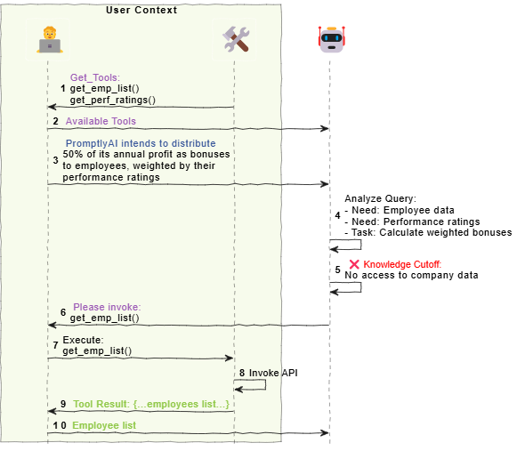
Solving Complex Tasks: LLM Coordinates Multiple Tools
Task: PromptlyAI intends to distribute 50% of its annual profit as bonuses to employees, weighted by their performance ratings

Slide 21
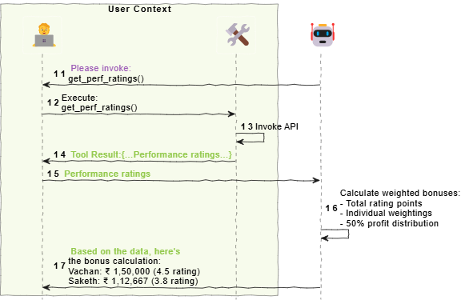
Solving Complex Tasks: LLM Coordinates Multiple Tools
Task: PromptlyAI intends to distribute 50% of its annual profit as bonuses to employees, weighted by their performance ratings

