Slide 1
Controller Area Network (CAN)

Slide 2
In-vehicle networks

Slide 3
Agenda
Need for network
CAN
MOST
FlexRay

Slide 4
Introduction
Is a serial communications protocol which efficiently supports distributed real time control with high level of security
Application ranges from high speed networks to low cost multiplex wiring
  Automotive electronics, engine control units, sensors, anti-skid systems
Bits rates up to 1Mbit/s

Slide 5
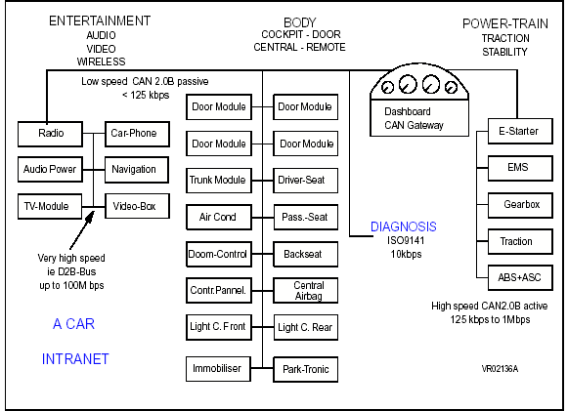

Slide 6
CAN specification
CAN spec consists of two parts, with
Part A describing CAN message format as it is defined in CAN specification 1.2
Part B describing both standard(11 identifier bits) and extended message(29 identifier bits) formats
For compatibility with 2.0 the implementation must be in conformance with part A or B

Slide 7
CAN specification - contd
CAN implementations that are designed according to part A of this or according to previous CAN specifications, and CAN implementations that are designed according to part B of this specification can communicate with each other as long as it is not made use of extended format
In this session we deal with only Part A of CAN specification

Slide 8
Can Specification2.0 - PART A

Slide 9
Basic concepts
CAN has following properties:
Prioritization of messages
Guarantee of latency times
Configuration flexibility
Multicast reception with time synchronization
System wide data consistency
Multimaster
Contd…….

Slide 10
Basic concepts- contd
Error detection and signaling
Automatic retransmission of corrupted messages as soon as the bus is idle again
Distinction between temporary errors and permanent failures of nodes and autonomous switching off of defect nodes

Slide 11
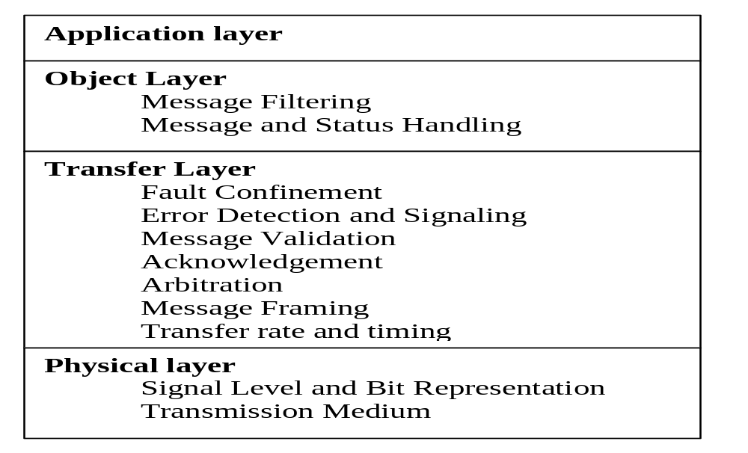
Layerered structure of a CAN node

Slide 12
Scope of CAN specification
Define the transfer layer and the consequences of the CAN protocol in the surrounding layers
Physical layer not defined to allow transmission medium and signal level implementations to be optimized for application. Within one network the physical layer has to be same for all nodes
Much freedom in defining object handling

Slide 13
Messages
Information on the bus is send in fixed format messages of different but limited length
When the bus is free, any connected unit may start to transmit a new message

Slide 14
Information Routing
System flexibility
  Nodes can be added without any software or hardware change
Message Routing
  Identifier denotes the meaning of message. MESSAGE FILTERING can be employed .
Multicast
  Any number of nodes can act upon message
Data consistency
  Either accepted by all nodes, or no nodes

Slide 15
Bit Rate
Speed of CAN is different in different systems
In a given system the bit rate is uniform and fixed
Up to 1Mbit/s

Slide 16
Frame Types
A Data Frame carries data from transmitter to receiver
A Remote Frame is transmitted by a bus unit to request the transmission of the Data frame with the same identifier
An Error Frame is transmitted by any unit detecting an error
An Overload Frame is used to provide an extra delay between frames

Slide 17
Priorities
IDENTIFIER defines a static message priority during bus access

Slide 18
Remote Data Request
By sending a Remote Frame a node requiring data may request another node to send the corresponding Data Frame.
The Data Frame and the corresponding Remote Frame are named by the same identifier

Slide 19
Multimaster
When the bus is free any unit may start to transmit a message. The unit with the message of higher priority to be transmitted gain bus access

Slide 20
Arbitration
Bus wise conflict is resolved by bit wise arbitration using the IDENTIFIER
Guarantees that neither information or time is lost
Data Frame has preference over Remote Frame with same identifier
During arbitration every bit send is compared with level monitored on bus. If values are different then unit has lost arbitration

Slide 21
Safety
Powerful measures of error detection, signaling and self checking are implemented in every CAN node
Error Detection
  Monitoring (transmitters compare the bit levels to be transmitted to the bit levels detected on the bus)
  Cyclic Redundancy check
  Bit stuffing
  Message Frame check

Slide 22
Error Signaling and Recovery time
Corrupted messages are aborted and transmitted automatically
Recovery time is at most 29 bit times, if there is no further error

Slide 23
Fault Confinement
Distinguish short disturbances from permanent failures
Defective nodes are switched off

Slide 24
Connections
Any number of units can be connected
Practically the number of units will be limited by delay times and/or electrical loads on the bus line

Slide 25
Bus
Consists of a single channel that carries bits
Channel implementation is not fixed in this specification
  Eg:- single wire(plus ground), two differential wires, optical fibres etc

Slide 26
Bus values
Two complimentary logical values – ‘dominant’ or ‘recessive’
During simultaneous transmission of dominant and recessive bits, the resulting value will be dominant
Physical states that represent the logical levels are not given in this specification

Slide 27
Acknowledgement
All receivers check the consistency of the message being received and will acknowledge a consistent message and flag an inconsistent message

Slide 28
Sleep mode/Wake Up
To reduce power consumption, a CAN-device may be set into sleep mode without any internal activity and disconnected bus drivers.
To wake up other nodes, which are in sleep, a special wake-up message with lowest possible Identifier(rrr rrrd rrrr) may be used
On wake up transfer layer will wait for crystal to stabilize and then wait for 11 recessive bits(synchronizing with bus activity)

Slide 29
Message Transfer

Slide 30
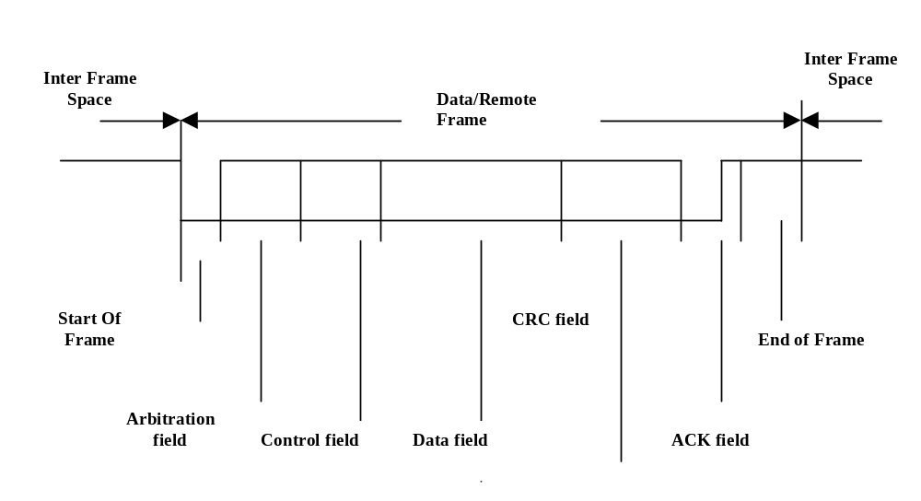
Data/Remote Frame

Slide 31
Data/Remote Frame
Start Of Frame: consists of a single dominant bit
Arbitration Field – consists of Identifer and RTR
  Identifier: bits are transmitted from ID10 – ID0. The 7 most significant bits must not all be recessive
  In Data Frame RTR is dominant and in Remote Frame it is recessive

Slide 32
Data/Remote Frame
Control Field – it includes Data length code and reserved bits
Data Field – Data to be transmitted. It can contain from 0 to 8 bytes, which each contain 8 bits which are transferred MSB first
CRC Field – CRC Sequence and CRC Delimiter

Slide 33
Data/Remote Frame
ACK Field – Two bits long and contains ACK Slot and ACK Delimiter
Transmitter sends two recessive bits
A Receiver who has received valid message reports by sending a ‘dominant bit’ during ACK slot
ACK delimiter – recessive bit
END Of Frame – seven recessive bits

Slide 34
Error Frame
Error Flag and Error Delimiter
Error Flag
  Active Error Flag : An ‘error active’ station signals error by 6 consecutive dominant bits.
  Passive Error Flag : An ‘error passive’ station signals by six consecutive recessive bits unless it is overwritten by ‘dominant bits’ from other nodes
Error delimiter – 8 recessive bits

Slide 35
INTERFRAME Spacing
Data and Remote frames are separated by inter frame spacing
Contains the bit fields INTERMISSION and BUS IDLE and, for ‘error passive stations’ which have been TRANSMITTER of previous message, SUSPEND TRANSMISSION

Slide 36
Overload Frame
Overload frame is generated to delay the next Data or Remote Frame
The internal conditions of a receiver, which requires a delay will prompt an Overload Frame
Detection of a dominant bit during ‘INTERMISSION’

Slide 37
Message validation
Transmitter:Message is valid if there is no error until the End Of Frame. If a message is corrupted, retransmission will follow automatically and according to prioritization
Receivers: Message is valid for Receivers , if there is no error until the last but one bit of End Of Frame

Slide 38
Coding
The Frame segments START OF FRAME, ARBITRATION FIELD, CONTROL FIELD, DATA FIELD and CRC Sequence are coded by method of bit stuffing
Remaining are not stuffed
The bit stream in a message is coded according to the Non-Return-to-Zero method.

Slide 39
Error Handling
5 type of errors
  BIT ERROR
  CRC ERROR
  STUFF ERROR
  FORM ERROR
  ACKNOWLEDGEMENT ERROR
A station detecting an error condition signals this by Error Flag

Slide 40
Fault Confinement
‘error active’ – Normal state
‘error passive’ – TRANSMIT or RECEIVE error counts exceeds 128. It also takes part in bus activities
‘bus off’ – TRANSMIT error count exceeds 256. It is not allowed to have any influence on the bus. Is permitted to become ‘error active’ with its counters set to zero after 128 occurrences of 11 consecutive recessive bits monitored on bus

Slide 41
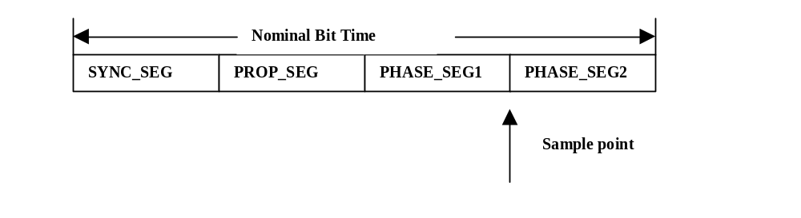
Bit Timing Requirements
SYNC_SEG – to synchronize all nodes
PROP_SEG – compensate physical delay
PHASE_SEG1,PHASE_SEG2 – compensate edge phase errors

Slide 42
More To Come
PART B – UPDATIONS
APPLICATIONS OF CAN
A Case Study – Writing a CAN driver – handling message slot registers, transmission, reception, filtering etc etc

