Slide 1
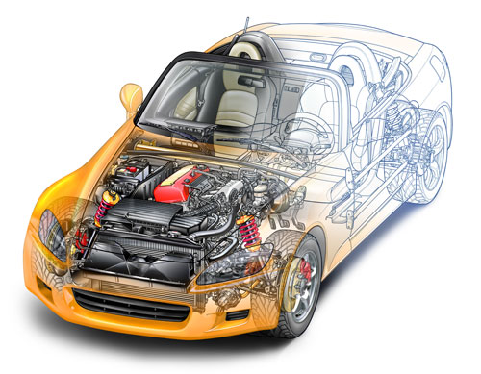
CONTROL AREA NETWORK(CAN)

Slide 2
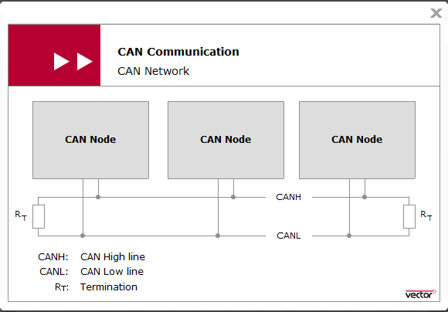
Introduction:
At the beginning of the 1980s, Bosch began to develop a serial communication system. It was given the name CAN (Controller Area Network).
CAN is characterized by very reliable data transmission that satisfies the real-time requirements of target usage areas.

Slide 3
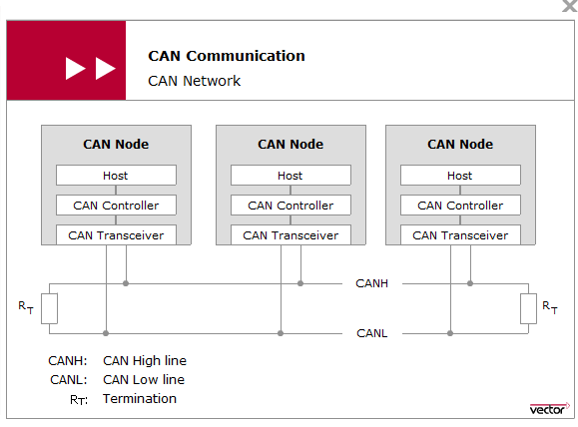
CAN transceiver connects the CAN controller to the physical transmission medium. Usually, the two components are electrically isolated by optical or magnetic decoupling, so that although overvoltages on the CAN bus may destroy the CAN transceiver, the CAN controller and the underlying host are preserved.
The maximum number of CAN nodes is specified as 32 in ISO 11898. In practice, the maximum number of CAN nodes largely depends on the performance of the CAN transceivers used and whether it is a high-speed or low-speed CAN network

Slide 4
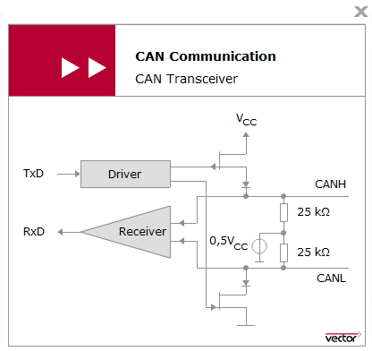
When both output transistors are blocking, both CAN lines assume the same potential (0.5*Vcc), and the differential voltage is zero. As soon as both transistors conduct, this produces a differential voltage between the two lines that is a function of the load resistance. According to ISO 11898-2 this difference should be 2 Volt.

Slide 5
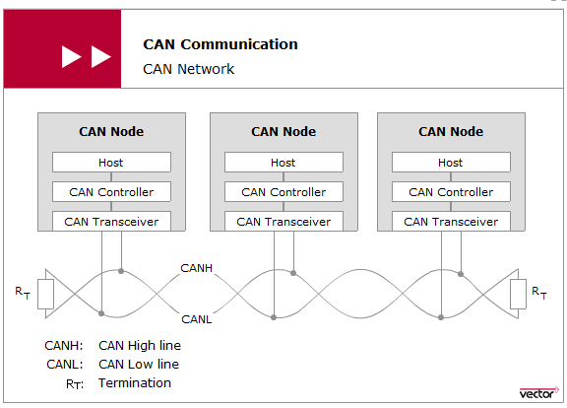
differential signal transmission:This effectively eliminates the negative effects of interference voltages induced by motors, ignition systems and switch contacts
Terminating the ends of the communication channel using termination resistors prevents reflections in a high-speed CAN network

Slide 6
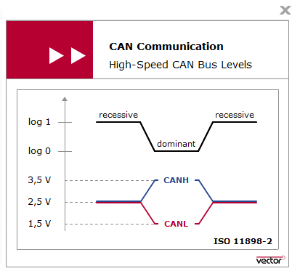
ISO 11898-2 assigns logical “1” to a typical differential voltage of 0 Volt. The logical “0” is assigned with a typical differential voltage of 2 Volt. High-speed CAN transceivers interpret a differential voltage of more than 0.9 Volt as a dominant level .
The dominant bus level corresponds to logical “0”. The recessive bus level corresponds to logical “1”

Slide 7
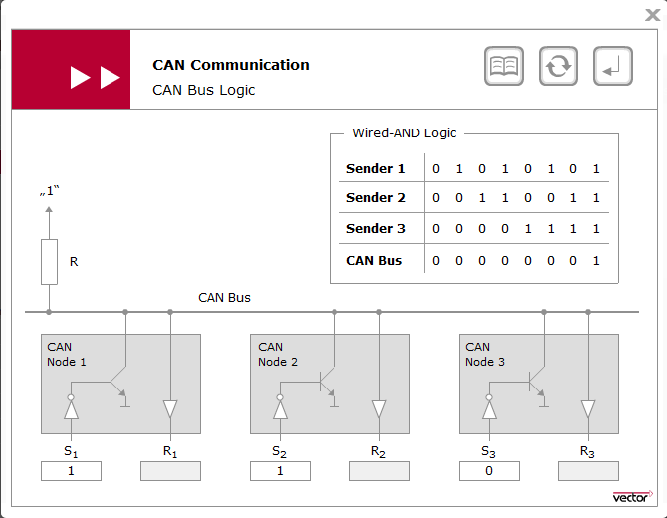

Slide 8
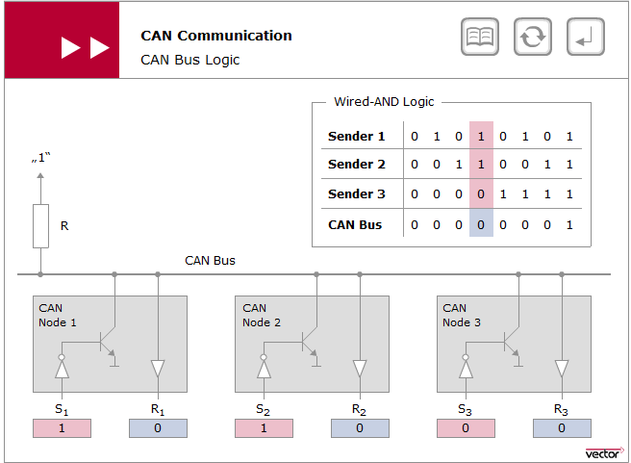

Slide 9
CAN Communication Principle
Each CAN node is authorized to place CAN messages on the bus in a CAN network. Every CAN message is available for every CAN node to receive (broadcasting)
Node-specific filtering.
It allows integration of additional CAN nodes without requiring modification of the CAN network.
See Can Communication principle Animation at following link
https://elearning.vector.com/index.php?seite=vl_can_introduction_en&root=378422&wbt_ls_kapitel_id=489560&wbt_ls_seite_id=522823&d=yes

Slide 10
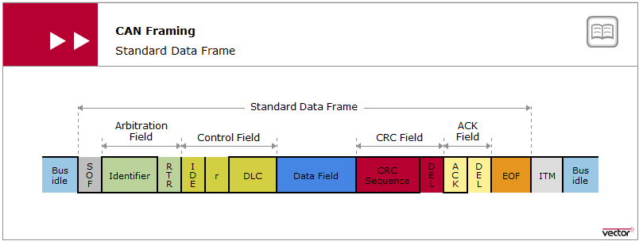
CAN FRAME TYPES
Data frame can transport a maximum payload of eight bytes. For that there is the so-called data field, which is framed by many other fields that are required to execute the CAN communication protocol. They include the message address (identifier or ID), data length code (DLC), checksum (cyclic redundancy check sequence — CRC sequence) and RX acknowledgement located in the acknowledgement field.

Slide 11
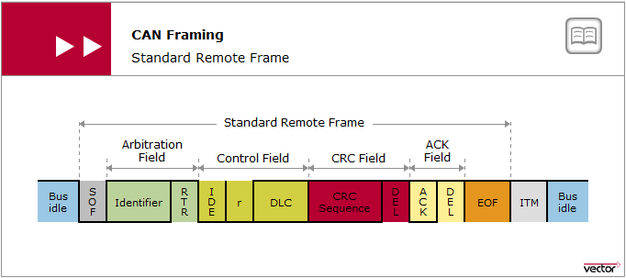
The data frame used to transport data, there is the remote frame .
This frame type used to request data, i.e. data frames, from any CAN node.

Slide 12
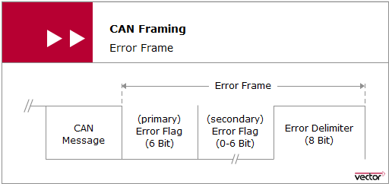
Error frame is available to indicate errors detected during communication. An ongoing erroneous data transmission is terminated and an error frame is issued

Slide 13
Transmission of a data frame begins with the start bit (Start of Frame — SOF). It is transmitted by the sender as a dominant level which produces a signal edge from the previous recessive (bus idle) level which is used to synchronize the entire network.
Following the SOF is the identifier (ID). This sets the priority of the data frame. The IDE bit (Identifier Extension bit) which follows serves to distinguish between standard format and extended format. In standard format the identifier has 11 bits, and in extended format 29 bits

Slide 14
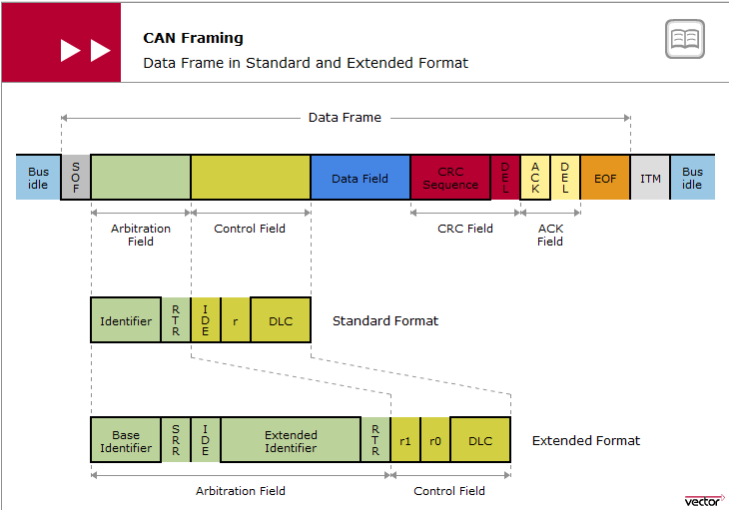

Slide 15
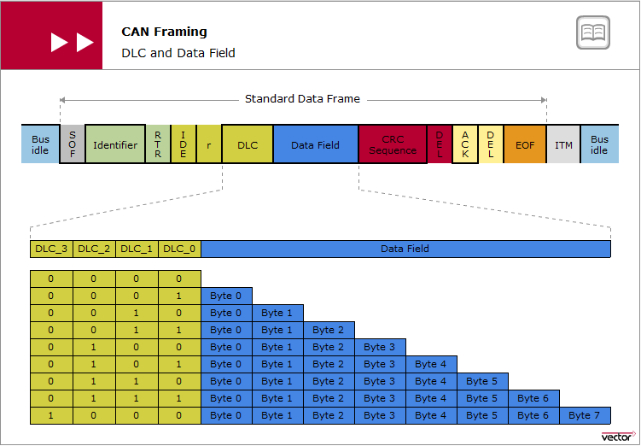

Slide 16
CRC and Ack Errors
In the CRC method, a CRC sequence is computed based on the bits to be transmitted (from SOF up to and including the data field) and a generator polynomial G(x) defined by ISO 11898-1.
Each receiver steers the acknowledgement, independent of any acceptance filtering. A receiver acknowledges either positively or negatively. A dominant level in the ACK slot represents a positive acknowledgement, while a recessive level represents a negative acknowledgement.
See the Animation

Slide 17
Bit Stuffing
A basic prerequisite for correct data transmission is synchronized communication partners. The dominant-to-recessive signal edge of the start bit serves to produce synchronism (Start Of Frame — SOF) of a CAN message. Afterwards, a resynchronization mechanism is used to maintain synchronism up to the end of the message transmission
The resynchronization mechanism is based on evaluation of recessive-to-dominant signal edges. Such signal edges are assured by the so-called bit stuffing mechanism. ISO 11898-1 prescribes that senders must transmit a complementary bit at the latest after transmitting five homogeneous bits; a stuff bit is added even if a complementary bit followed the five homogeneous bits anyway.
See the animation.

Slide 18
Principle of Bus Access
ISO 11898-1 defines a multi-master architecture to assure high availability and event-driven data transmission. Each node in the CAN network has the right to access the CAN bus without requiring permission and without prior coordination with other CAN nodes
The so-called CSMA/CA (Carrier Sense Multiple Access with Collision Avoidance) method is used here. The CSMA/CA method ensures that CAN nodes wishing to send do not access the CAN bus until it is available.
In case of simultaneous bus access, the CSMA/CA method based on bitwise bus arbitration ensures that the highest priority CAN message among the CAN nodes prevails. In principle, the higher the priority of a CAN message the sooner it can be transmitted on the CAN bus.
See the Animation and Bitwise arbitration

Slide 19
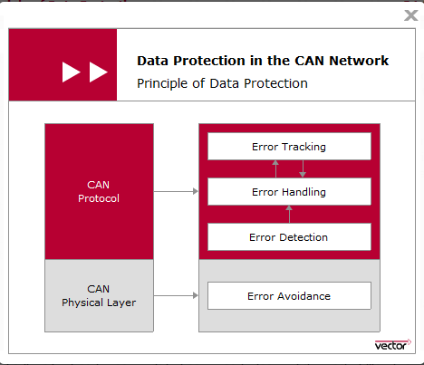
DATA PROTECTION
Reliable data transmission is a prerequisite for the safety and reliability of electronic systems in motor vehicles. Therefore, CAN not only has to satisfy strict real time requirements, but must always provide for reliable data transmission

Slide 20
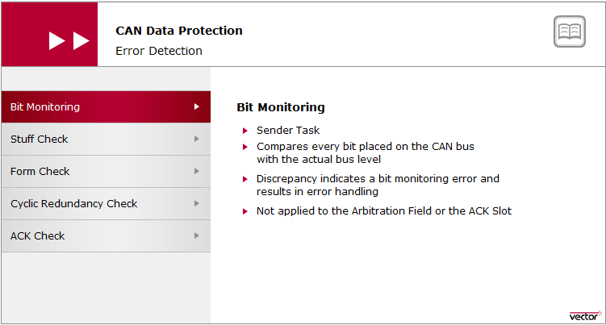

Slide 21
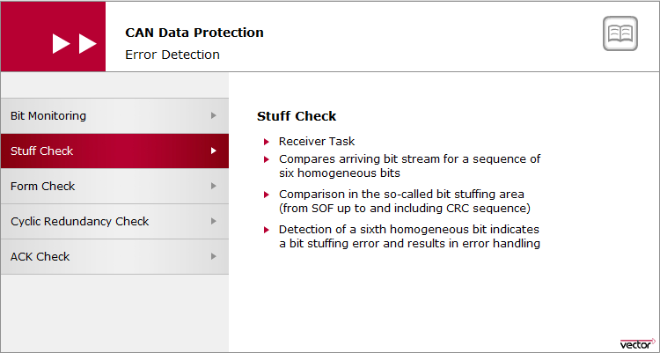

Slide 22
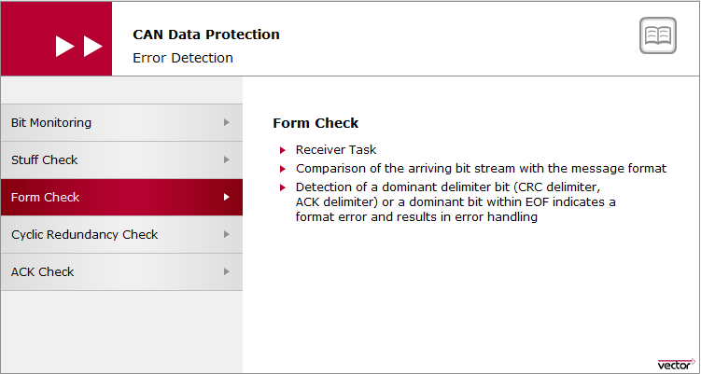

Slide 23
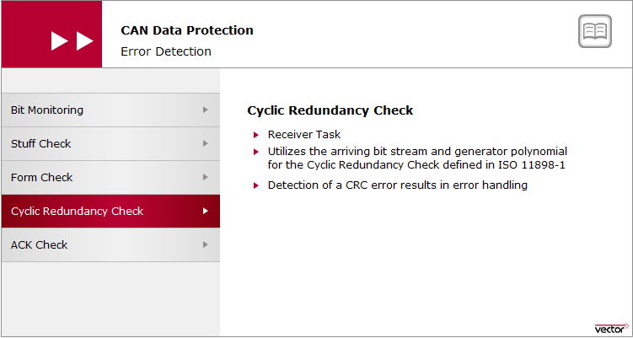

Slide 24
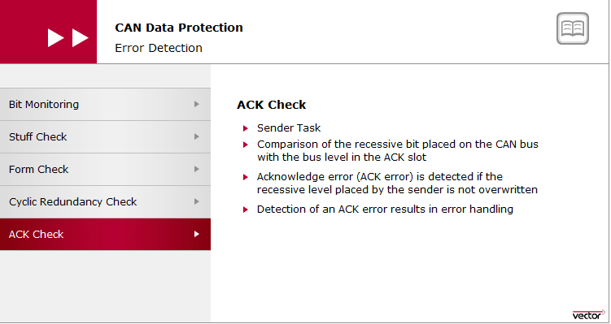

Slide 25
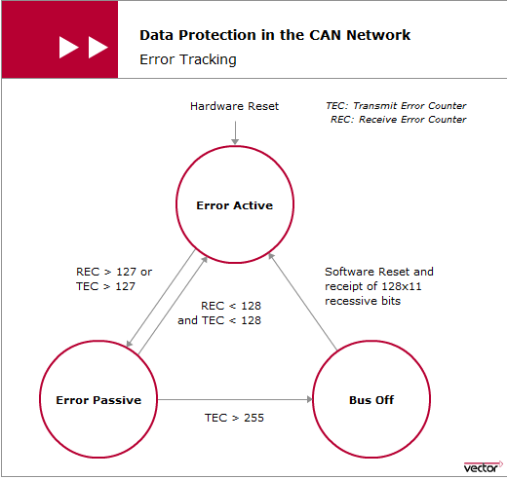
If a CAN controller fails or if there are extreme accumulations of errors, a state transition is made to the Bus Off state. The CAN controller disconnects from the CAN bus. The Bus-Off state can only be exited by intervention of the host (with a mandatory waiting time of 128 x 11 bits) or by a hardware reset

Slide 26
Thank you

