Slide 1
Intro to Controller Area Networks (CAN)
Part 2 of 2, E. Zivi, April 1, 2015
References:
A CAN Physical Layer Discussion Microchip Application Note AN00228a
Controller Area Network (CAN) Implementation Guide Analog Devices Application Note AN-1123
Controller Area Network, CANPRES Version 2.0 , Siemens Microelectronics, Inc., October 98
http://www.kvaser.com/en/about-can/the-can-protocol.html
http://www.kvaser.com/can-protocol-tutorial/
CAN physical layer ref: http://www.can-cia.org/index.php?id=systemdesign-can-physicallayer
Controller Area Network Physical Layer Requirements, TI SLLA270–January 2008
CAN Tutorial, http://www.computer-solutions.co.uk/download/Peak/CAN-Tutorial.pdf
CANopen Introduction,
ref: http://www.canopensolutions.com/english/about_canopen/about_canopen.shtml
Embedded Networking with CAN and CANopen, by Pfeiffer, Ayre and Keydel
CAN open Implementation: Applications to Industrial Networks, by Farsi and Barbosa
CS4700/CS5700 Fundamentals of Computer Networks, Alan Mislove, Northeastern University
Controller Area Networks http://electrosofts.com/can/index.html

Slide 2
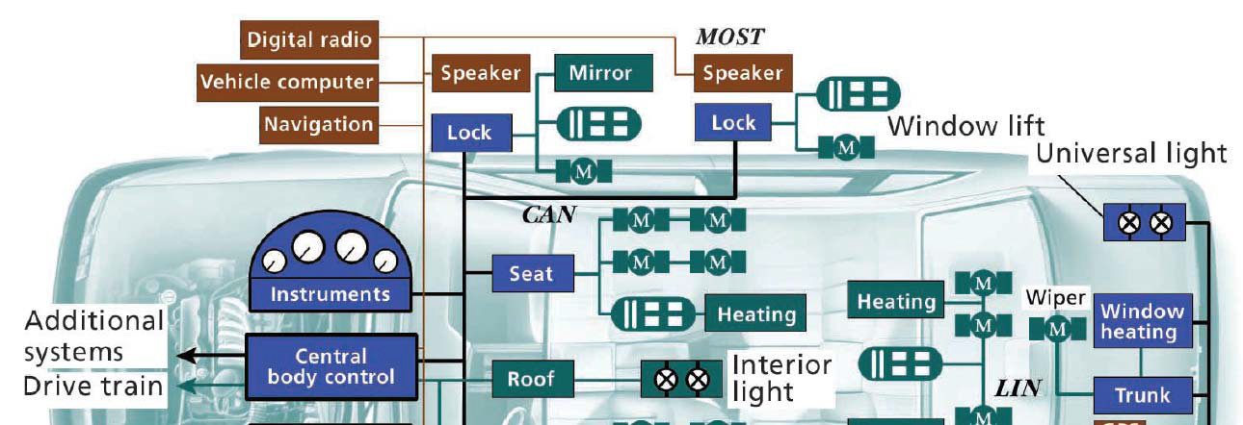
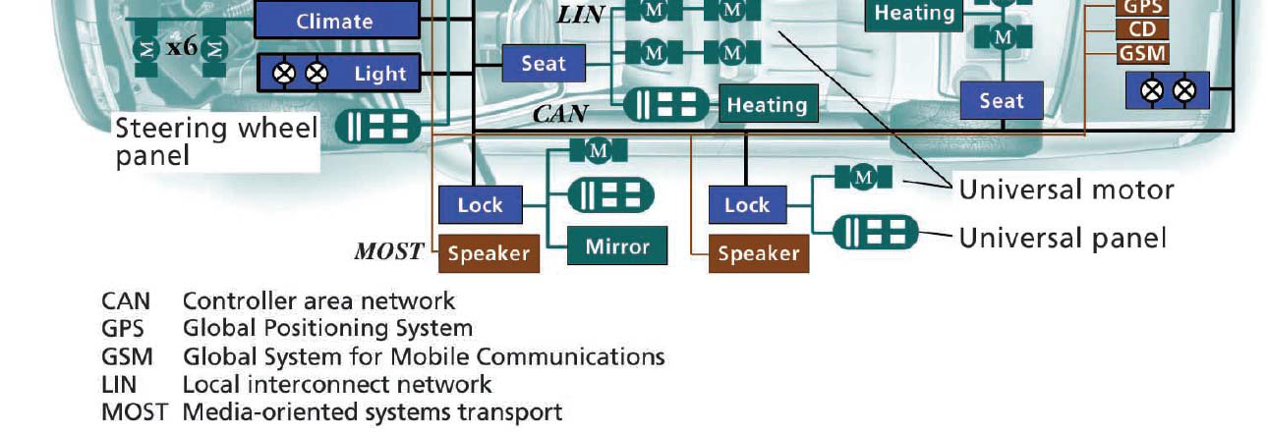
Review: CAN is the “Nervous System” of Many Complex Systems
New cars typically contain 50 to 100 microcontrollers

Slide 3
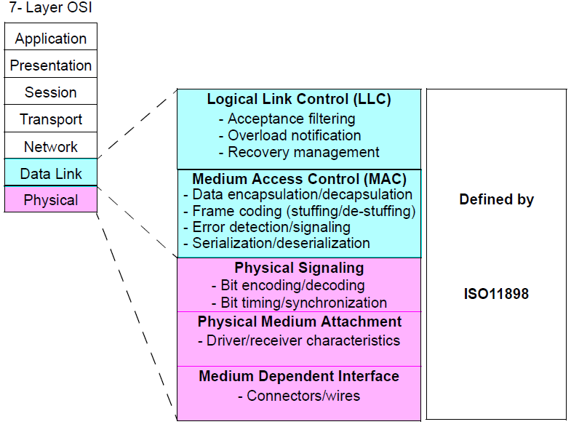
Review: CAN & International Standards Organization (ISO) Open Systems Interconnect (OSI) Reference Model
High level CAN Protocols implement Application layer and skip the four intervening layers

Slide 4
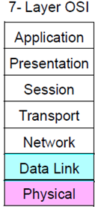
In Future Classes We’ll Introduce The CANopen Application
CiA 401
Generic I/O
Profile
CiA 402
Motion Control Profile
IEC 61131-3
Programmable Devices Profile
CiA 4xx Device Profiles
CiA 302 CANopen Framework for CANopen Managers & Programmable Devices
CiA 301 CANopen Application Layer & Communication Profile
Application
Not Implemented by CAN or CANopen
ISO 11898 CAN Data Link Layer
ISO 11898 CAN Physical Layer
High level CAN Protocols implement Application layers and skip the four intervening layers

Slide 5
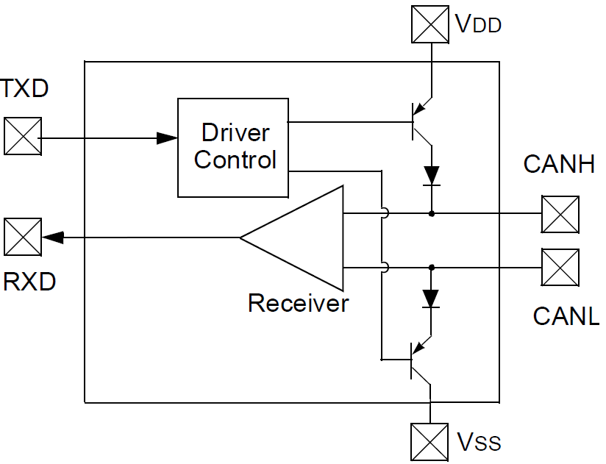
Review: CAN Differential Bus Interface Transceivers
Transistor
Switches
Split
Termination
Example
Capacitive
coupling
to ground
Micro-
controller
60Ω
60Ω
Transceiver
Additional
Transceivers …
The CAN idle state presents a recessive state, signaled by a small differential voltage across CANH and CANL. With the indicated split termination, this idle voltage will be halfway between VDD (positive supply) and VSS (ground).
The CAN dominant state occurs when one or more transceivers simultaneously close the indicated transistor switches driving CANH and CANL toward VDD and VSS, respectively.
This open collector transistor switch configuration is referred to as a “wired or” since any node transmitting a dominant bit always overrides a recessive bit. Since a dominant bit represents a logic 0, this arrangement is sometimes referred to as “wired and” since bus a logic “1” state is achieved only if all nodes (node 1 AND node 2 AND node 3 …) signal logic “1” recessive bits).

Slide 6
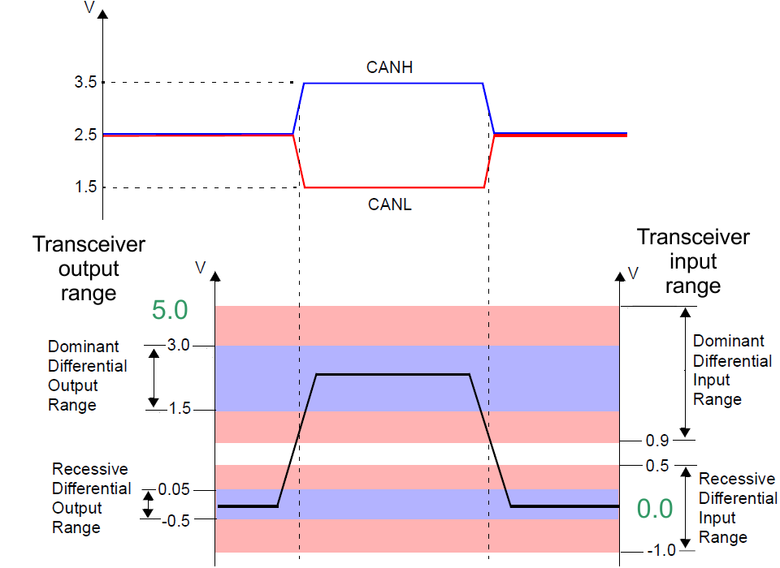
Review: CAN ISO11898 5V Nominal Bus Levels
Assuming Split Termination ⇒ Recessive voltage ≈ 2.5V

Slide 7
Example CAN Sample Signaling
Dominant bus state = logic 0
Recessive bus state = logic 1

Slide 8
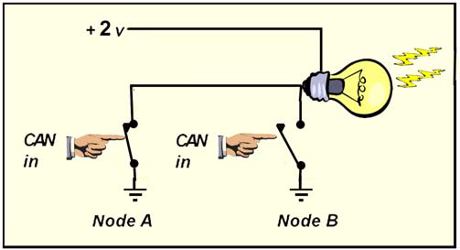
Review: “Wired OR”
Closing Node A switch OR closing Node B switch turns on the light.
Conversely, the light is off unless Node A switch is open AND
Node B switch is also open.

Slide 9
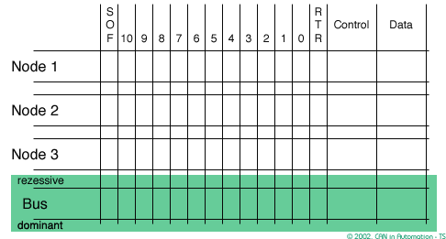
Review: CAN Arbitration Animation
Mouse over graphic to control animated bus arbitration example

Slide 10
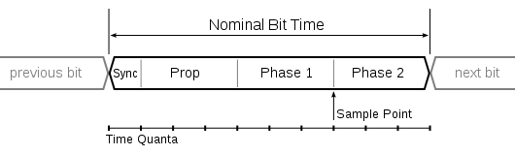
CAN Bit Synchronization, Timing & Propagation Delay
Signal
Propagation
Propagation delay
Settling time
Sample Point
CAN signaling is bit synchronized across the entire network during the Sync portion which is the time required for each node to synchronize with the leading edge of a recessive to dominant edge transition.
The Signal Propagation is the time for the bit signal to propagate throughout the network.
Longer networks result in longer Signal Propagation delays which require longer bits resulting in slower data rates.
The Phase 1 portion delays sampling so that the bit signal can settle to a stable value
Faster bit rates require shorter propagation delays and therefore, smaller networks.

Slide 11
CAN Bit Rate Versus Bus Length
For a CAN bus, the signaling rate is determined from the total system delay – down and back between the two most distant nodes of a system and the sum of the delays into and out of the nodes on a bus with the typical 5ns/m prop delay of a twisted-pair cable. A conservative rule of thumb for bus lengths over 100 m is:
Signaling Rate (Mbps) × Bus Length (m) ≤ 50
Bus Length (m) | Signaling Rate (Kbps)
40 | 1,000
100 | 500
200 | 250
500 | 100
1000 | 50

Slide 12
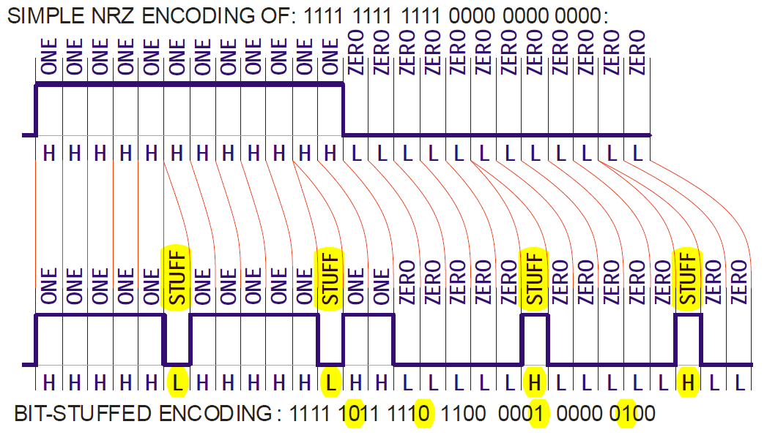
CAN Synchronization Via Bit Stuffing
CAN nodes use Recessive to Dominant edges to maintain bit synchronization.
Bit Stuffing ensures sufficient Recessive to Dominant edges to maintain bit synchronization
A stuff Bit inserted after 5 consecutive bits at the same state
A Stuff Bit is the inverse of previous bits and is discarded by the receiver

Slide 13
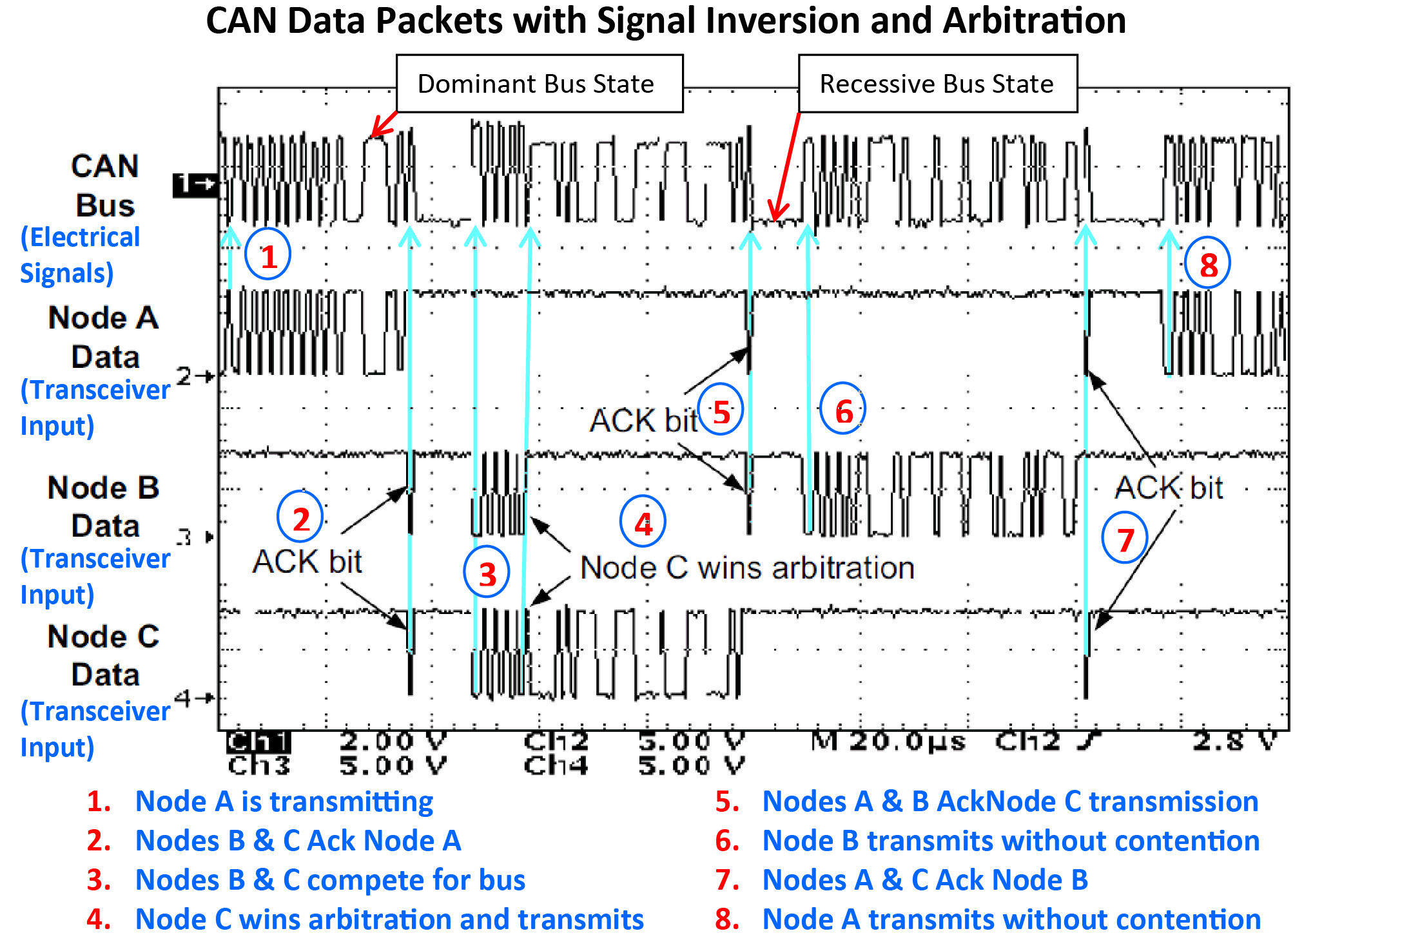

Slide 14
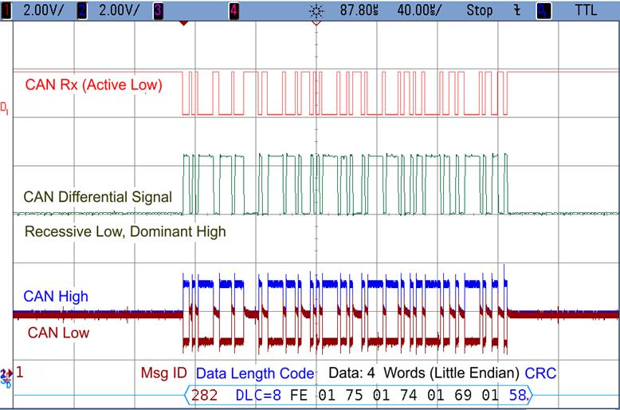
MicroMod TPDO 2 Transmit on Analog In Change of State Message (40 μS / Division):

Slide 15
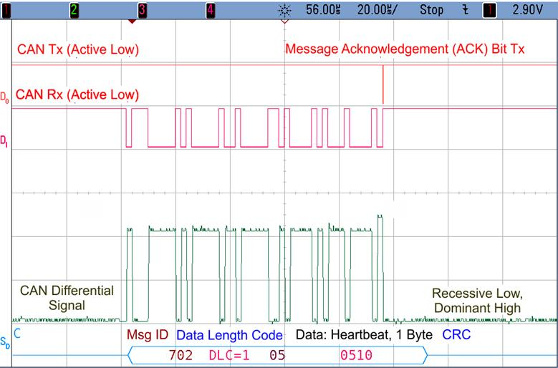
MicroMod Heartbeat, Note ACK bit transmitted by Receiving Node (40 μS / Division):

Slide 16
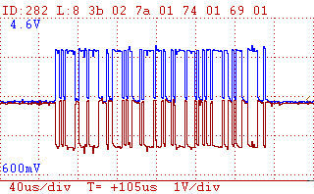
PCAN-Diag Hand Held Diagnostic Scope (40 μS / Div.)
TPDO 2 Analog Input Transited on change of state
4 Words, 2 Bytes each, little endian
10-bit Analog Input Conversion Factor
5 V / 1023 counts =
0.0048876 V / count
0x023b ⇒ 571₁₀ ⇒ 2.791 V
0x017a ⇒ 378₁₀ ⇒ 1.847 V
0x0174 ⇒ 372₁₀ ⇒ 1.818 V
0x0169 ⇒ 361₁₀ ⇒ 1.764 V

Slide 17
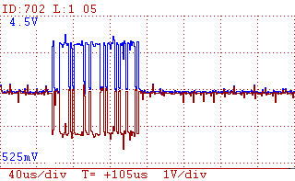
MicroMod Heartbeat, with ACK bit (40 μS / Div.)
Heartbeat 1 Byte Node Status
CANopen Heartbeat Messages
0: Boot-up
4: Stopped
5: Operational
127: Pre-operational

Slide 18
Five Types of CAN Error Checking
Bit error: Transmitting node compares transmitted & received bit value.
Stuff error: More than 5 successive recessive or dominant bits without a “Stuff Bit”.
CRC error: Sender CRC value in message does not match receiver CRC calculation.
Form error: Frame is not formatted properly.
Acknowledgement error: Transmitter sends recessive ACK bit. At least one receiver node must assert a dominant ACK reply into sender message.

Slide 19
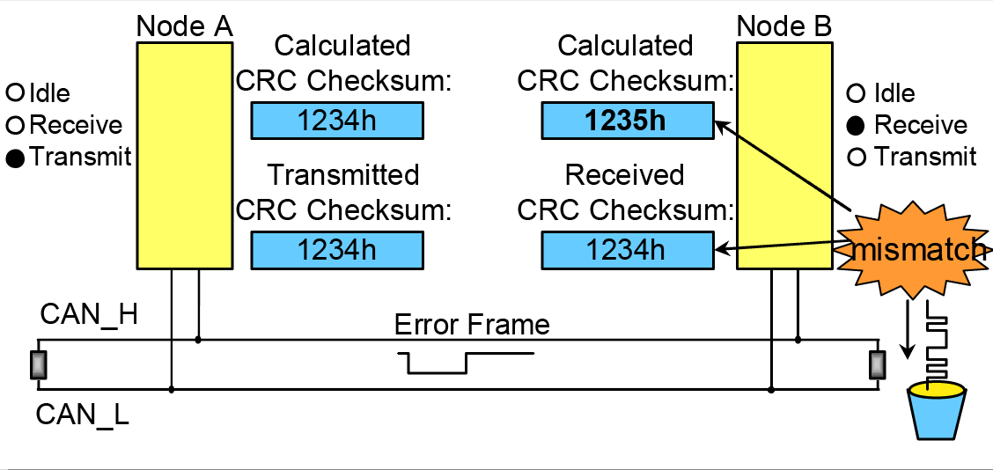
CAN Cyclic Redundancy Check
Error Frame is a superposition of 6 to 12 consecutive
Bits asserted by nodes that detect an error. Note
that Error Frame breaks bit stuffing rules
“Bit Bucket”
The cyclic redundancy check (CRC) method is used for detection of bit errors.
The binary polynomial used in CAN 2.0 is:
gCAN (x) = x15 + x14 + x10 + x8 + x7 + x4 + x3 + 1 = 1100 0101 1001 10012

Slide 20
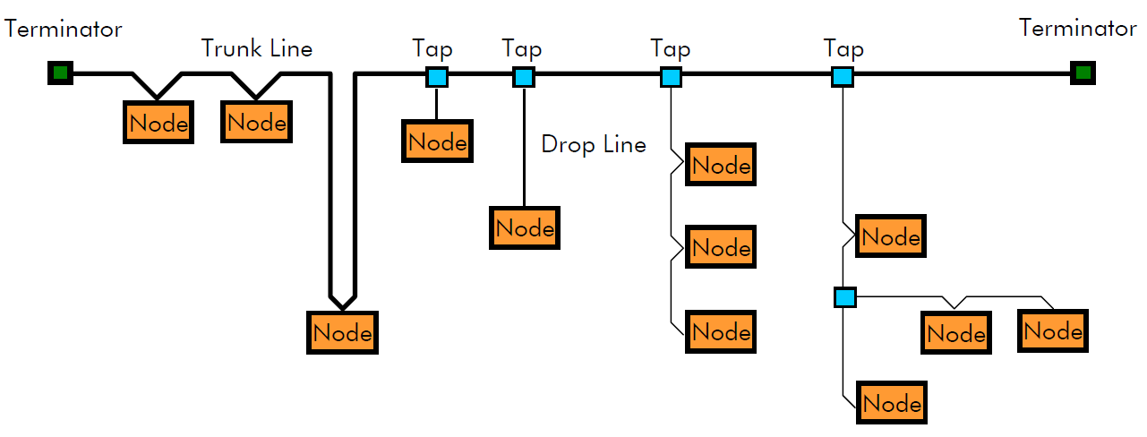
CAN Example Physical Network Layout

Slide 21
Typical Differential CAN Cabling
Differential signaling minimizes common mode noise
Twisting cables minimizes effects of electromagnetic interference
Optional cable shielding protects against electrostatic interface

Slide 22
CAN Typical Physical Layer Connector
CAN has a variety of connectors for various applications. The sub-D connector, shown above, is often used in laboratory setups. Only CAN_H and CAN_L are required, the other signals are optional. Note that CAN cables can distribute power to remote nodes.

Slide 23
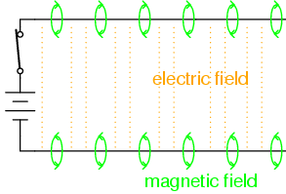
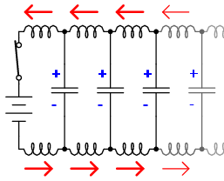
Characteristic Impedance of CAN Twisted Cable
Transmission line
inductance & capacitance
Equivalent Circuit
≈
Voltage charges capacitance, current charges inductance
as wave travels down transmission line.

