Slide 1
Controller Area Network
YoonMo Yeon
2007. 5. 31.

Slide 2
Contents
Introduction to CAN
CAN Protocol
  Physical Layer
  Data Link Layer
CAN Controller in AT91SAM9263

Slide 3
What is CAN?
Developed by BOSCH
Multi-master/broadcast
Maximum signaling rate of 1Mbps
Absence of node addressing
  Message ID : contents, priority
CSMA/CD with AMP
Asynchronous Serial Bus
Simple 2-wire differential bus

Slide 4
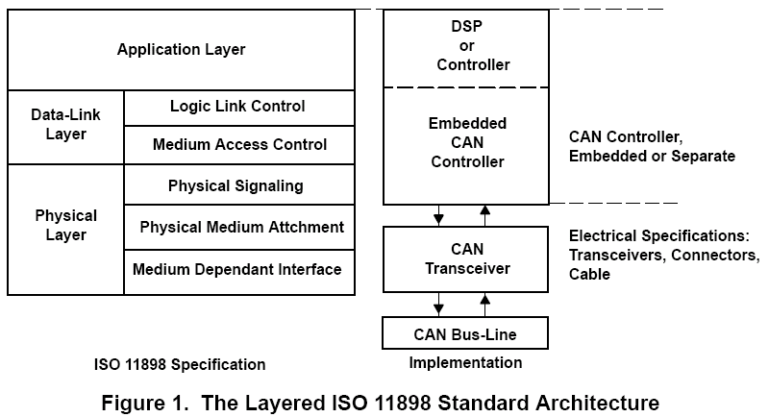
Architecture

Slide 5
CAN High Layer Protocols
CAN protocol defines only the physical and a low data link layer
The HLP defines :
  Start-up behavior
  Definition of message identifiers for the different nodes
  Flow control
  Transportation of messages > 8bytes
  Definition of contents of Data Frames
  Status reporting in the system

Slide 6
CAN High Layer Protocols
Existing HLPs
  CANOpen
  DeviceNet
  CAN Kingdom
  SAE J1939
  X-by-wire systems &
  Time-triggered protocols
  OSEK/VDX

Slide 7
Controller Area Network
Physical Layer

Slide 8
CAN Physical Layer
CAN Transceiver
  Driver/Receiver Characteristics
CAN Controller
  Bit Encoding/Decoding
  Bit Timing
  Bus Failure
  Synchronization Management

Slide 9
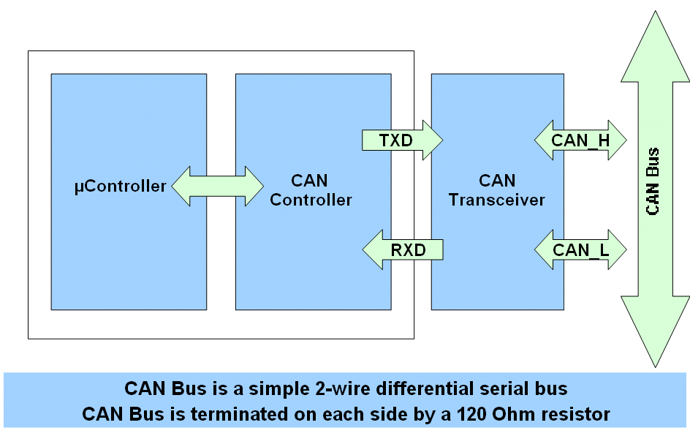
Typical CAN Node

Slide 10
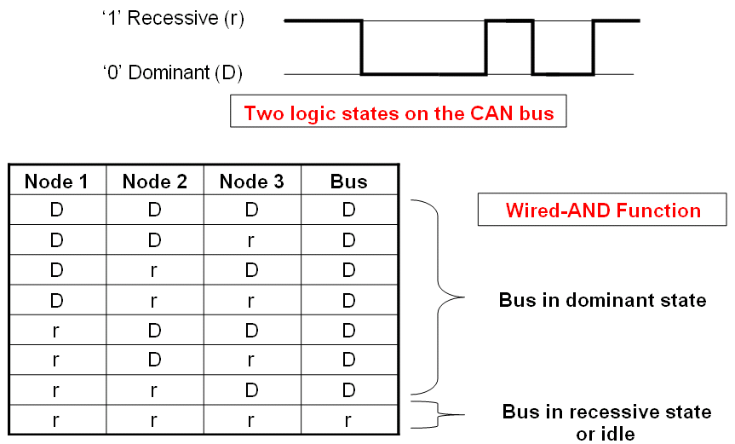
CAN Bus Logic

Slide 11
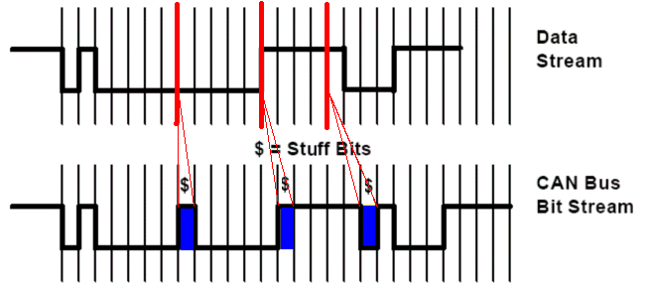
CAN Bit Coding & Bit Stuffing
NRZ Bit Coding
  Stuff Bits are inserted after 5 consecutive bits of the same level for synchronization

Slide 12
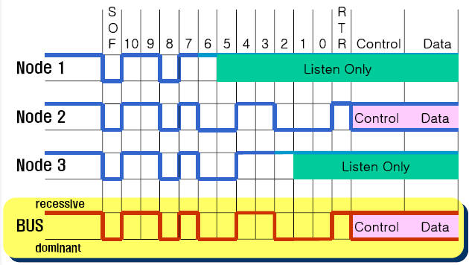
CAN Bus Arbitration
CSMA/CD with AMP(Arbitration by Message Priority)

Slide 13
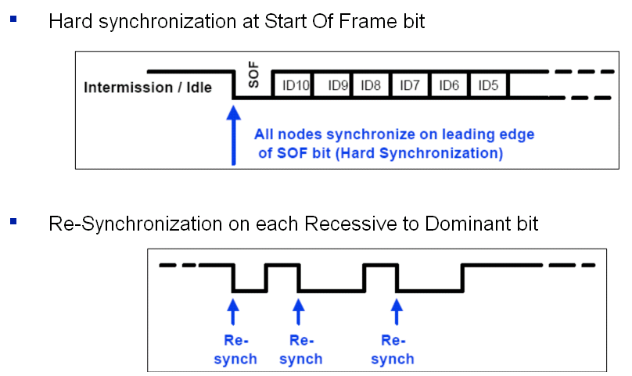
CAN Bus Synchronization

Slide 14
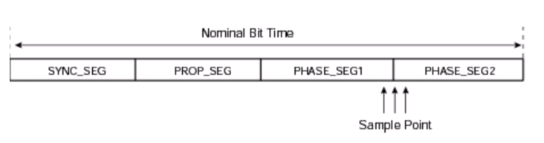
CAN Bit Construction
Partition of CAN Bit Time

Slide 15
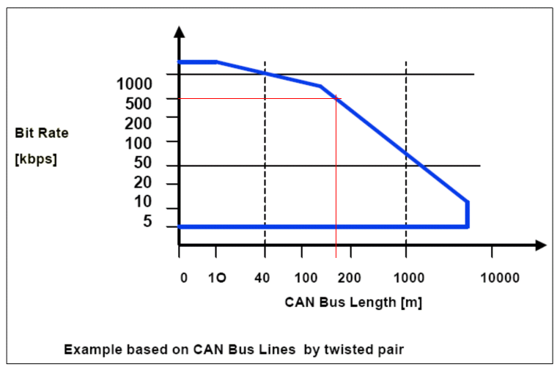
Relation between BaudRate and Bus Length

Slide 16
Controller Area Network
Data Link Layer

Slide 17
CAN Data Link Layer
CAN Controller
  Logical Link Control Sublayer (LLC)
    Acceptance Filtering
    Overload Notification
    Recovery Management

Slide 18
CAN Data Link Layer
CAN Controller
  Medium Access Control Sublayer (MAC)
    Data Encapuslation/Decapsulation
    Frame Coding(Stuffing, Destuffing)
    Medium Access Management
    Error Detection
    Error Signaling
    Acknowledgement
    Serialization./Deserialization

Slide 19
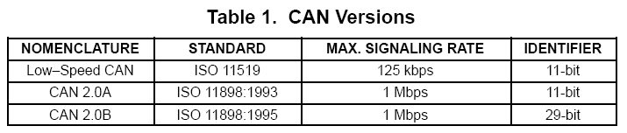
Standard/Extended CAN

Slide 20
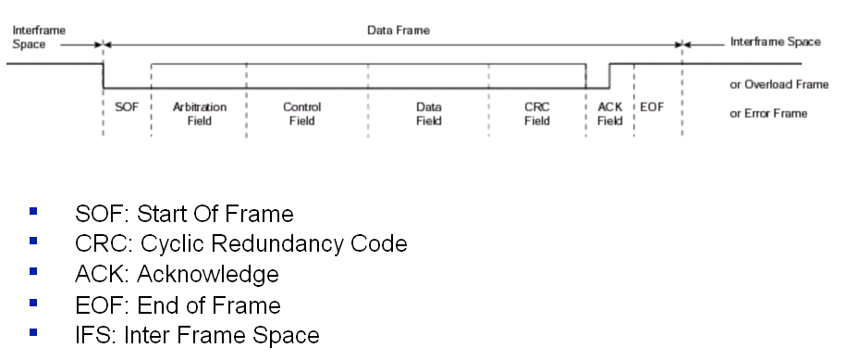
CAN Frame Formats

Slide 21
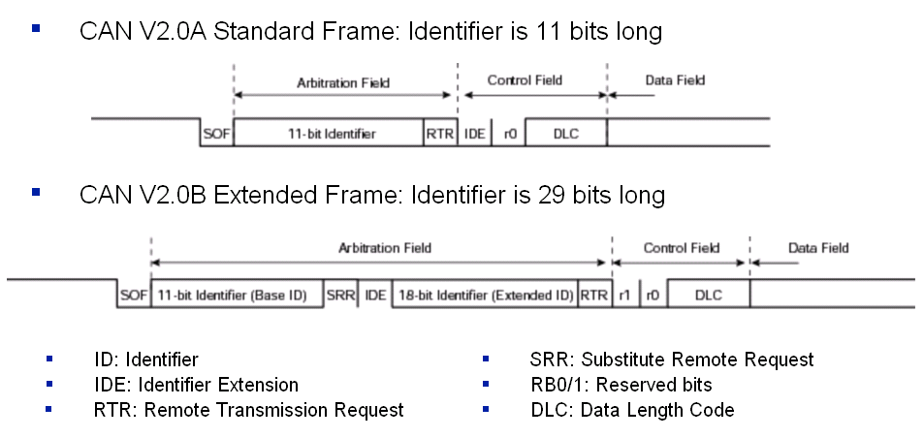
CAN Frame Formats

Slide 22
CAN Frame Formats
Four Frame Types
  Data Frame (RTR=0)
  Remote Frame (RTR=1 and no data field)
  Error Frame (after violation frame format)
  Overload Frame (Not really used)

Slide 23
Error Detection
Error Types
  CRC error
  Bit-stuffing error
  Bit error
  Form Error
  Acknowledgment error

Slide 24
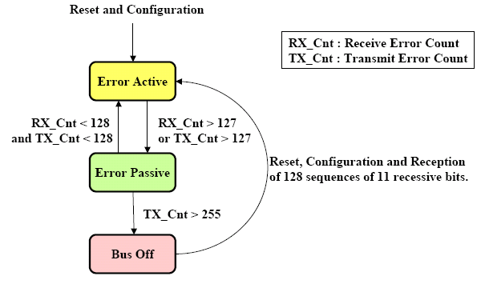
Fault Confinement

Slide 25
AT91SAM9263
CAN Controller

Slide 26
AT91SAM9263 CAN Controller
CAN 2.0A and CAN 2.0B
Bit rates up to 1Mbit/s
16 Mailboxes
  Each can be Receive or Transmit one
  Local Tag and Mask Filters
  16-bit Time Stamp
  32x2 Data Register

Slide 27
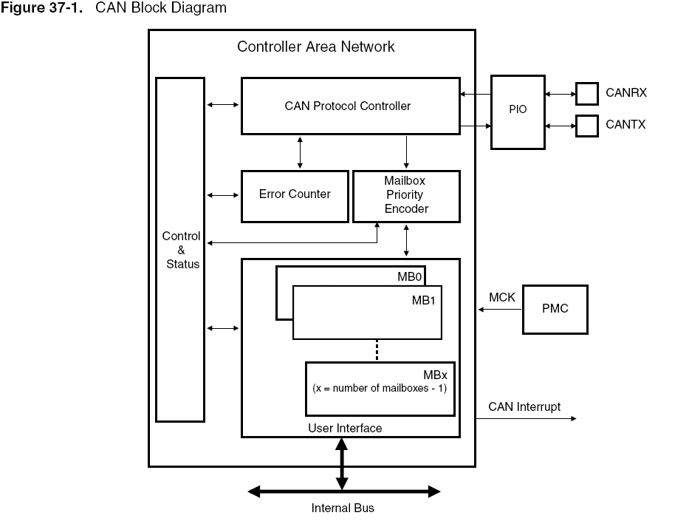
Block Diagram

Slide 28
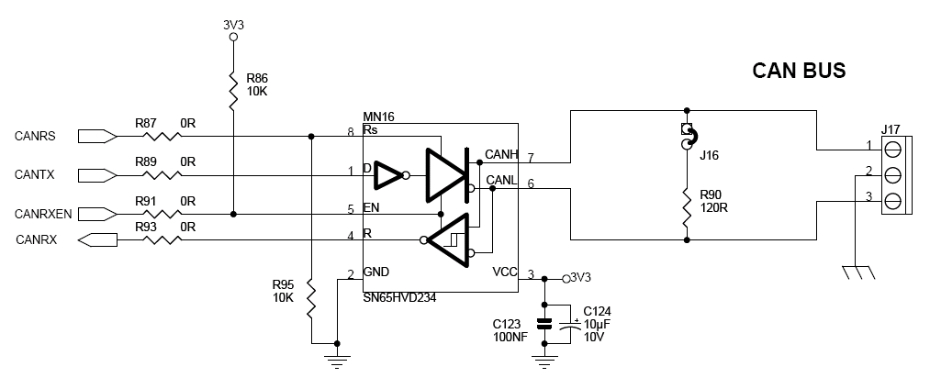
AT91SAM9263-EK CAN Circuit

Slide 29
Mailbox Organization
Mailbox
  Also called channels or buffers
  The CPU reads or writes data via the CAN controller mailboxes
  Each mailbox has an ID
    Several mailboxes can be configured with the same ID
  There are 16 mailboxes
  Can be configured in receive or transmit mode

Slide 30
Mailbox Priority
Receiption Mode
  Mailbox with the lowest number is serviced first
Transmission Mode
  Register CAN_MMR(Mailbox Mode Register)
    PRIOR:4bit – mailbox priority
  Same priority -> mailbox with lowest number first

Slide 31
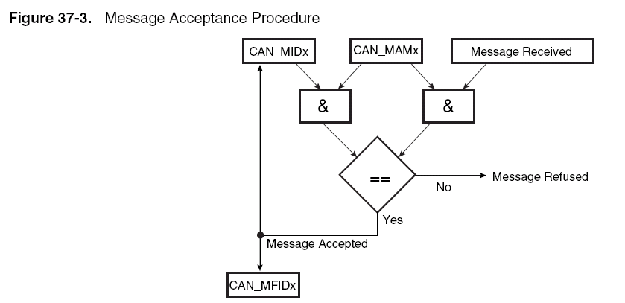
Message Acceptance Procedure
MIDx : Mailbox ID register
MAMx : Acceptance Mask register

Slide 32
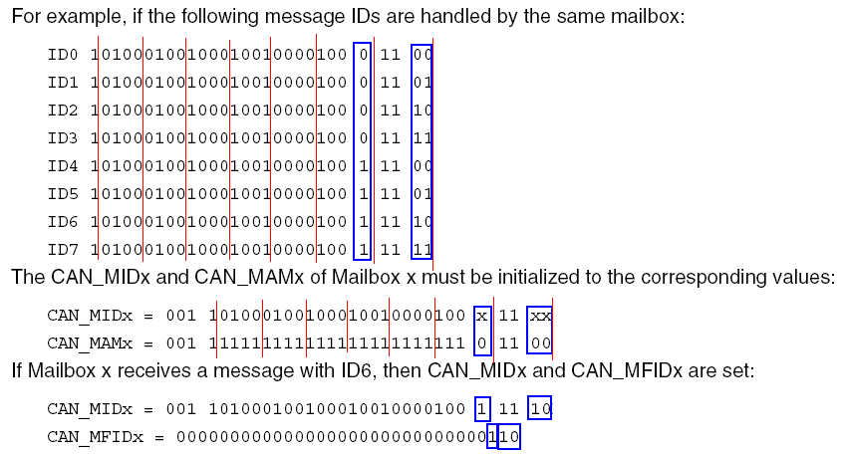
Message Acceptance Example

Slide 33
Mailbox Object Type
Receive Mailbox
  Receive
  Receive with overwrite
  Consumer
Transmit Mailbox
  Transmit
  Producer

Slide 34
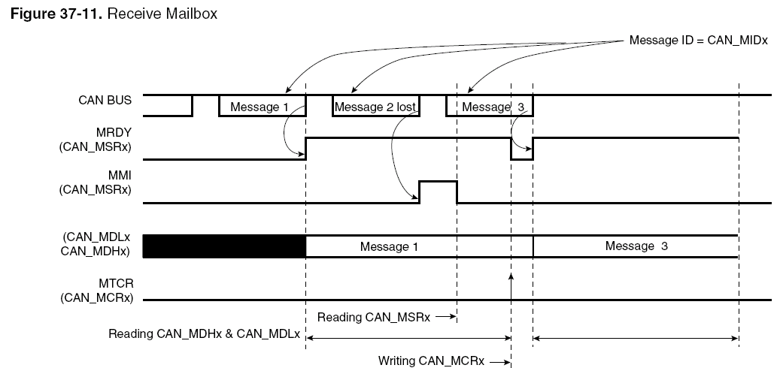
Receive Mailbox

Slide 35
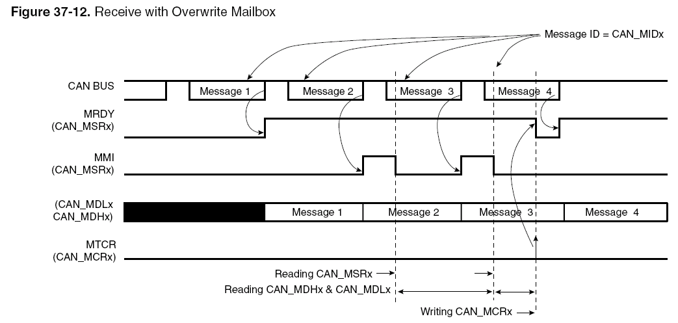
Receive with Overwrite Mailbox

Slide 36
Chaining Receive Mailboxes
All mailboxes are configured with same ID
The mailbox with the largest number is configured in receive with overwrite mode (others are configured in receive mode)

Slide 37
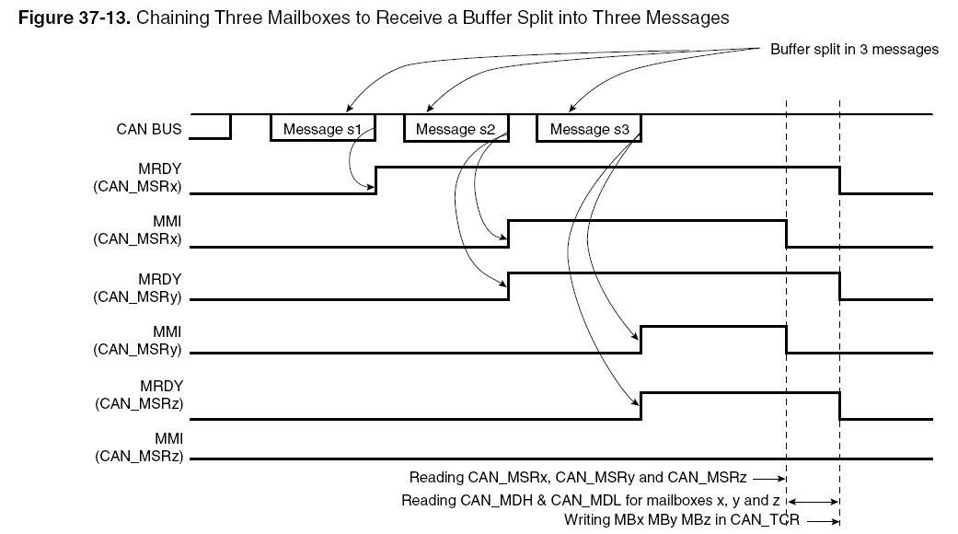
Chaining Receive Mailboxes

Slide 38
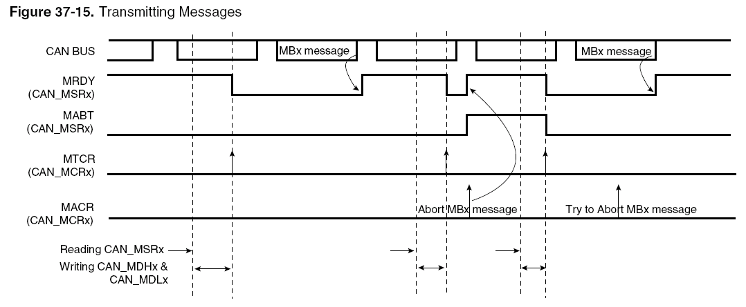
Transmitting Messages

Slide 39
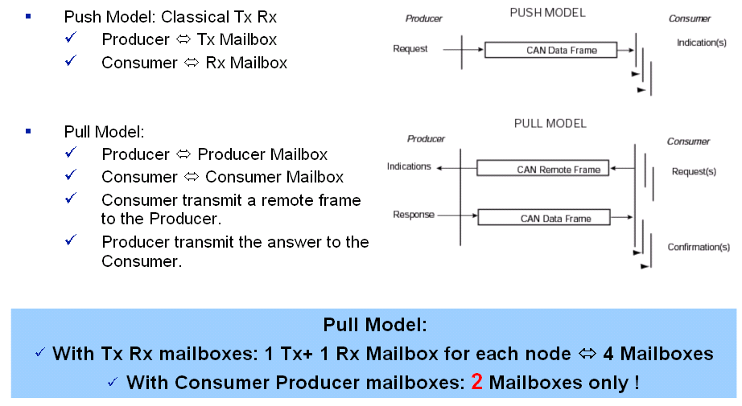
Producer/Consumer model

Slide 40
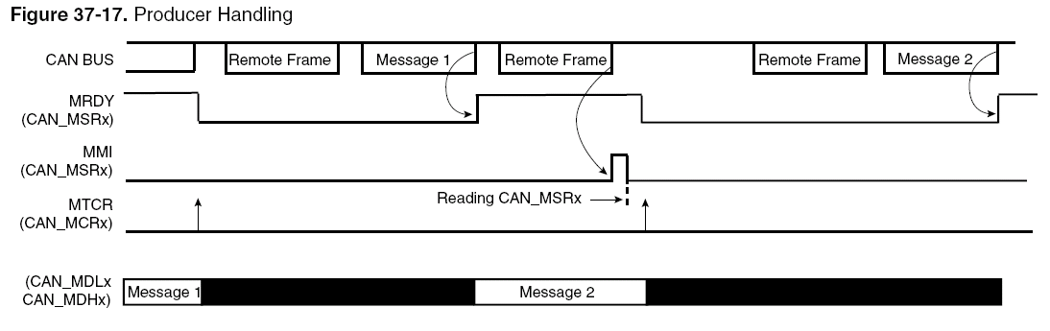
Producer Handling

Slide 41
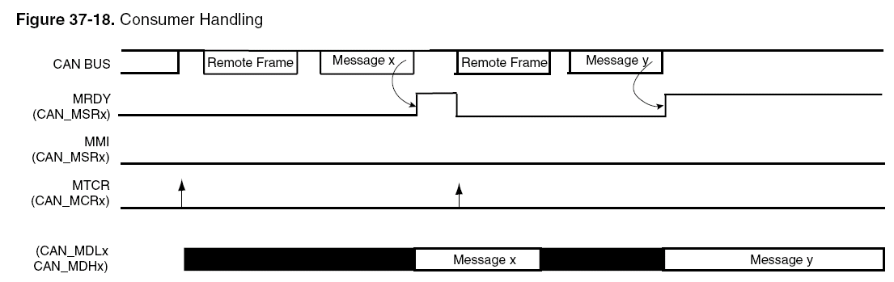
Consumer Handling

Slide 42
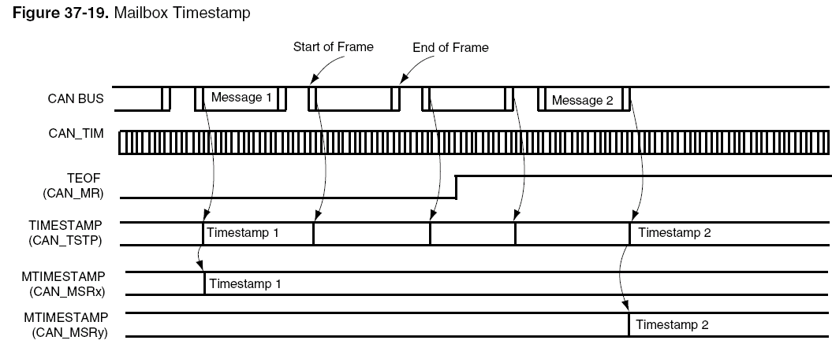
CAN Controller Timing Modes
Timestamping Modes
  The value of the internal timer is captured at each Start Of Frame or each End Of Frame

Slide 43
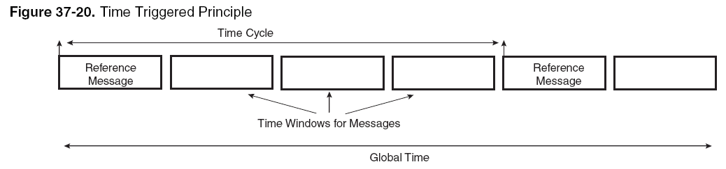
CAN Controller Timing Modes
Time Triggered Mode

Slide 44
Q & A

Slide 45
References
Self Training – CAN; Atmel
Introduction to the Controller Area Network; Steve Corrigan; Texas Instruments Application Report SLOA101
Datasheet
  SN65HVD234
  AT91SAM9263

