Slide 1
Control Area Network (CAN) Bus

Slide 2
Overview
CAN is an important embedded protocol
Primarily automotive, but used in many other places
CAN specifies:
  Physical layer
  Protocol layer
  Message filtering layer (with add-on protocols)
Note
  How message prioritization achieved
  How “small” nodes can be kept from overloading with received messages

Slide 3
The Development of CAN
The development of CAN began when more and more electronic devices were implemented into modern motor vehicles. Examples of such devices include engine management systems, active suspension, ABS, gear control, lighting control, air conditioning, airbags and central locking. All this means more safety and more comfort for the driver and of course a reduction of fuel consumption and exhaust emissions.
To improve the behavior of the vehicle even further, it was necessary for the different control systems (and their sensors) to exchange information. This was usually done by discrete interconnection of the different systems (i.e. point to point wiring). The requirement for information exchange has then grown to such an extent that a cable network with a length of up to several miles and many connectors was required. This produced growing problems concerning material cost, production time and reliability.

Slide 4
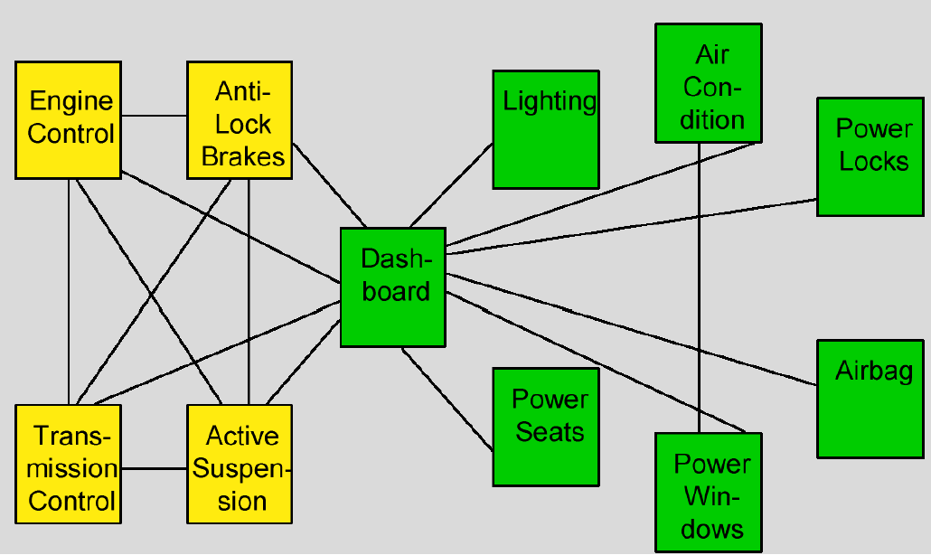
Before CAN

Slide 5
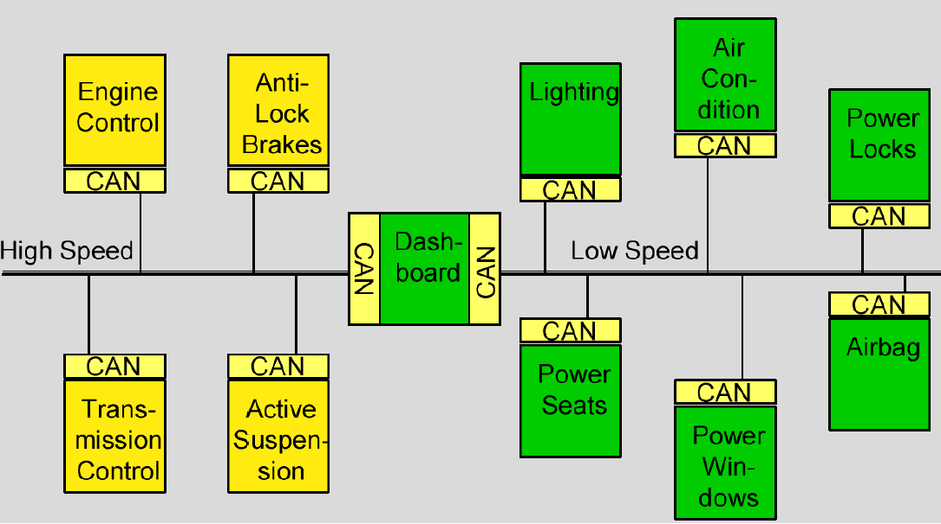
With CAN
The solution to this problem was the connection of the control systems via a serial bus system. This bus had to fulfill some special requirements due to its usage in a vehicle. With the use of CAN, point-to-point wiring is replaced by one serial bus connecting all control systems. This is accomplished by adding some CAN-specific hardware to each control unit that provides the "rules" or the protocol for transmitting and receiving information via the bus.

Slide 6
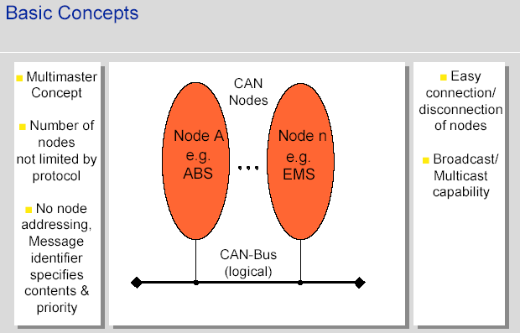
The CAN bus
CAN is a broadcast type of bus.
  This means that all nodes can "hear" all transmissions. There is no way to send a message to just a specific node; all nodes will invariably pick up all traffic. The CAN hardware, however, provides local filtering so that each node may react only on the “interesting” messages.

Slide 7
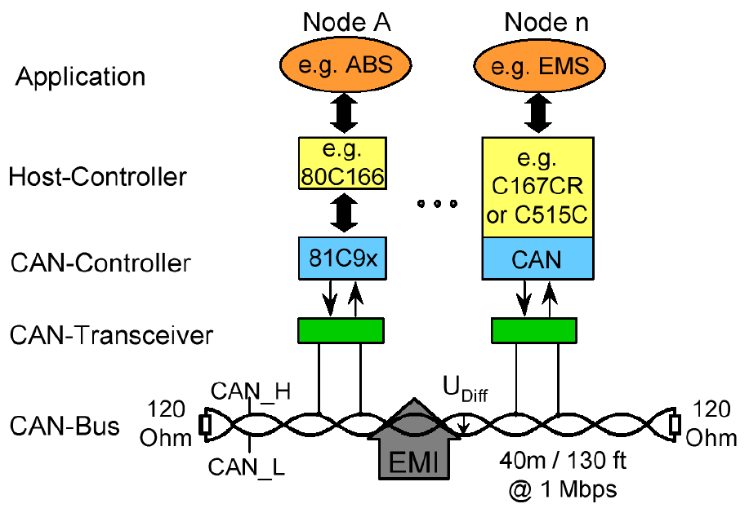
Basic Configuration

Slide 8
CAN Bus Overview
The physical layer uses differential transmission on a twisted pair wire. The bus uses Non-Return To Zero (NRZ) with bit-stuffing.
The nodes are connected to the bus in a wired-and fashion: if just one node is driving the bus to a logical 0, then the whole bus is in that state regardless of the number of nodes transmitting a logical 1.
Max. transfer rate of 1000 kilobits per second at a maximum bus length of 40 meters or 130 feet when using a twisted wire pair which is the most common bus medium used for CAN.
Message length is short with a maximum of 8 data bytes per message and there is a low latency between transmission request and start of transmission. The messages are protected by a CRC type checksum

Slide 9
CAN Bus Overview
The bus access is handled via the advanced serial communications protocol Carrier Sense Multiple Access/Collision Detection with Non-Destructive Arbitration. This means that collision of messages is avoided by bitwise arbitration without loss of time.
There is no explicit address in the messages, instead, each message carries a numeric value which controls its priority on the bus, and may also serve as an identification of the contents of the message.
An elaborate error handling scheme that results in retransmitted messages when they are not properly received.
There are effective means for isolating faults and removing faulty nodes from the bus.

Slide 10
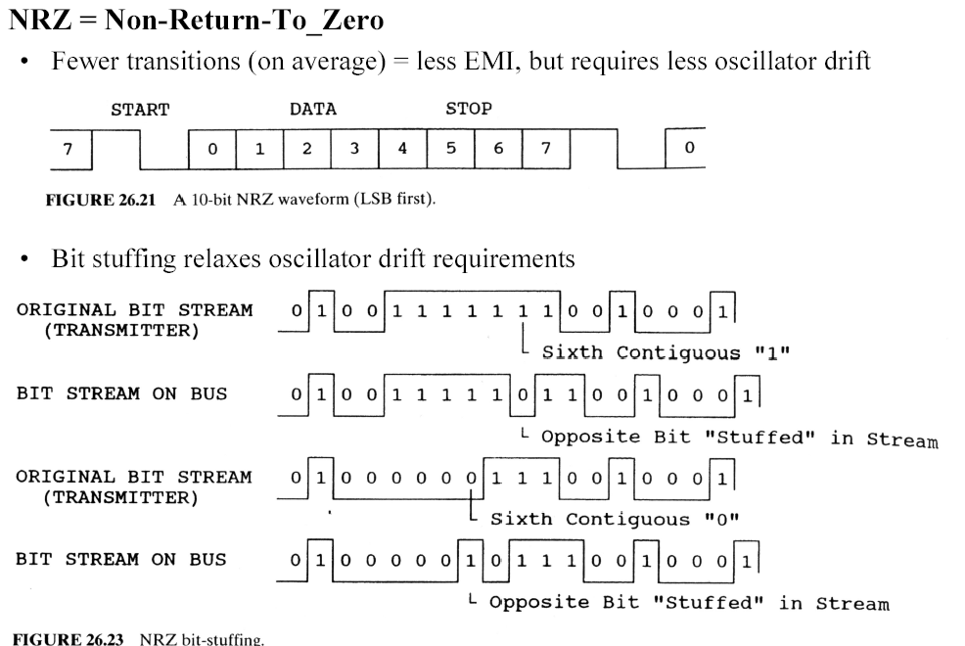
Basic Bit Encoding

Slide 11
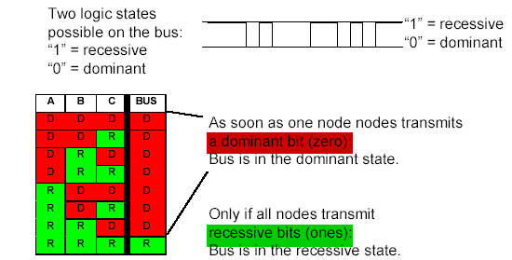
CAN Bus Characterstics

Slide 12
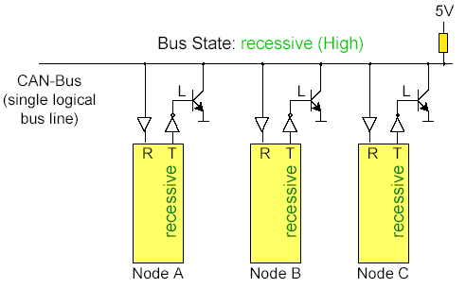
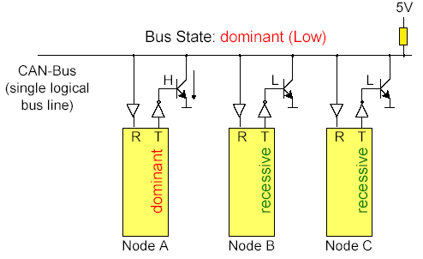
Bus Characteristics – Wired AND
Only if all nodes transmit recessive bits (ones), the Bus is in the recessive state.
If any one node transmits a dominant bit (zero), the bus is in the dominant state.
T is Transmitter, R is receiver. Note nodes can therefore check the line while transmitting. This is important particularly during arbitration.

Slide 13
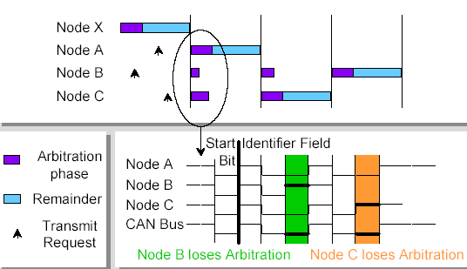
Bus Access and Arbitration – CSMA/CD NDA
CSMA/CD NDA – Carrier Sense Multiple Access/Collision avoidance by Non Destructive arbitration

Slide 14
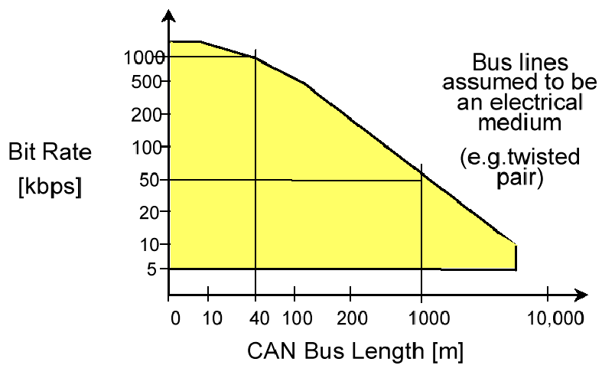
Bus Transmission Speed
Arbitration limits bus speed. Maximum speed = 2 x t_{pd}
tpd = propagation delay of electrical medium

Slide 15
The Can Protocol
Specifies how small packets of data may be transported from point A to point B using a shared communications medium.
It (quite naturally) contains nothing on topics such as
  flow control
  transportation of data larger than can fit in a 8-byte message
  node addresses
  establishment of communication, etc.

Slide 16
Higher layer protocols
Higher layer protocols are used in order to
  standardize startup procedures including bit rate setting
  distribute addresses among participating nodes or kinds of messages
  determine the layout of the messages
  provide routines for error handling at the system level
Some high layer protocols
  Device net
  CANKingdom
  CANopen

Slide 17
The CAN Standard
The CAN standard defines four message types
  Data Frame – the predominantly used message type
  Remote Frame
  Error Frame
  Overload Frame
The messages uses a clever scheme of bit-wise arbitration to control access to the bus, and each message is tagged with a priority.
The CAN standard also defines an elaborate scheme for error handling and confinement.
CAN may implemented using different physical layers, and there are also a number of different connector types in use.

Slide 18
1. The Data Frame
Summary: "Hello everyone, here's some data labeled X, hope you like it!"
The Data Frame is the most common message type. It comprises the following major parts (a few details are omitted for the sake of brevity):
the Arbitration Field, which determines the priority of the message when two or more nodes are contending for the bus. The Arbitration Field contains:
  For CAN 2.0A, an 11-bit Identifier and one bit, the RTR bit, which is dominant for data frames.
  For CAN 2.0B, a 29-bit Identifier (which also contains two recessive bits: SRR and IDE) and the RTR bit.
the Data Field, which contains zero to eight bytes of data.
the CRC Field, which contains a 15-bit checksum calculated on most parts of the message. This checksum is used for error detection.
an Acknowledgement Slot; any CAN controller that has been able to correctly receive the message sends an Acknowledgement bit at the end of each message. The transmitter checks for the presence of the Acknowledge bit and retransmits the message if no acknowledge was detected.

Slide 19
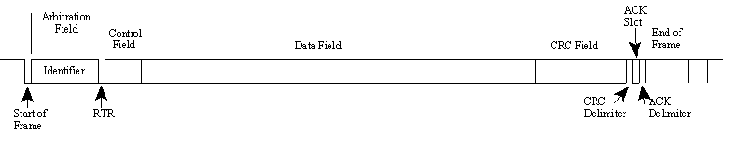
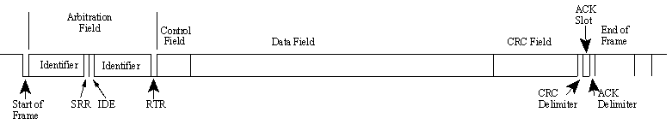
CAN Data Frames
Note 1: It is worth noting that the presence of an Acknowledgement Bit on the bus does not mean that any of the intended addressees has received the message. The only thing we know is that one or more nodes on the bus has received it correctly
Note 2: The Identifier in the Arbitration Field is not, despite of its name, necessarily identifying the contents of the message.
CAN 2.0A (“standard CAN” 11-bit ID) Data Frame.
CAN 2.0B (“extended CAN” 29-bit ID) Data Frame.

Slide 20
2. The Remote Frame
Summary: "Hello everyone, can somebody please produce the data labeled X?"
The Remote Frame is just like the Data Frame, with two important differences:
  It is explicitly marked as a Remote Frame (the RTR bit in the Arbitration Field is recessive), and
  there is no Data Field.
The intended purpose of the Remote Frame is to solicit the transmission of the corresponding Data Frame. If, say, node A transmits a Remote Frame with the Arbitration Field set to 234, then node B, if properly initialized, might respond with a Data Frame with the Arbitration Field also set to 234.
Remote Frames can be used to implement a type of request-response type of bus traffic management. In practice, however, the Remote Frame is little used. It is also worth noting that the CAN standard does not prescribe the behaviour outlined here. Most CAN controllers can be programmed either to automatically respond to a Remote Frame, or to notify the local CPU instead.

Slide 21
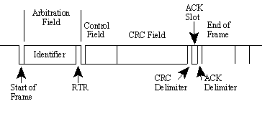
Remote Frame (contd.)
There's one catch with the Remote Frame: the Data Length Code must be set to the length of the expected response message. Otherwise the arbitration will not work.
Sometimes it is claimed that the node responding to the Remote Frame is starting its transmission as soon as the identifier is recognized, thereby "filling up" the empty Remote Frame. This is not the case.
A Remote Frame (2.0A type):

Slide 22
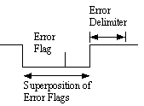
3. The Error Frame
Summary: (everyone, aloud) "OH DEAR, LET'S TRY AGAIN"
Simply put, the Error Frame is a special message that violates the framing rules of a CAN message. It is transmitted when a node detects a fault and will cause all other nodes to detect a fault - so they will send Error Frames, too. The transmitter will then automatically try to retransmit the message. There is an elaborate scheme of error counters that ensures that a node can't destroy the bus traffic by repeatedly transmitting Error Frames.
The Error Frame consists of an Error Flag, which is 6 bits of the same value (thus violating the bit-stuffing rule) and an Error Delimiter, which is 8 recessive bits. The Error Delimiter provides some space in which the other nodes on the bus can send their Error Flags when they detect the first Error Flag.
The Error Frame

Slide 23
4 The Overload Frame
Summary: "I'm a very busy little 82526 device, could you please wait for a moment?"
The Overload Frame is mentioned here just for completeness. It is very similar to the Error Frame with regard to the format and it is transmitted by a node that becomes too busy. The Overload Frame is not used very often, as today's CAN controllers are clever enough not to use it. In fact, the only controller that will generate Overload Frames is the now obsolete 82526

Slide 24
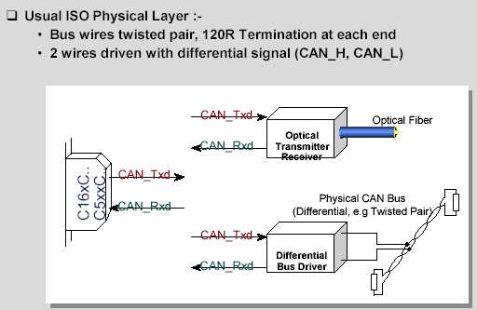
ISO Physical Layer
One of the most common and cheapest implementations is to use a twisted wire pair. The bus lines are then called "CAN_H" and "CAN_L". The two bus lines CAN_H and CAN_L are driven by the nodes with a differential signal. The twisted wire pair is terminated by terminating resistors at each end of bus line, typically 120 ohms.

Slide 25
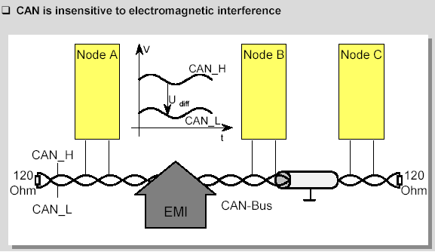
CAN and EMI
Due to the differential nature of transmission CAN is insensitive to electromagnetic interference, because both bus lines are affected in the same way which leaves the differential signal unaffected.
To reduce the sensitivity against electromagnetic interference even more, the bus lines can additionally be shielded. This also reduces the electromagnetic emission of the bus itself, especially at high baudrates.

Slide 26
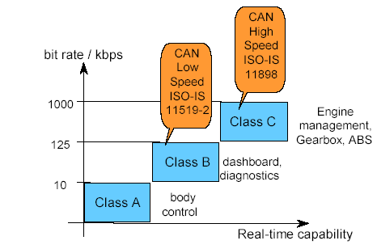
Standardisation
Vehicle bus system applications can be separated in three different categories according to their real-time capabilities.
  Class A for a low speed bus with bit rates up to 10 kbps, e.g for body control applications,
  Class B for a low speed bus with bit rates from 10 kbps to 125 kbps, e.g. for dashboard and diagnostics,
  Class C for a high speed bus with bit rates from 125 kbps to 1 Mbps for real time applications like engine management, Gearbox, ABS etc.
For the use of CAN in vehicles two standards have been defined for the bus interface:
  CAN High Speed according to ISO-IS 11898 for bit rates between 125 kbps and 1 Mbps
  CAN Low Speed according to ISO-IS 11519-2 for bit rates up to 125 kbps

Slide 27
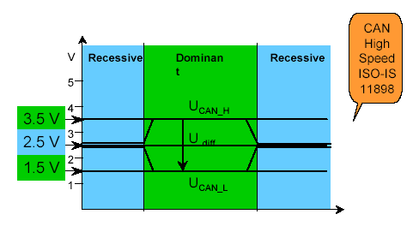
Bus Levels according to ISO-IS 11898
•These are the bus levels according to ISO-IS 11898. A recessive bit is represented by both CAN bus lines driven to a level of about 2.5 V so that the differential voltage between CAN_H and CAN_L is around 0 V.
•A dominant bit is represented by CAN_H going to about 3.5 V and CAN_L going to about 1.5 V. This results in a differential voltage for a dominant bit of about 2V.

Slide 28
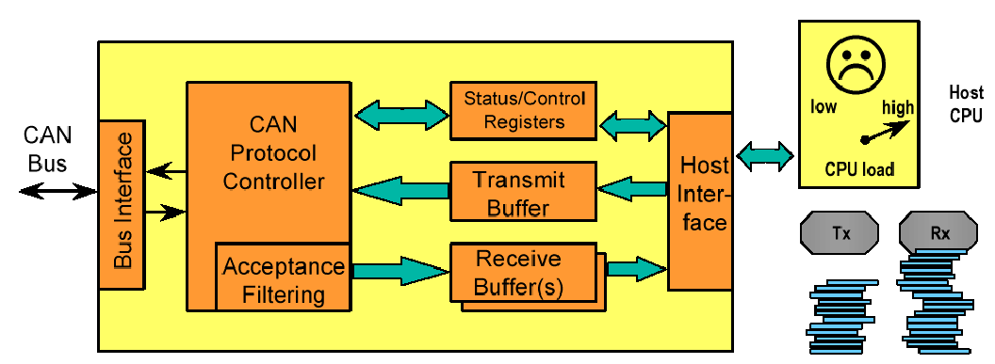
A Basic CAN controller
Cheap CAN controller – CPU could get overrun with messages even if it didn’t need them.

Slide 29
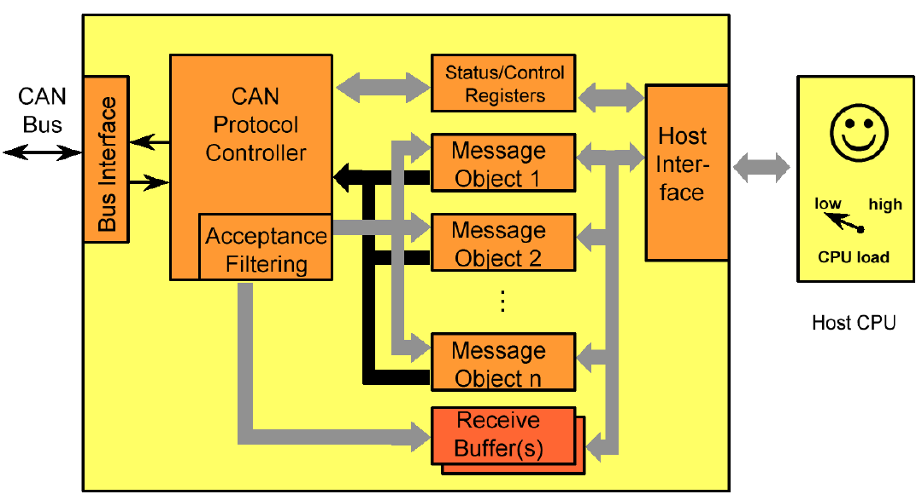
Full CAN Controller
Hardware message filters sort & filter messages without interrupting CPU

Slide 30
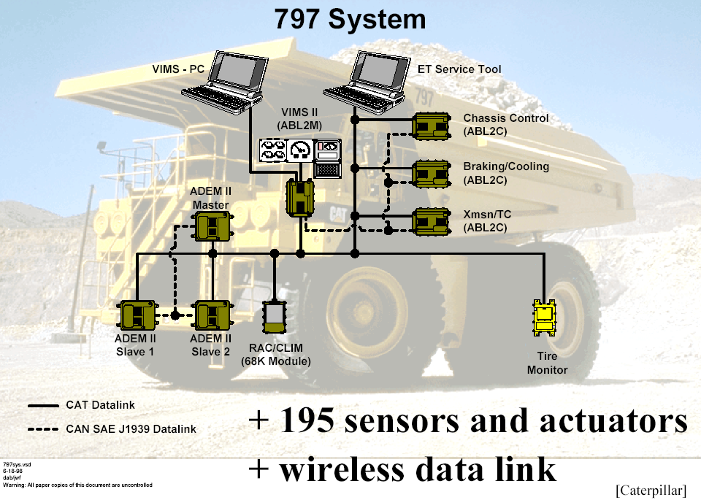
CAN (SAE J1939) Example: Caterpillar 797

Slide 31
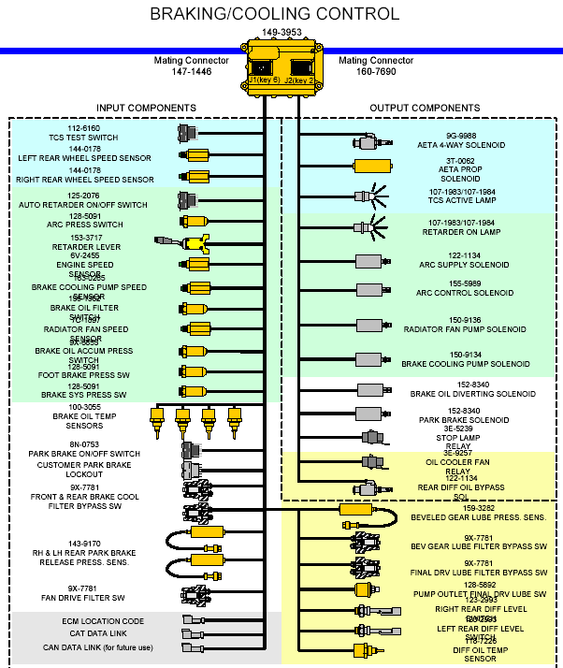
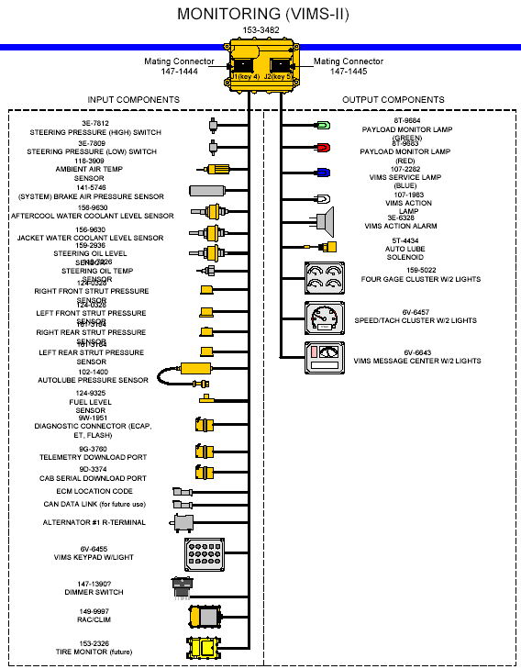
Caterpillar example

Slide 32
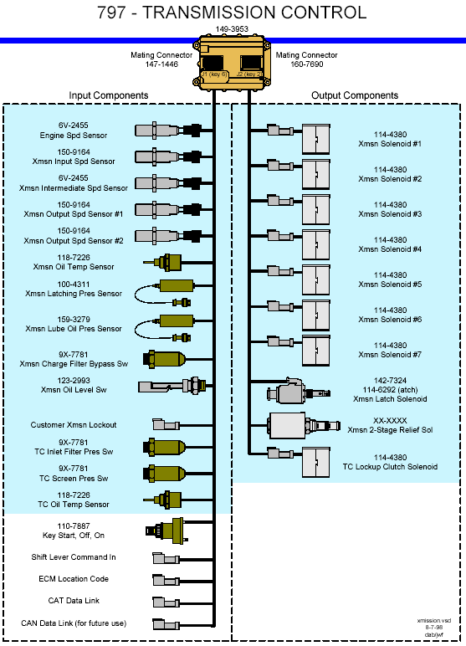
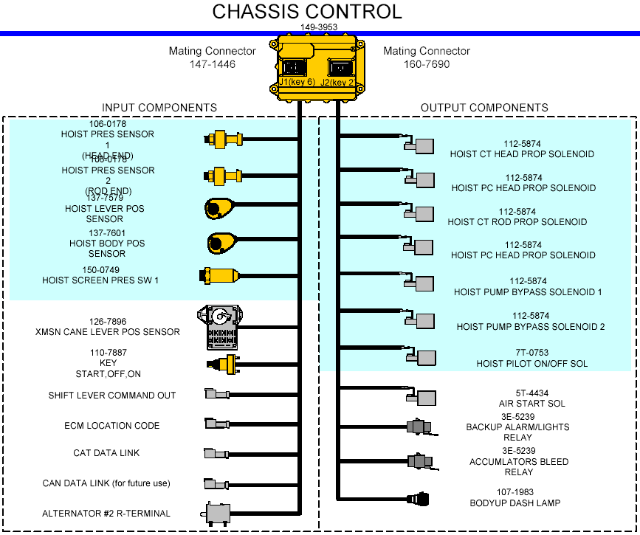
Caterpillar example

Slide 33
