Slide 1
Intro to Controller Area Networks (CAN)
Part 1 of 2, E. Zivi, April 1, 2015
References:
A CAN Physical Layer Discussion Microchip Application Note AN00228a
Controller Area Network (CAN) Implementation Guide Analog Devices Application Note AN-1123
Controller Area Network, CANPRES Version 2.0 , Siemens Microelectronics, Inc., October, 1998
http://www.kvaser.com/en/about-can/the-can-protocol.html
http://www.kvaser.com/can-protocol-tutorial/
CAN physical layer ref: http://www.can-cia.org/index.php?id=systemdesign-can-physicallayer
Controller Area Network Physical Layer Requirements, TI SLLA270–January 2008
CAN Tutorial, http://www.computer-solutions.co.uk/download/Peak/CAN-Tutorial.pdf
CANopen Introduction,
ref: http://www.canopensolutions.com/english/about_canopen/about_canopen.shtml
Embedded Networking with CAN and CANopen, by Pfeiffer, Ayre and Keydel
CAN open Implementation: Applications to Industrial Networks, by Farsi and Barbosa
CS4700/CS5700 Fundamentals of Computer Networks, Alan Mislove, Northeastern University
Controller Area Networks http://electrosofts.com/can/index.html

Slide 2
CAN History
In 1985 Bosch originally developed CAN, a high-integrity serial bus system for networking intelligent devices, to replace automotive point-to-point wiring systems.
As vehicle electronics became pervasive, complex wire harnesses which were heavy, expensive and bulky were replaced with CAN throughout the automotive industry.
In 1993 CAN became the international standard known as ISO 11898.
Since 1994, several widely used higher-level protocols have been standardized on top of CAN, such as CANopen* and DeviceNet.
In 1996 the OnBoard Diagnostics OBD-II standard which incorporates CAN becomes mandatory for all cars and light trucks sold in the United States.
Today markets including surface transportation, industrial automation, maritime and avionics systems have widely adopted CAN.
Today CAN is incorporated into many microcontrollers (our mbed has two CAN ports)
* We’ll investigate this higher level protocol once we cover the CAN basics

Slide 3
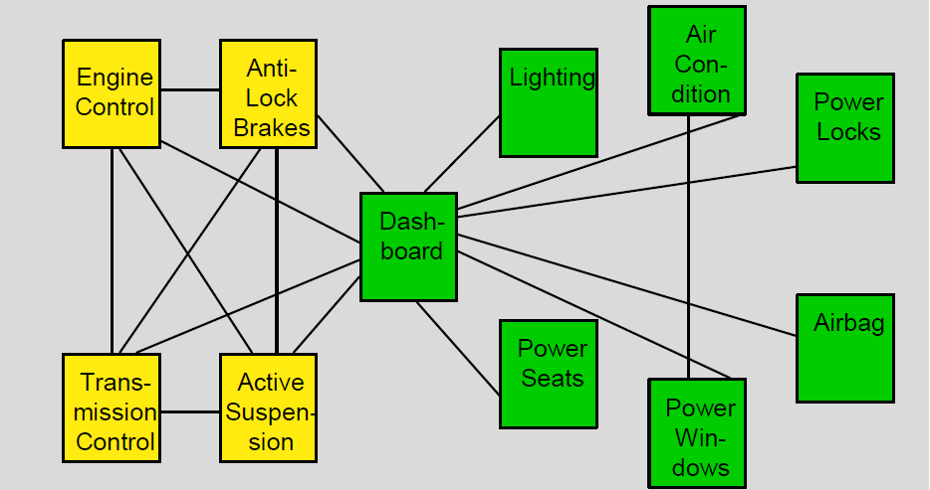
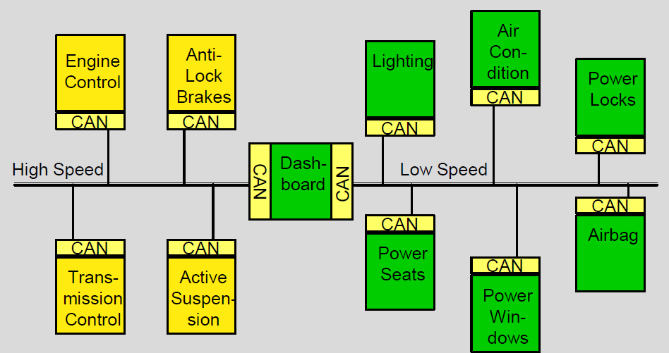
Vehicles Before CAN: Expensive, bulky point to point wiring, wiring harnesses and many connectors. Vehicles After CAN: Systems of Systems with multiple CAN busses, simplified wiring harnesses and many Fewer connectors
Before CAN
After CAN

Slide 4
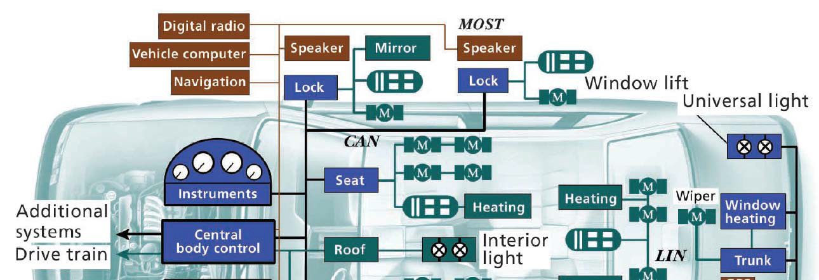
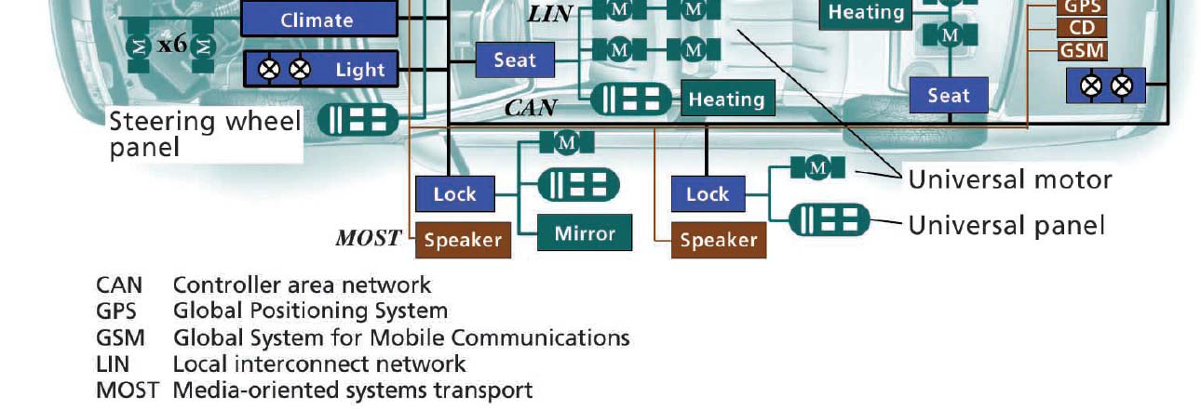
CAN is Now Central to Automotive Networks
New cars typically contain 50 to 100 microcontrollers

Slide 5
Advantages of CAN
Low cost network infrastructure which is often built into microcontrollers.
Large market segment with broad availability of hardware, software and systems engineering tools.
Light weight, low latency, highly deterministic design specifically for real-time embedded applications.
Reliable with strong error detection, fault tolerant versions available.
Flexible and highly configurable with various higher level application protocols.
Foundation for next generation technology controller area networks.

Slide 6
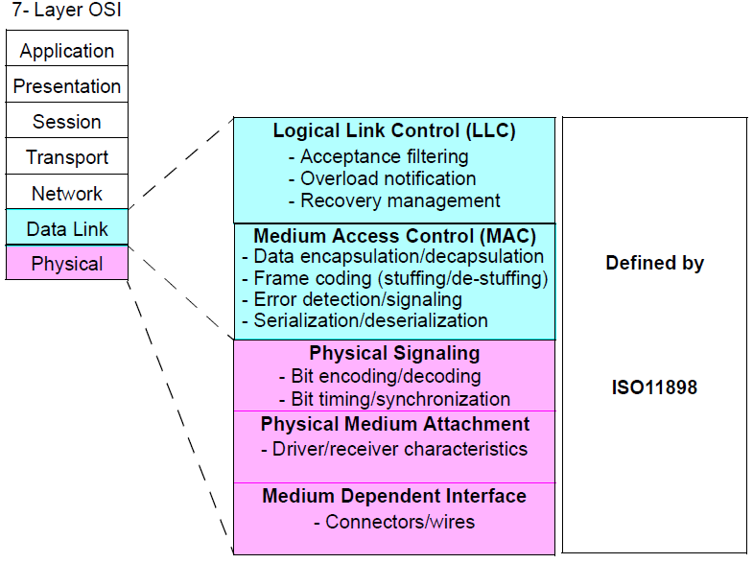
CAN & International Standards Organization (ISO) Open Systems Interconnect (OSI) Reference Model
High level CAN Protocols implement Application layer and skip the four intervening layers

Slide 7
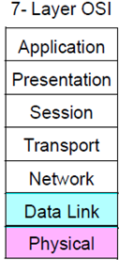
In Future Classes We’ll Introduce The CANopen Application
CiA 401
Generic I/O
Profile
CiA 402
Motion Control Profile
IEC 61131-3
Programmable Devices Profile
CiA 4xx Device Profiles
CiA 302 CANopen Framework for CANopen Managers & Programmable Devices
CiA 301 CANopen Application Layer & Communication Profile
Application
Not Implemented by CAN or CANopen
ISO 11898 CAN Data Link Layer
ISO 11898 CAN Physical Layer
High level CAN Protocols implement Application layers and skip the four intervening layers

Slide 8
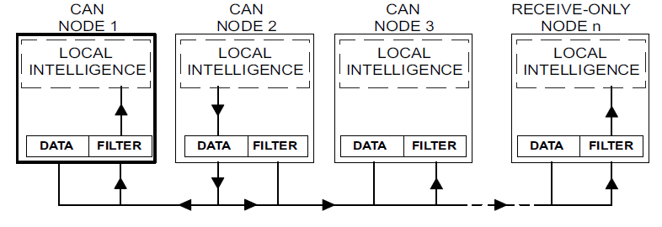
CAN Data-Flow Model
CAN NODE 1
Receives
Message
CAN NODE 2
Transmits
Message
CAN NODE 3
Ignores
Message
CAN NODE 4
Receives
Message
One node transmits, all nodes listen and processor data frames selectively.
Message filtering is typically performed in transceiver hardware. This data flow supports a broad range of network communication models:
Master / Slave : All communications initialed by master node
Peer-to-Peer : Nodes interact with autonomously with equal authority
Producer / Consumer : Producer nodes broadcast (push) messages to Consumer nodes
Client / Server : Client nodes request (pull) data from Server nodes

Slide 9
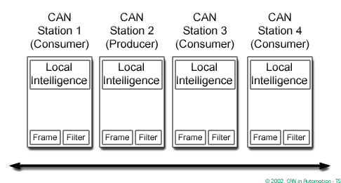
CAN Bus Broadcast Animation
Mouse over graphic to control animated CAN message example

Slide 10
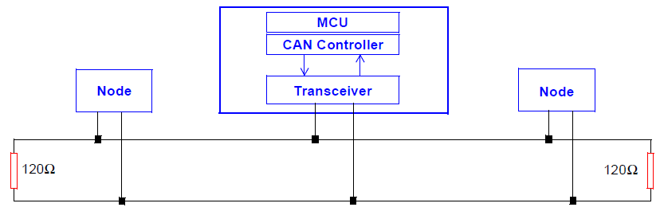
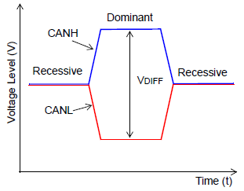
CAN Typical High-Speed Physical Layer
CAN uses differential signaling to improve signal to noise ratio. Termination resistors reduce signal reflection.
Idle bus state is Recessive with no applied differential signal: V_{CAN_H} ≈ V_{CAN_L}
Dominant state occurs when one or more nodes drive the bus state to: V_{DIFF}

Slide 11
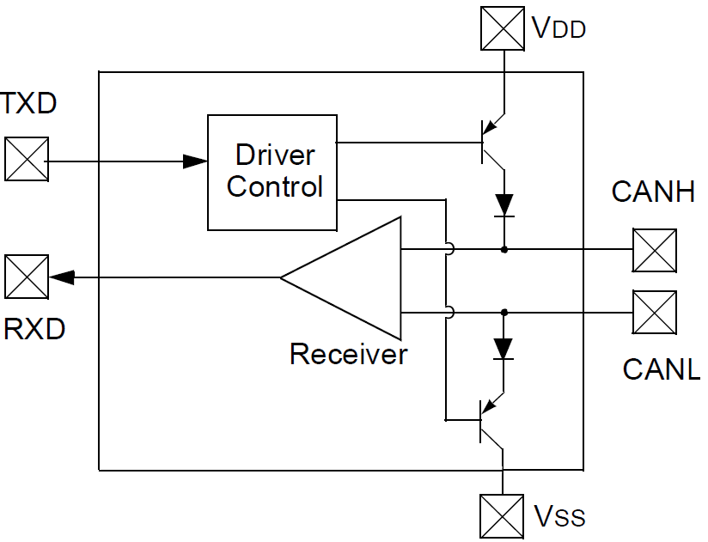
CAN Differential Bus Interface Transceivers
Transistor
Switches
Split
Termination
Example
Capacitive
coupling
to ground
Micro-
controller
60Ω
60Ω
Transceiver
Additional
Transceivers …
The CAN idle state presents a recessive state, signaled by a small differential voltage across CANH and CANL. With the indicated split termination, this idle voltage will be halfway between VDD (positive supply) and VSS (ground).
The CAN dominant state occurs when one or more transceivers simultaneously close the indicated transistor switches driving CANH and CANL toward VDD and VSS, respectively.
This open collector transistor switch configuration is referred to as a “wired or” since any node transmitting a dominant bit always overrides a recessive bit. Since a dominant bit represents a logic 0, this arrangement is sometimes referred to as “wired and” since bus a logic “1” state is achieved only if all nodes (node 1 AND node 2 AND node 3 …) signal logic “1” recessive bits).

Slide 12
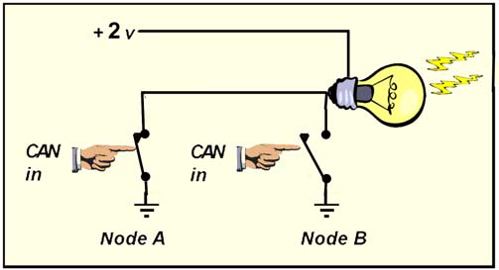
Example of a “Wired OR”
Closing Node A switch OR closing Node B switch turns on the light.
Conversely, the light is off unless Node A switch is open AND
Node B switch is also open.

Slide 13
Example CAN Sample Signaling
Dominant bus state = logic 0
Recessive bus state = logic 1

Slide 14
CAN Logic & Arbitration
CAN 2.0A messages begin with an 11-bit message ID which identifies the message type and also establishes the message priority.
As with many computer interfaces, the CAN transceivers invert the microcontroller signal. Thus, the dominant bus state occurs when a logic “0” is transmitted and the recessive state occurs when a logic “1” is transmitted.
CAN uses the message ID to perform bus access arbitration between nodes.
Each node waits for an idle bus state then begins to transmit its message ID.
Each node also listens to the bus to see if the bus state match its transmission.
If a node detects a dominant bus state while transmitting a recessive message ID bit (logic “1”), it drops out of the current arbitration round and will try again the next time the bus is idle
Coming up: CANarbitration.gif animated bus arbitration example

Slide 15
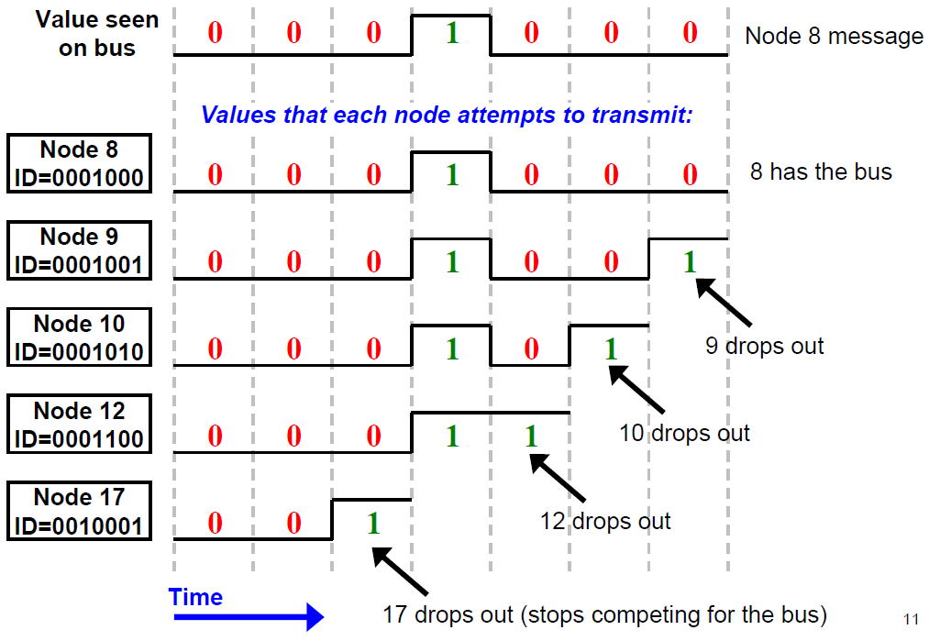
7-bit CANopen Node ID Arbitration Example

Slide 16
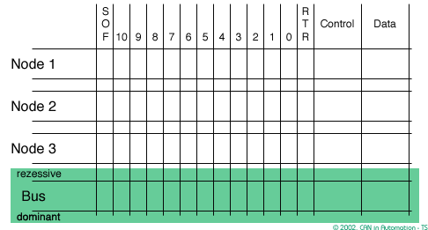
CAN Arbitration Animation
Mouse over graphic to control animated bus arbitration example

Slide 17
Key Advantages of CAN Bus Arbitration
Fast & deterministic.
Highest priority message gets immediate access once the bus is available.
Arbitration is essential “free” since message ID encodes message priority.
Unlike Carrier Sense Multiple Access with Collision Detect (CSMA/CD) arbitration propagation delays never cause message collisions.

Slide 18
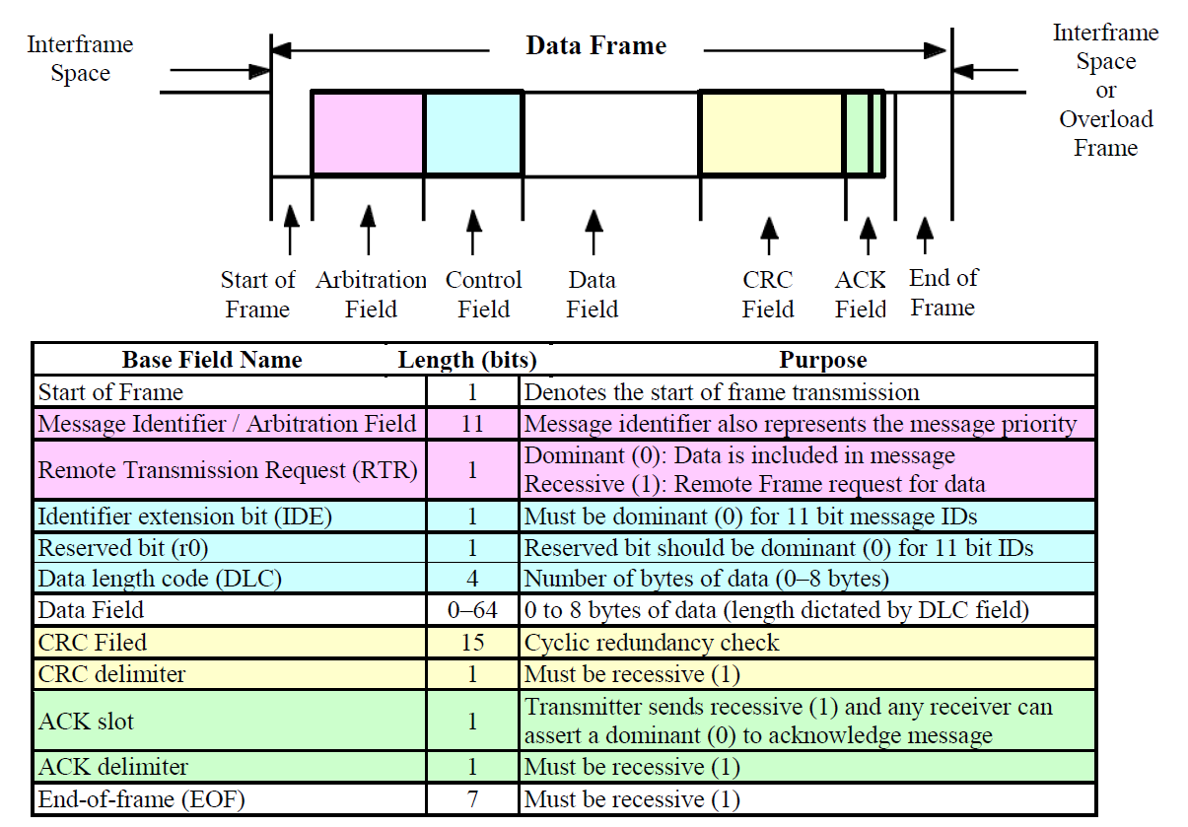
CAN Data Frame Format

