Slide 1
CAN BUS
(Controller Area Network)
Presented by: Alan Bailey
For: EE 587

Slide 2
Contents
Overview
Data Information
  Frame Format
  Protocol
  Error Detection
Implementations
  Basic CAN
  Full CAN
  FIFO
  Enhanced Full CAN
Manufacturers
Diagrams

Slide 3
Overview
CAN (Controller Area Network) is a serial bus system used to communicate between several embedded 8-bit and 16-bit microcontrollers.
It was originally designed for use in the automotive industry but is used today in many other systems (e.g. home appliances and industrial machines).

Slide 4
Overview (con’t)
Highest Baud Rate is 1Mbit.
CAN uses a message oriented transmission protocol.
There are no defined addresses, just defined messages.

Slide 5

Data Information – Frame Format
SOF – Start of Frame
Identifier – Tells the content of message and priority
RTR – Remote Transmission Request
IDE – Identifier extension (distinguishes between CAN standard,11 bit identifier, and CAN extended, 29 bit identifier.)
DLC – Data Length Code
Data – holds up to 8 bytes of data
CRC – “Cyclic Redundant Check” sum
ACK – Acknowledge
EOF – End of Frame
IFS – Intermission Frame Space. Minimum number of bits separating consecutive messages.

Slide 6
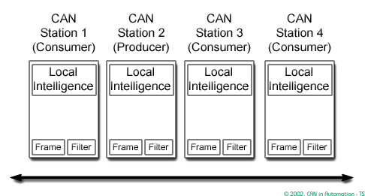
Data Information - Protocol
Messages are distinguished by message identifiers.
The identifier is unique to the network and defines the content & priority of the message.

Slide 7
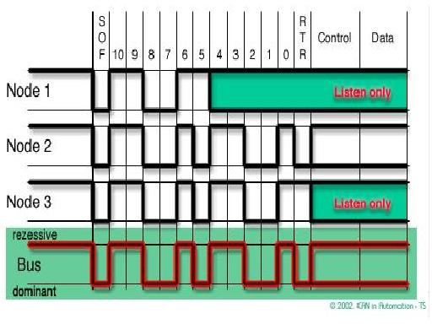
Data Information – Protocol (con’t)
When several messages access the bus at the same time, the one with the higher priority “wins”.
The identifier with the lowest binary number has the highest priority.
The priority are specified during system design and cannot be changed dynamically.

Slide 8
Data Information – Protocol (con’t)
Access conflicts on the bus are resolved by a “wired and” mechanism, where the dominate state overwrites the recessive state.
All “losers” automatically become receivers and they won’t try to send another message until the bus becomes available again.

Slide 9
Data Information – Error detection
If one or more errors are detected, the transmission is aborted. This prevents all other stations or nodes from accepting the message.
Re-transmission is automatic. If errors continue, then the station or node may switch itself off to prevent the bus from being tied up.
Error detection is done on two levels:
  Message level
  Bit level

Slide 10
Data Information – Error detection (con’t)
Message Level
  CRC = Cyclic Redundant Check sum
  Frame Check = compares message to fixed format and frame size
  ACK errors = if transmitter does not receive an ACK signal from the receivers
Bit level
  Monitoring = The transmitter monitors the bus signal as it sends the message and compares the bit sent to the bit received.
  Bit Stuffing = After five consecutive equal bits, the transmitter inserts a stuff bit with a compliment value into the bit stream. The receivers remove this stuff bit.

Slide 11
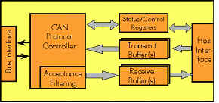
Implementations
Basic CAN
  Limited number of receive buffers and filters
  Can get bogged down quickly with multiple consecutive messages.

Slide 12
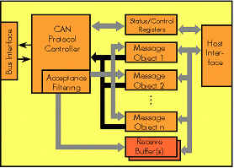
Implementation (con’t)
Full CAN
  Has several message objects (usually 15)
  Can loose data if message objects are setup for multiple filters
  Can still get bogged down if too many messages are sent consecutively

Slide 13
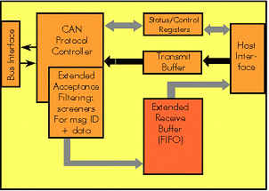
Implementation (con’t)
FIFO
  “First In First Out” receive buffer
  Fixes problem with multiple consecutive messages
  Cannot allow a high priority message to move to front. It has to wait its turn

Slide 14
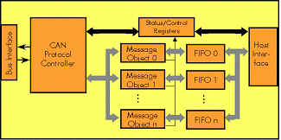
Implementation (con’t)
Enhanced Full Can
  Dedicated FIFO for each individual message object
  Very complicated to use
  Less common

Slide 15
Manufacturers
Over 20 different chip manufacturers produce microcontrollers with on-chip CAN interfaces.
Some more notable ones are:
  Cygnal
  Intel
  Motorola
  NEC
  Phillips
  Toshiba

Slide 16
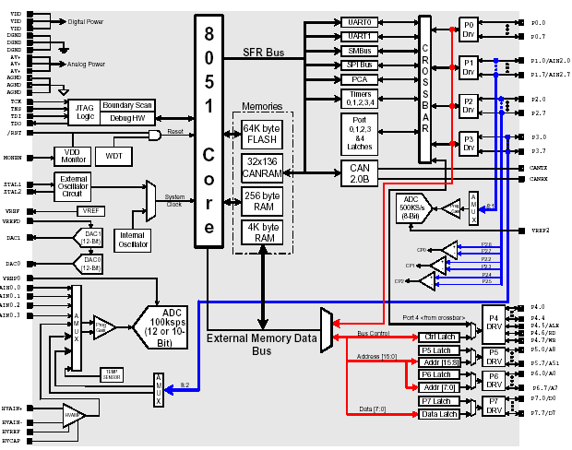
Cygnal C8051F040/042 Block Diagram

Slide 17
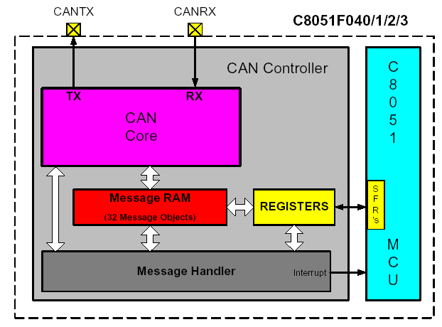
CAN Controller Diagram

Slide 18
Useful Links
Manufacturer and Product List
  http://www.can-cia.org/products/can/chips/
CAN Information
  http://www.canbus.us/
  http://www.can-cia.org/can/

Slide 19
Summary
CAN (Controller Area Network) is a serial bus system used to communicate between several embedded 8-bit and 16-bit microcontrollers
Data Information
  Frame Format
  Protocol – message oriented
  Error Detection
    Message level (CRC, frame check, ACK errors)
    Bit level (monitoring, bit stuffing)
Implementations
  Basic CAN
  Full CAN
  FIFO
  Enhanced Full CAN
Over 20 different chip manufacturers produce microcontrollers with on-chip CAN interfaces including Cygnal, Intel, and Motorala.

