Slide 1
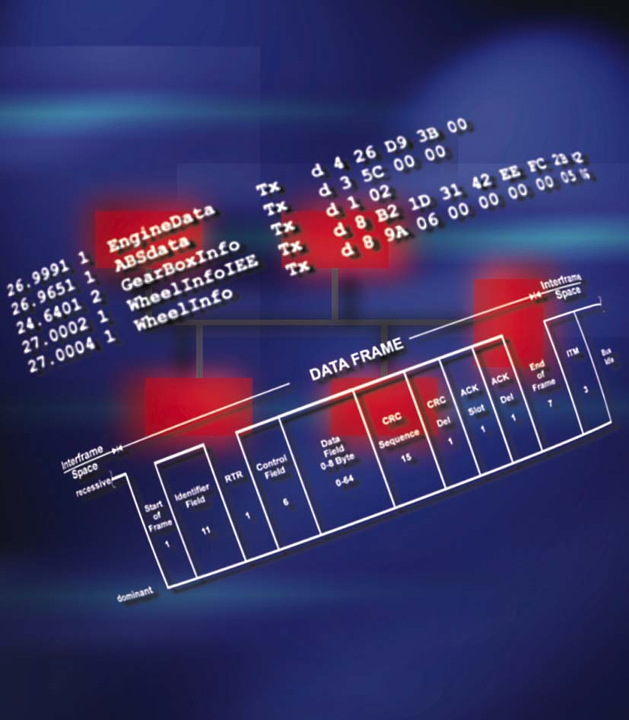
Predictability of Timing in
CAN Networks
2003-05-06, Oliver Falkner

Slide 2
Contents
CAN Protocol Basics
Critical Design Issues in CAN Systems
Calculation of Signal Latencies and Bus Loads
System Design and Simulation

Slide 3
CAN Protocol Basics: Characteristic of CAN Systems
Multi Master Architecture
Event Oriented
CSMA/CA-Bus-Access
  Carrier Sense Multiple Access / Collision Avoidance
Local Clock (Oscillator) for each node
Data Rate up to 1 Mbaud
Complex Error Handling
  Repetition of frames after error

Slide 4
CAN Protocol Basics: Bus Access
Multi-Master
Architecture
Event-
Oriented
CSMA/CA
Random Access
Priority-driven
Nondestructive
Collisions
Nondestructive
messages

Slide 5
CAN Protocol Basics: Message Prioritization
Bus access is controlled by message ID
Message priority
Lowest priority
Decreasing priority
Highest priority
Message address
0
0x7FF

Slide 6
CAN Protocol Basics: Bus Arbitration
Node 1
Node 2
Application
Application
RX-Buffer
TX-Buffer
RX-Buffer
TX-Buffer
ID 0x20
Data
ID 0x80
Data
delay
Send request Node 1
Send request Node 2
Time

Slide 7
Contents
CAN Protocol Basics
Critical Design Issues in CAN Systems
Calculation of Signal Latencies and Bus Loads
System Design and Simulation

Slide 8
Critical Design Issues in CAN Systems
Non deterministic system
  Event driven system
  No system-wide predefined scheduling
  Mix of periodic and event driven messages
Priority inversion
  Priority driven system
  Non ideal nodes
Bus load
  Calculation of bus load is difficult
  Calculation of latency time

Slide 9
Priority Inversion: Definition
Priority Based System - The Assumption
  Each message in the whole network is send according to the priority ASAP after the bus is idle
Priority Inversion - The Definition
  Since the message in the Tx buffer can normally not been requeued, other messages with a higher priority may be blocked
  A priority inversion results in a transmit time delay for a ready-to-send message, thus the overall message transmit time is enlarged
  The transmit time delay caused by a priority inversion for a message could be determined by comparing the ideal transmit time with the real transmit time

Slide 10
Priority Inversion: Definition
Priority Inversion - Detailed View
  The expected result of a CAN bus system is a dedicated message sequence according to message transmit time and priority
  A priority inversion is a deviation from this expected sequence
  The preconditions for a priority inversion are
  priorityMsgReadyInHwForTx < priorityMsgInQueue
  A priority inversion is not only forced by conditions locally to a node but to network global conditions (e.g. other messages on the bus)
  A priority inversion occurs for a message, if the message has the highest priority of all pending messages in the network but is blocked by an other message (in the Tx buffer and on the bus)
  A priority inversion is released, when the message wins the bus arbitration

Slide 11
Priority Inversion: Ideal system behavior
Node A
This node sends:
t = 0: 0x110
t = 1: 0x90
t = 2: 0x80
Node B
This node sends:
t = 0: 0x101
t = 1: 0x100
Priority sorted queue
First Element used for Bus Arbitration
Ready to send:
0x110
0x101
Ready to send:
0x110
0x100
0x90
Ready to send:
0x110
0x100
0x80
Ready to send:
0x110
0x100
Ready to send:
0x110
B: 0x101
A: 0x90
A: 0x80
B: 0x100
A: 0x110
Trace of an ideal system
t=0
t=t1
t=t2
A: 0x110
B: 0x101
A: 0x90
B: 0x100
A: 0x80

Slide 12
Priority Inversion: Real system behavior
Node A
This node sends:
t = 0: 0x110
t = 1: 0x90
t = 2: 0x80
Node B
This node sends:
t = 0: 0x101
t = 1: 0x100
Priority sorted
queue
Queue head element
used for bus arbitration
Ready to send:
0x110
0x101
Ready to send:
0x90
0x110
0x100
Ready to send:
0x90
0x80
0x110
Ready to send:
0x80
0x90
Ready to send:
0x90
One possible sequence on
the bus, when priority
inversion occur in a node
B: 0x101
B: 0x100
A: 0x110
A: 0x80
A: 0x90
B: 0x101
A: 0x90
A: 0x80
B: 0x100
A: 0x110
Trace of an ideal system
t=0
t=t1
t=t2
Delay caused by priority inversion
A: 0x110
B: 0x101
A: 0x90
B: 0x100
A: 0x80

Slide 13
Priority Inversion: Requirements to CAN Nodes
Ideal CAN Node
  Has a priority sorted transmit queue
  Has always a priority driven access to the CAN TX hardware object, i.e. lower-priority messages are removed from the CAN controller, when a higher priority message gets ready to be send
  Is able to send with 100% bus load
Requirements to prevent priority inversion
  At least 3 transmit objects with priority driven transmit behavior
  Controller must be able to requeue pending messages
  One transmit object for each transmit message for systems with static, TX object driven priority
  TX messages limited to max. number of available TX objects (e.g. 14)
  Causes higher CPU load for SW message filtering in BasicCan if message usage are not optimized
Notes:
(1): Other concepts use extended CAN ID’s with 16 bit of the ID used for node address filtering to reduce the CPU load for unnecessary frames. Until using such a concept, the usage of all hardware TX objects has no impact to the CPU load. The disadvantage of such a concept is the limitation to max. 16 nodes in a network for ideal hardware filtering. If >16 nodes are supported, CPU load increases but could possibly part of a network wide optimization strategy to keep CPU load small, too.

Slide 14
Priority Inversion: Requirements to CAN Nodes
Non ideal CAN Node
  Has a priority sorted transmit queue
  Has a priority driven access to the CAN TX hardware object when sending from the queue
  Does NOT requeue pending messages, when a higher priority message gets ready to send
  Node can not send with 100% bus load
Advantage of using a non ideal CAN Node
  Each CAN controller is usable, even if only 1 TX object is available or message requeuing is not supported
  Short driver runtime and small RAM/ROM requirements
  No handling of removed message data needed
  Node is not able to occupy the bus with 100% load in case of failure

Slide 15
Priority Inversion: CAN Bus User View and Needs
If a latency issue arises in the real system user is interested in
  Knowing the reasons of bus latency due to high bus load with higher priority messages and other issues, e.g. ECU local Priority Inversion
  Knowing the number of deadline misses and the shares of bus and internal wait times on each deadline miss event
Possible changes
  Changing the bus priorities
  Changing e.g. ECU local calls to application modules
  Selecting other driver features or an other driver architecture
Could not foresee the PI effects to the signal/message latencies and PI makes worst case scenarios more worse
Needs help (tool, algorithms) to foresee the effects of changes

Slide 16
Contents
CAN Protocol Basics
Critical Design Issues in CAN Systems
Calculation of Signal Latencies and Bus Load
System Design and Simulation

Slide 17
System Calculation: Introduction
The predictability of the system’s behavior is very important for the system layout
Goal is to proof, that all jobs are finished within their deadline
Classes of schedulability analysis
  Threshold analysis (Grenzwertanalyse)
  Range analysis (Ausschnittsanalyse)
  Schedule table analysis (Tabellarische Analyse)
The effort but also the expressiveness increases in the listed order

Slide 18



System Calculation: Motivation
Functional design
max. delay _{SensorToActor} = 50ms
max. delay _{SensorToActor} = 90ms

Slide 19
System Calculation: Motivation
Functional design
Hardware mapping and communication setup
Shared resources
(e.g communication via the
bus) influences independent
functions !?
max. delay _{SensorToActor} = 50ms
ECU 1
ECU 3
ID
Data
0x123
0x01 0x03 ...
ID
Data
ECU 2
0x05
0x02 0x7F ...
Hardware System Setup
max. delay _{SensorToActor} = 90ms

Slide 20

System Calculation: Motivation
Functional design
Hardware mapping and communication setup
Verification process to guarantee requirements
max. delay _{SensorToActor} = 50ms
ECU 1
ECU 3
ID
Data
0x123
0x01 0x03 ...
ID
Data
ECU 2
0x05
0x02 0x7F ...
Hardware System Setup
max. delay _{SensorToActor} = 90ms

Slide 21


System Calculation: Module and CAN Network Basics
Time path for signal transfer from sensor to actor via CAN
max. delay _{SensorToActor} = 50ms
ECU1
ECU3
1
Application
Time bases
are with
tolerance
Application
2
5
3
TX
RX
4
Debouncing and application handling
Communication layer handling (e.g. each 10ms)
Queue wait time (and bus arbitration wait time)
Bus transfer time
Receive driver and communication layer handling (e.g. each 10ms)

Slide 22
System Calculation: Module and CAN Network Basics
CAN limitations and preconditions
  CAN protocol has stuff bits, Δ length ≈ 18% for DLC=8
  Signal latencies can only be calculated for worst case
  Signal latency in reality is often much better than worst case
Message send types
  Periodic: send in a fix cycle (e.g. all 100ms)
  OnEvent: sporadic messages (NM, TP, ...)
  Cyclic/OnEvent: send in a fix cycle with additional spontaneous transmissions

Slide 23
System Calculation: Calculating Network Behavior
The base for each schedulability analysis is a (more or less) simple model
  Priorities are statically or dynamically assigned
  Priority handling is done within sender and for the bus access
  Common transport medium (CAN bus) used
  n:m communication

Slide 24
System Calculation: Calculating Network Behavior
Schedule Table Analysis
  Threshold and range analysis could not be used, if specific conditions and/or results close to the reality are required
  An explicit schedule has to be set up for at least the hyper-period of all events
  The schedule table could be setup statically or dynamically to control the message flow
  The additional information within the schedule table could be used to get additional results (e.g. statistic values)

Slide 25
System Calculation: Calculating Network Behavior
Vector’s approach to calculate the network behavior
  Based on the Guaranteed Message Latencies (GML) method, an iterative algorithm has been developed
  The algorithm considers
    Non-ideal CAN controllers and non-ideal but efficient CAN drivers
    Known system behaviors like e.g. OSEK/NM ring messages
    Optional startup-delay for transmit time slices within a node
  The calculation has to be performed with all messages “periodic”
    Usage of “scenarios” close to the reality is recommended
    A scenario covers one ore more inspected use cases
    Different scenarios are necessary to yield a good knowledge
    about the vehicles behavior under all working conditions

Slide 26
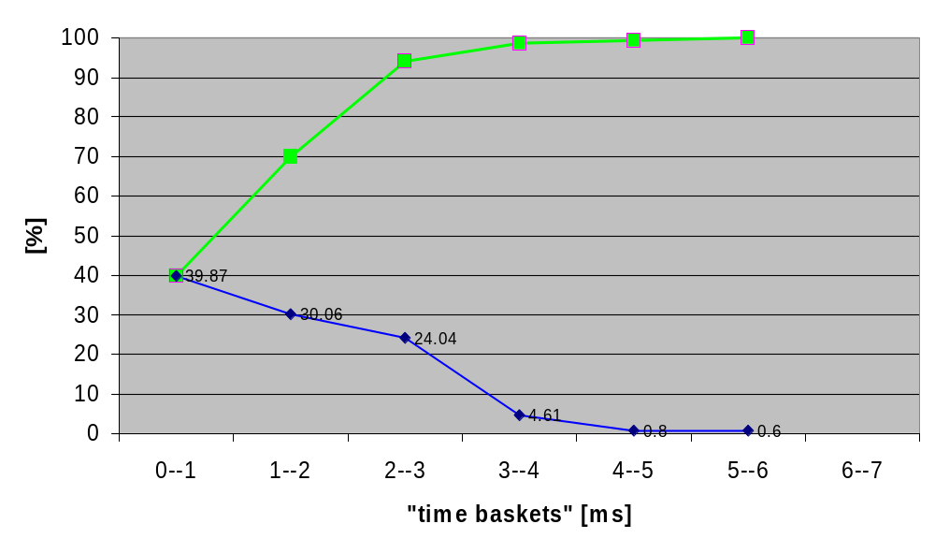
System Calculation: Powertrain of a car MY2003
Probability for bus access
Probability to
gain bus access
within next
xx ms
Probability for
“bus is busy
for xx ms”
No message has to wait more
than 6ms from ready-to-send to
bus transmission in this network!
The likelihood for this wait time
is 0.6%
All “bus busy” phases
between 0ms and 1ms
are stored in this basket

Slide 27
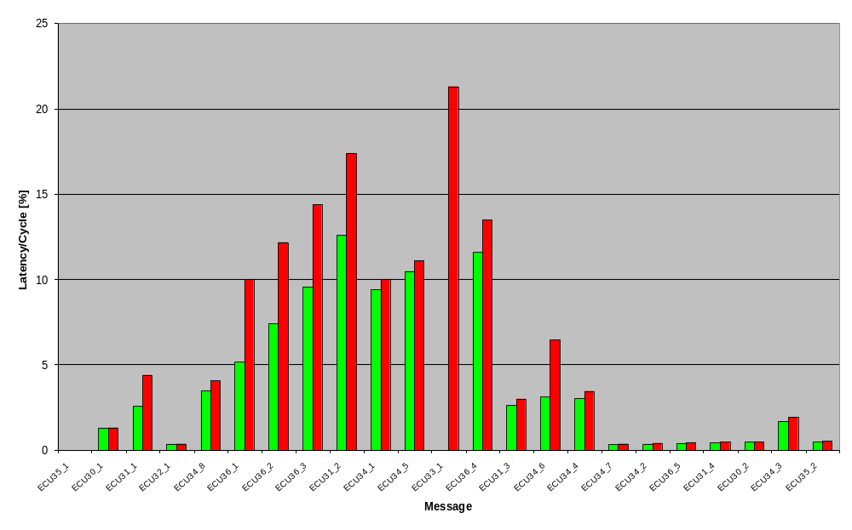
System Calculation: Powertrain of a car MY2003
Message Latency / Deadline
max. relative
message latency
min. relative
message latency
No message has more than 21.3%
of the own deadline to wait from
ready-to-send to bus transmission
start in this network.

Slide 28
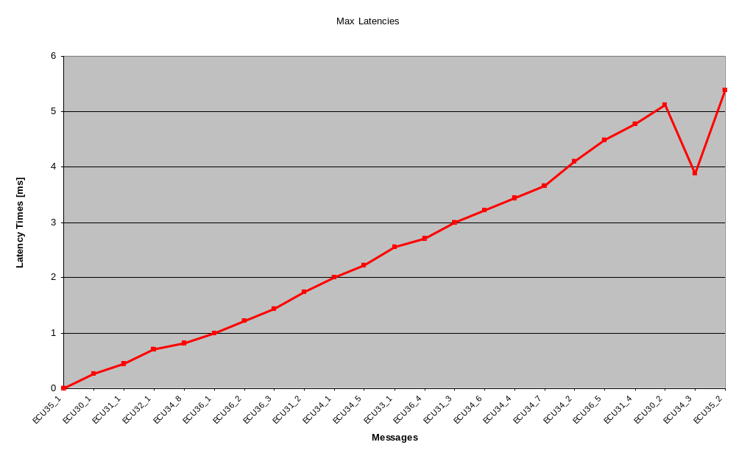
System Calculation: Powertrain of a car MY2003
Maximum message latency in [ms] per message

Slide 29
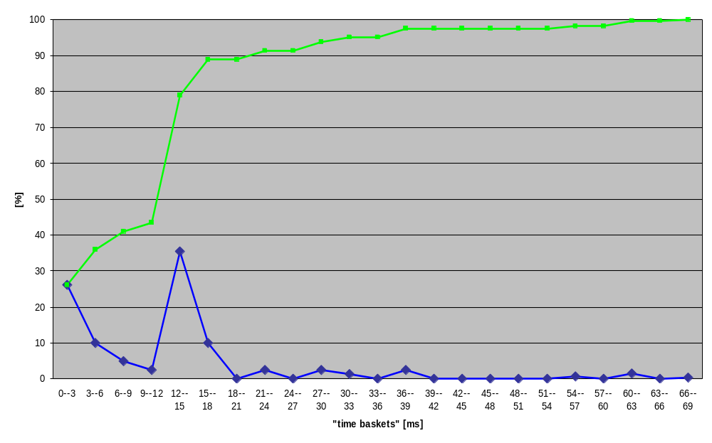
System Calculation: Body bus of a car MY2003 (bad case scenario)
Probability for bus access
89% of all wait times are below 21ms.
No message has to wait more
than 69ms from ready-to-send
to bus transmission in this network!
The likelihood for this wait time
is 0.31%.
Probability to
gain bus access
within next xx ms
Probability for
“bus is busy
for xx ms”

Slide 30
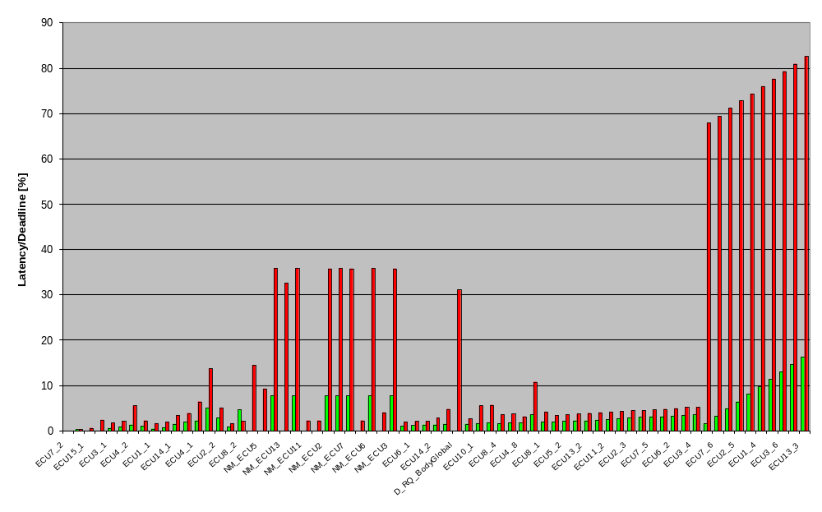
System Calculation: Body bus of a car MY2003 (bad case scenario)
Message Latency / Deadline
Spontaneous development
messages, assumed with
80ms cycle
max. relative
message latency
min. relative
message latency
All application and NM messages are below 35,8%, even with
high additional sporadic development bus load on the bus

Slide 31
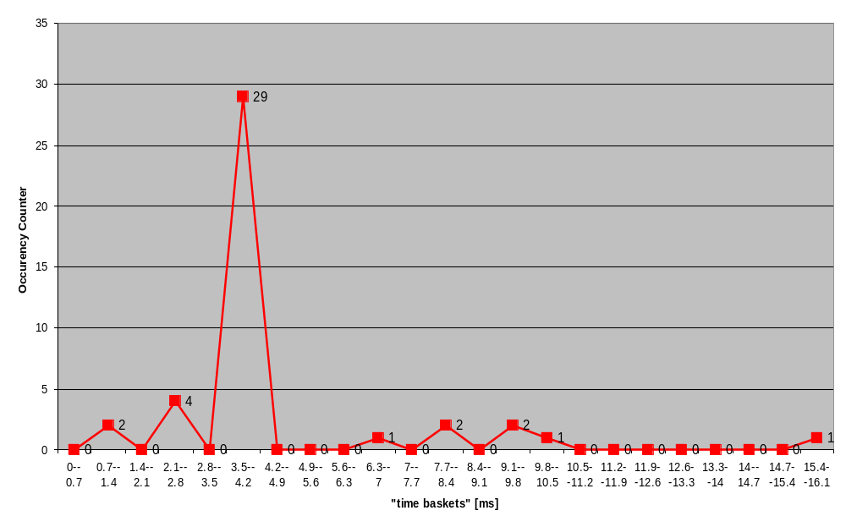
System Calculation: Body bus of a car MY2003 (bad case scenario)
Priority Inversion Situations
There are 42 priority inversions in this bad case
scenario. The scenario itself lasts for 84s with
22156 message transmissions.
One priority inversion (2.4%) lasts for 16.1ms.
About 74% of the situations are cleared within 4.2ms.
Occurrences of
priority inversion
situations

Slide 32
System Calculation: Conclusion and Future
Conclusion
  The calculation of typical body and power-train busses is now possible close to the real behavior
  Vector provide means to calculate the network in a detailed way to allow the user to set its own priorities during the development phase
  The algorithms are part of the Vector tool chain (CANdb++ Admin)
Future
  Algorithms will be improved to show the stability of the system against disturbances
  Calculation of bus behavior and latencies using non-cyclic messages
  New, system-wide working tools (e.g. DaVinci) have knowledge about a lot of signal usage details. The signal mapping could then be performed concerning all aspects including e.g. OS, bus scheduling and application algorithms. Especially the scenario setup will be much easier due to the possible event rate is then known in detail.

Slide 33
Contents
CAN Protocol Basics
Critical Design Issues in CAN Systems
Calculation of Signal Latencies and Bus Loads
System Design and Simulation

Slide 34
CANdb++ Database Design Support: Motivation and Goals
Design and management of communication networks
Improve quality of network design
Optimize system runtime behavior
Rate network performance
Offer suggestions and/or automatic correction
„Design-Assistants“

Slide 35
CANdb++ Database Design Support: Features
Compute bus load
  worst case estimation
  scenarios: choose set of relevant signals
  (e.g. no diagnosis)
Compute signal latency
  based on timing attributes
Check timing parameters
Support signal mapping
  Suggestions for optimal mapping
  Fully automated signal mapping

Slide 36
CANoe System Simulation: Features
Simulation of communication behavior
Drawbacks of real system build in the simulation kernel
  Jitter and drift of local clocks
  priority inversion caused by limited access to TX buffer
  delay in reloading TX buffer
Same kind of results as in CANdb++
  Result of static analysis are easily comparable with simulated results
Test and verify behavior of real nodes and systems
  Check against system design defined in CANdb++

Slide 37
Thank you for your attention!
www.vector-informatik.com

