Slide 1
The CAN Protocol

Slide 2
What is CAN
Controller Area Network
serial communication
multimaster
multicast
no routing

Slide 3
Strengths and Weaknesses of CAN
Widely accepted standard
Robust
  Handles extreme conditions (does not exhibit thrashing)
  Simple to configure
  Good error detection
  Two wire fault detection
Lots of hardware and software that support CAN

Slide 4
Strengths and Weaknesses of CAN
Easy to add a receiver node
New transmitting nodes require will affect the network load
Messages are delivered according to priority
One node can “shout” over everyone else
Limited efficiency because only one bit can be transmitted over ~2 propagation delays

Slide 5
CAN Protocol
Defines the physical and data link layers
Two standards
  CAN 2.0A has 11 bit identifier
  CAN 2.0B has 29 bit identifier

Slide 6
Details of CAN Communication
Physical layer
Frame Contents
Arbitration
Node Synchronization
Error Detection & Handling

Slide 7
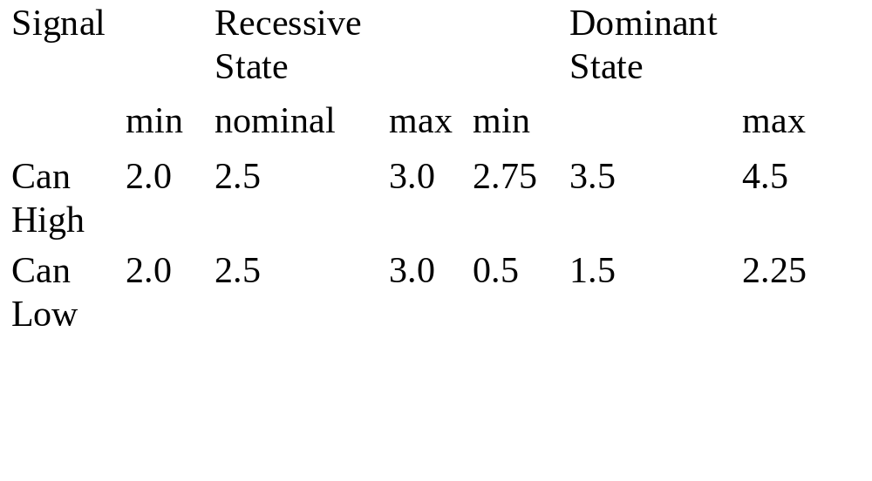
Physical Layer
Twisted pair wire
Differential signal for noise rejection

Slide 8
Frame Contents
SOF Start Of Frame bit
RTR Remote Transmission request bit
IDE Identifier extension bit
DLC Data Length Code
CRC Cyclic Redundancy Check
ACK ACKnowledge
INT INTermission

Slide 9
Arbitration
Carrier Sense - Multiple Access with Collision Avoidance (CSMA/CA)
  Simultaneous requests for the bus result in one node transmitting (no thrashing)
  CSMA/CD (e.g. Ethernet) exhibits thrashing
Bits on bus are either recessive (high) or dominant (low)
The first node to transmit a dominant bit during arbitration gets the bus

Slide 10
Node Synchronization
Nodes synchronize oscillators on bit edges
Bit-stuffing is used to ensure a sufficient number of edges

Slide 11
Node Synchronization
Bit Stuffing
  Bit stuffing is used to guarantee enough edges in the NRZ bit stream to maintain synchronization.
  After five identical and consecutive bit levels have been transmitted, the transmitter will automatically inject (stuff) a bit of the opposite polarity into the bit stream.
  Receivers of the message will automatically delete (de-stuff) such bits.

Slide 12
Error Detection
Message Level
  Cyclic Redundancy Checks
  Frame Checks
  Acknowledgment Checks
Bit Level
  Bit Monitoring
  Bit Stuffing
  If any node detects six consecutive bits of the same level, a stuff error is flagged.

Slide 13
Message Level Error Detection
CRC Each receiver calculates the CRC from the message and checks against received CRC.
  If it does not match a CRC error is flagged

Slide 14
Message Level Error Detection
Frame Format If any of the following are incorrect a frame error is flagged
  CRC delimiter
  ACK delimiter
  End of Frame Bit Field
  Interframe Space (the 3 bit INTermission field and a possible Bus Idle time).

Slide 15
Message Level Error Detection
ACK Error Check
  Each receiving node writes a dominant bit into the ACK slot
  If a transmitter determines that a message has not been ACKnowledged then an ACK Error is flagged.
  ACK errors may occur because of transmission errors, because the ACK field has been corrupted or because there are no operational receivers.

Slide 16
Bit Level Error Detection
Bit Monitoring
  Each bit level (dominant or recessive) on the bus is monitored by the transmitting node.
  Bit monitoring is not performed during arbitration or on the ACK Slot.

Slide 17
Bit Level Error Detection
Bit Stuffing
  The coding for bit stuffing requires that five consecutive bits of the same level to be followed by a complimentary bit level.
  Six consecutive bits of the same level cause a bit stuffing error

Slide 18
Error Flag
If a node detects an error, it terminates transmission by transmitting an error flag
The error flag is six consecutive dominant bits
  All other nodes respond to the error flag by transmitting an error flag

Slide 19
Error Counting
The error flags are counted and stored.
  Receive errors are given a weighting of 1.
  Transmit errors are given a weighting of 8.
Transmitting node errors can be quickly detected.

Slide 20
Error Active Mode
If an error count in either the transmit or receive register is greater than zero, the node enters Error Active mode.
  Error Active nodes are still fully functional, but are in an alert condition.
  Subsequent good messages decrement the Error Count registers by a count of 1.
  If no further errors are detected, and both Error Counts go back to zero, an Error Active node returns to Normal mode.

Slide 21
Bus-Off Mode
If the Error Count in either the transmit or receive registers exceeds 255, the node will take itself off-line by going into Bus-Off mode.
  Permanently faulty nodes will cease to be active on the bus.
  Nodes in the Bus Off state can go back to Error Active mode with 128 occurrences of 11 consecutive recessive bits on the bus.

Slide 22
CAN vs. TTP
CAN - event triggered communication
  Messages should communicate events not states
  Suited for aperiodic communication
  Priority determines which message goes first
TTP - time triggered communication
  Messages should communicate states not events
  Each node has a dedicated time slot for comm.
  Node cannot be silenced by another node

Slide 23
Recommenation According to Kopetz
Hard real-time systems communicate via TTP
Soft real-time systems communicate via CAN (or similar protocol)

Slide 24
TTCAN
Communication can be ET or TT
Time slots are allocated
  Reserved slot
  Arbitration slot
  Free slot
Requires global time synchronization

