Slide 1
Aura Networks

Slide 2
Project 1
Overload Detection & Control (OVDC)

Slide 3

OVDC Abstract
Overload Detection & Control
In multi processes environment Operating System like Unix if….
- One of the process occupies maximum CPU execution then
- Other process which are important may not scheduled for execution
This makes system instability
This is called CPU Overload

Slide 4
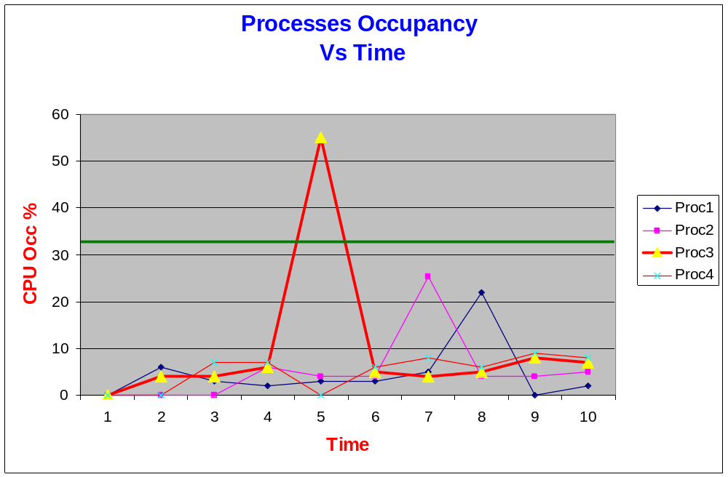
OVDC – Overload Scenario
In above case, “Proc3” occupying 55% CPU causing Overload for a duration of 1 sec

Slide 5
OVDC - responsible for…
To detect CPU Overload
Control overload
Take appropriate defense action(s)
Keep track of each process CPU occupancy for each interval (ex. 1 Sec)

Slide 6
OVDC -responsible for…(Cont)
It measures CPU occupancy of each process in the system using "proc" file system
Based on the measured CPU occupancy OVDC decides whether the system encounters CPU overload
CPU Overload may cause system instability

Slide 7
OVDC -responsible for…(Cont)
To reduce the CPU Overload, it takes appropriate defense actions
It sends signal(s) to process(es) which are causing overload
This also logs information to administrators about Overload condition
It also Warnings and Errors to "Error Handling sub system" and sends corresponding faults

Slide 8
OVDC - Architecture
OVD
OVC
Proc1
UI
Read from PIPE
DB
Proc1
List all Processes
IPC
“/Proc” File System
Check DB
Read Proc
PIPE
Proc1
Configuration
.
Calculate CPU occ
.
.
Write to OVC
.
Send Signals
Proc..n

Slide 9
Environment - Hardware
ARM7 Development Board based on Samsung S3C4510 Microcontroller
S3C2510 Micro Controller
10M/100M Ethernet interface connector(RJ45)
4 M bytes Flash(2M x 16bit)
5.0V DC or USB power supply
16 M bytes SDRAM(2M x 32bit)
2K x 8 EEPROM
2x RS232
USB connecter
IDE44 port: for 2.5" hard disk
LCD port
2 PS2 port
4 key buttons
Reset button
4 LEDS
Beeper
20-pin JTAG interface connector

Slide 10
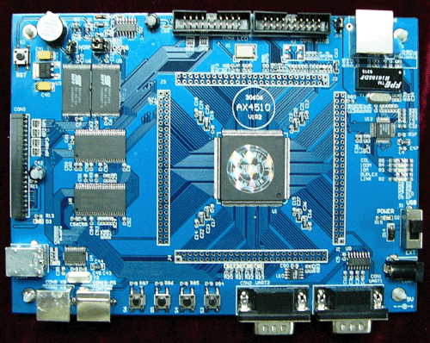
Environment – Hardware
ARM7 Samsung Ax4510 Microcontroller

Slide 11
Environment - Software
C
Embedded ucLinux
Data structures
Makefile
GDB
GCC Compiler
Proc File system

Slide 12
Environment - Software
Sub components | Details | Technical Details
OVD | File manipulation | C
 |  | Using open, read, write system calls
 |  | Parsing Strings
 |  | atoi and itoa
 | /proc file system | Operation System (Unix or Linux)
 |  | What is….. Bellow?
 |  | PID?
 |  | PPID?
 |  | User Mode execution?
 |  | Kernel Mode execution?
 |  | CPU and CPU Occupancy?
IPC | Pipes, Message Queues | Operation System (Unix or Linux)
 |  | What is ……bellow?
 |  | Process memory area?
 |  | Named & Un-named PIPE?
 |  | Message Queues?
 |  | Difference Between PIPE & MQs?

Slide 13
Environment - Software
OVC | Read/Write to DB | C
 |  | Arrays (Sorting and Searching)
 |  | Double Dimension Array
 | Calculate CPU Occupancy | Reading from IPC
 |  | Reading from Array
 | Sending Signals | Operation System (Unix or Linux)
 |  | What is signal?
 |  | Different signals?
 |  | How to send signal?
 |  | What is nice value?
DB | Storing Data | C
 |  | Arrays (Sorting and Searching)
 |  | Double Dimension Array
 | Searching DB | Searching elements
 | Removing Data | Removing elements in Array
Configuration file | APIs to Config file | Tuning configurable values
 | How to write config file | Building User interface

Slide 14
Environment - Software
Signals | What are all signals | Building Signal handlers
 | How to send a signal | Raising signals
Testing | Testing OVDC | Simulating….
 |  | Process with high occupancy
 |  | Creating more processes

Slide 15
Thank You

