Slide 1
Introduction to CAN

Slide 2
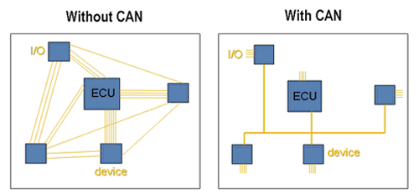
What is CAN and what are some of its features?
Serial communication
Multi-Master Protocol
Compact
  Twisted Pair Bus line
1 Megabit per second

Slide 3
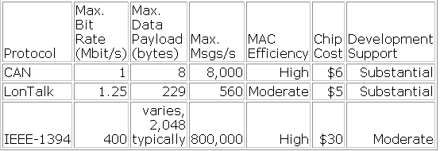
Why is CAN used?
  Robust in noisy environments
  Priority Signal Setting
  All devices on the network receive every bit of information sent on the BUS
  Cost Effective

Slide 4
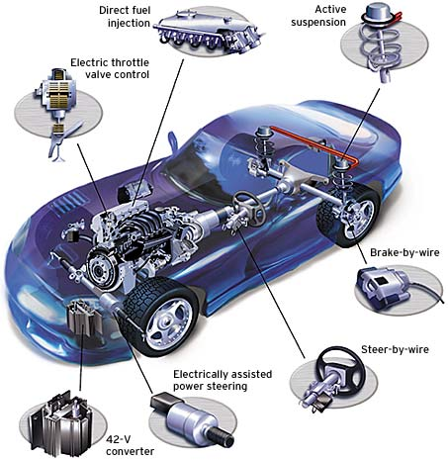
What are some real world applications of CAN?
  Controller Area Networks are used in many different fields, the bulk of which are
    Auto-motive industry
    Factory Automation
    Machine Control
    Medical Equipment and devices
    And more….

Slide 5
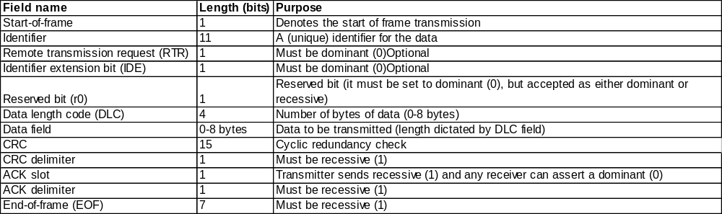
What is transmitted?
All messages sent over a CAN network follows this format. Each bit is used either to verify the validity of the message, or is data itself.

Slide 6
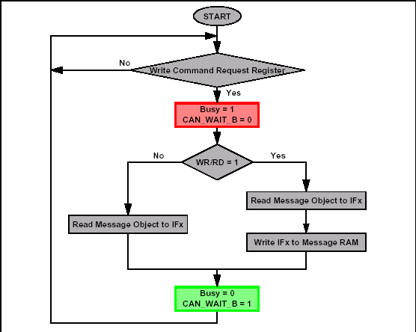
What is the process of sending a message?
At each CAN device, the start of frame bit notifies a transmission is being sent.
The identifier bit shows the priority of the message along with determining which device the data belongs to.

Slide 7
CAN Message Transmission

Slide 8
Basic message frame format
Field name | Length (bits) | Purpose
Start-of-frame | 1 | Denotes the start of frame transmission
Identifier | 11 | A (unique) identifier for the data
Remote transmission request (RTR) | 1 | Must be dominant (0)
Identifier extension bit (IDE) | 1 | Must be dominant (0)
Reserved bit (r0) | 1 | Reserved bit (it must be set to dominant (0), but accepted as either dominant or recessive)
Data length code (DLC) | 4 | Number of bytes of data (0-8 bytes)
Data field | 0-8 bytes | Data to be transmitted (length dictated by DLC field)
CRC | 15 | Cyclic redundancy check
CRC delimiter | 1 | Must be recessive (1)
ACK slot | 1 | Transmitter sends recessive (1) and any receiver can assert a dominant (0)
ACK delimiter | 1 | Must be recessive (1)
End-of-frame (EOF) | 7 | Must be recessive (1)

Slide 9
Arbitration Field

Slide 10
Message Objects
32 message objects
Configured to transmit or receive or both
Configured using the Message Object Interface Registers
Each identifier is stored in a Message object.
Message number is the receive/transmit priority for the Message Objects
  Message Object 1 has the highest priority, while Message Object 32 has the lowest priority

Slide 11

Message Object Interface register
ID28-0 Message Identifier
  ID28 - ID0 29-bit Identifier (“Extended Frame”).
  ID28 - ID18 11-bit Identifier (“Standard Frame”).
Dir Message Direction
  one Direction = transmit
  zero Direction = receive
Data 0 1st data byte of a CAN Data Frame
Data 1 2nd data byte of a CAN Data Frame

Slide 12
Error Field

Slide 13
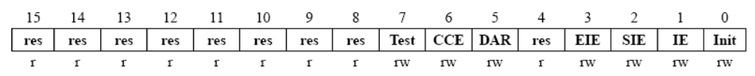
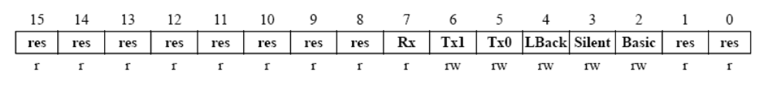
Enable test mode to use the modes below
Loop Back Mode
Silent Mode
Basic Mode

Slide 14
Status Register
  Transmit successfully
  Receive successfully
  Stuff Error -Form Error
  AckError -Bit1Error
  Bit0Error -CRCError

Slide 15
Debugging
Oscilloscope
  Useful in Lab 1
    read the message frame and error bits
    calculate the frequency of a message frame

Slide 16
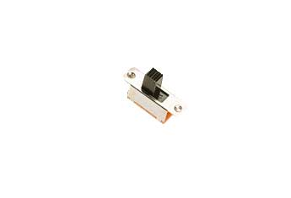
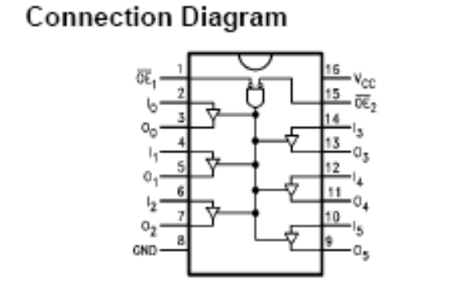
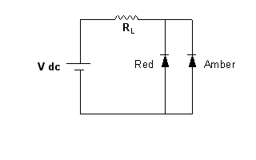
Components for Lab 1
Slide Switch
74F365 Hex Buffer
Bi color LED

