Slide 1

Circular Queue: Efficient Queue Management with a Ring Buffer

Slide 2



What is a Circular Queue?
A queue where the last element connects back to the first, forming a continuous circle.
Also known as a Ring Buffer, it strictly adheres to the FIFO (First In First Out) principle.
Memory Efficiency
Crucially, it solves the memory wastage issues of linear queues by reusing freed spaces.

Slide 3
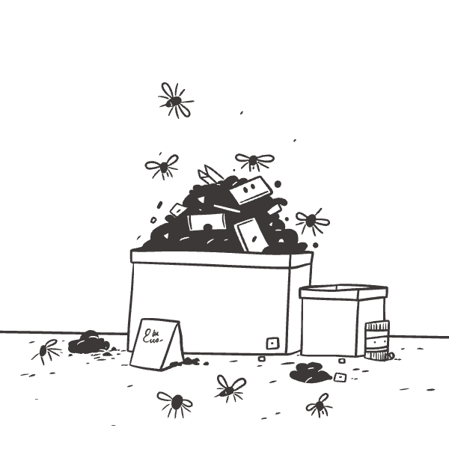
The Problem with Linear Queues
Linear queues insert elements at the rear and remove them from the front. A significant limitation arises as elements are dequeued: empty spaces appear at the front of the array.
These spaces cannot be reused for new insertions. Once the rear pointer reaches the end of the array, no more insertions are possible, even if there's available space at the beginning.
This leads to inefficient memory utilization and potential "queue overflow" scenarios, where the queue appears full despite having available slots.

Slide 4




How Circular Queue Works
Modulo Arithmetic
Pointer Movement
Utilizes modulo arithmetic to wrap the rear and front pointers around the fixed-size array.
Pointers update as: rear = (rear + 1) % capacity and front = (front + 1) % capacity.
Seamless Operations
Full Condition
This enables continuous enqueue and dequeue operations without the need for element shifting.
The queue is considered full when (rear + 1) % capacity == front.

Slide 5
Core Operations of Circular Queue
1
2
Enqueue(value)
Dequeue()
Inserts an element at the rear of the queue, provided the queue is not already full.
Removes an element from the front of the queue, provided the queue is not empty.
3
4
Front()
Rear()
Retrieves the element currently positioned at the front of the queue without removing it.
Retrieves the element currently positioned at the rear of the queue without removing it.
All these essential operations (Enqueue, Dequeue, Front, and Rear) are executed with optimal O(1) time complexity, ensuring highly efficient queue management.

Slide 6
THE END

