Slide 1
RCDN SPACE
Revolutionizing construction with technology

Slide 2


ABOUT US
A digital platform transforming construction project management. Offers tools for contractors, consultants, suppliers, and clients to streamline and optimize the construction process.

Slide 3
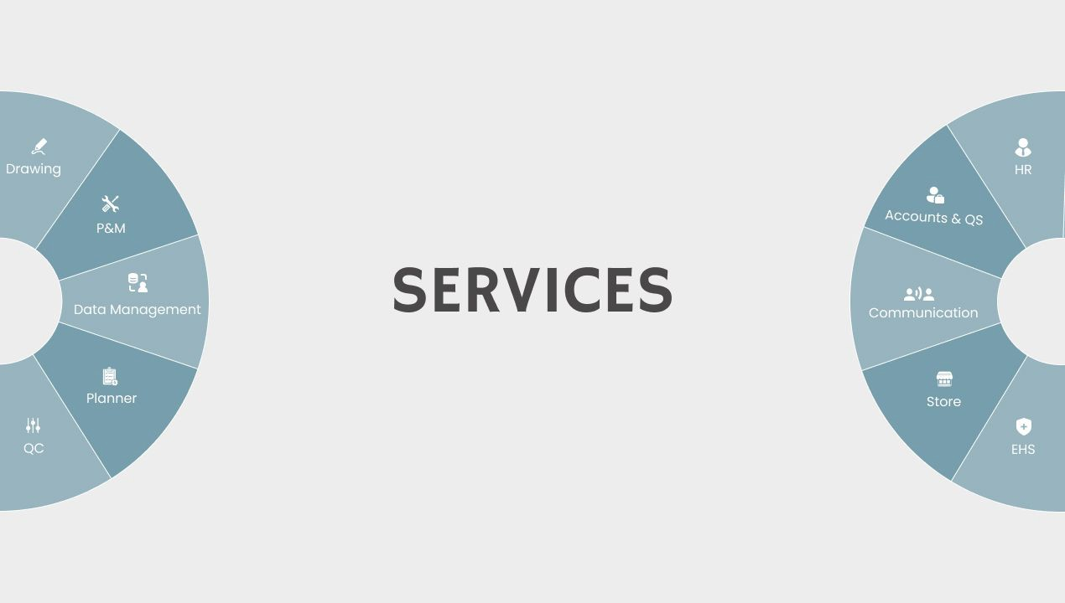

Slide 4

DRAWING MODULE
The drawing module in RCONSPACE is designed to streamline the flow of construction plans across multiple stages, ensuring that each level has the necessary clarity and precision to execute the project effectively.

Slide 5


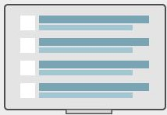
l I
l I
l
Consultant |  | Head Office |  |  | Sitehead
Site
WEBSITE FOR MANAGEMENT
MOBILE FOR VIEW
-
View Drawing Files
Downloading File
RFI Raising & Resolving
Soft copy upload
Hard copy upload
-
Analysis Dashboard
View Drawing File
Notification
-
-

Slide 6
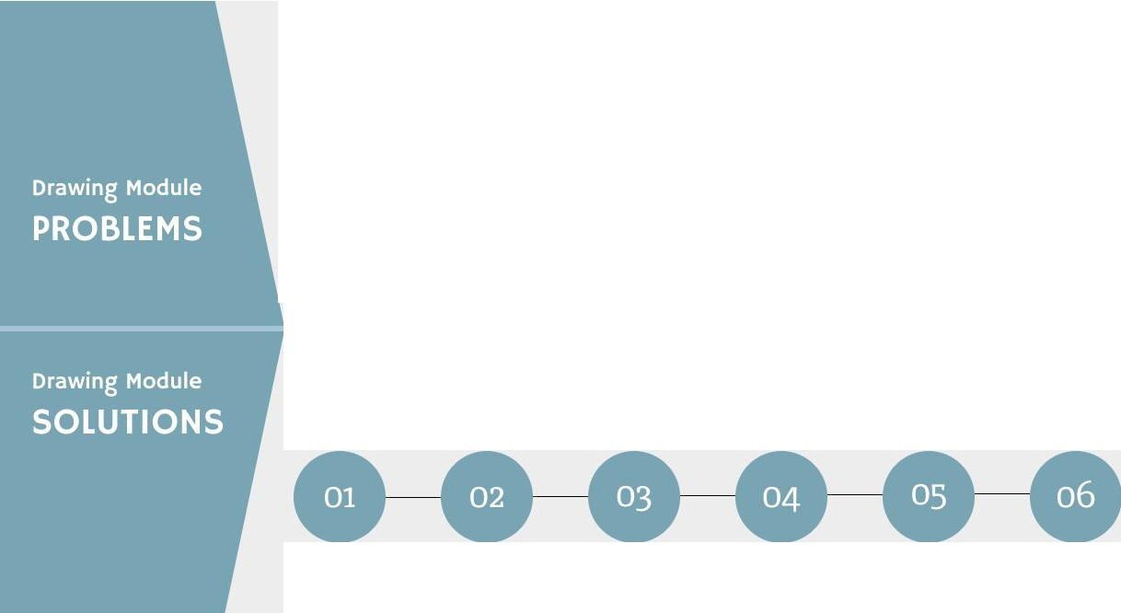

Drawing register co-ordination
RFI
co-ordination
Delayed registers Analysis
Data sharing systems
Drawing data management
Analysis
Fixed drawing register schedules
Request the RFis in structured timelines.
Tracking the delayed register
Cloud based sharing system
Delivering the drawings to site
On time Analysis

Slide 7
THANK YOU

