Slide 1


DOCKER
AN INTRODUCTION TO DOCKER

Slide 2
What a developer should know?
Moby Dock
Run and Manage Containers
Images
Docker Hub
Build Images with a Dockerfile

Slide 3
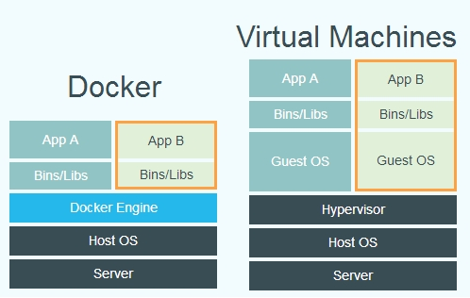
INTRODUCTION
Why Docker ?

Slide 4
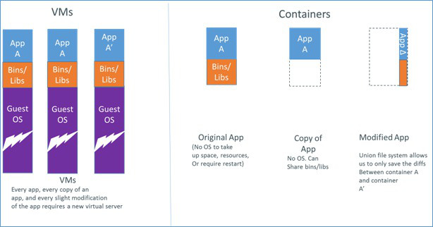
CONTAINERS
CONTAINERS HAVE :
PROCESS SPACE
NETWORK INTERFACE
SHARE KERNEL
ISOLATED PROCESS
NAMESPACES
CGROUPS

Slide 5
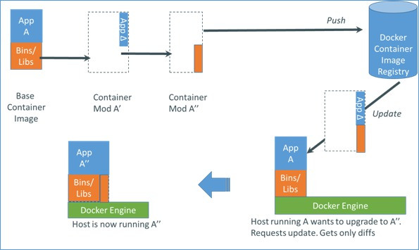
NAMESPACES
CGROUPS
PID
MNT
NET
UTS
UID
MEMORY
CPU
BLKIO
DEVICES

Slide 6
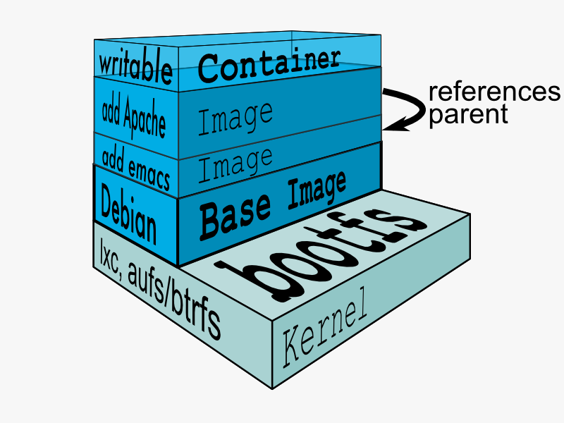
DOCKER IMAGES
1.Docker images are filesystems layered over each other.

Slide 7
DOCKERFILE
WHAT IS A DOCKER FILE?
INSTRUCTIONS ARGUMENTS

Slide 8
INSTRUCTIONS
FROM
FROM ubuntu
RUN
RUN apt-get install -y nginx
CMD
CMD ["/bin/bash", "-l"]
Note: override the CMD
ENTRYPOINT
ENTRYPOINT ["/usr/sbin/nginx" ]
$ sudo docker run -t -i myimage -g "daemon off;"
MAINTAINER
MAINTAINER <name> “name@mail.com”

Slide 9
INSTRUCTIONS
WORKDIR
WORKDIR /v1/app/db
RUN bundle install
Note:-Overridding the working directory $ sudo docker run -t -i -w /var/www ubunt
ENV
ENV TARGET_DIR /v1/app
WORKDIR $TARGET_DIR
USER
USER docker
VOLUME
VOLUME ["/opt/projectss"]
docker run -d -P -v /var/www/html:/webapp/app image_name /bin/bash

Slide 10
DOCKERFILE
WHAT IS A DOCKER FILE?
INSTRUCTIONS ARGUMENTS

Slide 11

Thank You
For more information :
Tel: 303-459-4310
Email: info@qwinixtech.com
www.qwinixtech.com

