Slide 1
Using
Google API
By Bhagwat Kumar

Slide 2

Agenda
What is Google API?
Create API key
Javascript Anonymous functions
Translate API
Transliteration API
Web Search API
Map API
Demo

Slide 3
What is the Google Web API?
The API* exposes the Google engine to developers. You can write scripts that access the Google search in real-time. For example, you could query all pages containing "hello", and output the page-count. Or anything else imaginable.
http://blogoscoped.com/archive/2003_06_22_index.html

Slide 4

Popular Google APIs
Translation service
Blog Search
Calendar
Feeds
Libraries
Maps
Search
YouTube

Slide 5
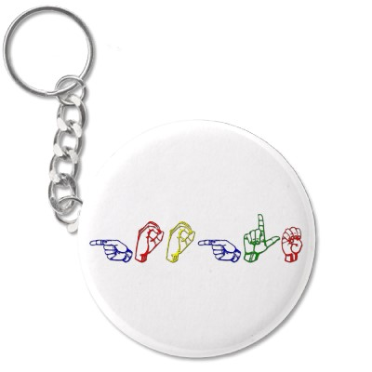
Create API key
To begin using the Google APIs, first you need to sign up for an API key. The API key costs nothing, and allows google to contact you directly if they detect an issue with your site.
Some of the APIs can be used without the need of key. e.g. Google Map Version3.

Slide 6
Create API key cont...
Create your API key here :
http://code.google.com/apis/loader/signup.html
To begin using the Libraries API, include the following script in the header of your web page.
<script type="text/javascript" src="https://www.google.com/jsapi?key=INSERT-YOUR-KEY"></script>
Now you can use statements like :
google.load("jquery", "1.4.4");
google.load("jqueryui", "1.8.6");
google.load("dojo", "1.5");
google.load("prototype", "1.6.1.0");
google.load("yui", "2.8.2");

Slide 7

Javascript Anonymous functions
Function with no name
Mostly Used in ajax calls
Syntax/Uses similar to groovy closure

Slide 8
Anonymous function cont...
var myFunction= function() {
alert("My Function called");
}
$('buttonSelector').click(myFunction)
$('buttonSelector').click(function() {
alert("My Function called");
})

Slide 9
Anonymous function cont...
var ajaxCallHandler=function(data){
alert("Data received : "+data)
}
$.get(url, data, ajaxCallHandler)
$.get(url, data, function(data){
alert("Data received"+data)
});
function anotherTypeOfHandler(data){
alert("Received data in another type of handler : "+data)
}
$.get(url, data, anotherTypeOfHandler)

Slide 10
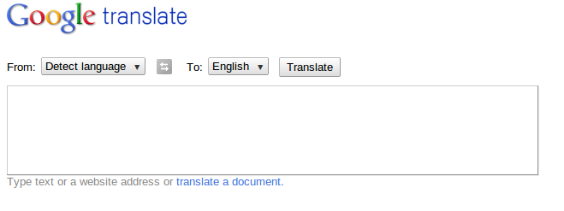
Translate API
Translate text from one language to another
Which library to use : language
Usage : http://translate.google.com/
google.language.translate(content,
SourceLanguageOrEmpty, DestinatinLanguage,
function(result) {
alert( "Translated text : "+ result.translation);
});

Slide 11
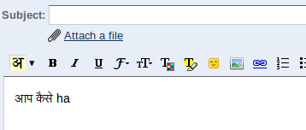
Transliteration API
Makes you type in different language inside the text area
Which library to use : elements
Usage : Press Ctrl+G while Composing in gmail
new google.elements.transliteration.TransliterationControl(
{sourceLanguage: "en", destinationLanguage: ["hi"]}
);

Slide 12
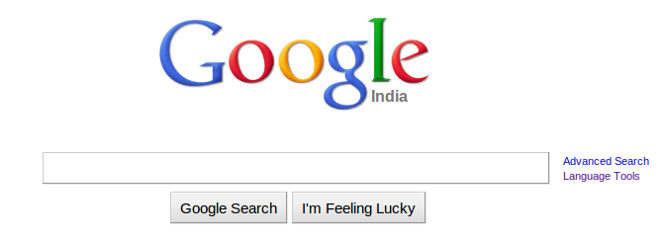
Web Search
Integrate google search in your application
Which library to use : search
Usage Sample : http://www.google.co.in/
var searchControl = new google.search.SearchControl();
searchControl.addSearcher(new google.search.BlogSearch());
searchControl.draw(document.getElementById("canvas"));
searchControl.execute("Bhagwat Kumar");

Slide 13
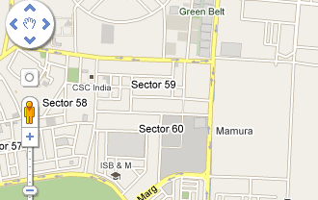
Google Map
Which library to use : http://maps.google.com/maps/api/js
Usage : http://maps.google.com/
Demo includes :
Simple Map centered at given (Latitude, Langitude)
Maps with Marker
Maps with InfoWindow
Using geocoding to get address of given (Latitude, Langitude) position

Slide 14

Demo

Slide 15
Helpful Links and references
Get sample code and presentation
http://code.google.com/apis/libraries/devguide.html
http://code.google.com/apis/ajax/playground/
http://code.google.com/apis/language/translate/v1/reference.html
http://code.google.com/apis/maps/documentation/javascript/tutorial.html
https://github.com/bhagwat/Google-Web-API-Samples

Slide 16


