Slide 1
FEDERATED INTRUSION DETECTION
A Privacy-Preserving IDS for Edge-IoT Networks
Nine real IoT devices jointly detect attacks — without ever pooling their raw traffic
Sparsh Y Bhagwat · Tanya Singh · Adithya Santosh
Computer Networks — Course Project

Slide 2
Agenda
01
Problem, Aim & Objectives
04
System Design & Methodology
02
Literature Review & Research Gap
05
Results
03
How We Built It
06
Live Demo, Conclusion & Future Work

Slide 3
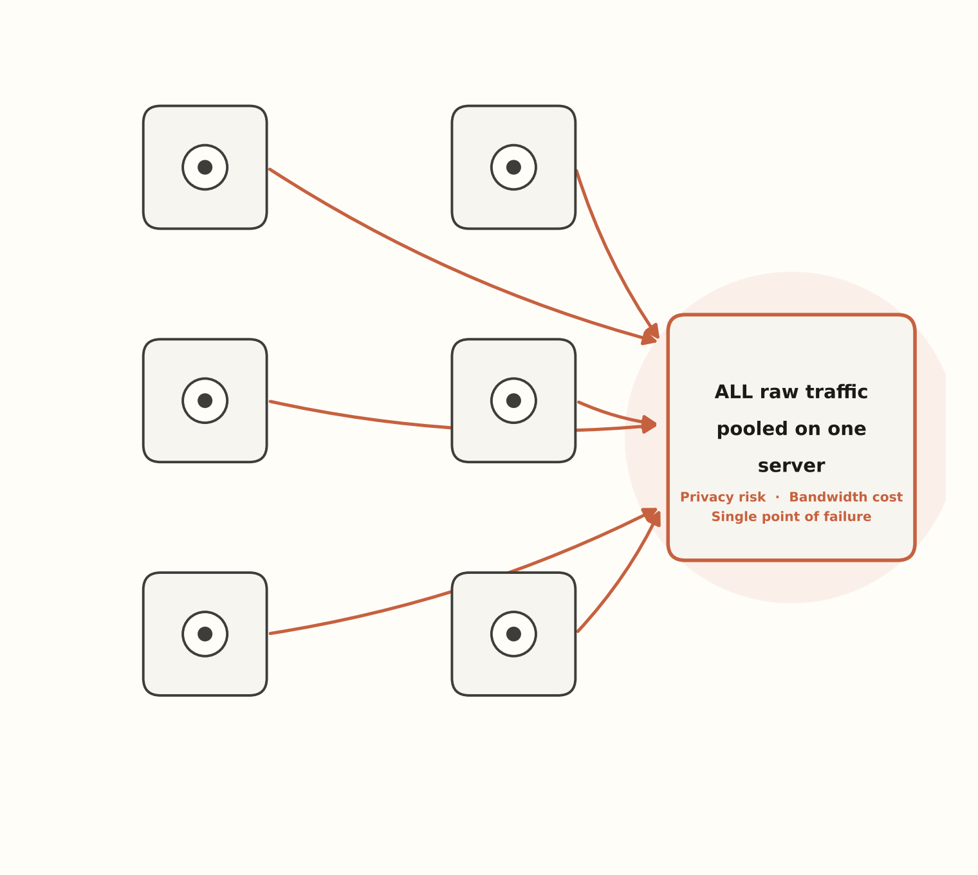
The Problem
IoT devices — cameras, doorbells, thermostats — are a fast-growing attack surface for botnets like Mirai and Gafgyt
Traditional IDS pools every device's raw traffic on one central server to train a detector
That costs real privacy (your camera footage leaves your network), real bandwidth, and creates a single point of failure
Can we detect attacks well without ever centralizing raw traffic?

Slide 4
AIM
Build a federated learning–based intrusion detection system that lets 9 real IoT devices jointly detect network attacks — accurately, explainably, and over a real network — without ever sharing raw traffic.

Slide 5
Objectives
1
Establish honest bounds
4
Explain decisions without exposing data
Centralized (ceiling) vs. local-only (floor) baselines
Client-side SHAP, validated against ground truth
2
Train a federated detector
5
Validate on a real network
FedAvg & FedProx across 9 non-IID real devices
Real machines, real Mininet delay, real measured bytes
3
Test genuine zero-day generalization
6
Report honestly, across seeds
An entire attack family withheld from every client
Every headline number is a mean ± std over 3 runs

Slide 6
Literature Review — N-BaIoT & Federated Foundations
[1]
Rey et al., “Federated Learning for Malware Detection in IoT Devices,” arXiv:2104.09994 (2021)
Foundational: trains supervised and unsupervised FL models on N-BaIoT across seen & unseen devices. Also shows FedAvg's aggregation step is vulnerable to a single malicious client.
[2]
“A Lightweight FL Approach for Privacy-Preserving Botnet Detection in IoT,” arXiv:2510.03513 (2025)
Compares a decentralized model against centralized learning on N-BaIoT — but uses an ensembling technique to simulate FL rather than running real client processes.
GAP WE FOUND
Paper 2 simulates FL via ensembling instead of real client processes; paper 1 predates FedProx, explainability, and any systems-level (real-network) layer.
WHAT WE DID
We run actual Flower ClientApps as independent processes — never ensembling — including over a real emulated network topology (Mininet, Phase 6).

Slide 7
Literature Review — FedProx & Non-IID Robustness
[3]
Chen et al., “An Efficient Federated Learning Framework for IoT Intrusion Detection” (FedKD-Prox), IEEE (2024)
Combines knowledge distillation with FedProx — reports that FedProx significantly improves robustness for IoT IDS under heterogeneity.
[4]
Izadi et al., “Mist-Assisted FL for Intrusion Detection in Heterogeneous IoT Networks,” arXiv:2511.00271 (2025)
Uses FedProx on TON_IoT specifically — 98–99% accuracy and stable convergence under heterogeneous, large-scale settings.
GAP WE FOUND
Neither paper reports a μ sweep as granular as ours, nor pairs it with a straggler / variable-epoch participation condition — so it's unclear exactly where FedProx's gains come from.
WHAT WE DID
We sweep μ ∈ {0, 0.001, 0.01, 0.1, 1} on both datasets over 3 seeds, and report honestly even where FedProx ≈ FedAvg under full participation.

Slide 8
Literature Review — Explainability in FL-IDS
[5]
“Explainable Federated Learning for Botnet Detection in IoT Networks,” IEEE CSR (2024)
Aggregates client-side SHAP explanations server-side, without accessing raw client data.
[6]
“FedShield-IDS,” Scientific Reports (2026)
Federated 1D-CNN-LSTM with SHAP for smart-home IoT IDS — close architectural comparison point.
[7]
“XAI FL-IDS,” arXiv:2605.19448 (2026)
Pairs FL with SHAP at both local and server levels — reports over 99% accuracy.
[8]
Kalakoti, “FedXAI” — TalTech PhD thesis (2025)
Proposes secure aggregation of client-based SHAP values under privacy constraints.
GAP WE FOUND
None of papers 5–8 check whether the federated importance vector actually agrees with SHAP computed centrally on ground truth — they show SHAP plots, but never validate agreement.
WHAT WE DID
We rank-correlate our federated SHAP vector against centralized ground-truth SHAP (Spearman ρ = 0.70 / 0.90, both p < 1e-17).

Slide 9
Literature Review — Systems Validation & Surveys
[9]
“FLEET: A Federated Learning Emulation and Evaluation Testbed,” arXiv:2509.00621 (2025)
Integrates Flower + Containernet — our closest systems-level precedent, bridging FL theory and real network conditions.
[10]
Rezaei et al., “A Survey on Security and Privacy in FL-Based IDS for 5G and Beyond Networks,” IEEE OJCOMS (2025)
Explicitly states it identifies open gaps in FL-IDS research for IoT/5G environments.
[11]
Vyas, Lin & Hwang, “Privacy-Preserving FL for Intrusion Detection in IoT Environments: A Survey,” IEEE Access (2024)
Broad survey of privacy-preserving FL-IDS approaches and their open problems.
GAP WE FOUND
FLEET emulates the network but isn't paired with SHAP or an honest FedAvg-vs-FedProx sweep; both surveys independently flag XAI and real-network validation as open, underdeveloped directions.
WHAT WE DID
Phase 5 (explainability) and Phase 6 (real Mininet network) are combined with the Phase 3/4 FedAvg/FedProx sweep — in one pipeline.

Slide 10
The Research Gap, Stated Plainly
Across all 11 papers, nobody does all of the following at once:
No honest 3-way comparison
Zero-day claims are hand-waved
Most papers report one headline accuracy number only — misleading, since benign traffic dominates these datasets
Genuinely-unseen-attack evaluation, paired with explainability, is repeatedly flagged as underdeveloped
Explainability is unvalidated
Real network evaluation is rare
SHAP-in-FL papers show plots but never rank-correlate against centralized ground truth
Most FL-IDS work stays in pure simulation — bandwidth/latency savings are assumed, not measured
Our combination — two non-IID tracks × FedAvg/FedProx sweep × honest macro-F1 × client-side SHAP × real Mininet measurement — isn't duplicated by any single paper above.

Slide 11
Our Contribution — Closing Each Gap
Gap in the literature
What we did
Result
Honest 3-way comparison, not one headline number
Centralized / local-only / FedAvg / FedProx, macro-F1, averaged over 3 seeds
75% vs. 60% macro-F1 (N-BaIoT)
Zero-day claims usually hand-waved
Entire attack family withheld from every client, tested — volatility reported honestly
85% ± 7% Mirai catch rate
Explainability unvalidated against ground truth
Client-side SHAP, rank-correlated against centralized SHAP
ρ = 0.70 / 0.90, p < 1e-17
Real network evaluation is rare
Real Mininet emulation — actual bytes and round-time measured, not assumed
7.3 MB vs. 1.2 GB raw traffic

Slide 12
How We Built It — Implementation Logic
Independent Flower ClientApps run as separate processes, each loading only its own data partition — never post-hoc ensembling of predictions, the shortcut prior work takes.
Real FL, not simulated
μ ∈ {0, 0.001, 0.01, 0.1, 1} swept across both datasets × 3 seeds, plus a variable-epoch / straggler condition per client, aggregated via FedAvg / FedProx weighted averaging on the server.
Granular robustness sweep
Each client computes SHAP locally on its own held-out batch (raw data never leaves the device), uploads only a mean-|SHAP| vector; we Spearman-correlate the aggregate against SHAP computed on the centralized model as ground truth.
Validated explainability
A 9-process Mininet topology with tc-netem–injected link delay (5 / 20 / 50 ms); bytes transmitted and wall-clock round time are measured directly from socket and process logs, not estimated.
Real, not assumed, network cost

Slide 13
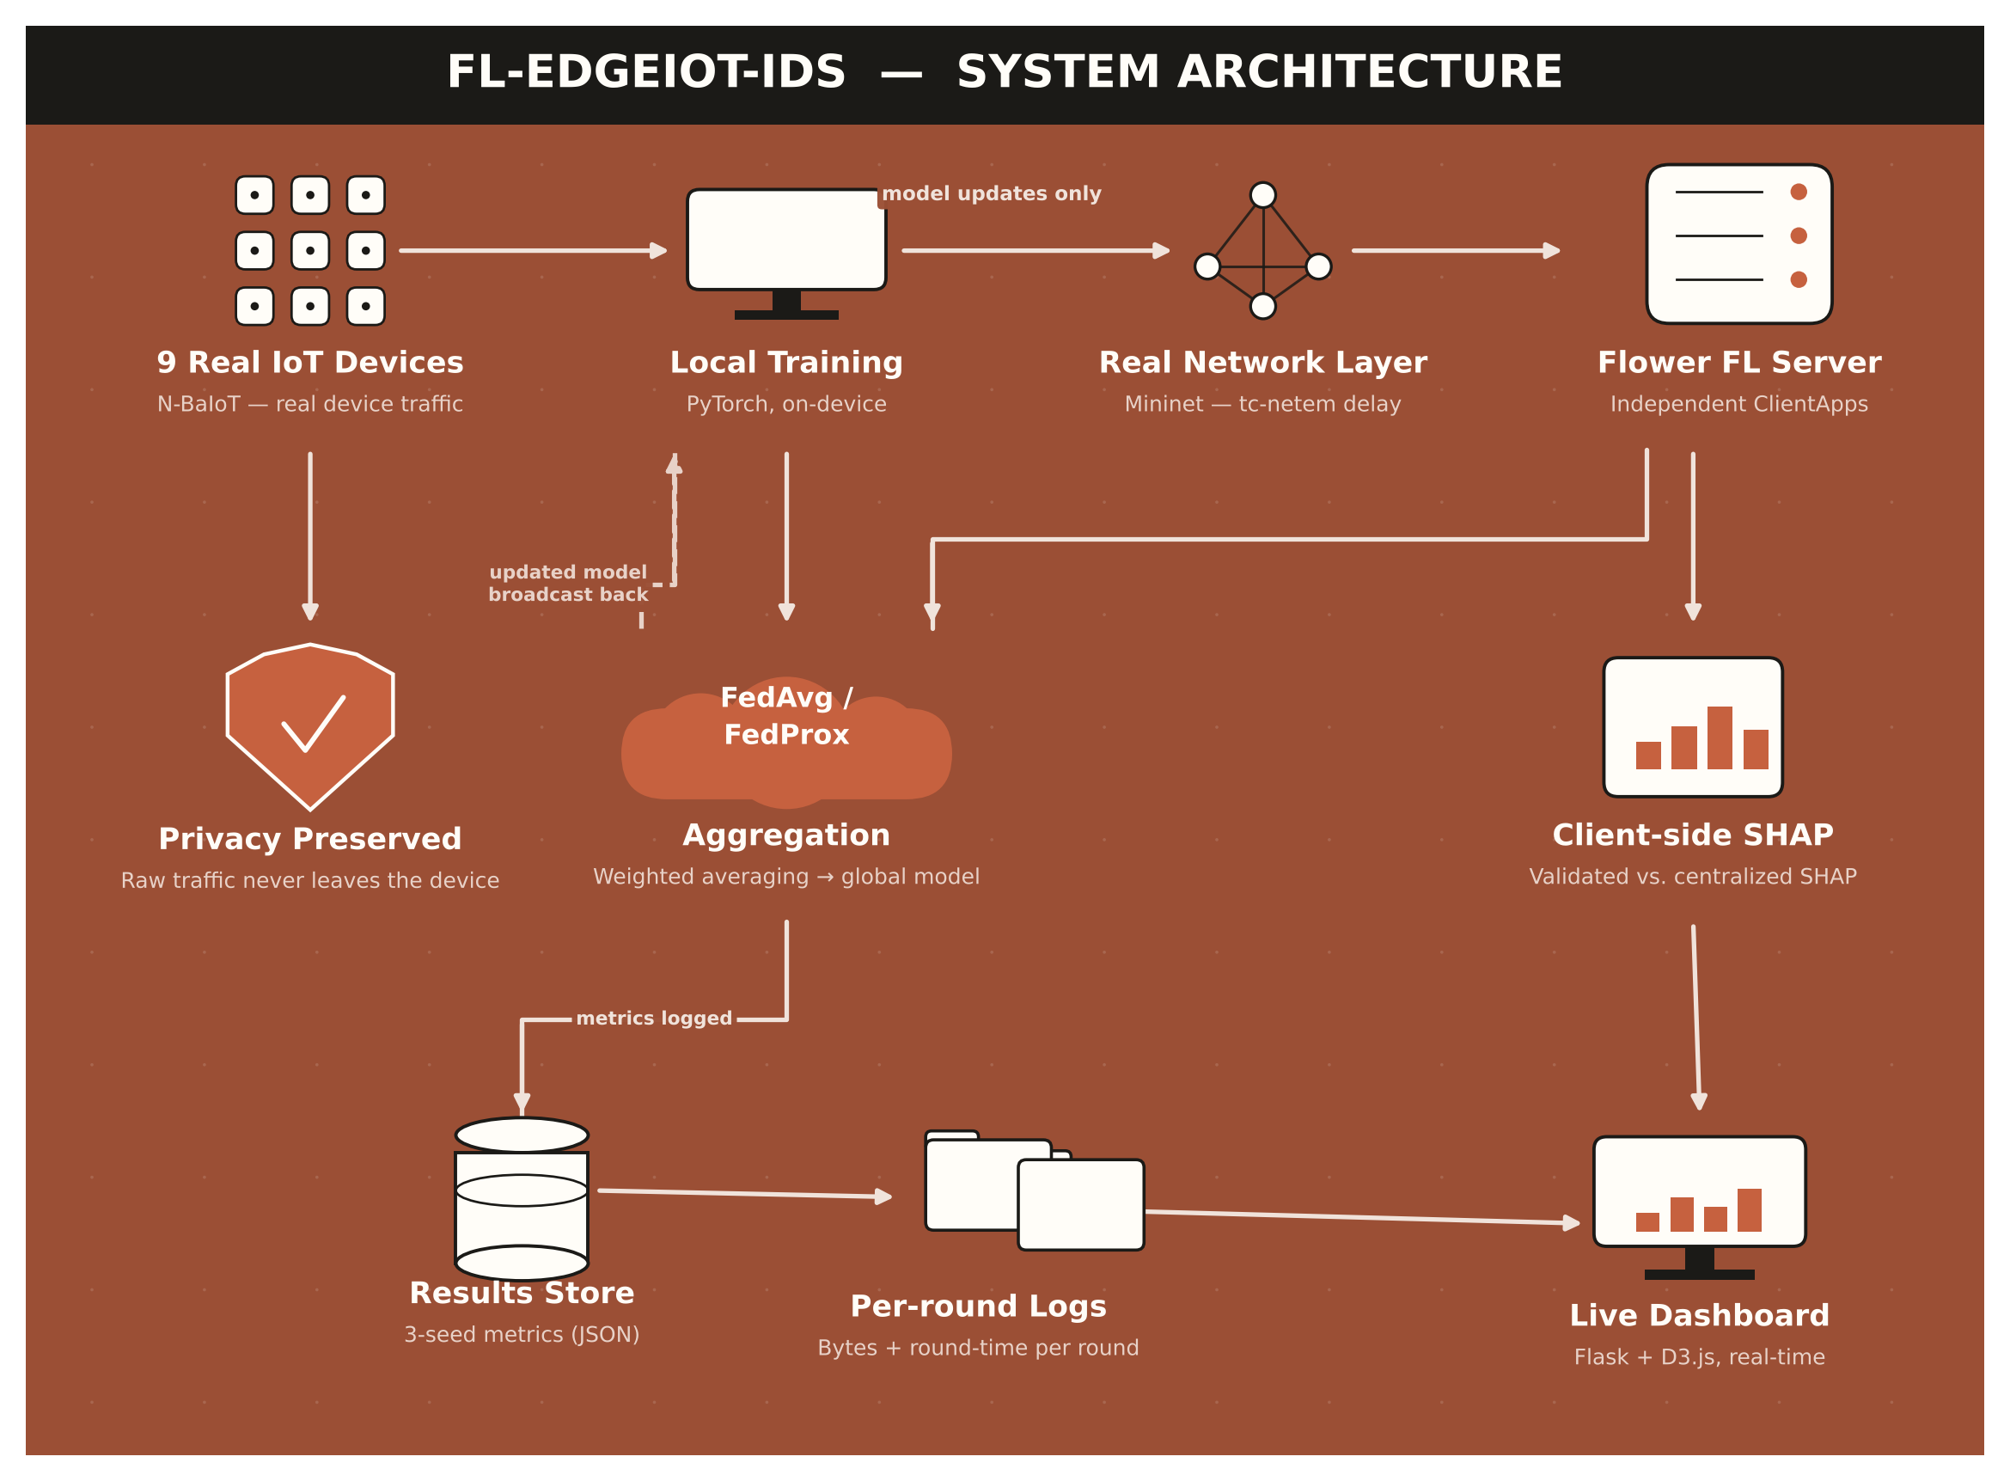

Slide 14
Datasets
N-BaIoT
TON_IoT
9 real IoT devices — doorbells, cameras, a baby monitor, a thermostat
115 packet-window features per record
11 classes: benign + Mirai & Gafgyt attack variants
Natural non-IID split — 1 device = 1 client, free of artificial partitioning
Realistic simulated network flow telemetry
45 flow-level features per record
10 classes: benign + multiple attack families incl. ransomware
No natural client split — partitioned via Dirichlet sampling (α ∈ {0.1, 0.5, 1.0}) across 9 clients

Slide 15
Tech Stack
PyTorch
Flower
SHAP / Captum
Models — MLP baseline & 1D-CNN-BiLSTM
Federated learning — FedAvg & FedProx
Client-side explainability
Mininet
scikit-learn
Flask + D3.js
Real network emulation — delay, bandwidth
Metrics, Dirichlet partitioning support
The local results dashboard you just saw

Slide 16
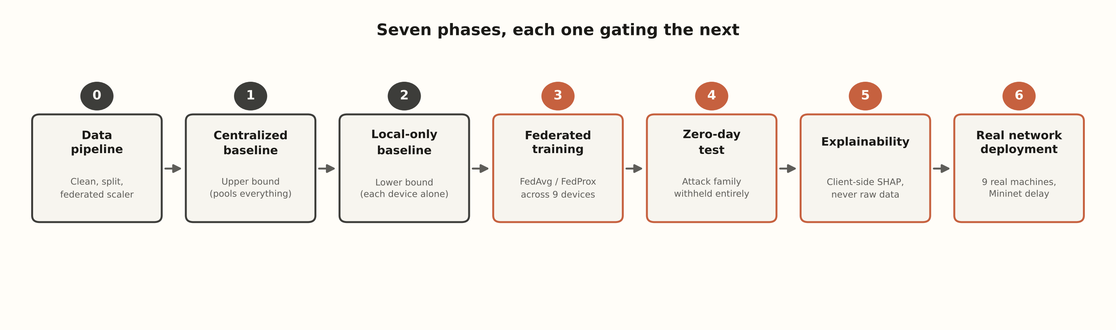
Methodology — Seven Phases
Each phase gates the next — a result is checked before the next phase starts
Vanilla-first: plain PyTorch data/model code, zero Flower imports, so the same code runs centralized, local-only, federated, or in Mininet with no rewrites

Slide 17
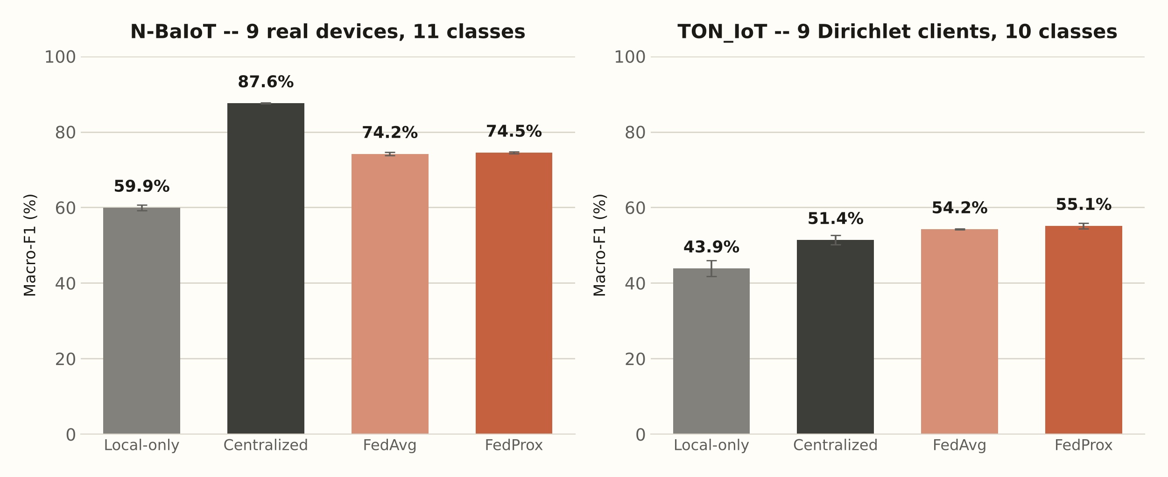
Results — Does Sharing Notes Actually Help?
On N-BaIoT, federated training reaches 74.5% macro-F1 — well above the 59.9% each device manages alone, closing most of the gap to the 87.6% centralized ceiling. Every bar is a mean over 3 random seeds; the spread was small and stable across all four approaches.

Slide 18
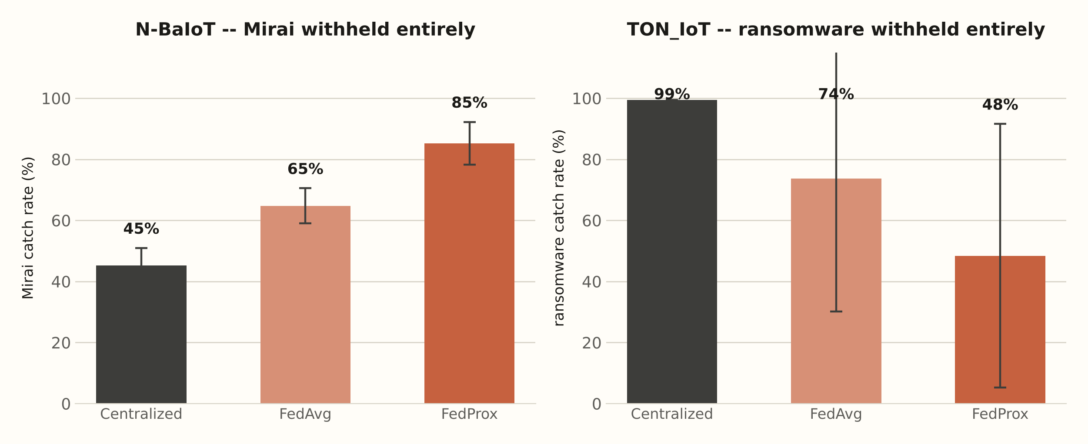
Results — Catching an Attack It Has Never Seen
N-BaIoT: federated FedProx catches 85% ± 7% of withheld Mirai traffic — beating even the centralized ceiling, stable across all 3 seeds. TON_IoT: the federated ransomware result swung wildly by seed (24%–98%) — reported honestly rather than picking the flattering run.

Slide 19
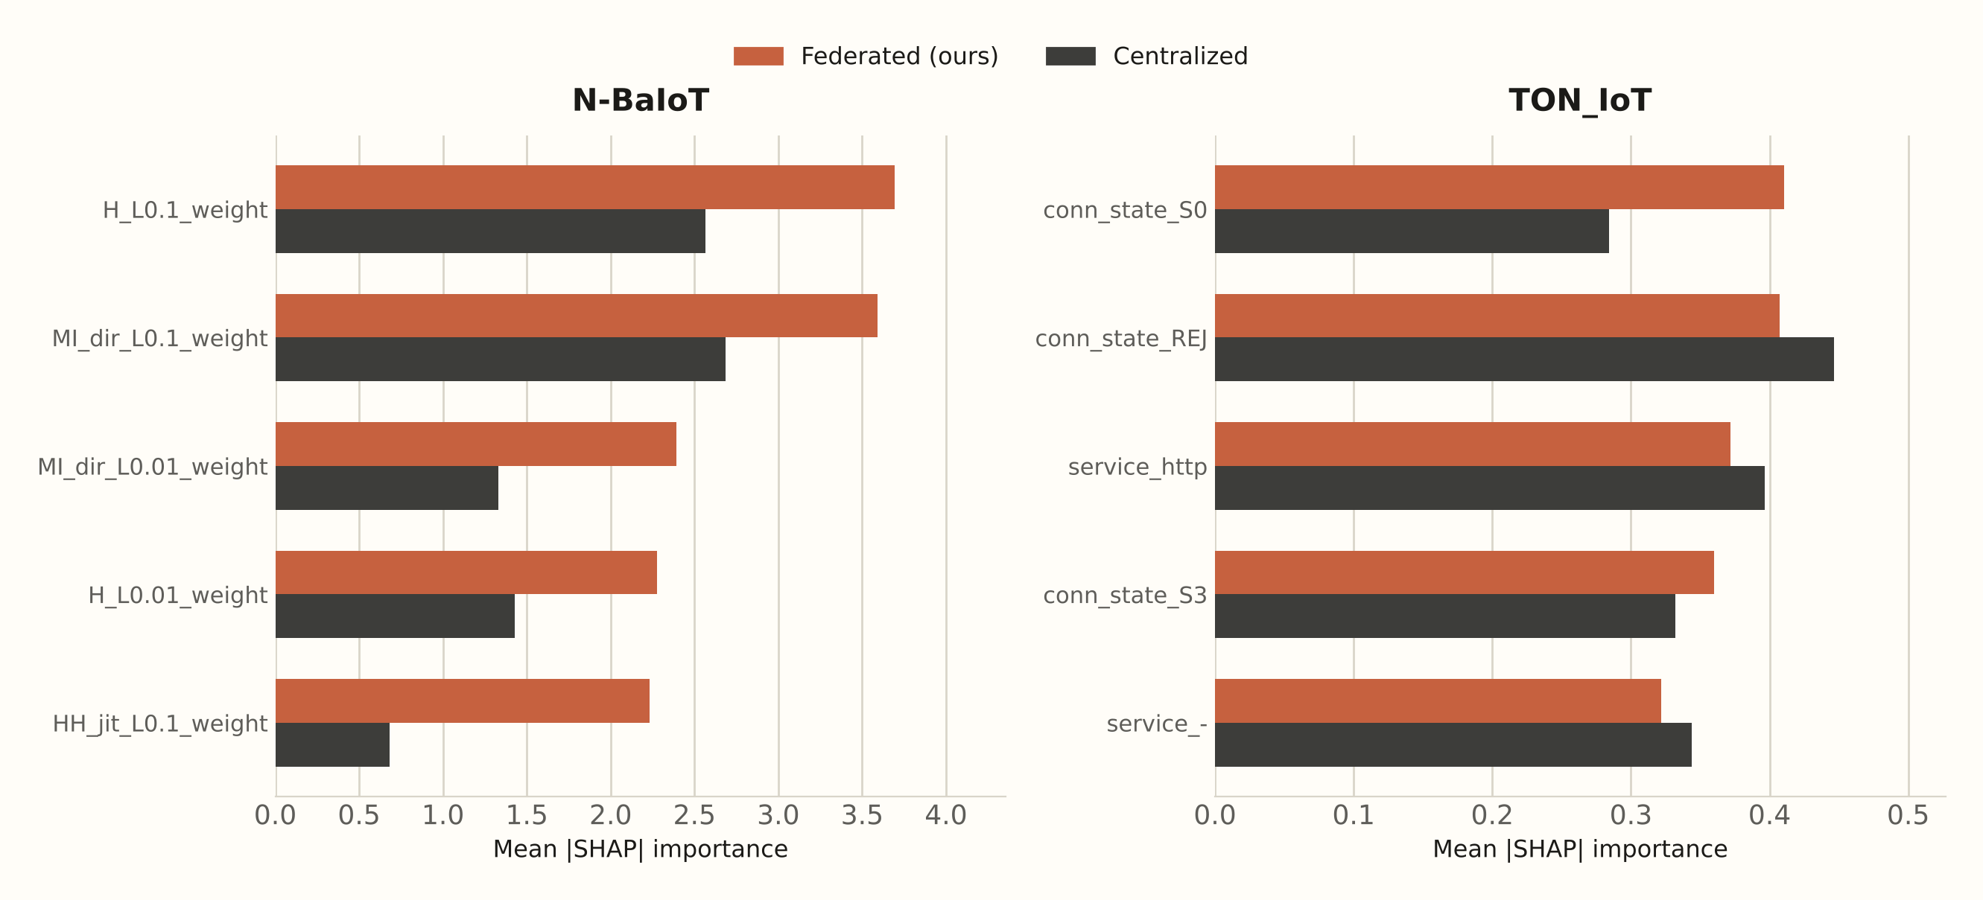
Results — Explainable, Not Just Accurate
ρ = 0.70
N-BaIoT agreement
p < 1e-17 (Spearman)
ρ = 0.90
TON_IoT agreement
p < 1e-22 (Spearman)
Each client explains its own decisions locally and uploads only an aggregate importance vector. Both agreement scores are strongly significant — the federated model keys off essentially the same signals as a model that saw all the data.

Slide 20
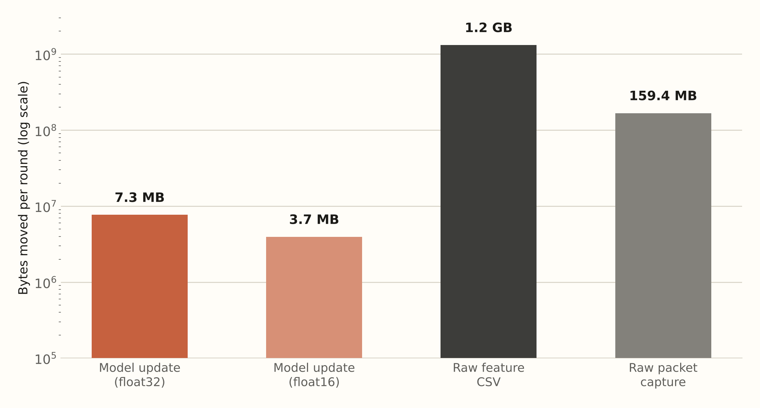
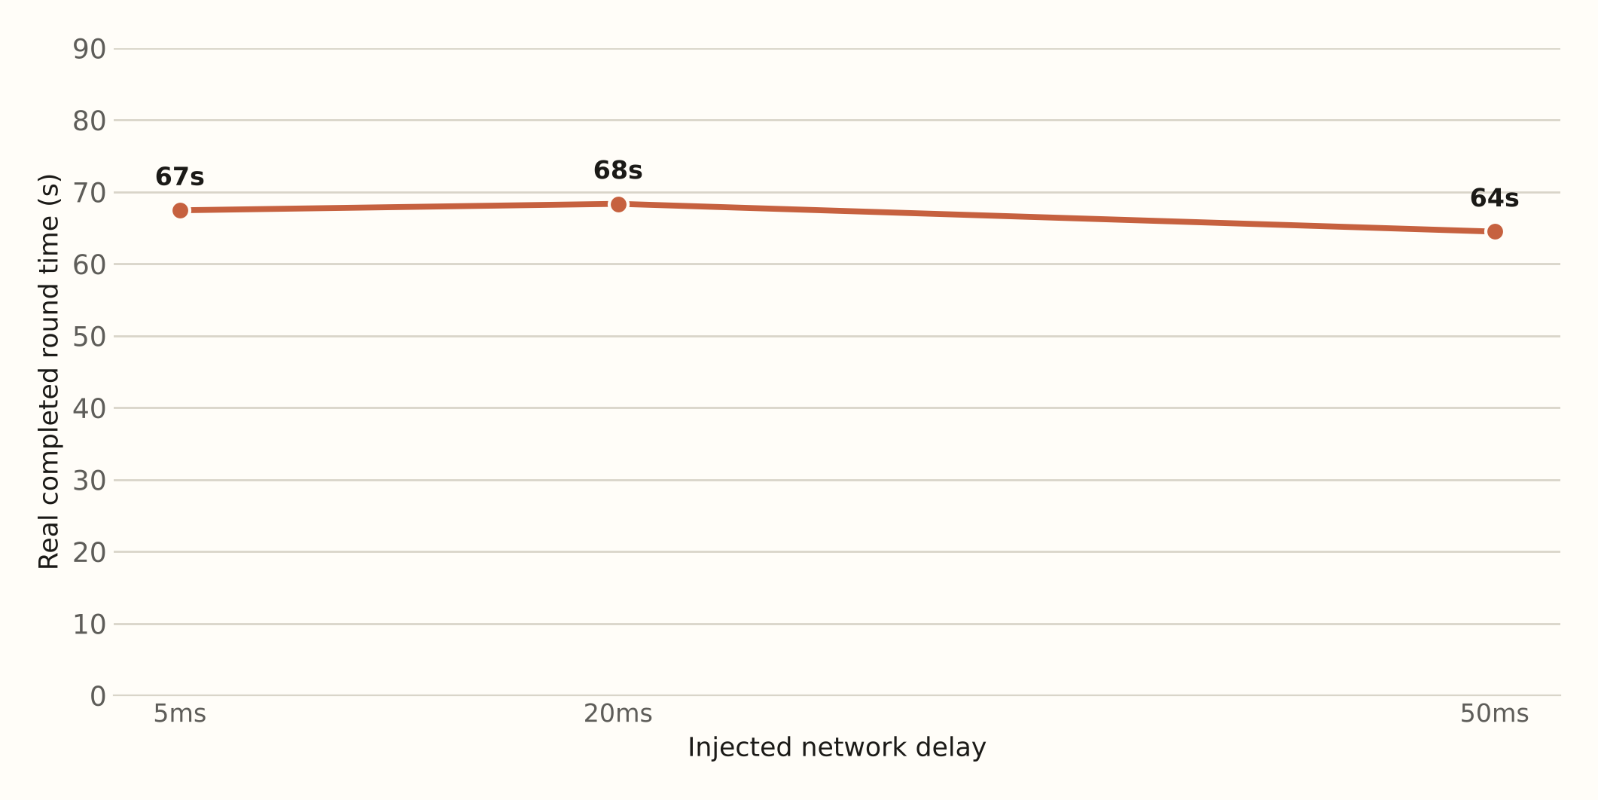
Results — Real Network Deployment
53.1%
53.1%
49%
9 real machines, real Flower deployment, real injected delay. Model updates are ~170× smaller than raw features; round time stays flat as delay rises — this rig is compute-bound, not network-bound.
macro-F1, float32
macro-F1, float16
smaller payload
no accuracy lost
free bandwidth win

Slide 21
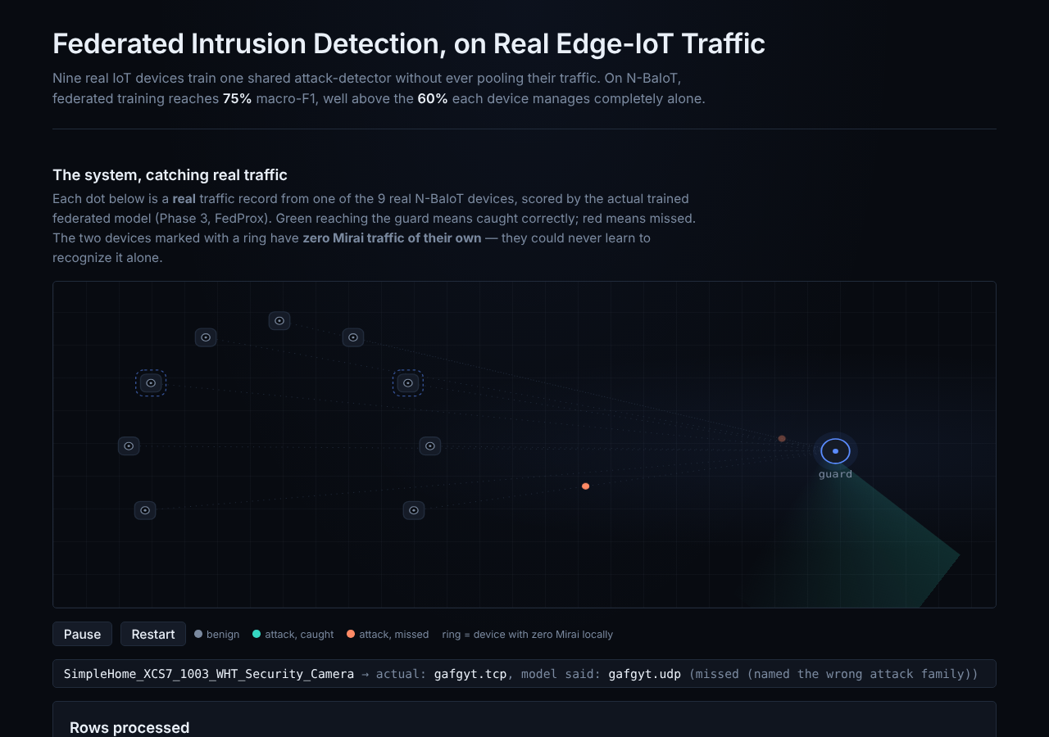
Live Demo — The Local Dashboard
Every dot is a real recorded traffic row from the 9 real N-BaIoT devices
Scored live by the actual trained federated model
Teal = attack caught, coral = attack misnamed (never let through as benign)
Dashed ring = a device with zero Mirai of its own — yet still protected
Runs locally — Flask + D3.js, no internet required

Slide 22
Key Findings, at a Glance
74.5%
85% ± 7%
ρ = 0.70 / 0.90
federated macro-F1
zero-day Mirai catch
explainability agreement
vs. 59.9% alone (N-BaIoT)
beats the centralized ceiling
vs. ground-truth SHAP
170× smaller
0% accuracy lost
3 seeds
bandwidth per round
float16 compression
every headline number
model update vs. raw features
49% smaller payload
mean ± std, not cherry-picked

Slide 23
Honest Limitations
TON_IoT zero-day volatility — the federated ransomware catch-rate swung from 24% to 98% by seed; in-distribution accuracy stayed stable throughout, only unseen-class generalization is volatile
Compute-bound test rig — round time staying flat under 5–50ms delay reflects a 2-CPU-core test rig, not a universal claim that federated learning is always network-insensitive
Scope cut — Phase 7 stretch goals (differential privacy, poisoning defenses, 6G extensions) were explicitly out of scope for this pass
SHAP & Mininet results are diagnostic, not reseeded — explainability and systems numbers are single-run by design (they're expensive to repeat and not the headline accuracy claims)

Slide 24
Conclusion & Future Work
Conclusion
Future Work
Federated learning closes most of the gap to a privacy-violating centralized model, with real numbers on real traffic
It can catch attacks a device has never personally seen — the project's central, non-obvious result
It's explainable, not a black box — reasoning matches a model that saw everything
It's practical — proven on real machines, over a real network, with real bandwidth savings
Differential privacy on top of FedAvg/FedProx aggregation
Defenses against a malicious client poisoning the shared model
Stabilizing zero-day generalization on TON_IoT (the honest open problem from this pass)
Windowed-sequence inputs instead of per-record (Phase 7 stretch, scoped out here)

Slide 25
References
[1] Rey, V. et al. “Federated Learning for Malware Detection in IoT Devices.” arXiv:2104.09994, 2021.
[2] “A Lightweight Federated Learning Approach for Privacy-Preserving Botnet Detection in IoT.” arXiv:2510.03513, 2025.
[3] Chen, et al. “An Efficient Federated Learning Framework for IoT Intrusion Detection” (FedKD-Prox). IEEE, 2024.
[4] Izadi, et al. “Mist-Assisted Federated Learning for Intrusion Detection in Heterogeneous IoT Networks.” arXiv:2511.00271, 2025.
[5] “Explainable Federated Learning for Botnet Detection in IoT Networks.” IEEE CSR, 2024.
[6] “FedShield-IDS.” Scientific Reports, 2026.
[7] “XAI FL-IDS.” arXiv:2605.19448, 2026.
[8] Kalakoti, R. “FedXAI.” PhD thesis, TalTech, 2025.
[9] “FLEET: A Federated Learning Emulation and Evaluation Testbed.” arXiv:2509.00621, 2025.
[10] Rezaei, et al. “A Survey on Security and Privacy in Federated Learning-Based Intrusion Detection Systems for 5G and Beyond Networks.” IEEE OJCOMS, 2025.
[11] Vyas, Lin & Hwang. “Privacy-Preserving Federated Learning for Intrusion Detection in IoT Environments: A Survey.” IEEE Access, 2024.

Slide 26
Thank You
Questions welcome
Sparsh Y Bhagwat · Tanya Singh · Adithya Santosh

