Slide 1

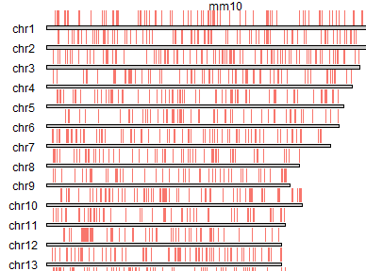
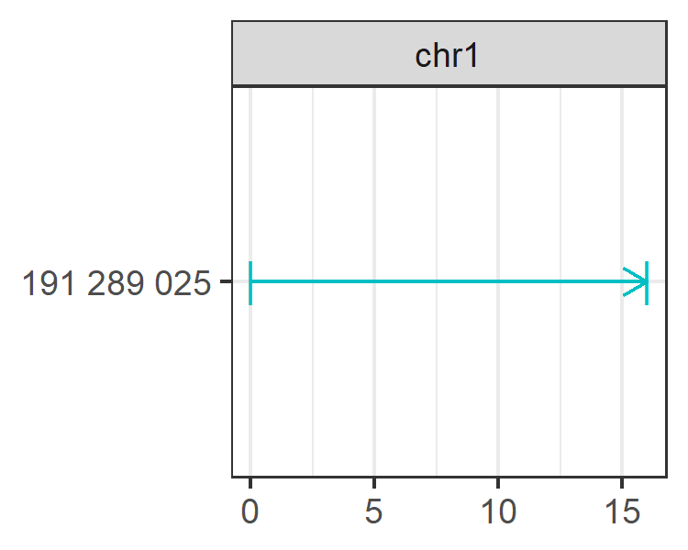
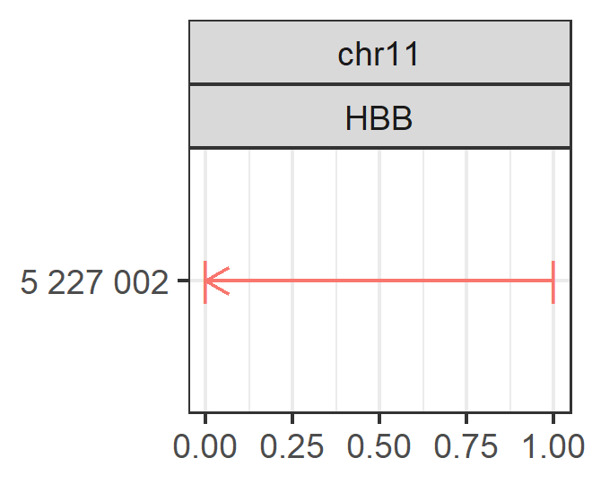
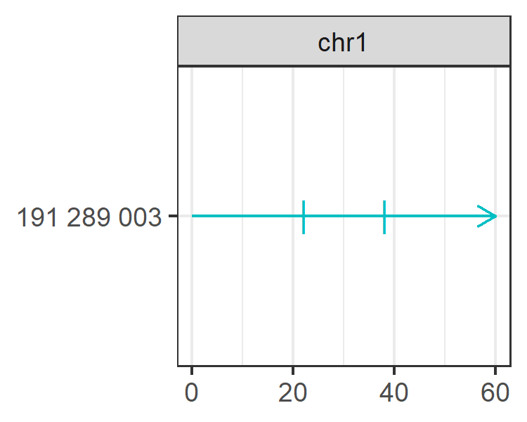
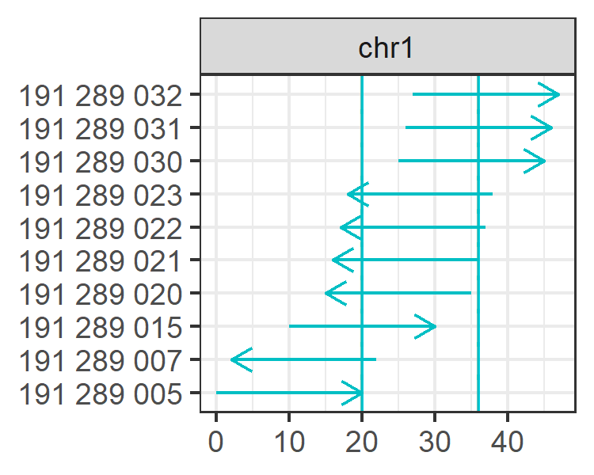
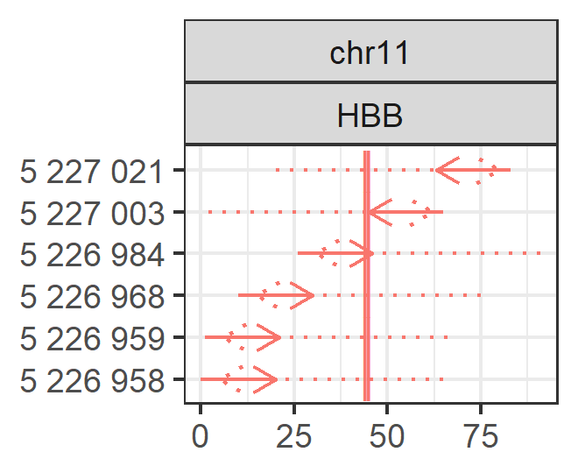
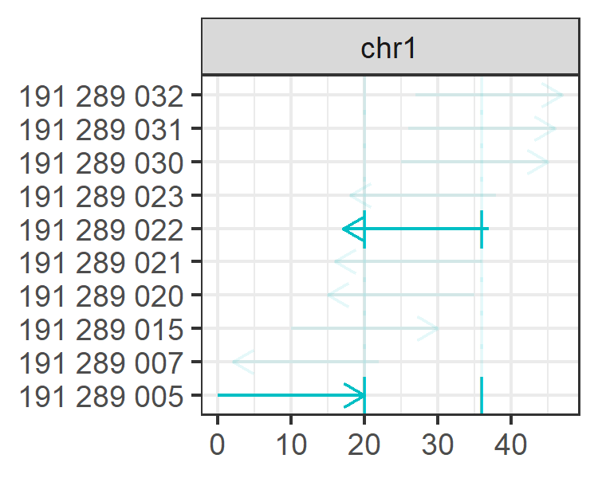
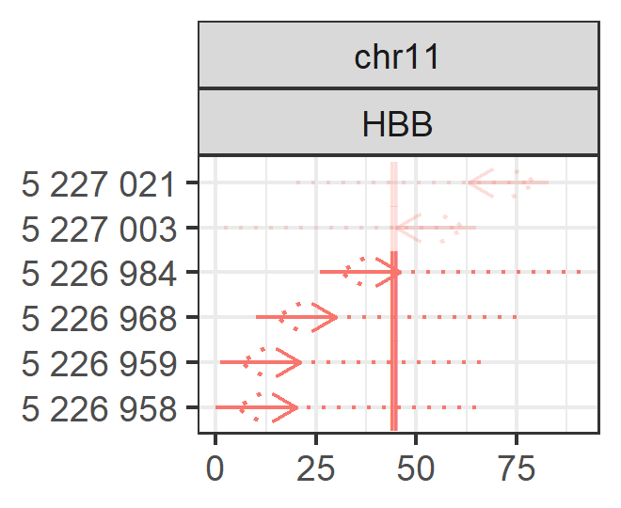
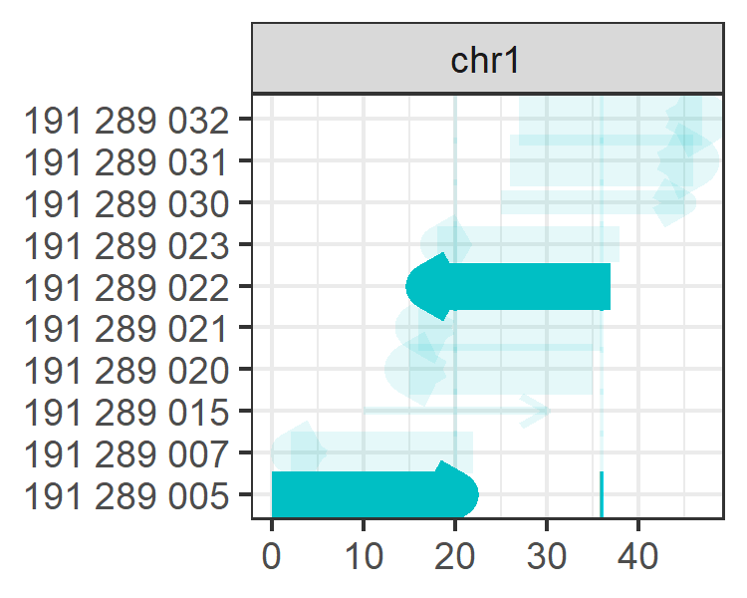
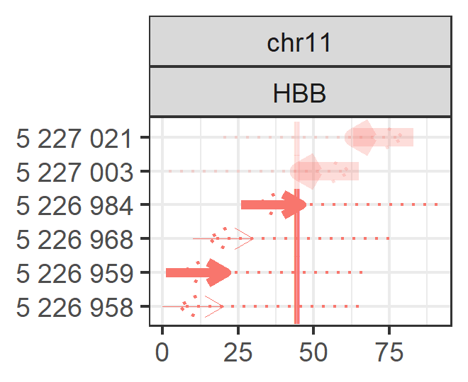
Parallel Targeting
of SRF binding sites
Prime Editing
the sickle cell locus
DEFINE TARGETS
bed_to_granges
genes_to_granges
genefile_to_granges
char_to_granges
TRANSFORM
extend
up_flank
down_flank
double_flank
FIND SPACERS
find_spacers
find_pe_spacers
ADD OFFTARGETS
add_offtargets
ADD EFFICIENCY
add_efficiency
ranges
chr1:191…032-191…051:+
chr1:191…007-191…026:-
targetranges
chr1:191…025-191…040
chr1:191…025-191…040
spacer
AGA…CAG
CAC…GTG
pam
GGG
AGG
T0 T1 G0 G1 G2
1 0 1 0 0
1 0 1 0 0
Doench2016
0.65
0.65
DEFINE TARGETS
ranges
chr11:5226984-5227003:+
chr11:5226959-5226978:+
targetranges
5227002
5227002
spacer
primer
revtranscript
G0
1
1
Doench2016
0.61
0.52
pam
CCACGTTCACCTTGCCCCACAGGGCAG... TGG
GTAACCGGCAGACTTCTCCTCAGGAGTA…AAC

Slide 2
ADD OFFTARGETS
add_offtargets

