Slide 1
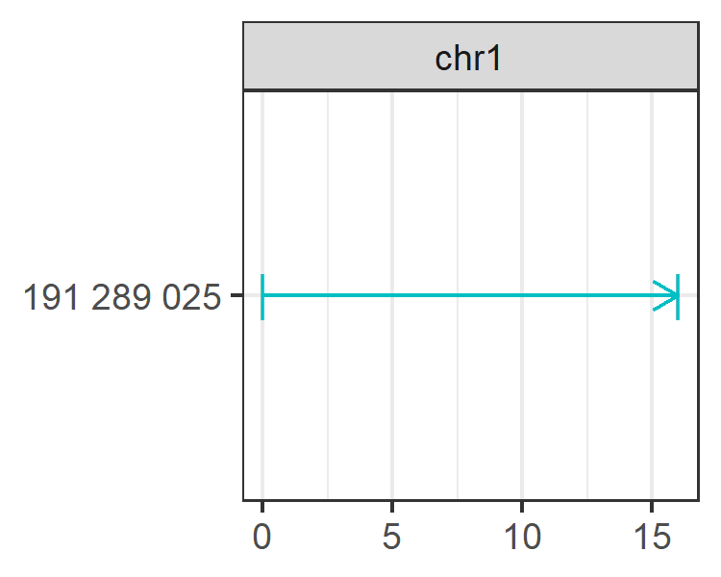
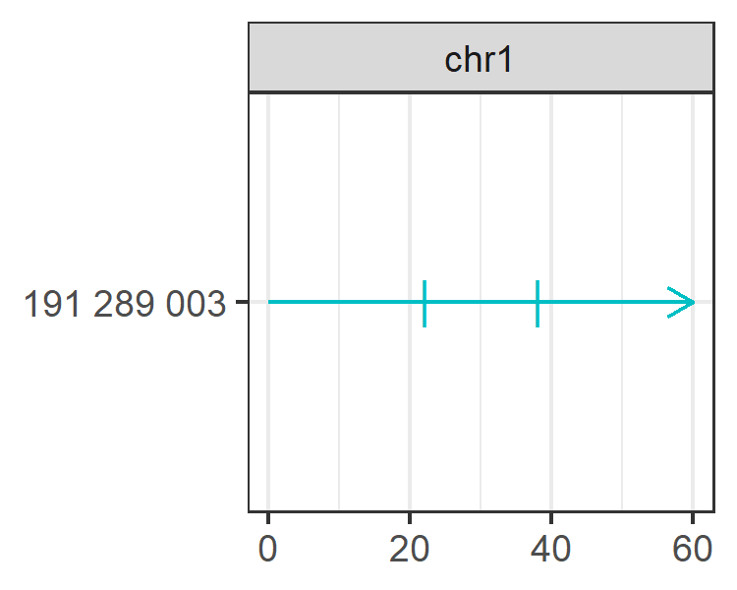
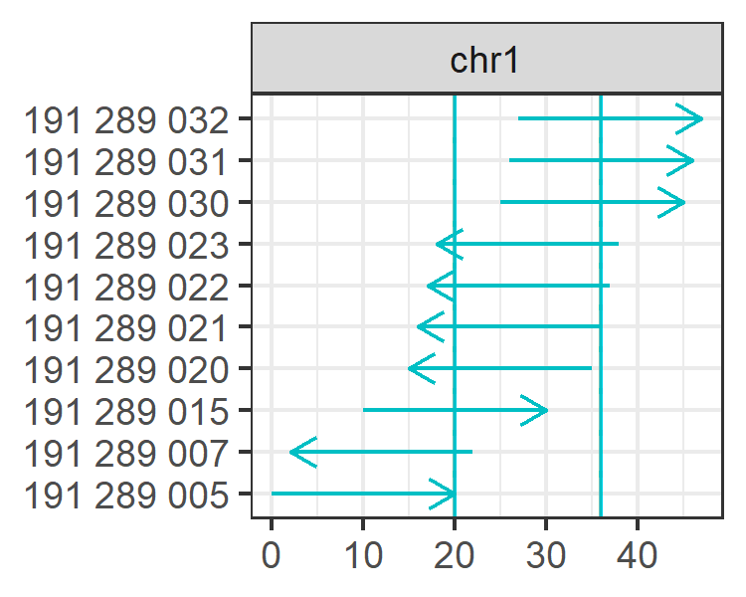
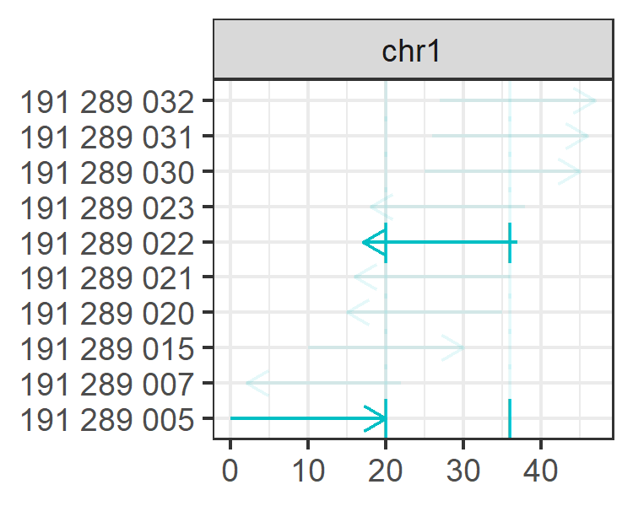
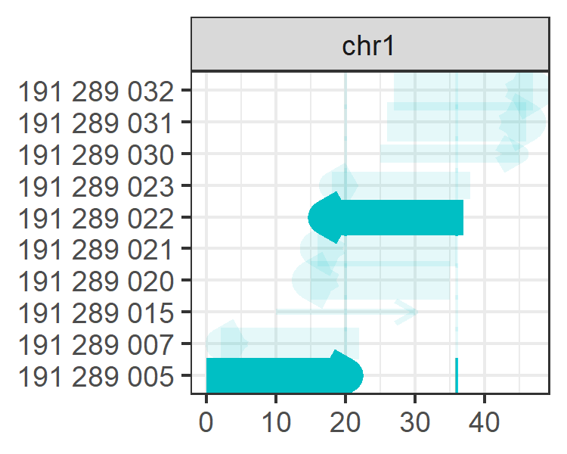
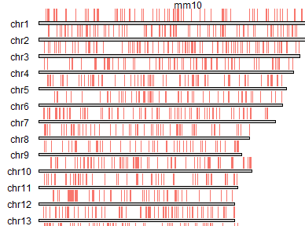

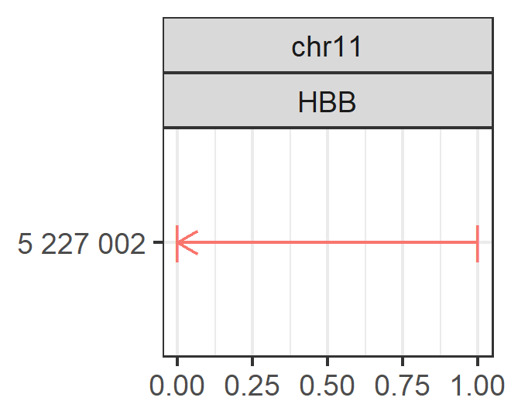
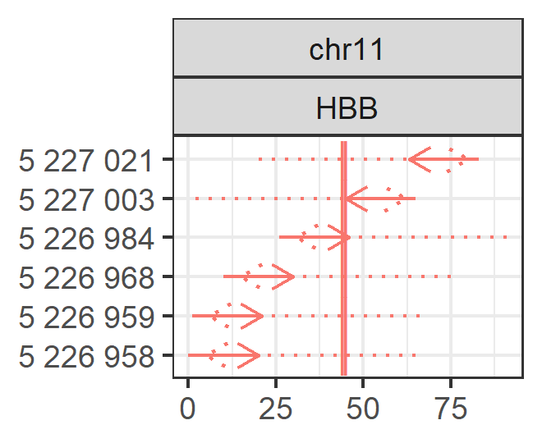
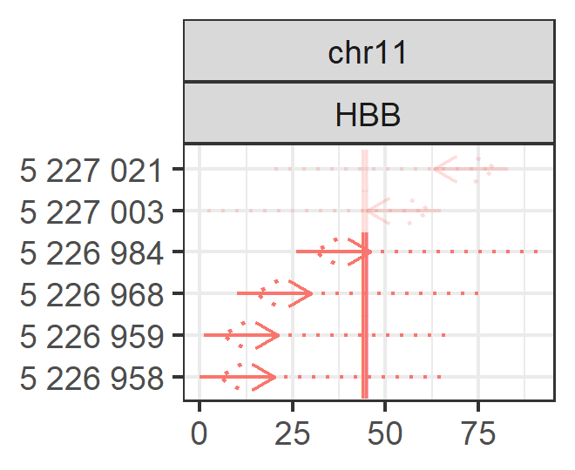
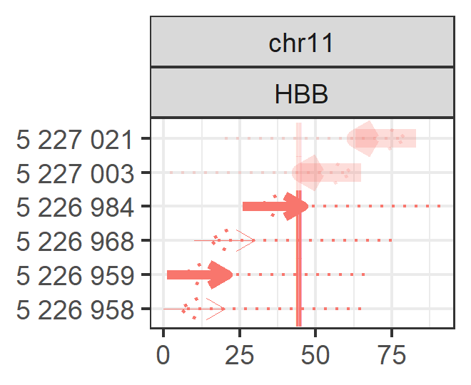
seqnames
chr1
chr1
ranges
191289032-191289051
191289007-191289026
strand
+
-
targetranges
191289025-191289040
191289025-191289040
spacer
AGATGGACAGAAAGCAACAG
CACCAGGGGGCGCTATTGTG
pam
GGG
AGG
T0 T1 T2 G0 G1 G2
1 0 0 1 0 0
1 0 0 1 0 0
Doench2016
0.65
0.65
Parallel
Targeting
bed_to_granges()
genes_to_granges()
genefile_to_granges()
char_to_granges()
extend()
up_flank()
down_flank()
double_flank()
find_spacers()
find_pe_spacers()
add_specificity()
add_genome_counts()
add_efficiency()
DEFINE TARGETS
TRANSFORM
FIND SPACERS
ADD SPECIFICITY
ADD EFFICIENCY
Prime
Editing
seqnames
chr11
chr11
ranges
5226984-5227003
5226959-5226978
strand
+
+
targetranges
5227002
5227002
spacer
primer
pam
reversetranscript
G0
1
1
Doench2016
0.61
0.52
CCACGTTCACCTTGCCCCACAGGGCAGTAACGGCAGACTTCTCCTCAGGAGTCAGATGCACCATGG
GTAACCGGCAGACTTCTCCTCAGGAGTCAGATGCACCATGGTGTCTGTTTGAGGTTGCTAGTGAAC

