Slide 1


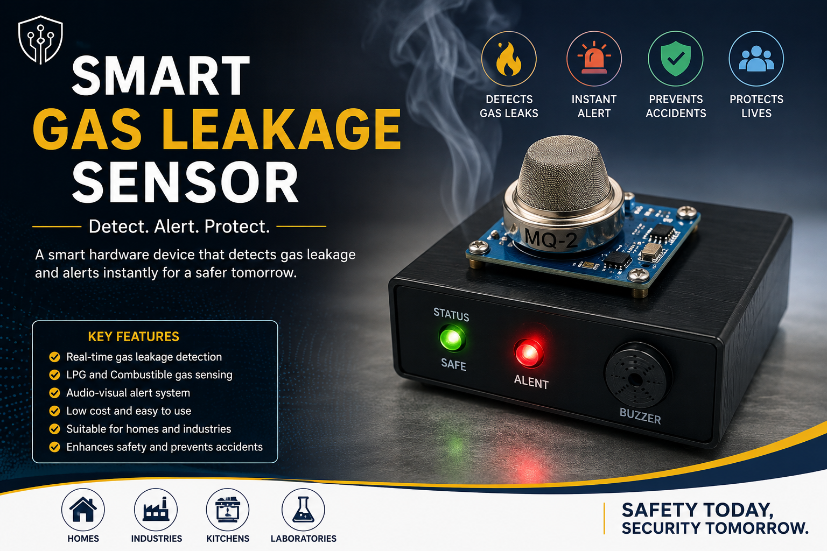
INNOVATION AND DESIGN THINKING LAB(1BIDTL158)
Problem Statement Title-Smart Gas Leakage Sensor
Theme- MedTech/BioTech/HealthTech
PS Category-Hardware
Team ID- 55
Team Name – IDEATEX
Team Member- 6
TEAM MEMBERS:
ANU RAKESH PATIL
BHAGYA
BHAVANA M V
BHUVAN REDDY
DHARSHAN R
HARSHITHA .A

Slide 2




IDEATEX
PROPOSED SOLUTION
PROBLEM
SOLUTION
WHY IT MATTERS?
Gas leakage from LPG cylinders and pipelines can lead to fire accidents, explosions, and health hazards.
Develop a Smart Gas Leakage Sensor using an MQ-series gas sensor and microcontroller.
Prevents fire accidents and explosions.
Many households and industries cannot detect gas leaks immediately.
Continuously monitor the concentration of LPG and combustible gases.
Protects human life and property.
Provides early detection of hazardous gas leaks.
Existing safety measures often rely on human observation, causing delays.
Detect gas leaks instantly when gas levels exceed the safe threshold.
Improves safety in homes, industries, laboratories, and commercial kitchens.
Offers a low-cost and reliable safety solution.
Lack of an early warning system increases the risk of property damage and loss of life.
Activate a buzzer and LED alert system for immediate warning.

Slide 3




IDEATEX
METHODOLOGY AND IMPLEMENTATION
Our initial idea was to create a hardware-based safety device that:
Detects LPG gas leakage instantly.
Alerts users through sound and light indicators.
Operates continuously with minimal maintenance.
Is affordable and easy to install.
Based on feedback, we improved our design by:
Using an MQ-2 gas sensor for leak detection.
Integrating a microcontroller for processing sensor data.
Adding a buzzer for audible alerts.
Adding LEDs for visual alerts.
Optimizing sensitivity for reliable detection.
User Feedback
Concept Refinement
Final Idea
Brainstorm
After discussing with users and observing common safety concerns:
Many people cannot detect gas leaks at an early stage.
Gas leakage accidents often occur due to delayed detection.
Users preferred a simple and automatic warning system.
Households need an affordable safety device.
A Smart Gas Leakage Sensor that:
Continuously monitors gas concentration.
Detects LPG leakage in real time.
Activates buzzer and LED alarms automatically.
Provides a quick and effective safety warning system.

Slide 4
IDEATEX
FEASIBILITY AND VIABILITY
Research
Prototyping
Final Build
Studied common causes of LPG gas leakage in homes and industries. Analyzed accident reports related to gas explosions and fire hazards. Researched various gas sensing technologies and their performance. Compared different gas sensors based on sensitivity, cost, and reliability. Reviewed safety standards and gas leakage prevention methods. Examined existing commercial gas detectors and their limitations.
Integrated MQ-2 gas sensor with Arduino/ESP32 microcontroller. Connected buzzer and LED indicators for alert generation. Developed circuit connections and tested sensor responses. Conducted calibration for accurate gas detection. Evaluated sensor performance under different gas concentrations. Verified real-time detection capability.
Fully functional hardware prototype completed. Successfully detects LPG gas leakage. Generates instant audio and visual alerts. Demonstrates practical real-world application. Scalable for future enhancements. Ready for further deployment and testing.
Ideation
Feedback & Revisions
Brainstormed multiple safety solutions for gas leak detection. Focused on creating a low-cost and efficient hardware system. Selected components that are easily available in the market. Designed a compact and user-friendly prototype. Prioritized real-time detection and instant alert mechanisms. Ensured the design can be used in both domestic and industrial environments.
Gathered suggestions from faculty and peers. Improved sensor placement for better detection. Enhanced alert visibility using high-intensity LEDs. Optimized buzzer volume for effective warning. Simplified wiring and circuit layout. Improved overall system reliability

Slide 5
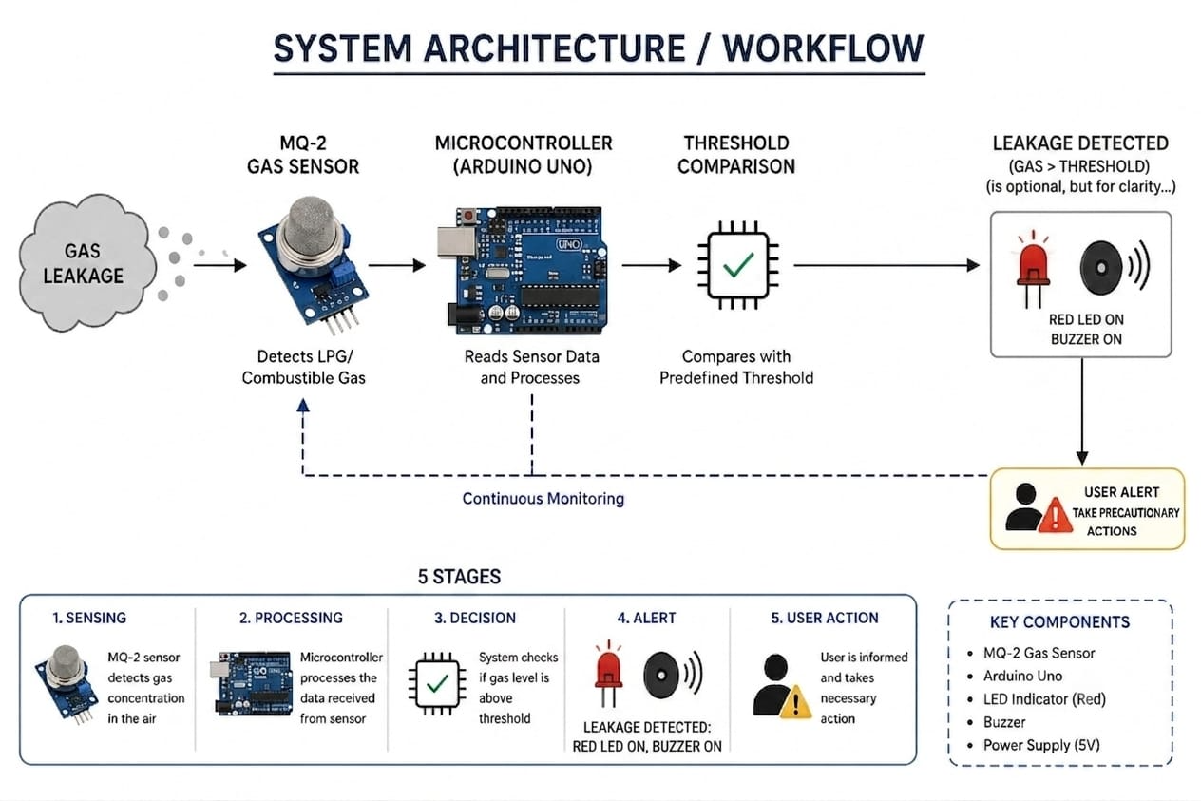
IDEATEX
SYSTEM ARCHITECTURE / WORKFLOW
1.MQ-2 sensor continuously monitors gas levels.
2.Sensor detects LPG and combustible gases. 3.Sensor data is sent to the Arduino/ESP32. 4.Microcontroller processes the sensor readings.
5.Gas concentration is compared with threshold values.
6.Safe condition → Green LED remains ON. 7.Leakage detected → Red LED turns ON. 8.Buzzer activates to alert users immediately. 9.User takes preventive safety measures.
10.System continues monitoring until gas levels return to normal.

Slide 6
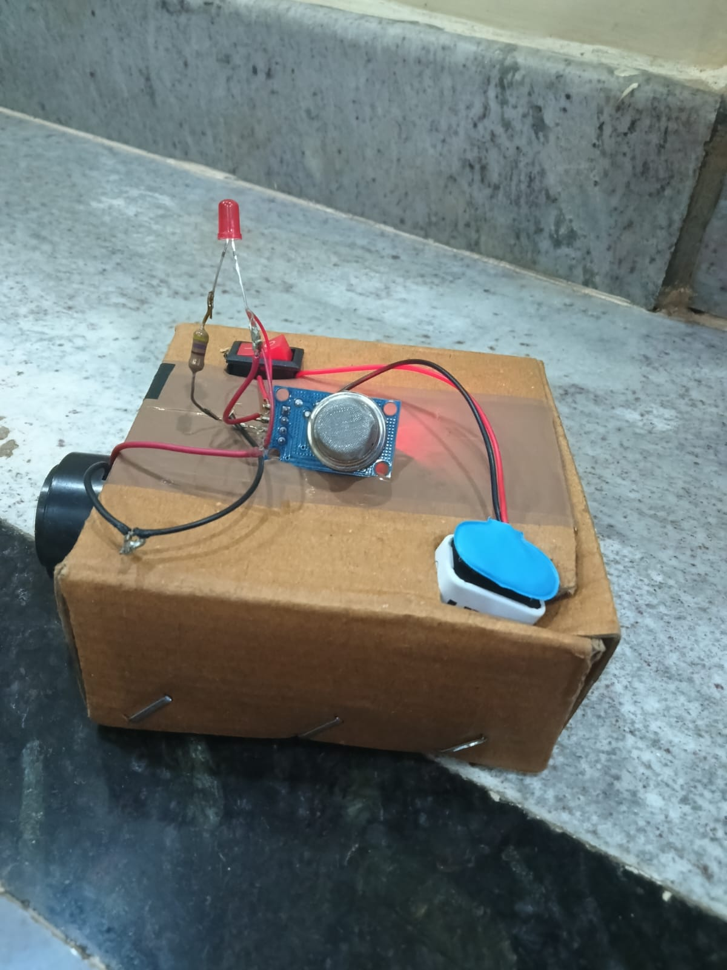
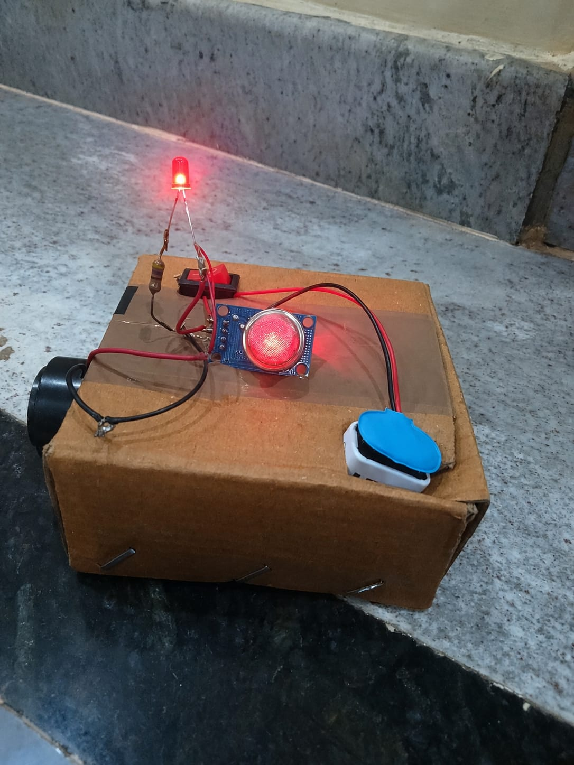
IDEATEX
WORKING PROTOTYPE AND SYSTEM OUTPUT
Normal Condition
Gas concentration below threshold.
Green LED remains ON.
Buzzer remains OFF.
Leakage Condition
Gas concentration exceeds threshold.
Red LED turns ON.
Buzzer sounds immediately.
User is alerted to potential danger.

Slide 7
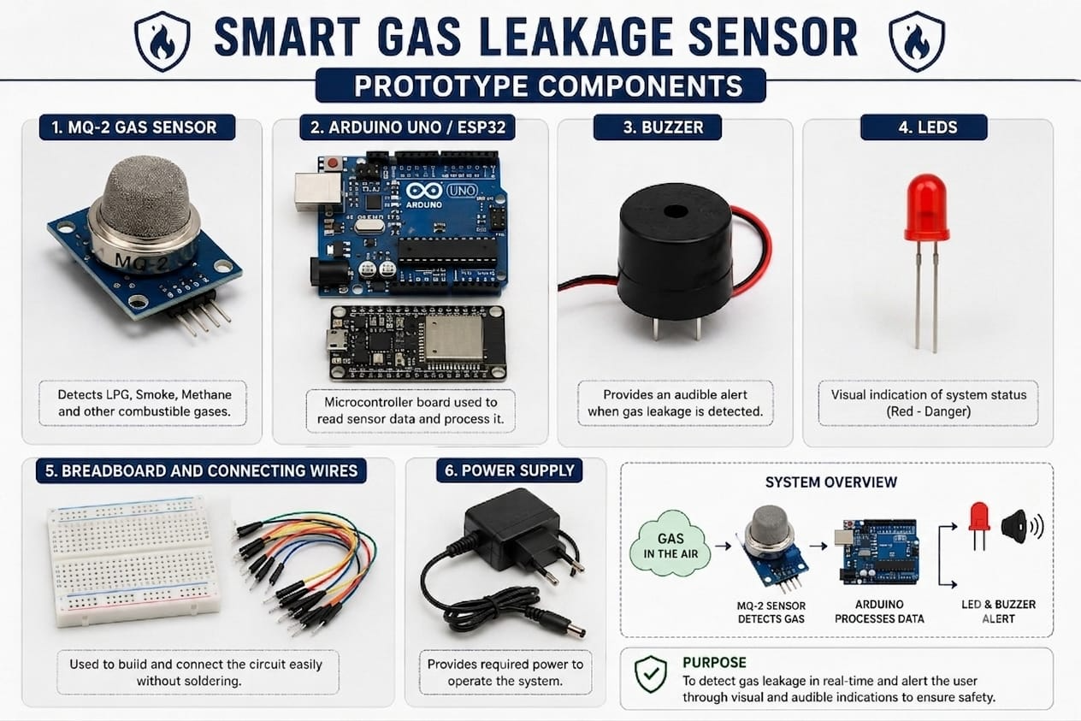
IDEATEX
WORKING PROTOTYPE AND SYSTEM OUTPUT
Prototype Components
MQ-2 Gas Sensor
Arduino Uno / ESP32
Buzzer
LEDs
Breadboard and Connecting Wires
Power Supply

Slide 8
IDEATEX
IMPACT AND BENEFITS
🌍 Impact
Enhances public safety and accident prevention.
Reduces risk of fire outbreaks and explosions.
Protects lives in residential and industrial environments.
Promotes awareness about gas safety practices.
Encourages adoption of smart safety technologies.
Supports safer workplaces and homes.
Minimizes property damage caused by gas leaks.
Contributes to a safer and more secure community.
✅ Benefits
Detects gas leakage in real time.
Provides immediate audio and visual alerts.
Low-cost and easy-to-implement solution.
Requires minimal maintenance.
Compact and portable design.
Operates continuously for 24/7 monitoring.
Easy installation in homes, hotels, and industries.
Reduces emergency response time.

Slide 9
Integration with GSM module for SMS and call alerts during gas leakage.
Development of a mobile application for remote monitoring.
IoT-based real-time monitoring through cloud platforms.
Automatic gas regulator shut-off system to prevent accidents.
Support for detecting multiple gases such as LPG, methane, and carbon monoxide.
Battery backup for uninterrupted operation during power failures.
Integration with smart home automation systems.
Addition of LCD/OLED display for live gas concentration monitoring
Enhanced sensor accuracy using advanced gas sensing technologies.
Deployment in industries, laboratories, hotels, and commercial kitchens.
Voice-based warning system for improved user awareness.
AI-based prediction and analysis of potential gas leakage risks.
IDEATEX
FUTURE SCOPE

Slide 10


IDEATEX
SDG GOALS
SDG 3:GOOD HEALTH AND WELL-BEING
SDG 9 – Industry, Innovation and Infrastructure

Slide 11
IDEATEX
RESEARCH AND REFERENCES
Arduino Official Documentation
https://www.arduino.cc
MQ-2 Gas Sensor Datasheet
Technical specifications and working principles of MQ-2 gas sensors used for LPG, methane, and smoke detection.
National Fire Protection Association (NFPA)
https://www.nfpa.org
Fire safety standards and gas leakage prevention guidelines.
Occupational Safety and Health Administration (OSHA)
https://www.osha.gov
Workplace safety standards related to hazardous gases.

Slide 12
THANK YOU

