Slide 1
Agentic AI – Module 1 - Review
Wells Fargo Premier logo
Updated December 2025
© 2025 Wells Fargo Bank, N.A.

Slide 2
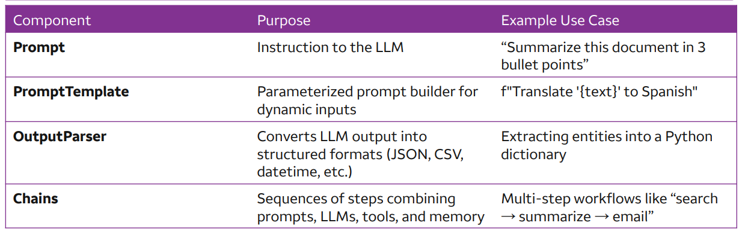
LangChain
OpenSource Framework to develop application powered by LLM’s
Makes the LLM Data Aware & Agentic(make decisions)
Components of LangChain
-
Why LangChain
Part of OPL Stack( OpenAI, PineCone, LangChain )
Interest in GenerativeAI
Time Savings for Development
Demo on invoking LLM using Langchain & Without
LangChain Schema
AI Message
System Message
Human Message

Slide 3
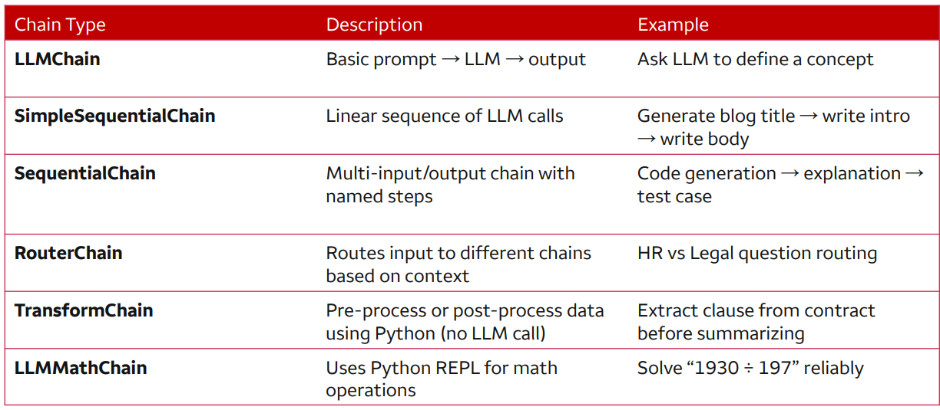
LangChain
Model Response
Index
Role
Content
Prompt Tokens
Completion Tokens
Output Parser
Memory Types
Conversation Buffer – Simple & Stores all items until token limit is exceeded.
Conversation Buffer Window – Control of number of threads stored.
Conversation Token Buffer – Limit is based on number of tokens
Conversation Summary - Summarized information stored
Chain – Take content from one LLM call & use it for another.

Slide 4
LangChain Expression Language ( LCEL )
Backbone for LangChain Framework
Uses the pipe ‘|’ operator to define data flow ( left to right )
Components
Prompt Template
Model
Output Parser
Piping is achieved due to the implementation of “Runnable” interface
Output of one component’s “invoke()” is passed as input to another
Essential Runnable Classes
Runnable PassThrough –> No data modification ; Output is same as Input ; usually combined with other Runnables
Runnable Lambda -> Allows wrapping custom Python functions & share the “Runnable” interface.
Runnable Parallel -> Two or more tasks run using the same initial input & facilitating branching away from input. -> For eg, one might transform data & another might pass through.
Advanced Composition Techniques
Nested Chains -> Running multiple sub-chains in parallel )
Adding Keys on-the –fly -> Specifically useful when building context progressively
Chain Combination -> Combining multiple chains using the pipe operator

Slide 5
HandsOn - Review
Langchain_openai.ipynb
Prompt_templates.ipynb
Lcel.ipynb
Output_parser.ipynb
Sequential_chain.ipynb

Slide 6
Next Step - Module 1 Self Learning
Memory & State | https://www.youtube.com/watch?v=SsZO2Q9LWCo
RAG | https://www.youtube.com/watch?v=ea2W8IogX80
 | https://www.youtube.com/watch?v=38aMTXY2usU
Note – Reference hands-on Python code will be made available via a personal Google Drive. Please avoid bringing that to Wells Fargo Network

