Slide 1
Agentic AI – Module 3 - Review
Wells Fargo Premier logo
Updated January 2026
© 2026 Wells Fargo Bank, N.A.

Slide 2

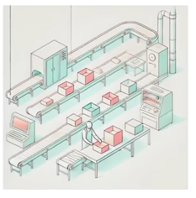
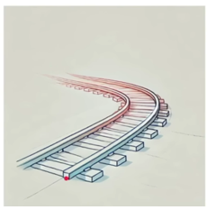
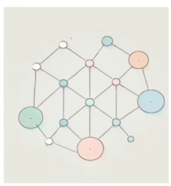
LangGraph
For building multi-agent workflows & complex/non-linear logic
Components
State -> Shared data structure representing the context of the entire application
including user inputs, action taken
-> Analogy – White board in a meeting room . Participants( nodes) read/write
information on the whiteboard(state) to stay updated & coordinate
Nodes -> Individual actions such as executing a function / LLM call etc
-> Each node receives input (often current state) , processes it & produces output
-> Analogy – Assembly line stations – Each station does on job
Edges -> Define the connection between nodes that determine flow of execution
-> Tells which node should be executed next
-> Analogy – Train Tracks – Each track ( edge ) connects stations ( nodes )
Graph -> Structure that maps out how different tasks ( nodes ) are connected & executed
-> Visual workflow with sequence & conditional paths between various operations
-> Analogy – Roadmap - displaying different routes connecting cities along with
intersections offering choices on which path to take next

Slide 3




LangGraph
Components contd..
Start -> Virtual entry point in LangGraph
-> Analogy – Race starting line – the place where a race officially begins
End -> Signifies conclusion of the workflow in LangGraph
-> Graph’s execution stops, indicating that all intended processes have stopped
-> Analogy – Finish line of a race – The race is over when you cross
Conditional Edges -> Specialized connections that decide the next node to execute
based on specific conditions or logic in current state
-> Analogy – Traffic lights– The condition(light color) decides the next step
Tools -> Specialized functions used within a node to perform a specific task( eg, API call )
-> Enhance capabilities of node by providing additional functionalities
-> Analogy – Tools in a ToolBox - Hammer for nails, screwdriver for screws

Slide 4
LangGraph - Checkpointer
Checkpointer – Mechanism where LangGraph saves the state of agent at specific execution points.
ThreadId is unique to a specific conversation
Internal memory structure
Data organization - Structured as Dict, where ThreadId is key
Checkpoint progression - Thread contains multiple checkpoints
Content - Node output(Human, AI or tool message ) is appended to checkpoint list
Metadata - Tracks current & next node
Thread ID | Checkpoint | Message Content | State Metadata
Thread_01 | Checkpoint 1 | Human: "Hi, I'm Harish" | Next Node: Chatbot
Thread_01 | Checkpoint 2 | AI: "Nice to meet you!" | Next Node: End
Thread_01 | Checkpoint 3 | Human: "What's my name?" | Next Node: Chatbot

Slide 5
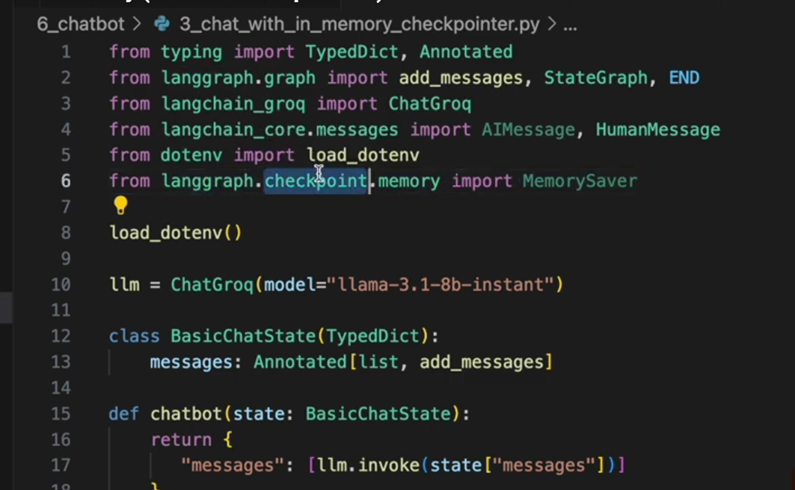
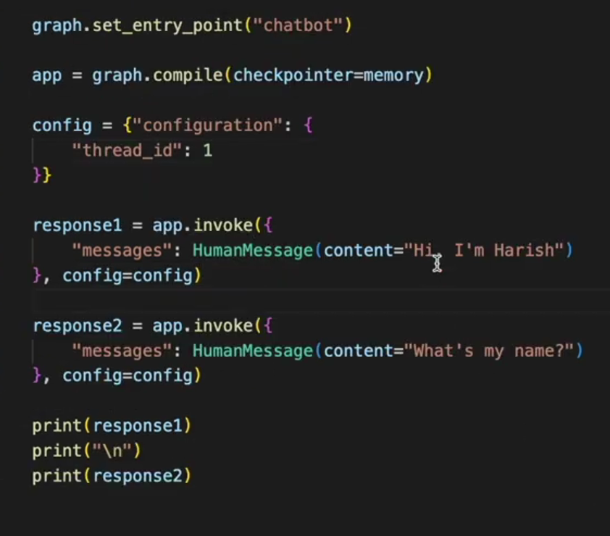
LangGraph - Checkpointer

Slide 6

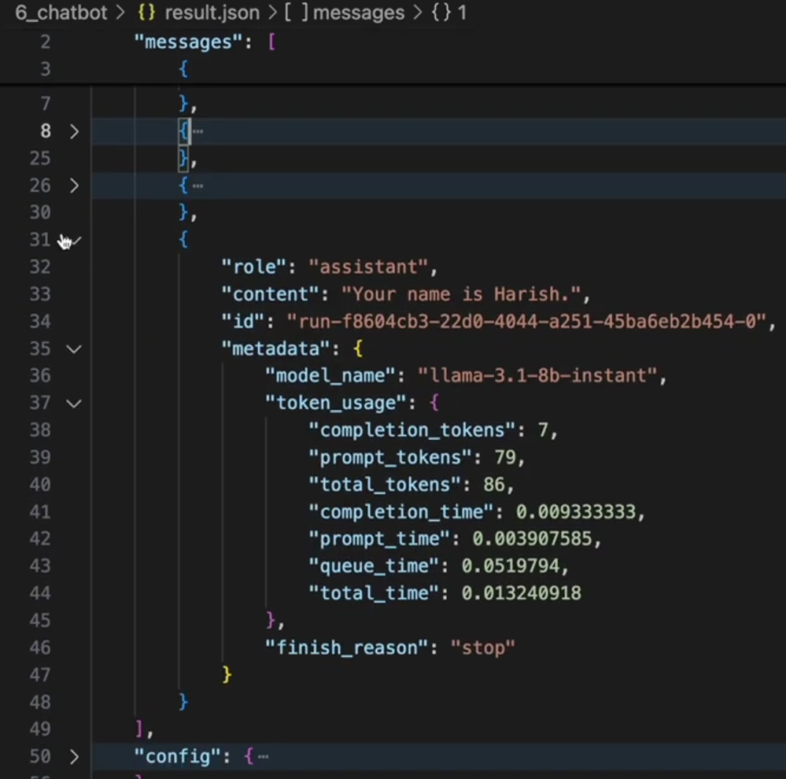
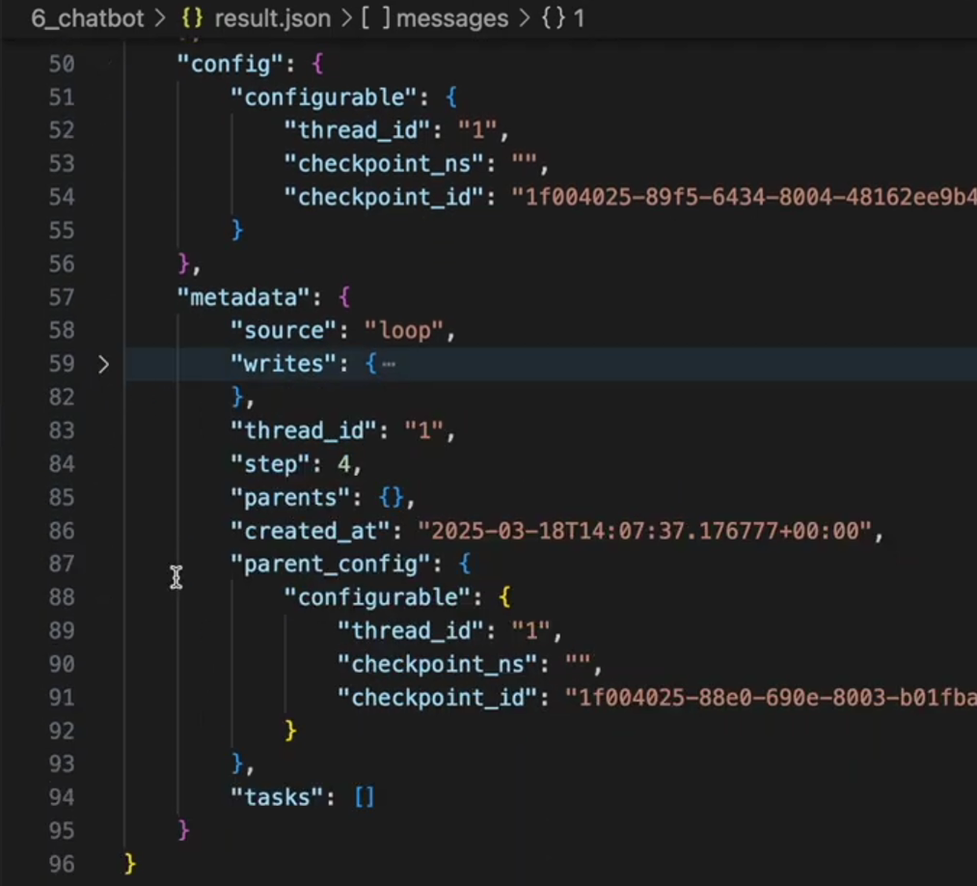
LangGraph - Checkpointer

Slide 7
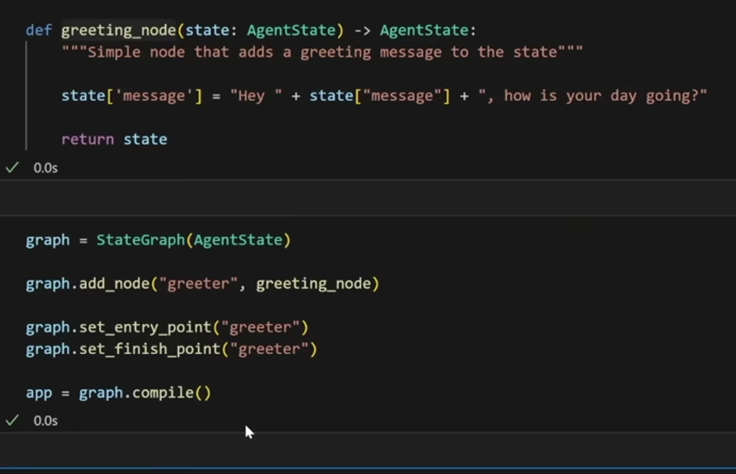
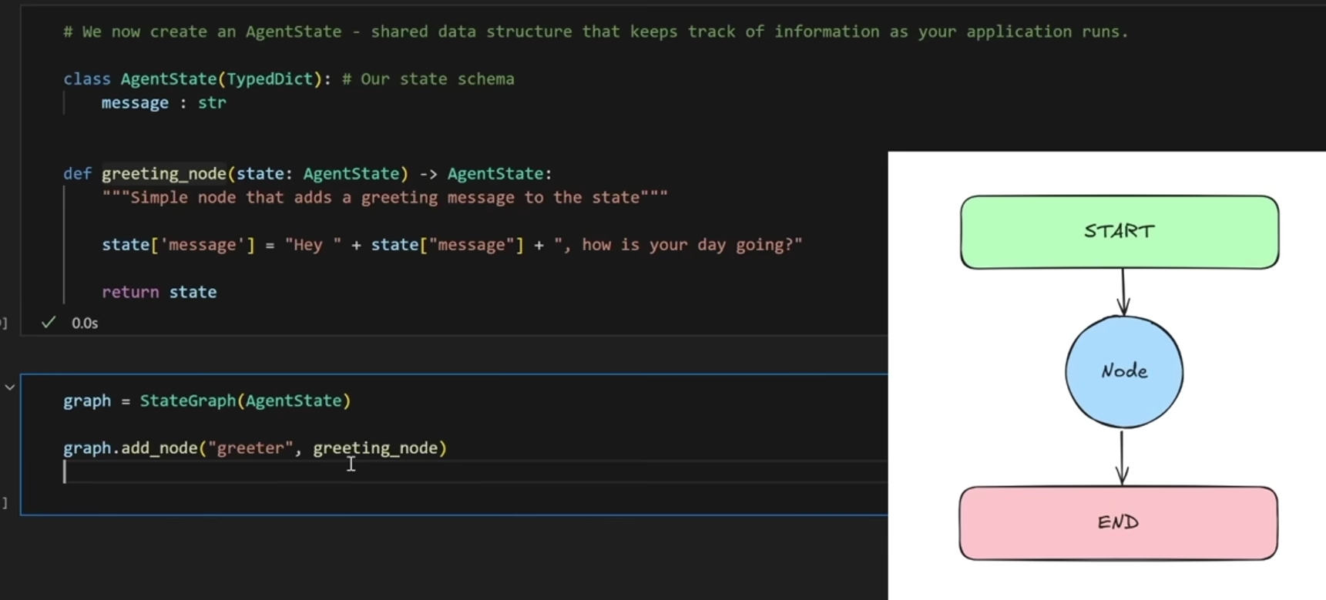
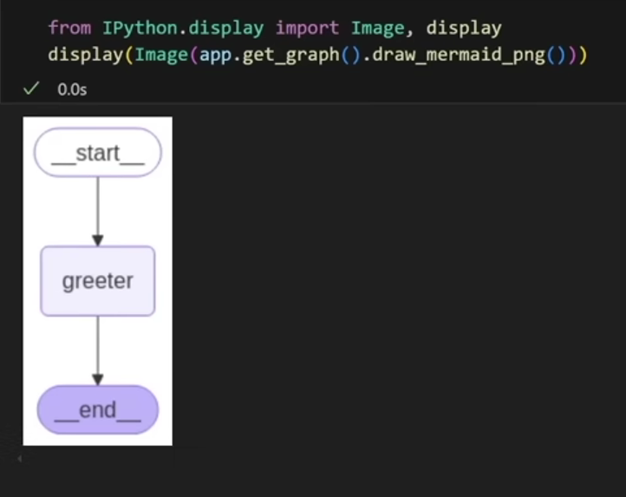
LangGraph - Handson
Graph 1 – Basic

Slide 8
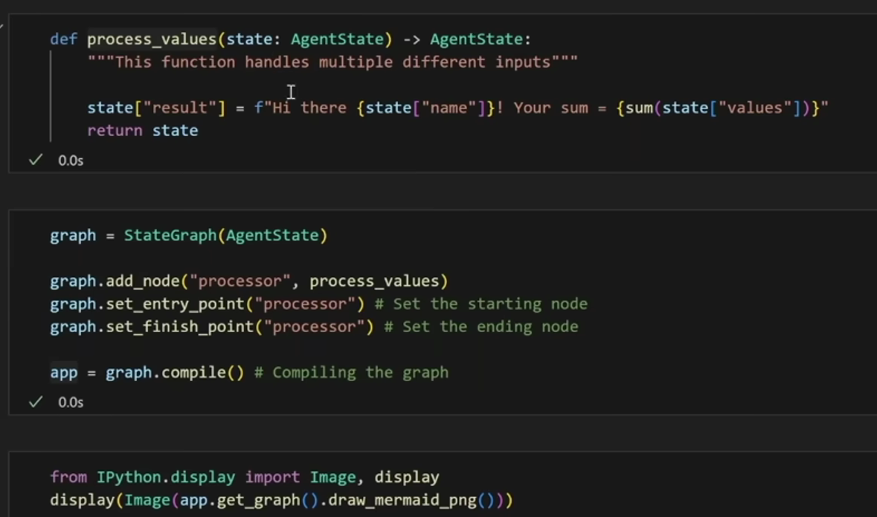
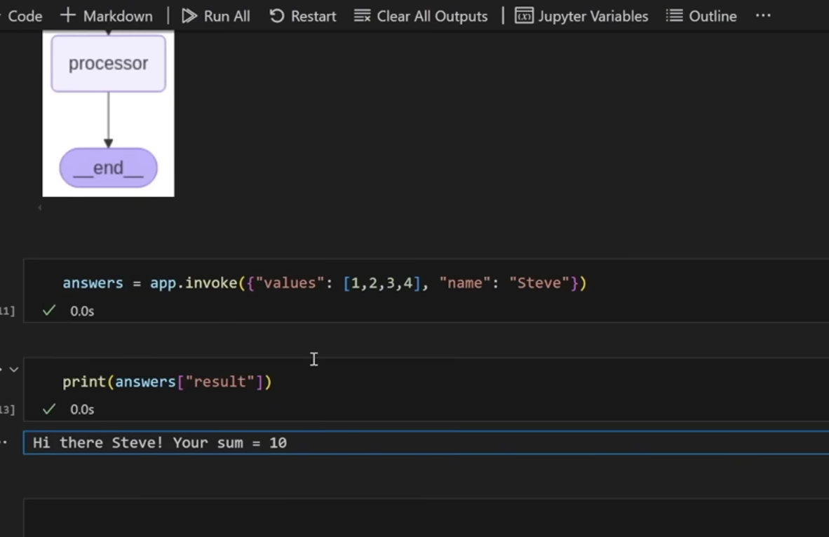
LangGraph - Handson
Graph 2 – Multiple Inputs & sum it up

Slide 9
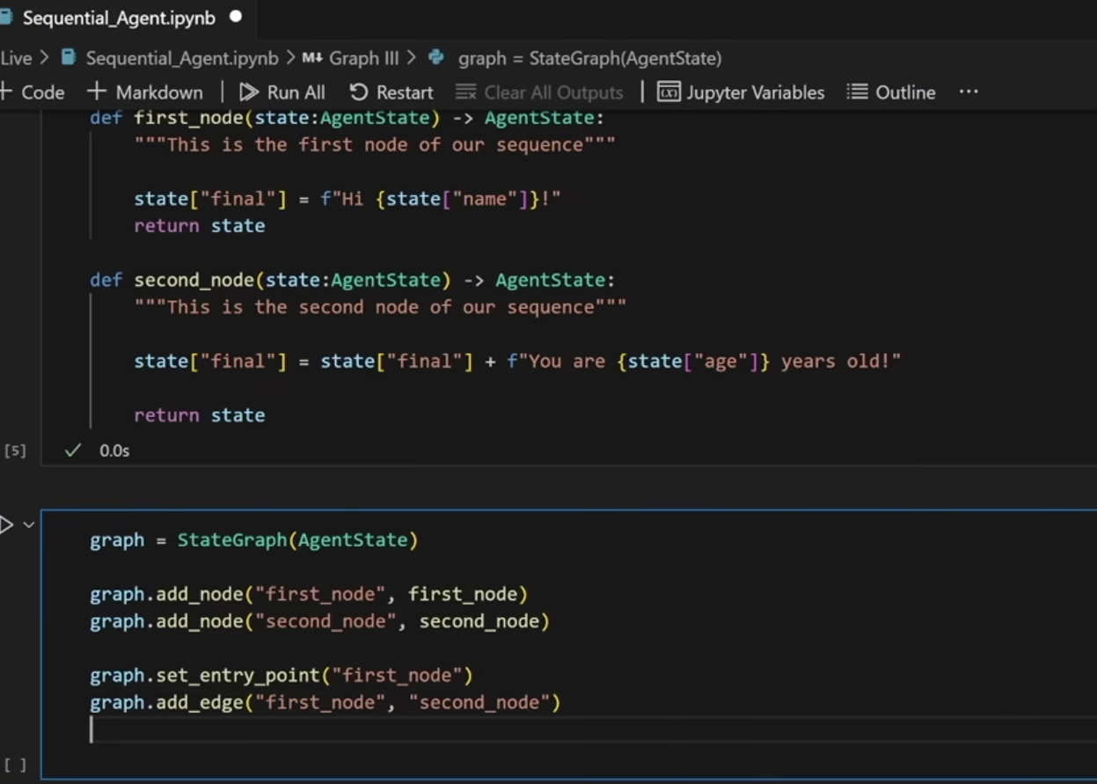
LangGraph - Handson
Graph 3 – Sequential nodes

Slide 10
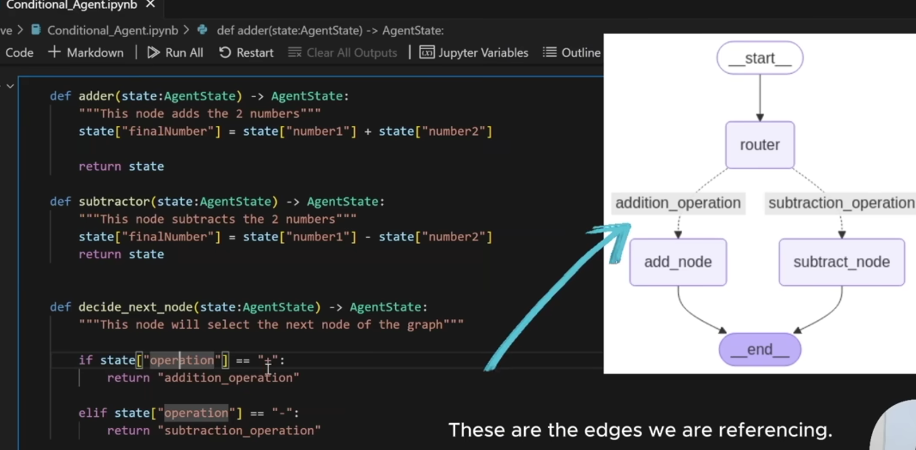
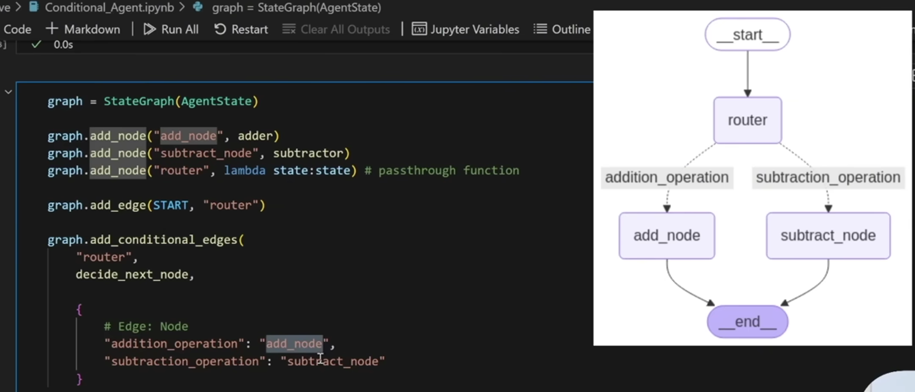
LangGraph - Handson
Graph 4 – Conditional graph

Slide 11
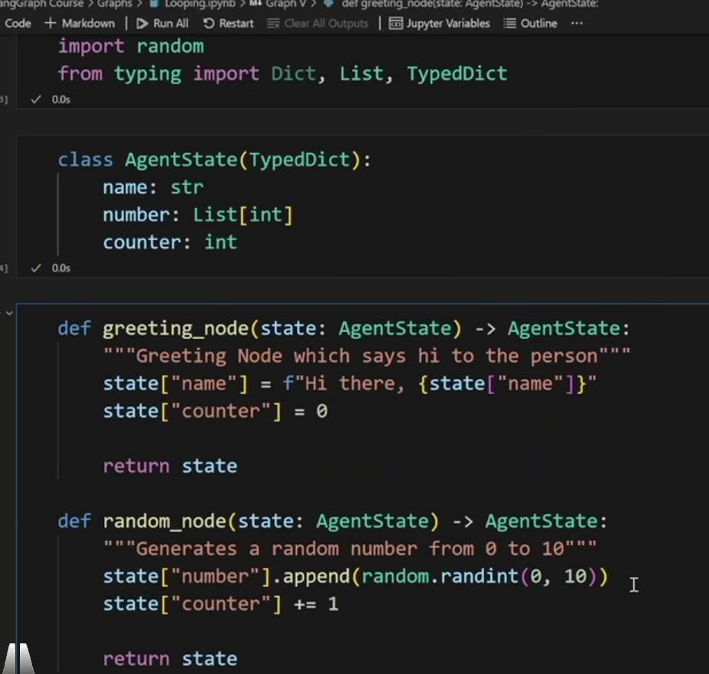
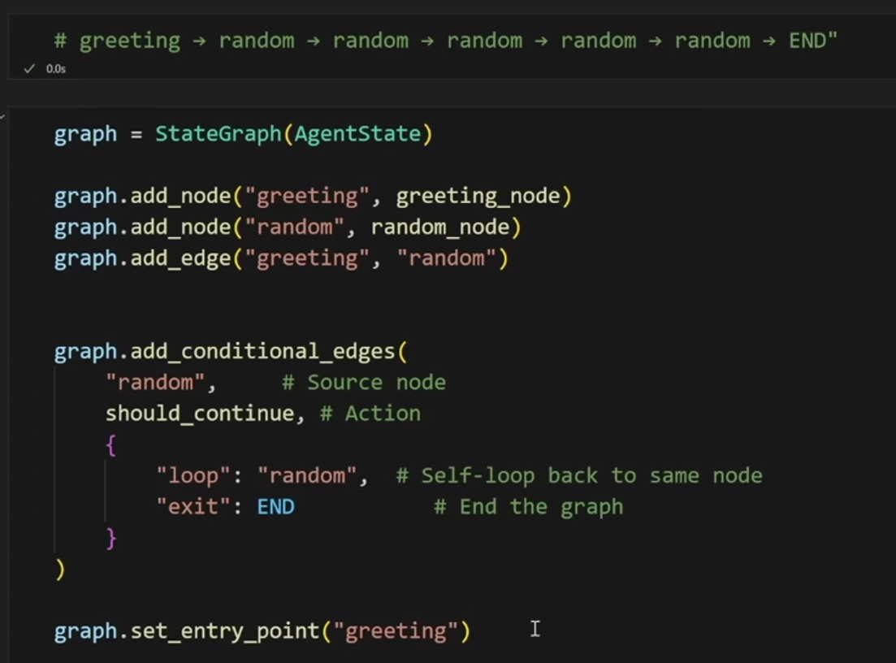
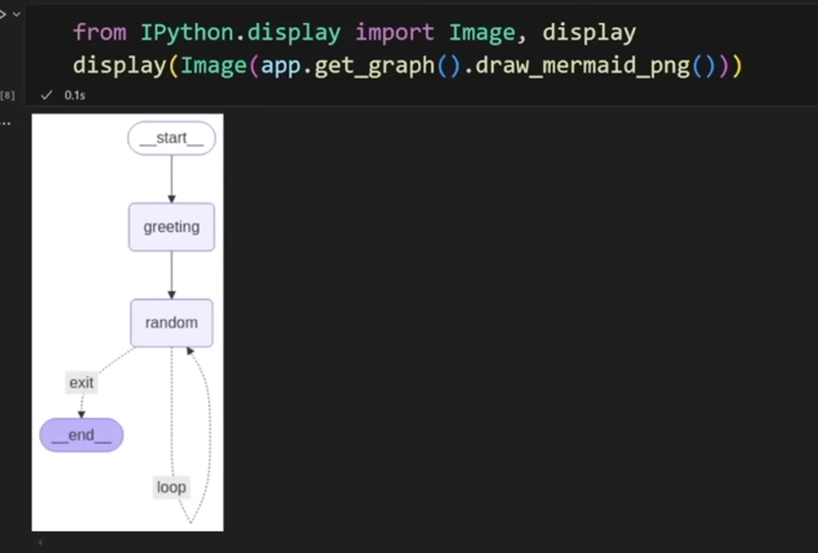
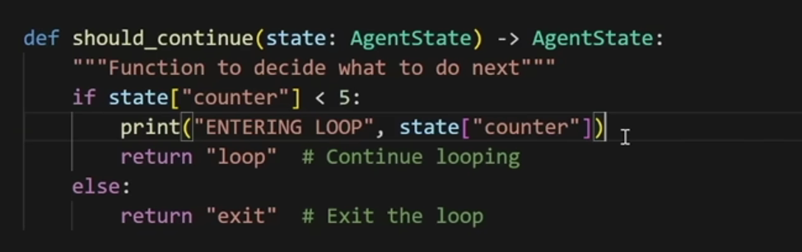
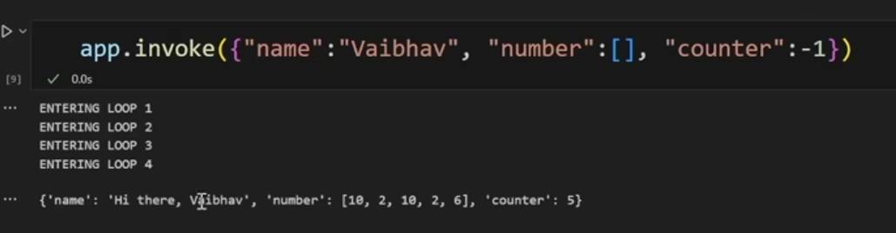
LangGraph - Handson
Graph 5 – Looping graph

Slide 12
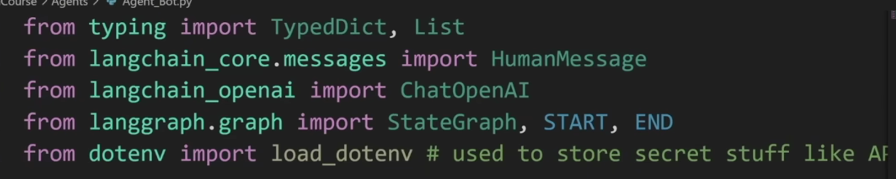
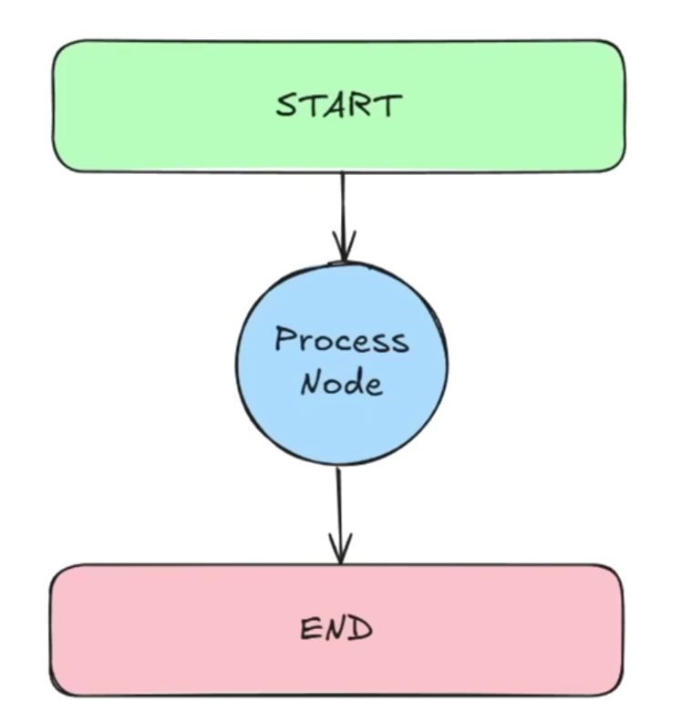
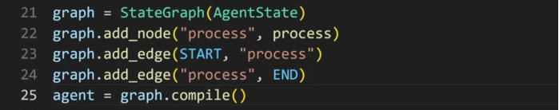
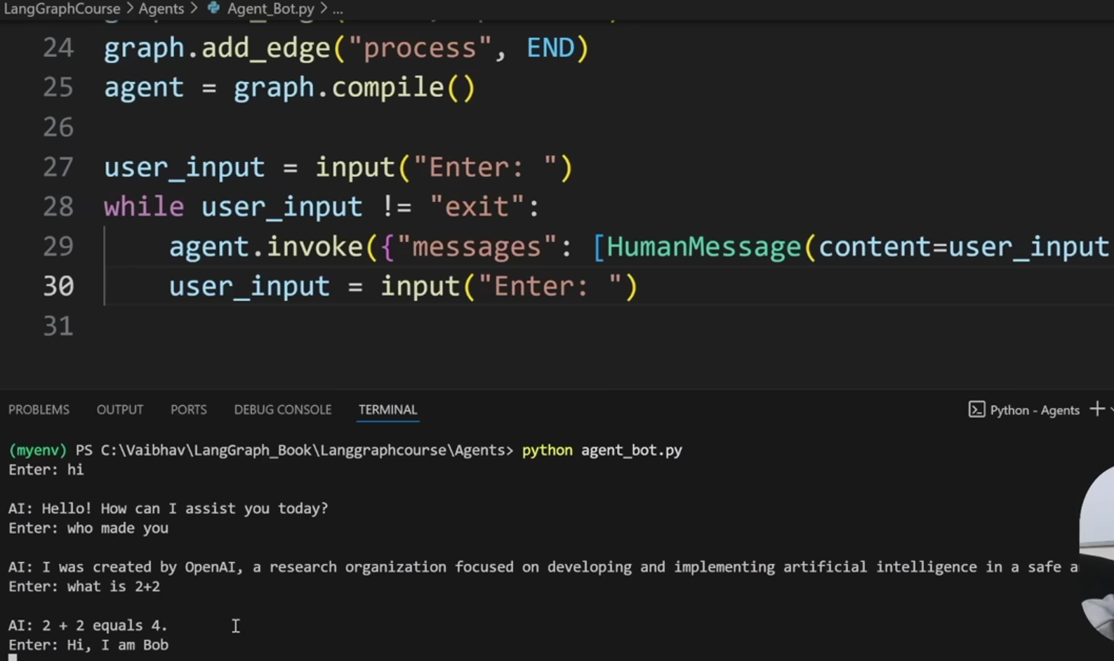
LangGraph - Handson
Agent Graph 1 – Simple Chatbot

Slide 13
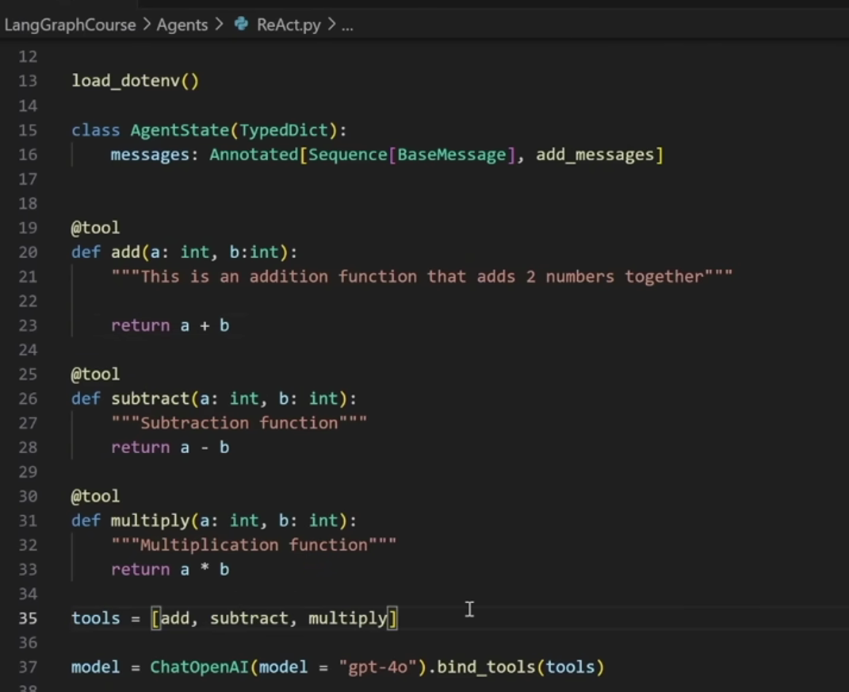
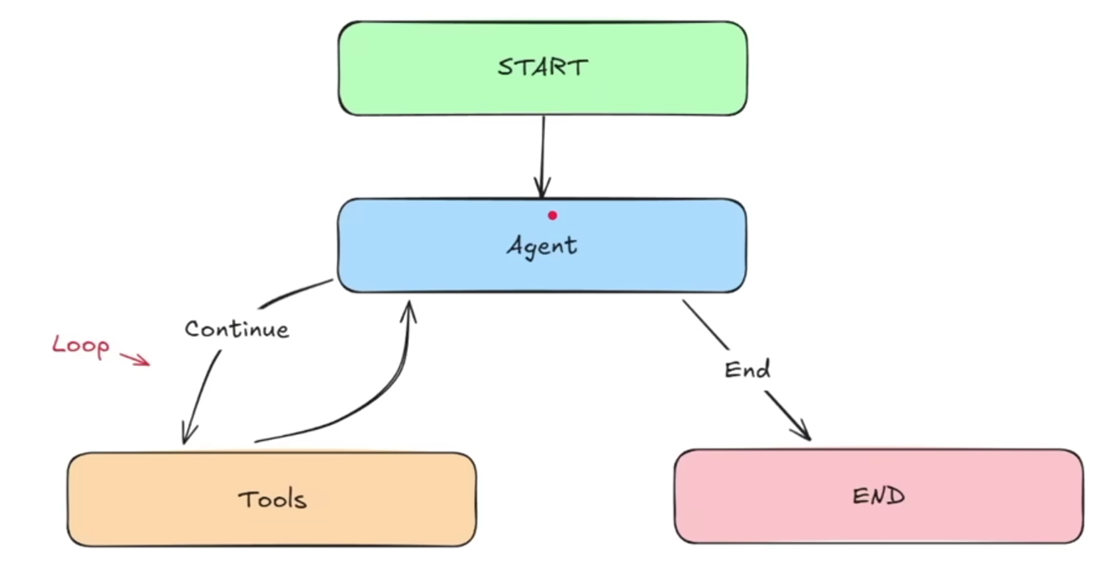
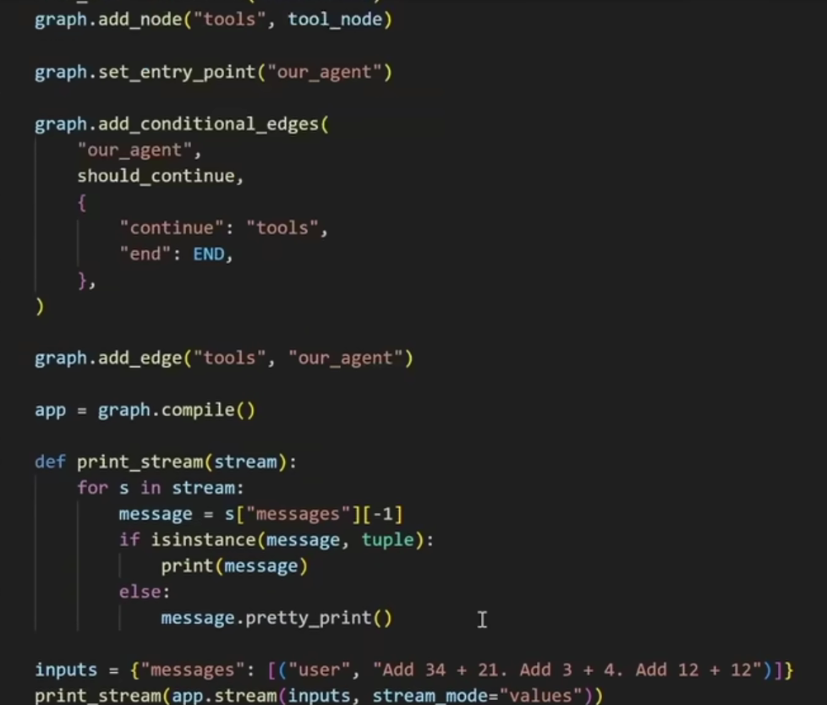
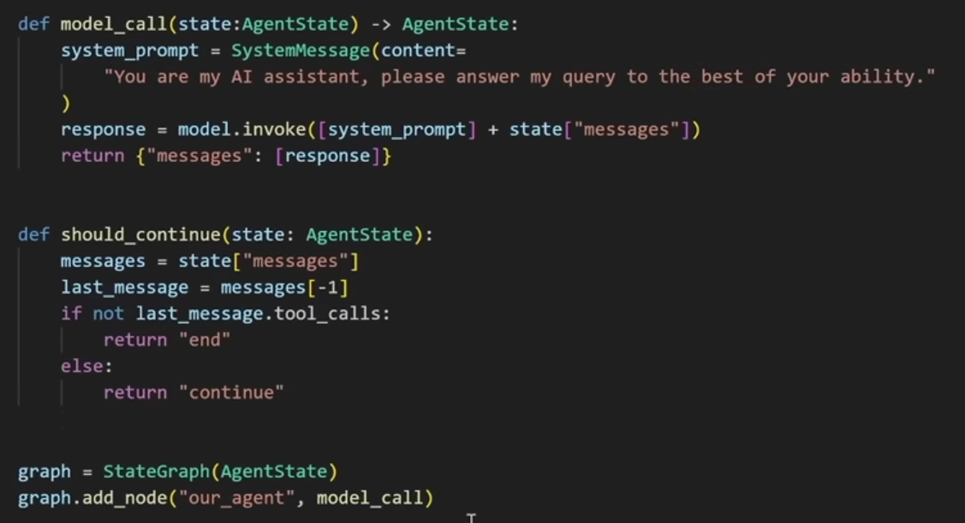
LangGraph - Handson
Agent Graph 2 – ReAct Agent ( Reasoning & Acting )

Slide 14
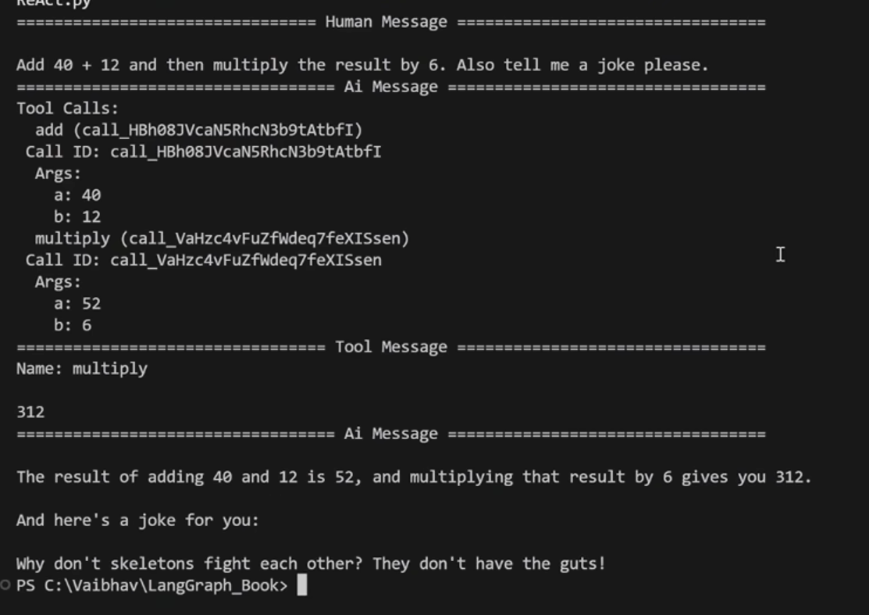
LangGraph - Handson
Agent Graph 2 – ReAct Agent ( Reasoning & Acting )

Slide 15
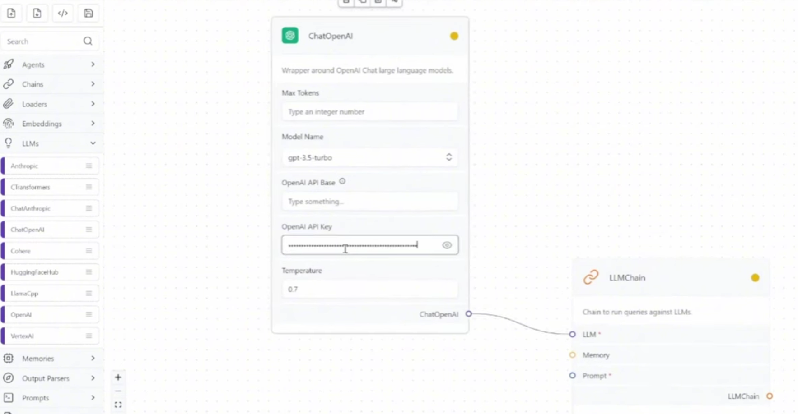
LangFlow
Drag & drop visual interface on LangChain
Rapid experimentation & creating MVP’s.
Create workflows , chains & agents without writing code
Installation – locally or on cloud server.

Slide 16
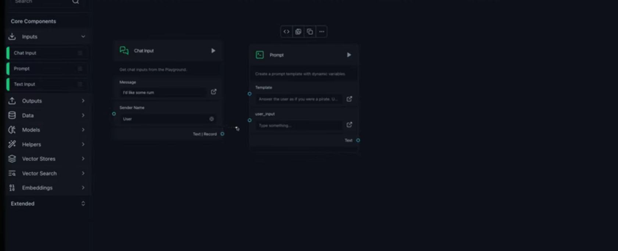
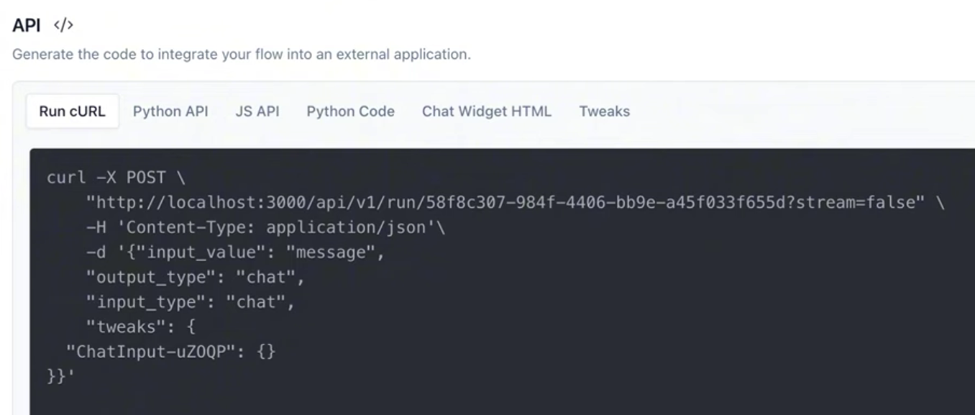
LangFlow
Can be accessed with API’s

Slide 17
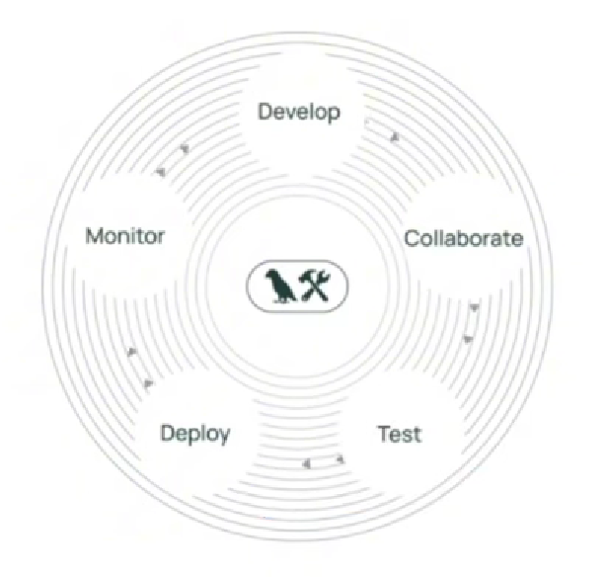
LangSmith
Entire lifecycle of an application – prototyping, beta testing, production
Key Capabilities
Tracing - Use “traceable” annotation to log every step of the application’s execution
Analytics Dashboard - Track token usage, total cost, error rates & latency.
Can be used with any LLM framework & not just LangChain

Slide 18
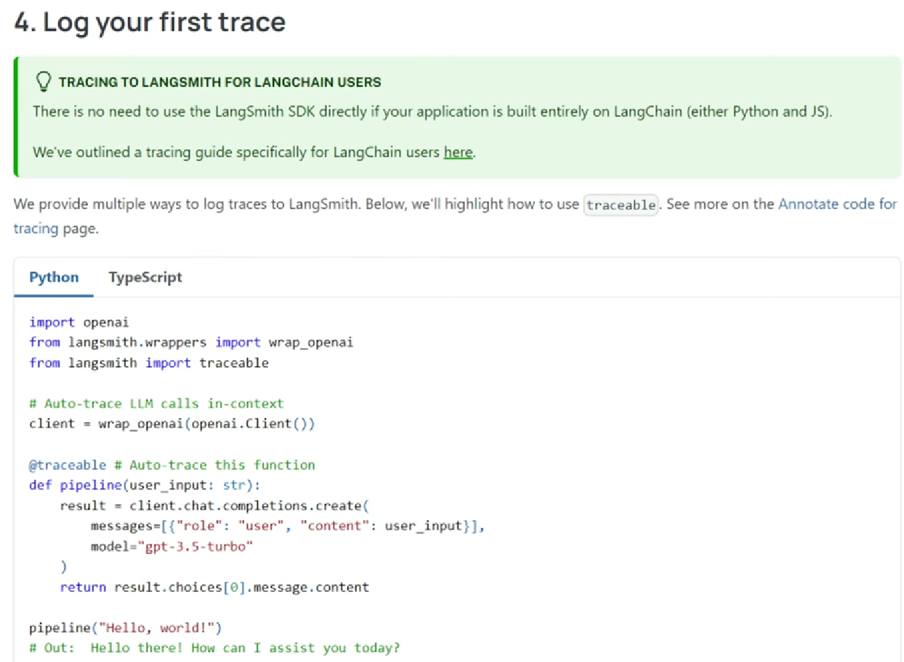
LangSmith
Hello World - pipeline

Slide 19
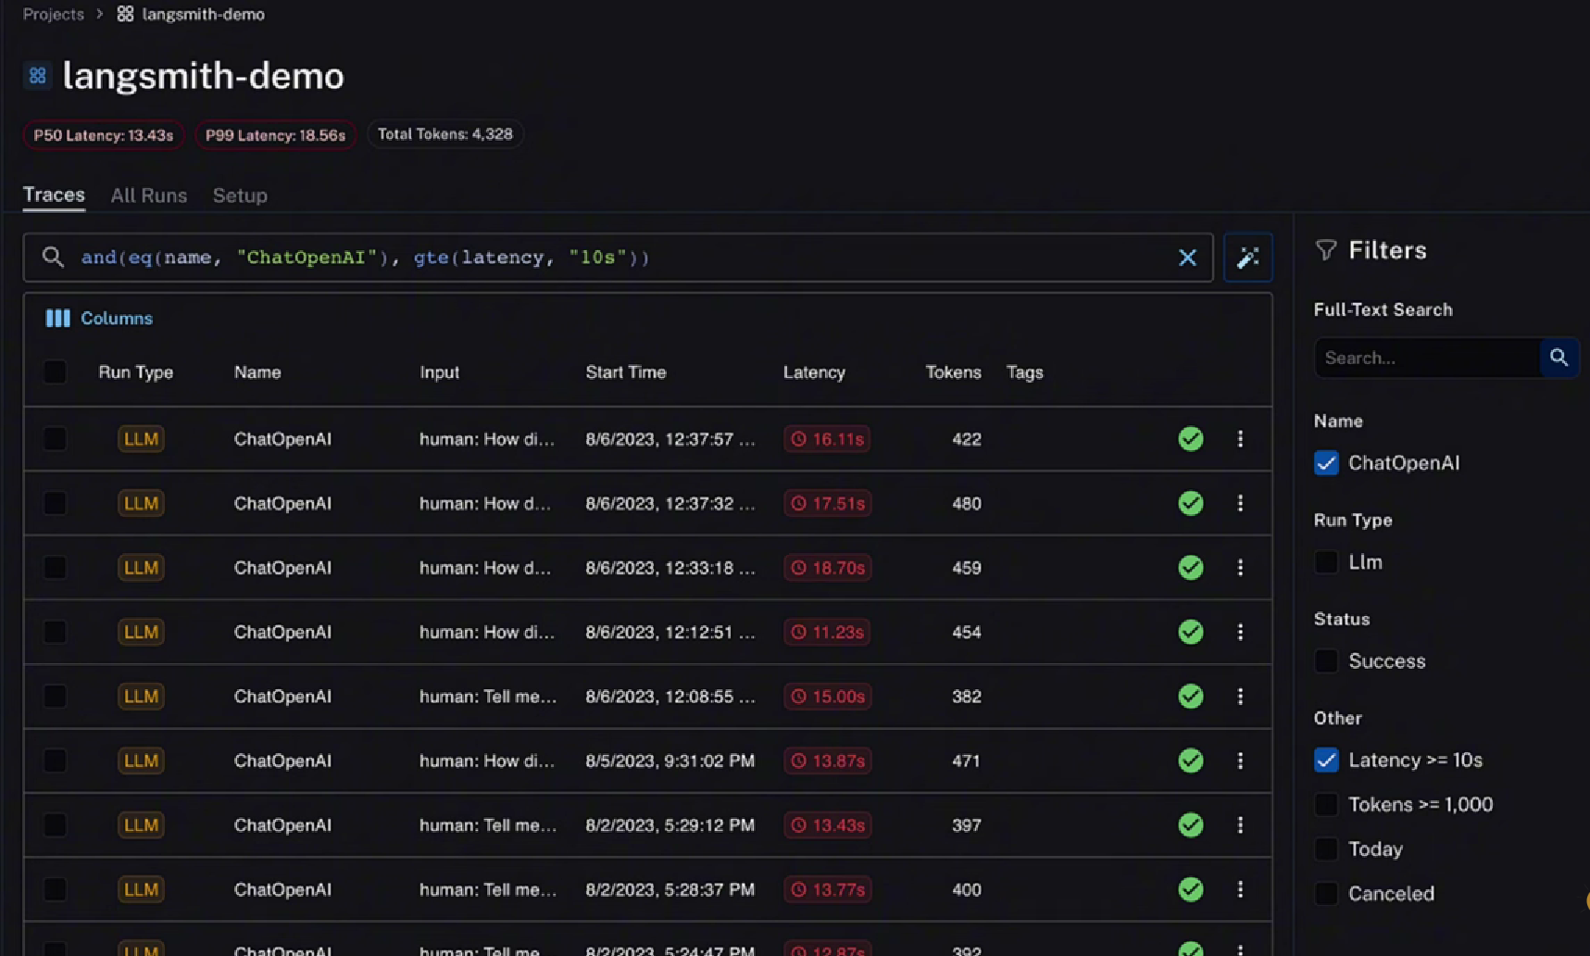
LangSmith
Demo screen

Slide 20
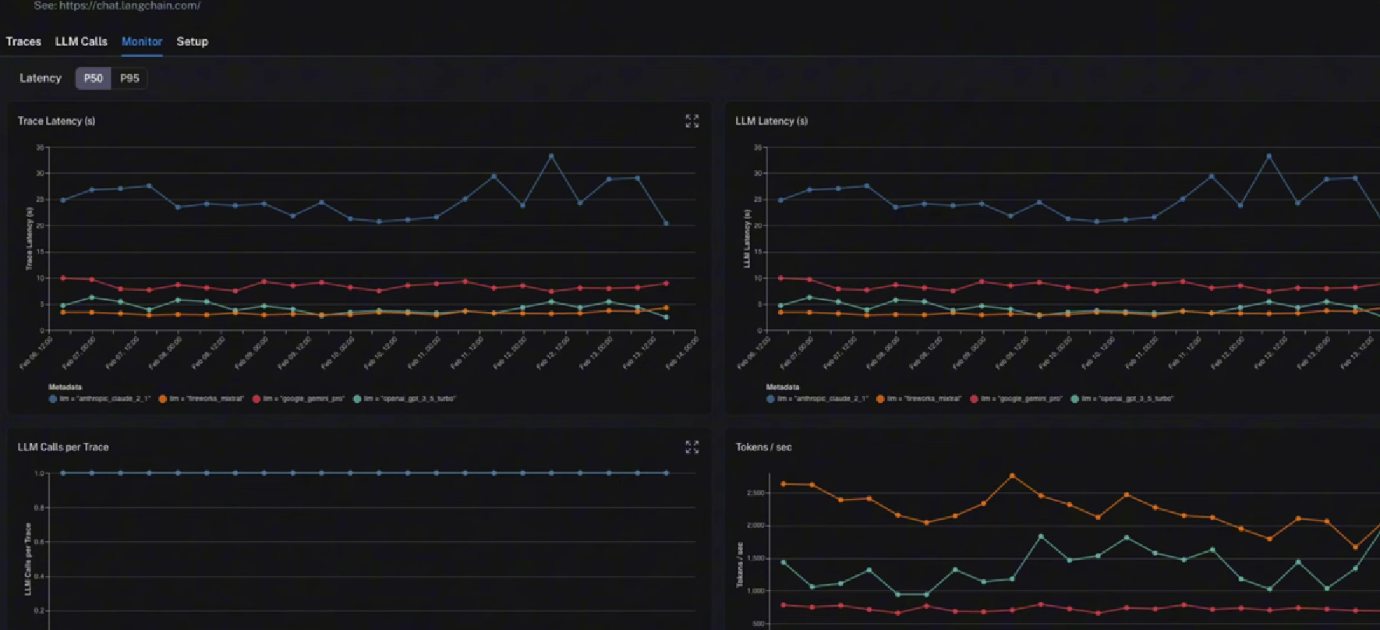
LangSmith
Demo screen

Slide 21
Comparison
-
Class | Primary Purpose | Key Advantage
LangChain | Framework for building LLM apps | Reduces boiler plate code
LangGraph | Multi-agent orchestration | Supports cyclical decision making
LangFlow | Visual UI for LangChain | Perfect for fast prototyping & MVP’s
LangSmith | Monitoring & Evaluation | Tracks cost, tokens, errors.

Slide 22
Next Step - Module 4 Self Learning
LangGraph Crash Course: Human in The Loop | https://www.youtube.com/watch?v=UOSMnDOC9T0
 | https://www.youtube.com/watch?v=9JHMLBQzU3s
 | https://www.youtube.com/watch?v=Ib4PQOrCh0g
 | https://www.youtube.com/watch?v=3MsGtLN793w
Agent with Tools | https://www.youtube.com/watch?v=XvGfrXsu76A
MCP | https://www.youtube.com/watch?v=RhTiAOGwbYE&t=3s
 | https://www.youtube.com/watch?v=dIb-DujRNEo (1:52:39 – 2:26:00)
Note – Reference hands-on Python code will be made available via a personal Google Drive. Please avoid bringing that to Wells Fargo Network

