Slide 1
Agentic AI – Module 4 - Review
Wells Fargo Premier logo
Updated February 2026
© 2026 Wells Fargo Bank, N.A.

Slide 2
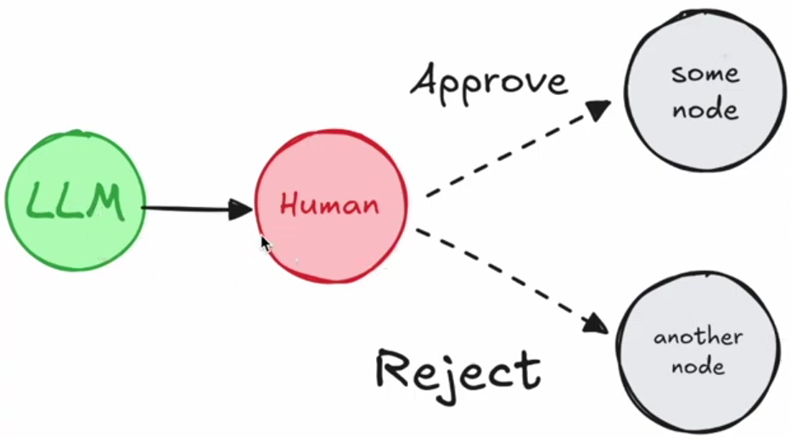
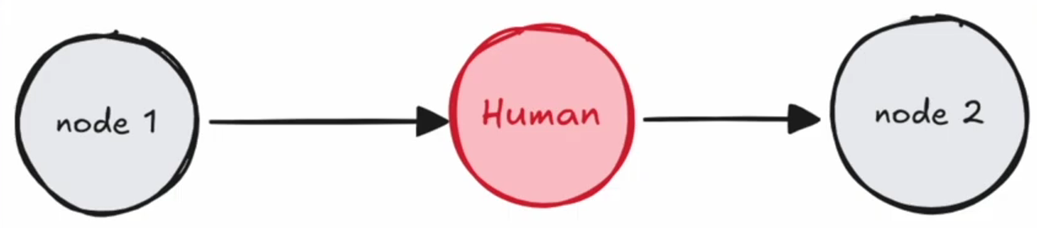
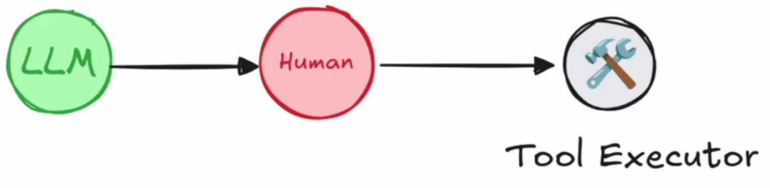
Human in the Loop ( HITL )
Integrates human intervention into automated process for reviewing, validating output & provide additional context
Design Patterns
Approve or Reject – Pause before a critical step ; re-route / stop
Review or Edit state – Modify the “state” of graph ; correct mistakes or add info

Slide 3
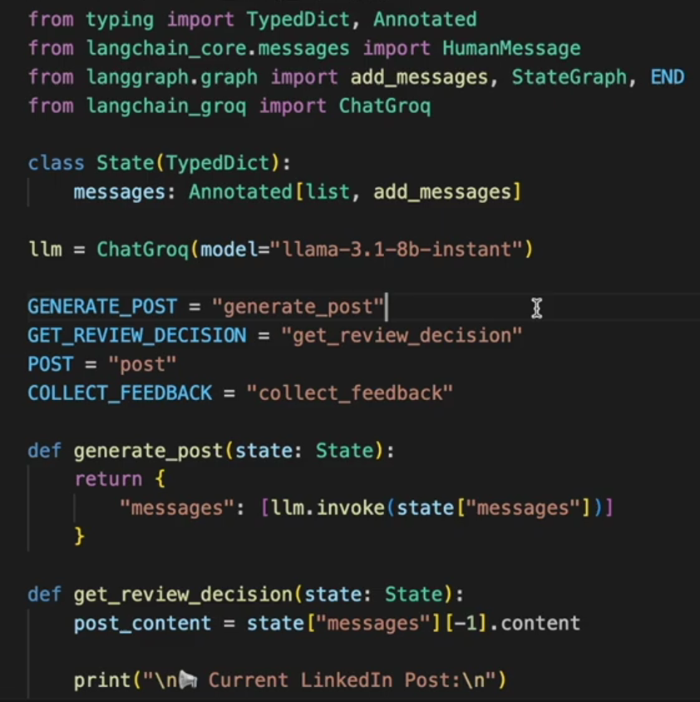
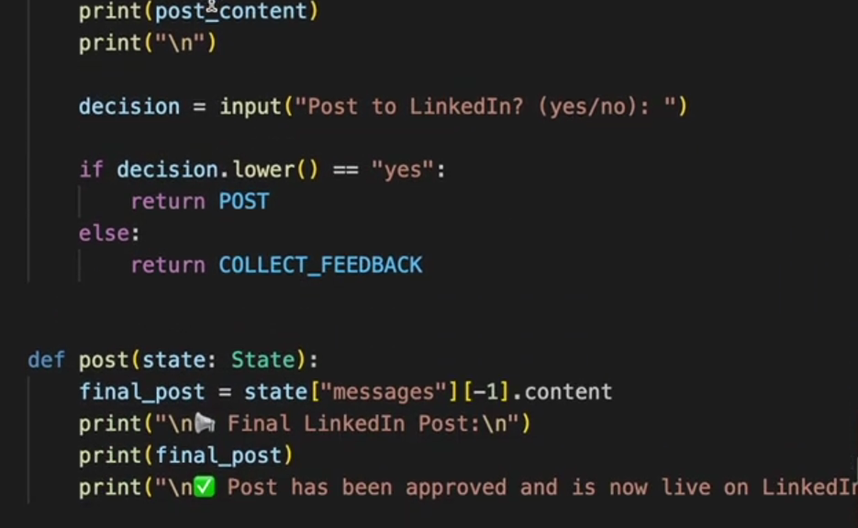
Human in the Loop ( HITL )
Feedback Loop

Slide 4
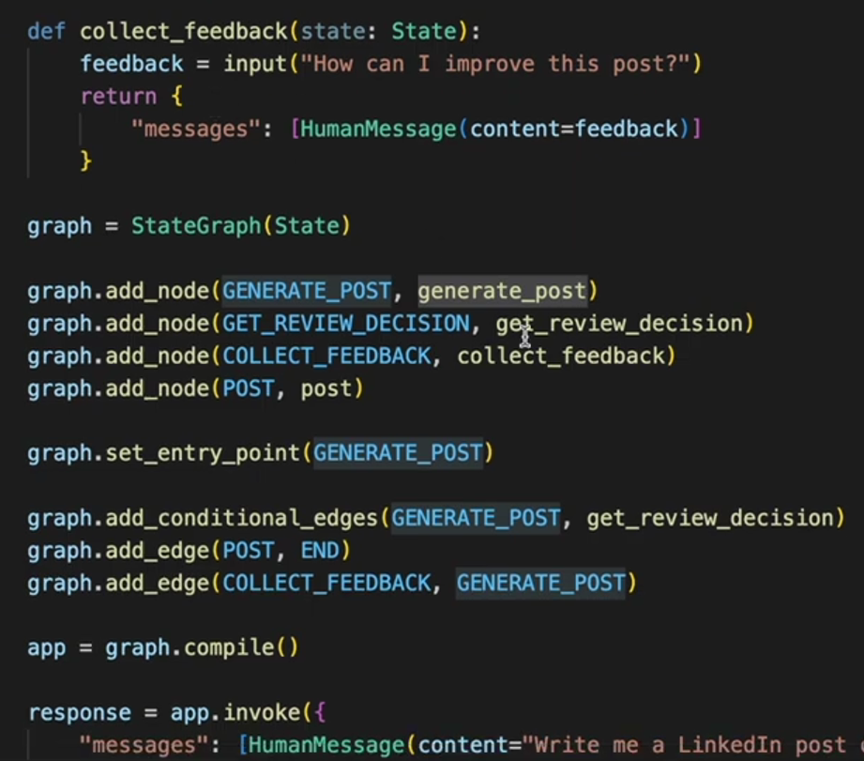
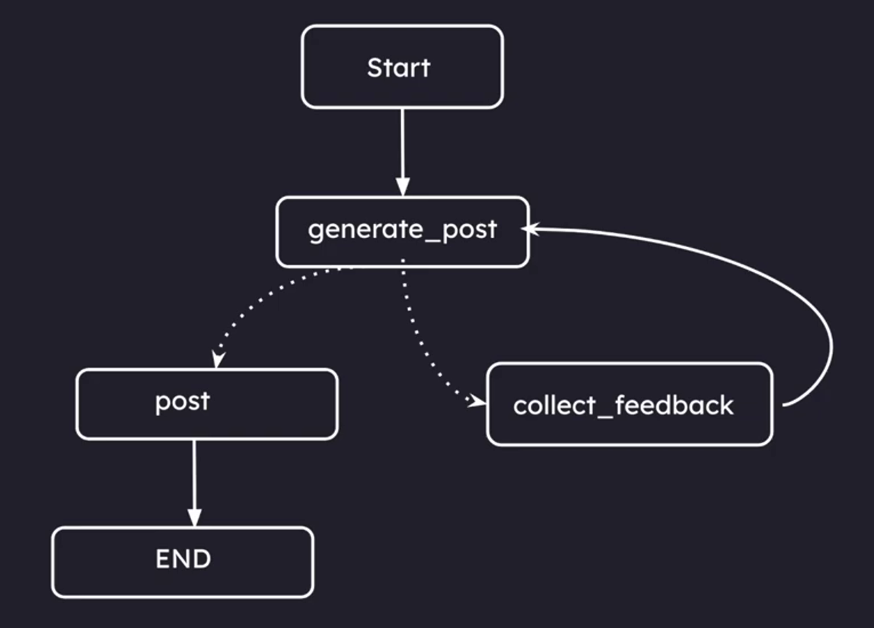
Human in the Loop ( HITL )
Feedback Loop – contd…
Human asks LLM to write a LInkedIn Post

Slide 5
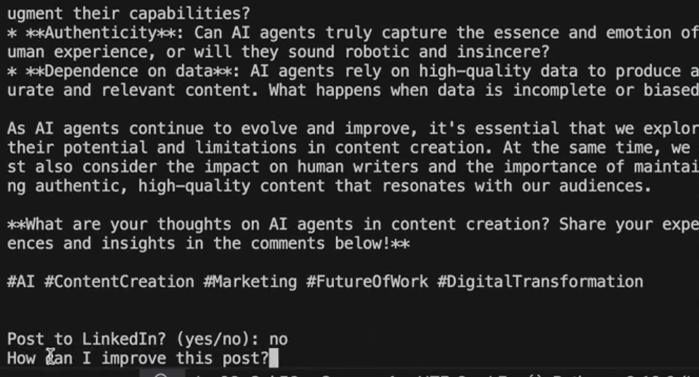
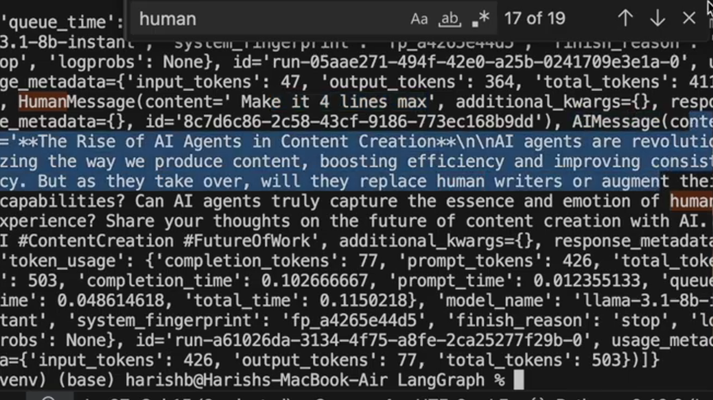
Human in the Loop ( HITL )
Feedback Loop – contd…
LLM provides initial post for review
Human provides feedback to post in 4 lines
LLM summarizes & provides updated post for review

Slide 6
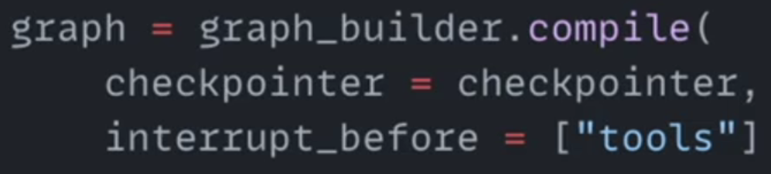
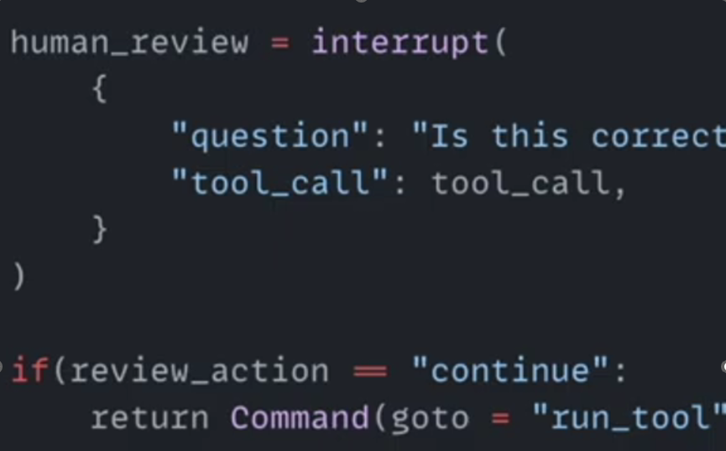
Human in the Loop ( HITL )
Interrupt() – Integrated with Checkpointer
Pauses workflow / saves the state to continue later
Works in web apps, API etc
Multiple users/sessions at once
Survives program crashes
Lets humans take time to respond
Interrupt during compile
Interrupt in Command Class

Slide 7
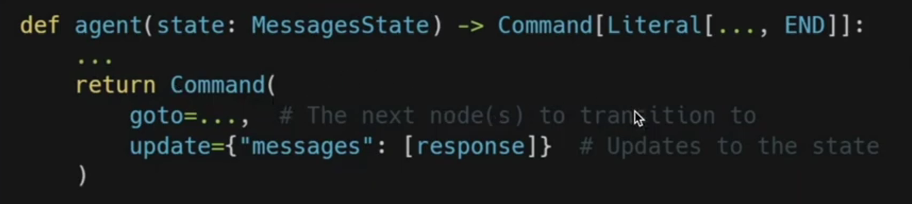
Human in the Loop ( HITL )
Command Class
Edgeless workflows
Path for next step is contained within the current node
Provides more flexibility & readability reg logic within each node
Move away from using the “Add_edge()”
Components
Goto -> Next node to transition to
Update -> Handle state management

Slide 8
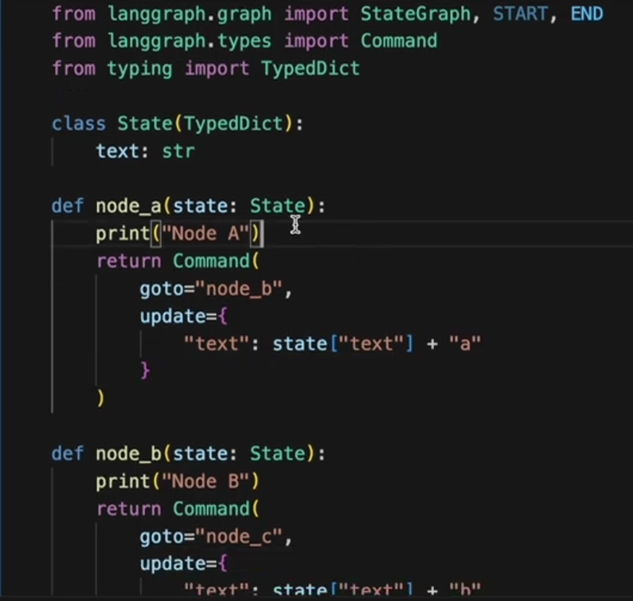
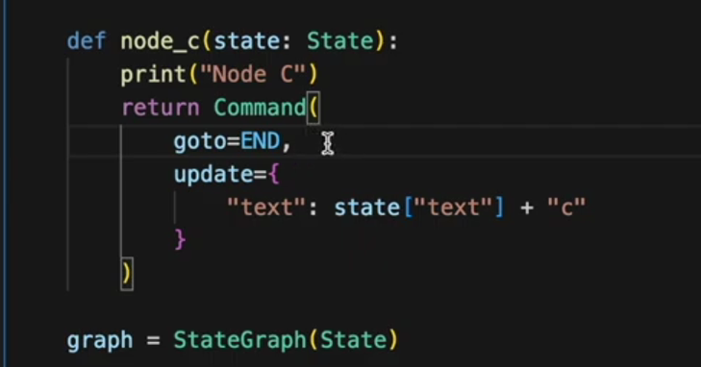
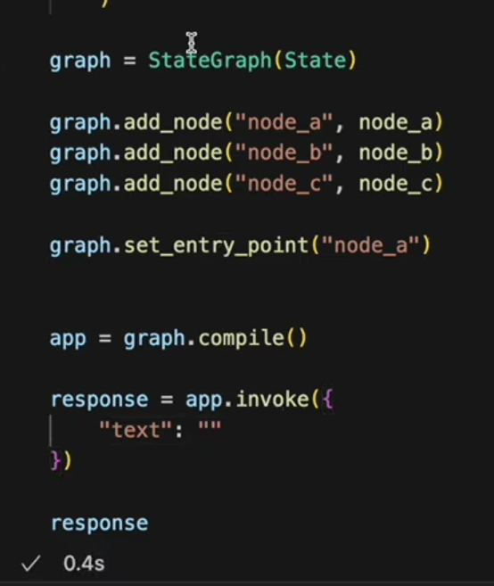
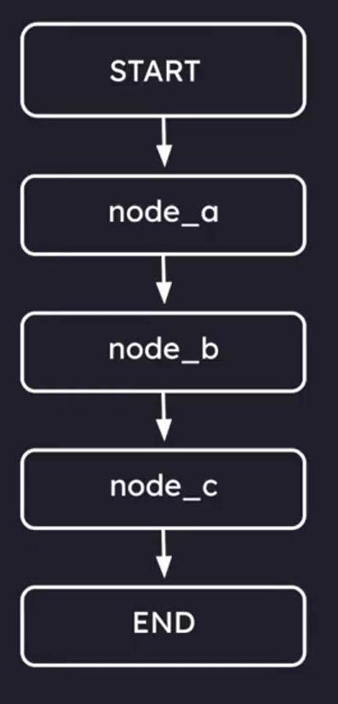
Human in the Loop ( HITL )
Command Class.. contd

Slide 9
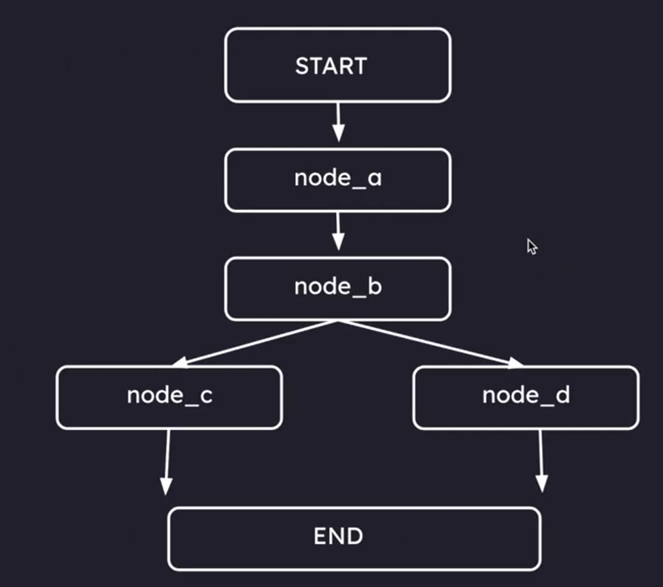
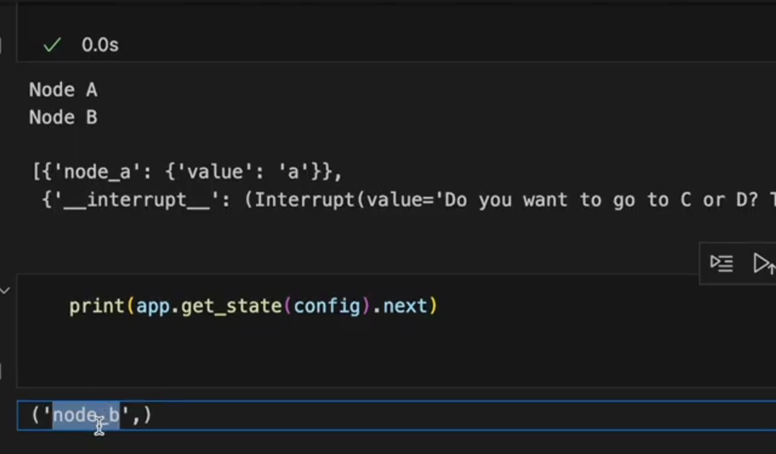
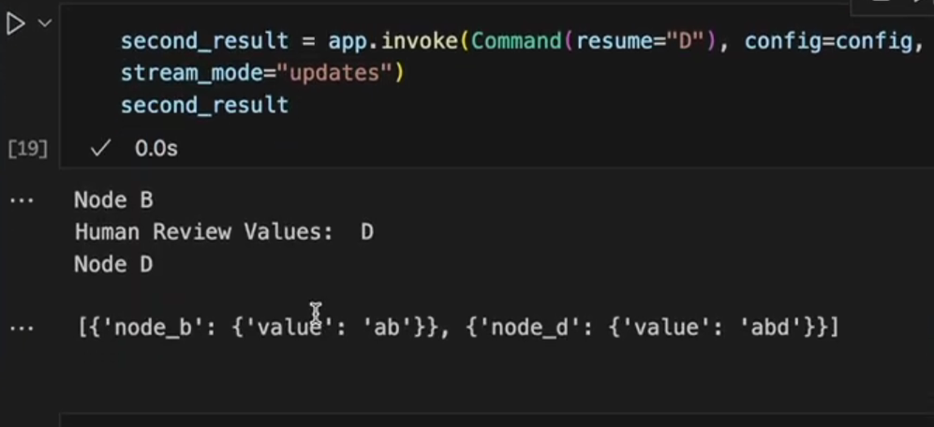
Human in the Loop ( HITL )
Resume graph – Pause execution to seek human input
Achieved using interrupt()
Graph exits the state during interrupt, saves it & waits for “resume”
Key control operations
Resume with existing state
Update & Resume
Rewind
Branch
Abort

Slide 10
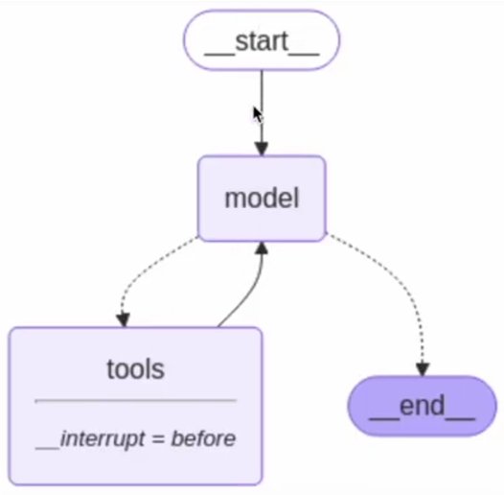
Human in the Loop ( HITL )
Review Tool Calls :
Human to review need for tool execution before it actually happens
Helps reduce expensive tool calls
Uses global compile instead of interrupt inside a note
Process breakdown
User Input -> User asks real-time question
LLM Suggestion -> LLM generates tool call message
The pause -> Interrupt exits the graph & saves state
Human Action -> Human reviews the suggested search query for tool
Resumption -> Resumes the graph, tool executes & LLM formulates output.
Can use both interrupt_before=[“tools”] & interrupt_after=[“tools”]
Graph can be resumed using app.invoke(None) or app.stream(None).. (None – resumes form last checkpoint )

Slide 11
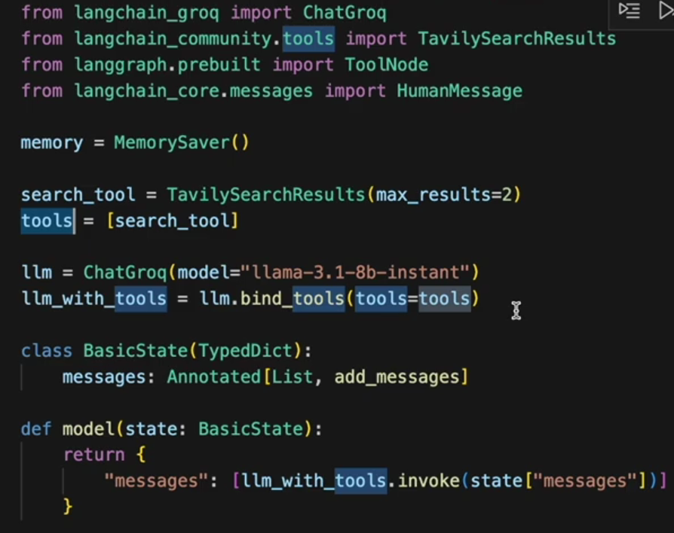
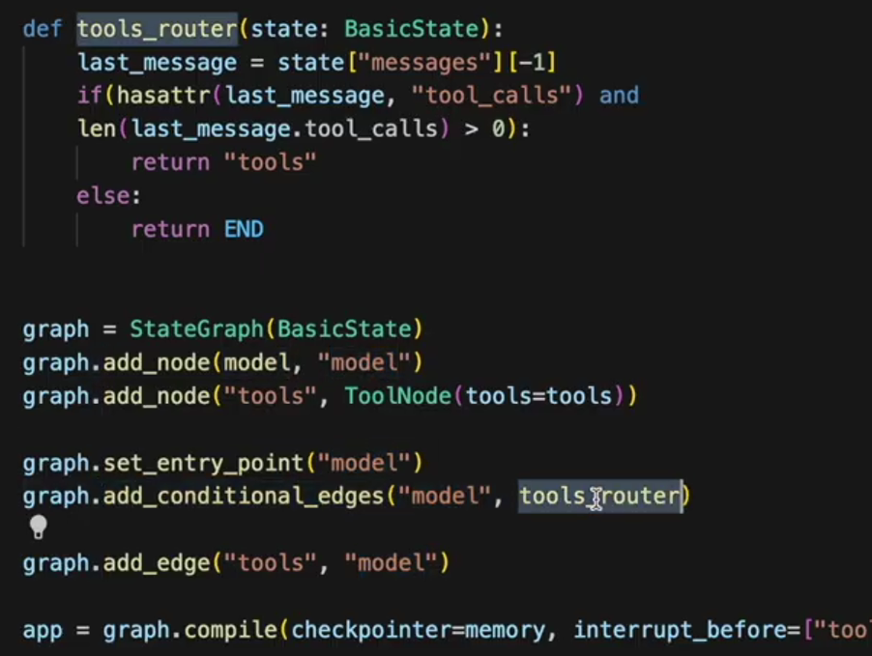
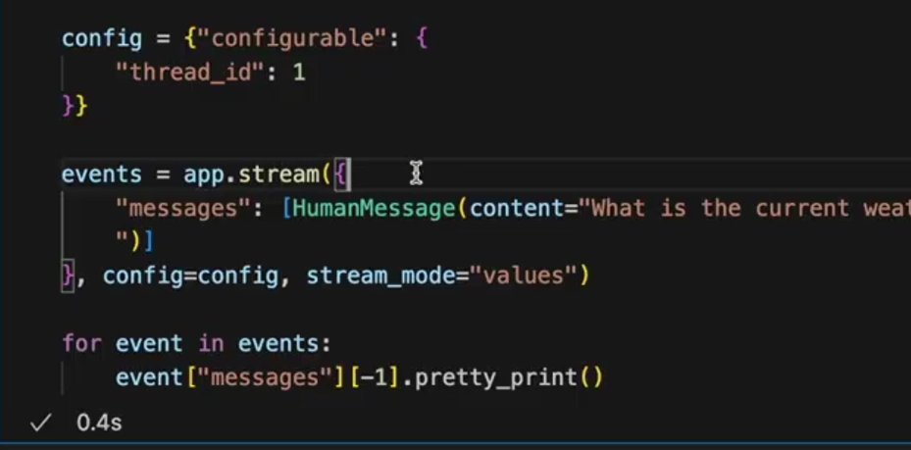
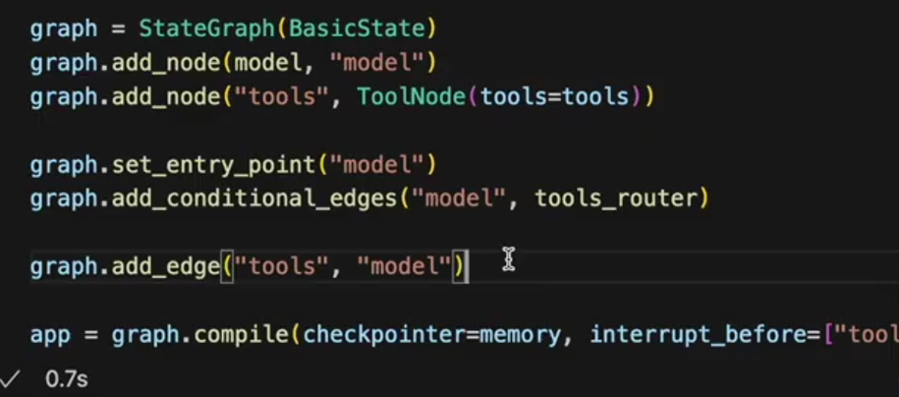
Human in the Loop ( HITL )
Review Tool Calls .. contd

Slide 12
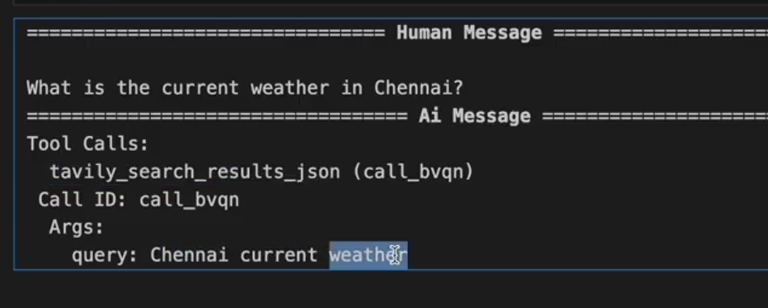
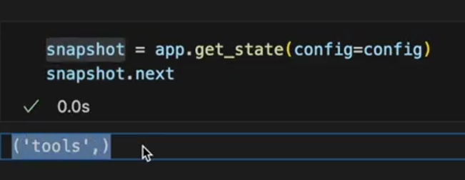
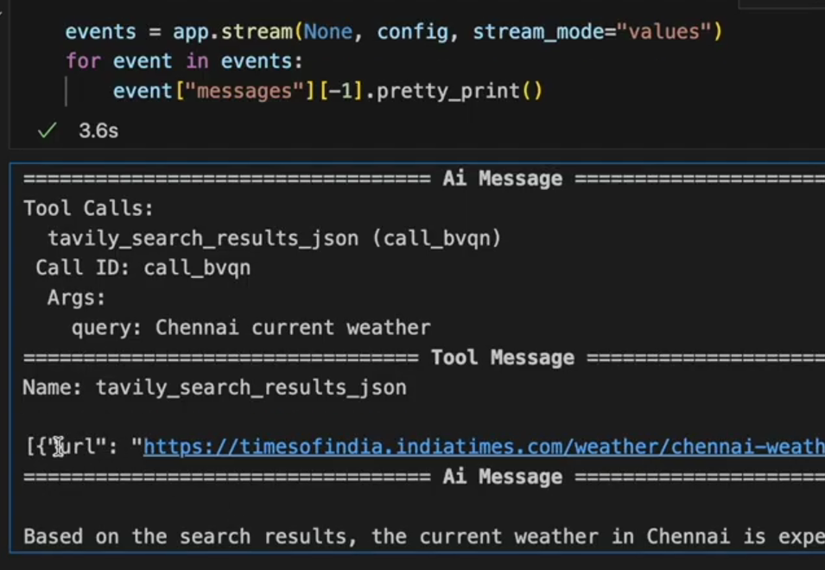
Human in the Loop ( HITL )
Review Tool Calls .. contd
Graph pauses after user query
Current state is saved as ‘tools’
Upon resume – it continues tool call

Slide 13
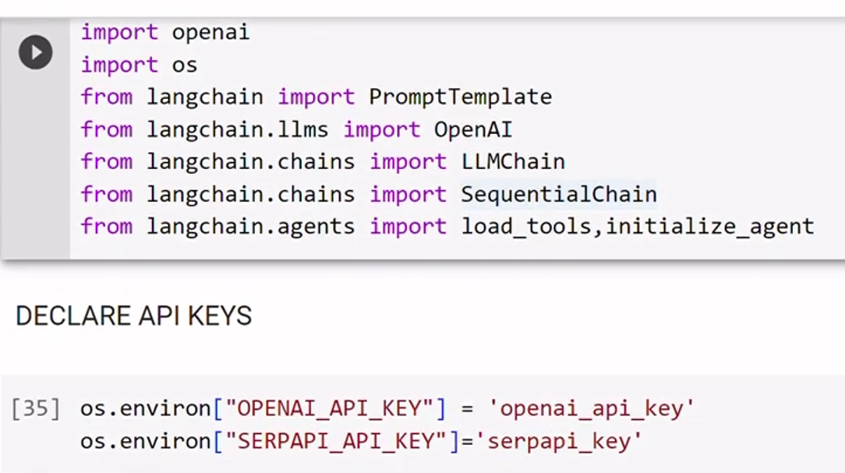
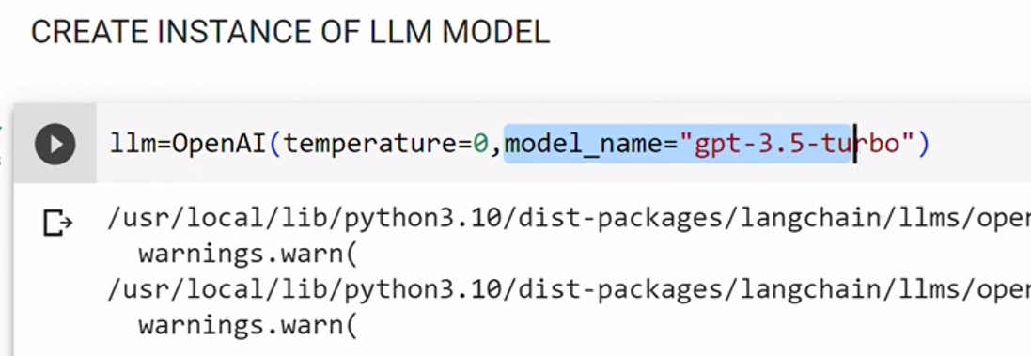
Agent with Tools – Google Search
User question – “Who is older, the President of America or Narendra Modi? Take the older man's age and give me a square root”
Agent Thinking with Google Search
Search 1: Find the age of the US President.
Search 2: Find the age of Narendra Modi.
Comparison: Determine who is older based on the retrieved data.
Math Action: Use the calculator tool to find the square root of that age.
Final Answer: Deliver the comprehensive result to the user.

Slide 14
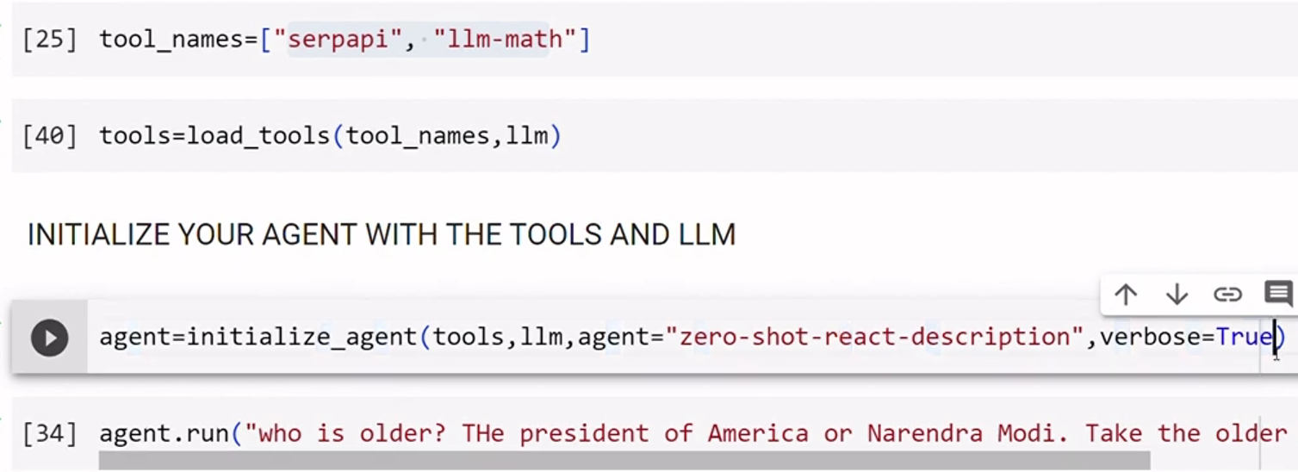
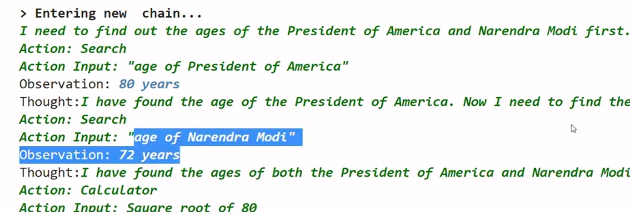
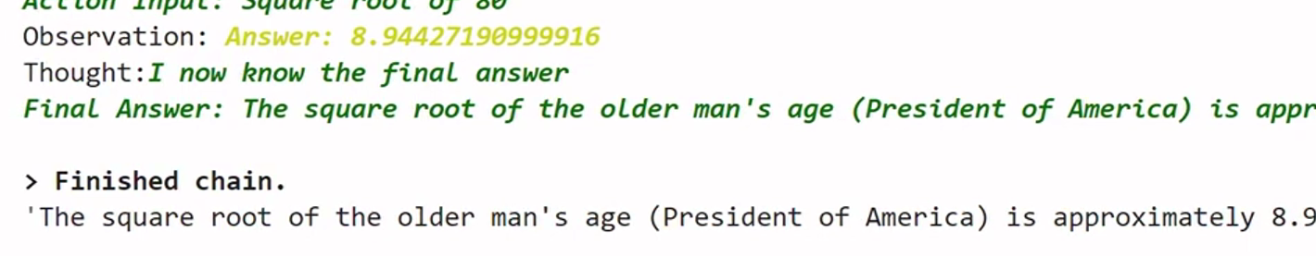
Agent with Tools – Google Search
Google search - Contd…

Slide 15
Model Context Protocol ( MCP )
MCP defines how AI applications interact with each other.
Model – The LLM
Context – Providing model with third party data or situational awareness.
Protocol – Standards for communication
Developers build MCP servers that allow a compatible client to use their services.
Follows Client –Server architecture & communication usually occurs via JSON RPC 2.0
Pillars of MCP Server
Tools ( Actions ) - Function calls by Agent
Resources ( Data ) - Static or Dynamic data for Agent ( eg, user preferences )
Prompts ( Templates ) - Predefined instructions to guide the LLM on how to use the tools effectively
MCP Client
Context - Allows the server to send status/debug messages back to the client
Roots - Defines “safe” folders the client allows the server to see
Sampling - Allows server to ask Client to perform LLM call on its behalf, keeping server decoupled from LLM
Elicitation - Enables server to ask end-user more information through the client

Slide 16
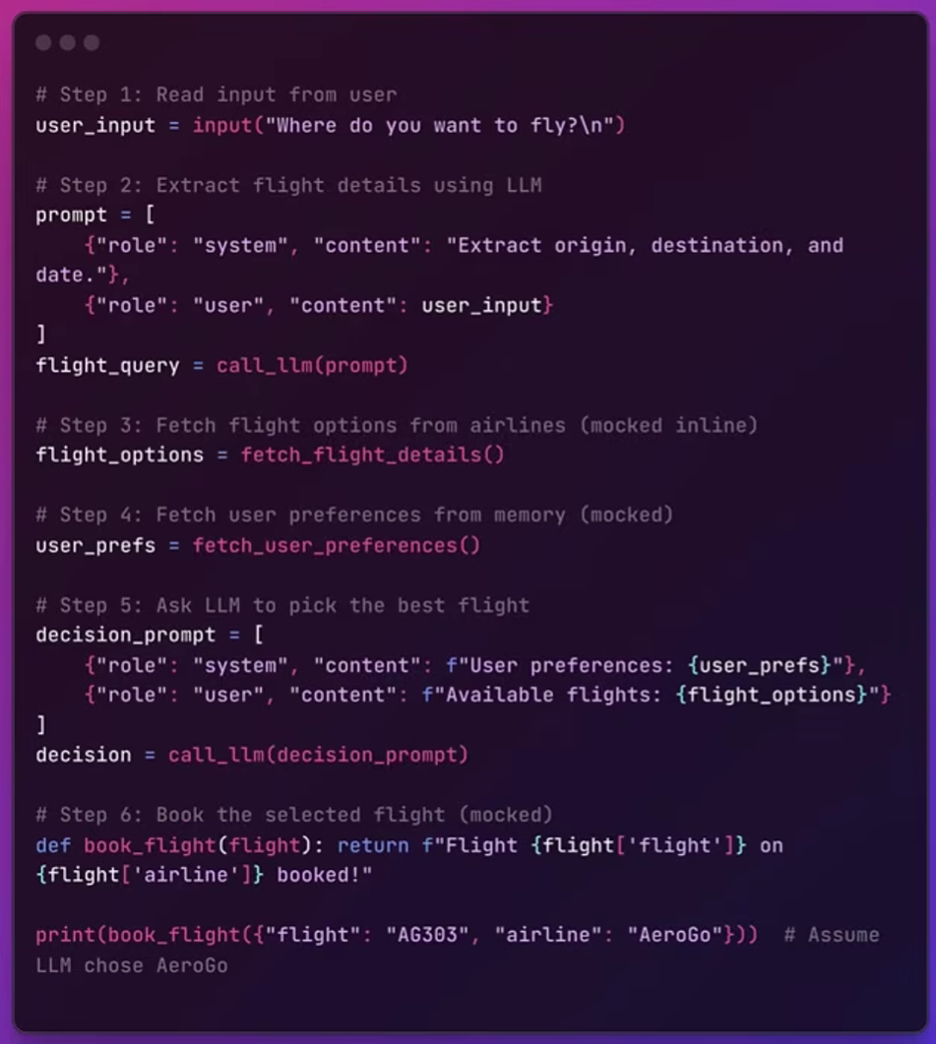
Model Context Protocol ( MCP )
Simplified version of AI Agent needing MCP

Slide 17
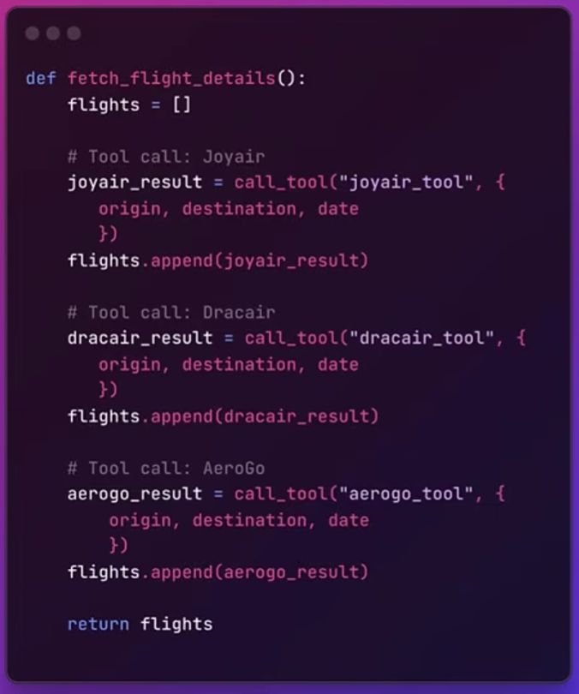
Model Context Protocol ( MCP )
Simplified version of AI Agent needing MCP.. Fetch flight details

Slide 18
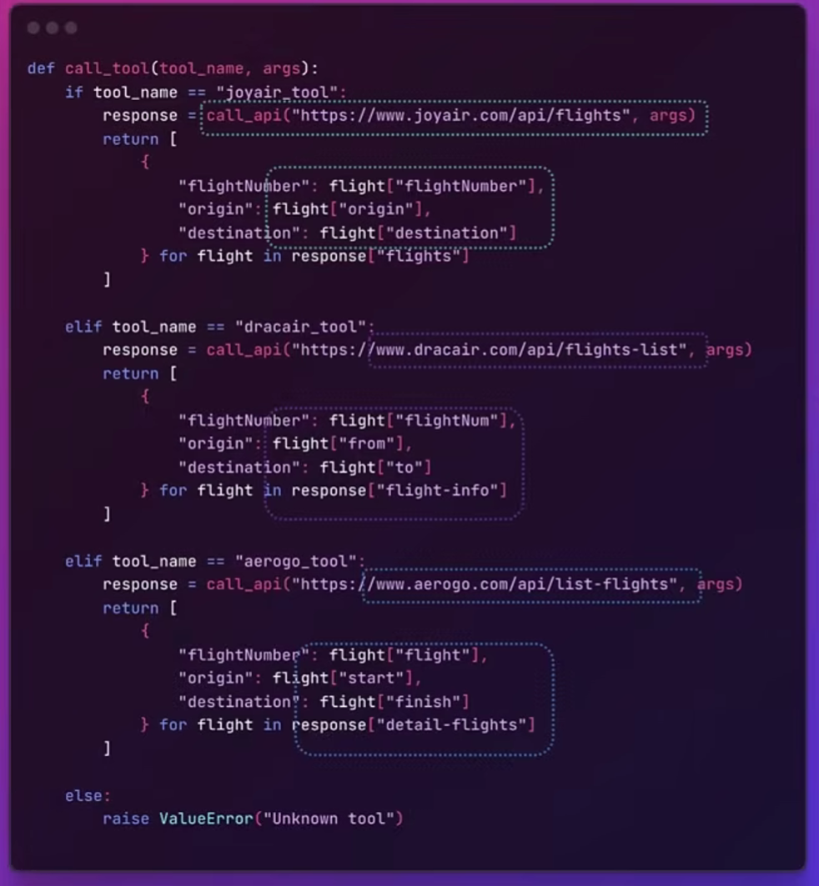
Model Context Protocol ( MCP )
Simplified version of AI Agent needing MCP.. Tool calls

Slide 19
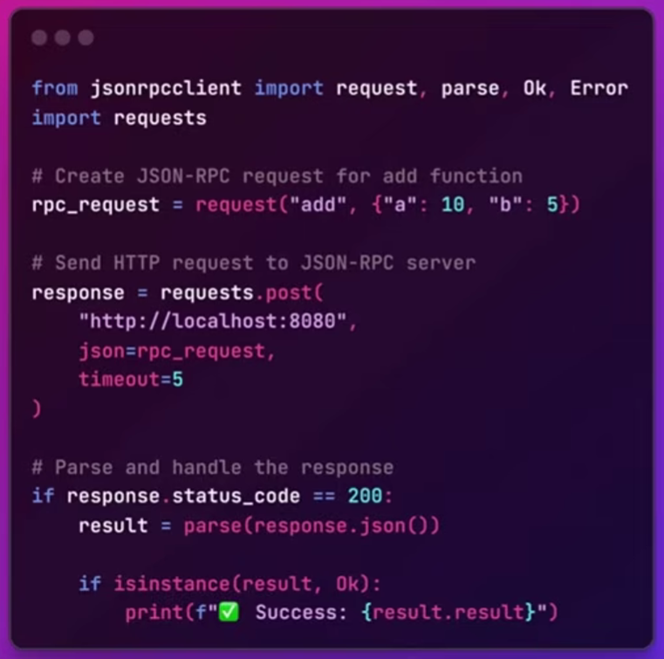
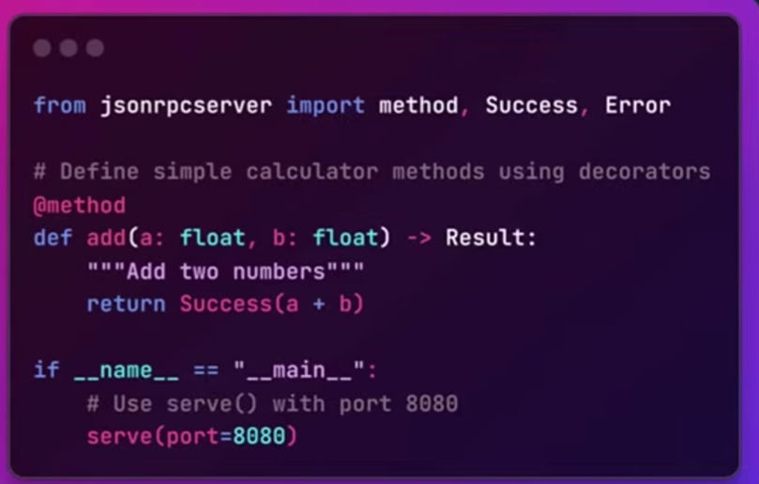
Model Context Protocol ( MCP )
JSON RPC 2.0 – Client vs Server

Slide 20
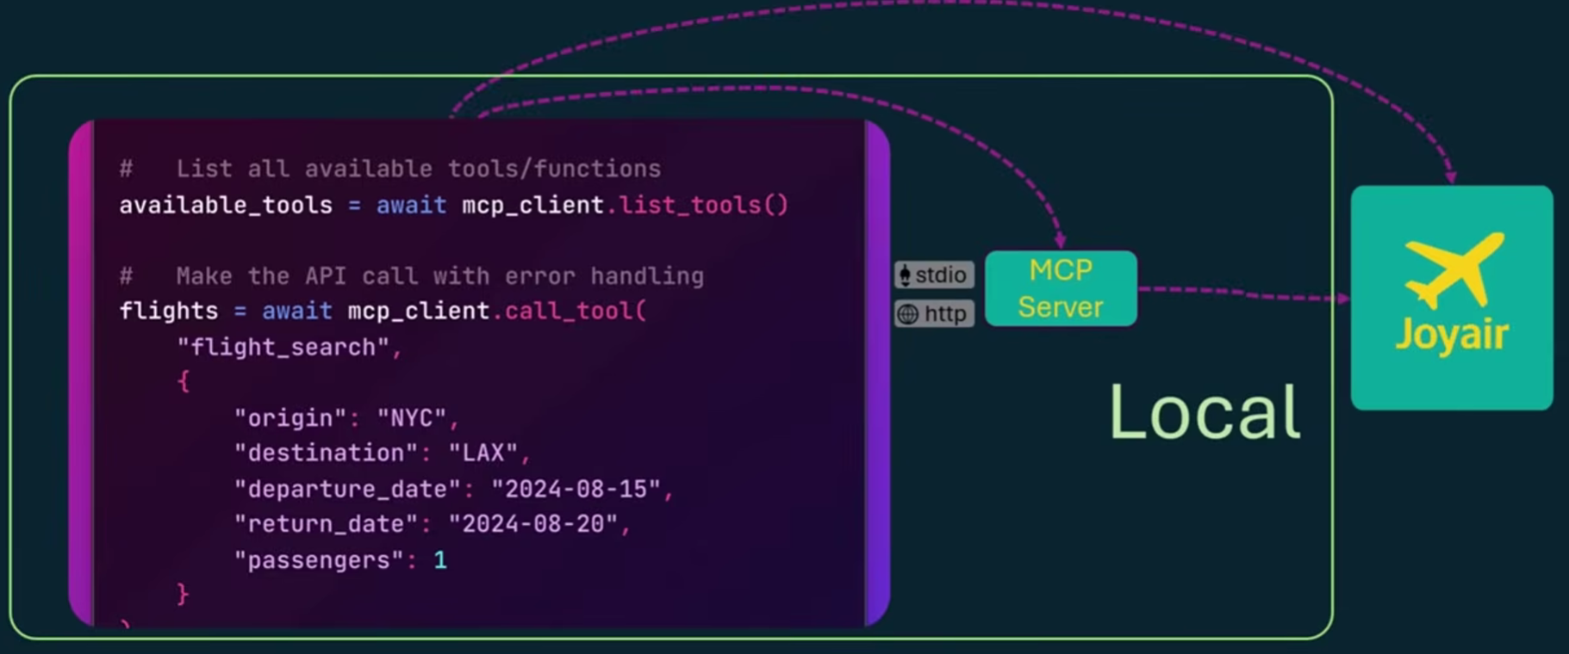
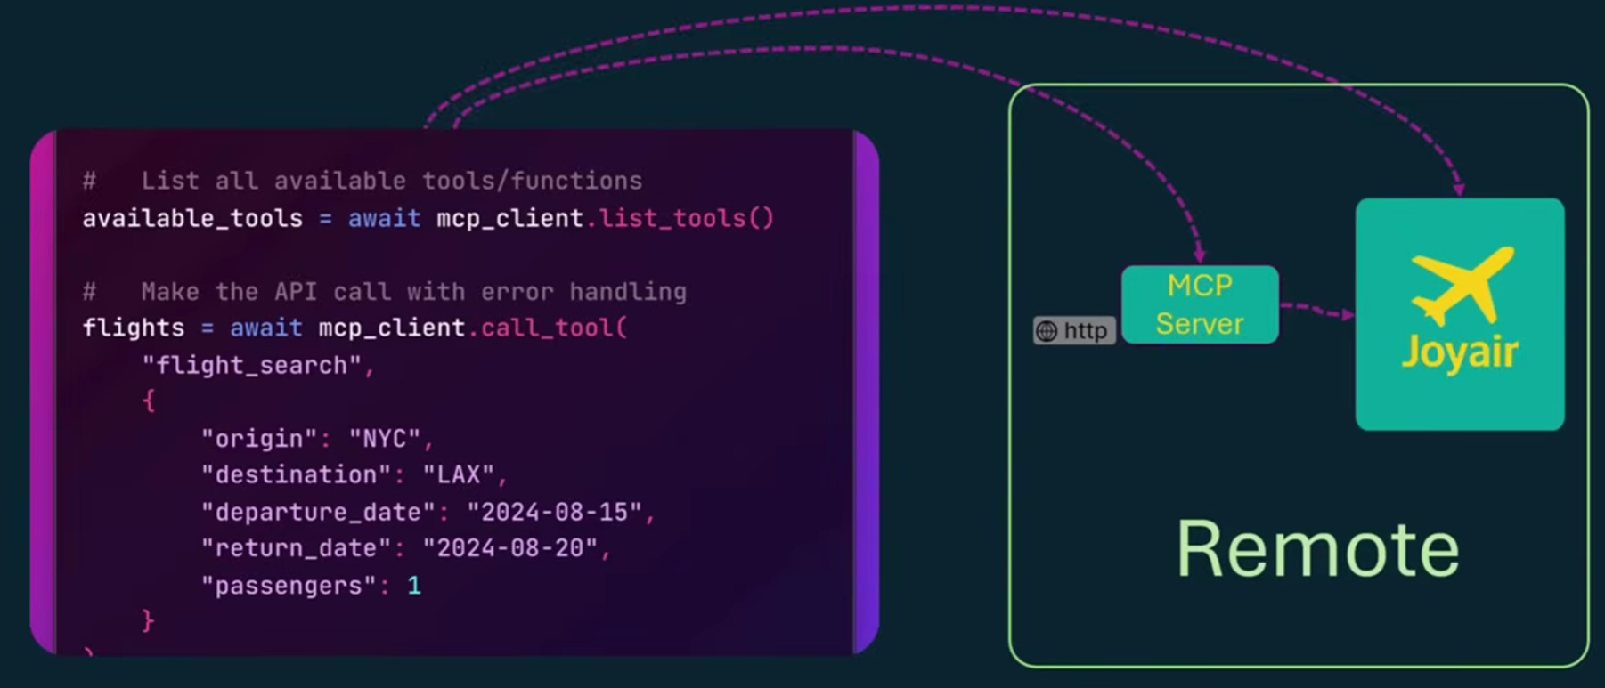
Model Context Protocol ( MCP )
MCP server – Local vs Remote

Slide 21
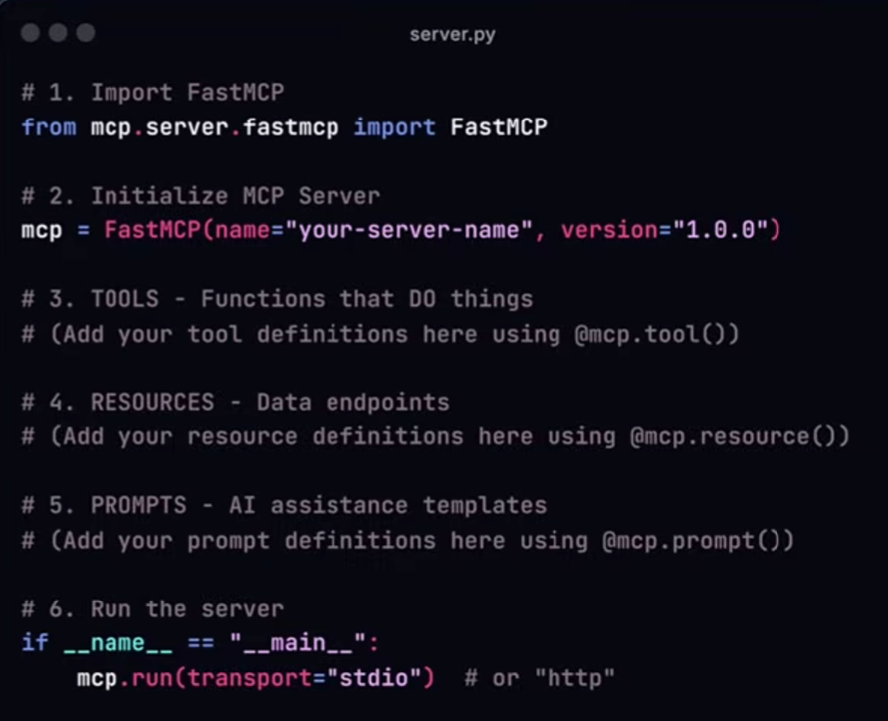
Model Context Protocol ( MCP )
Building MCP Server - FastMCP

Slide 22
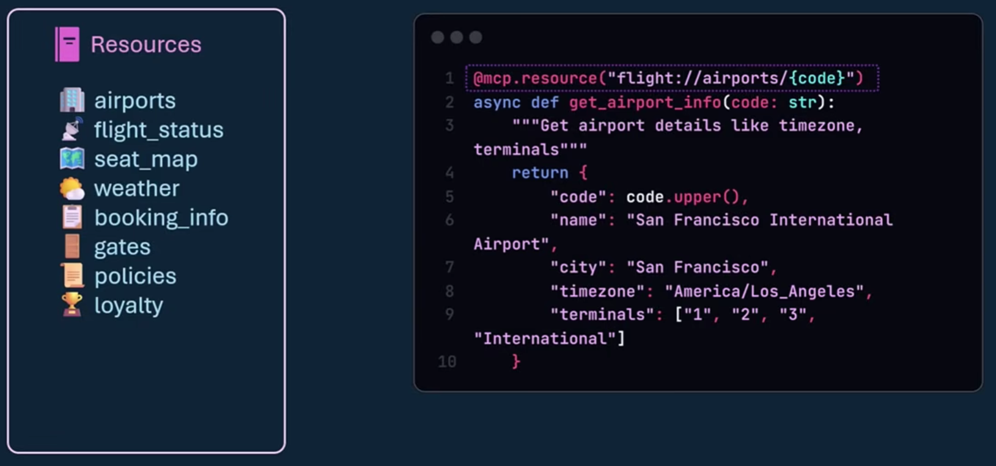
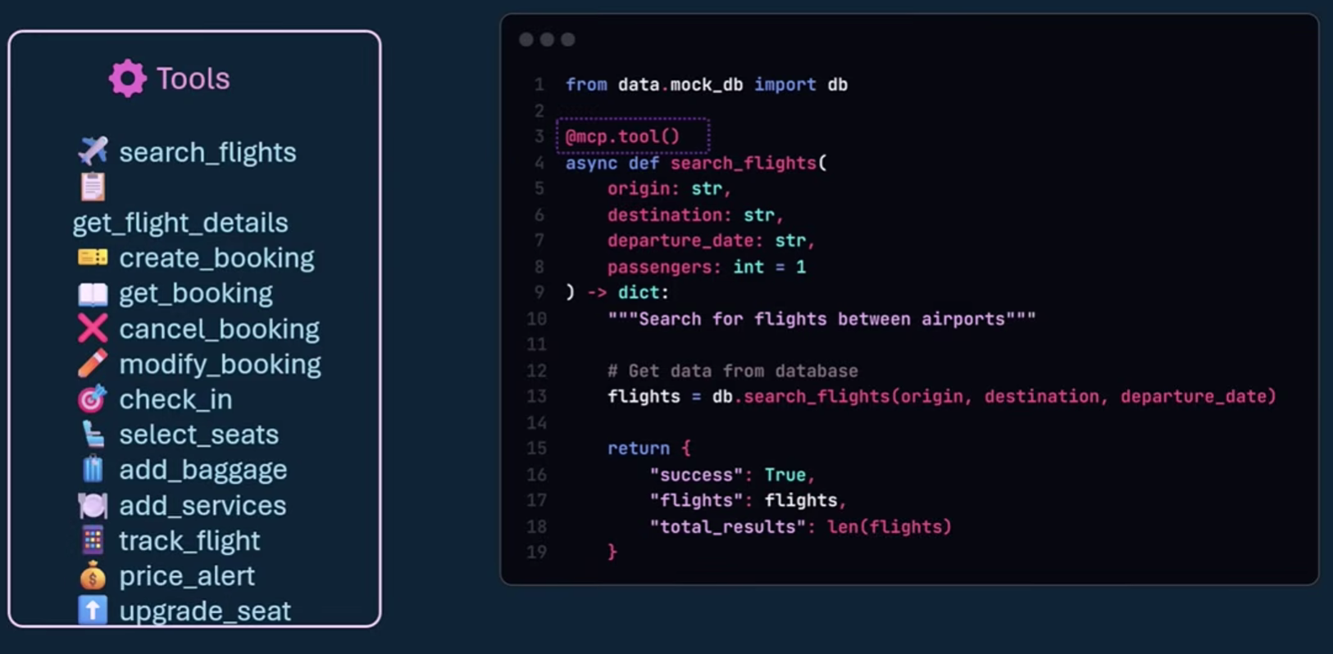
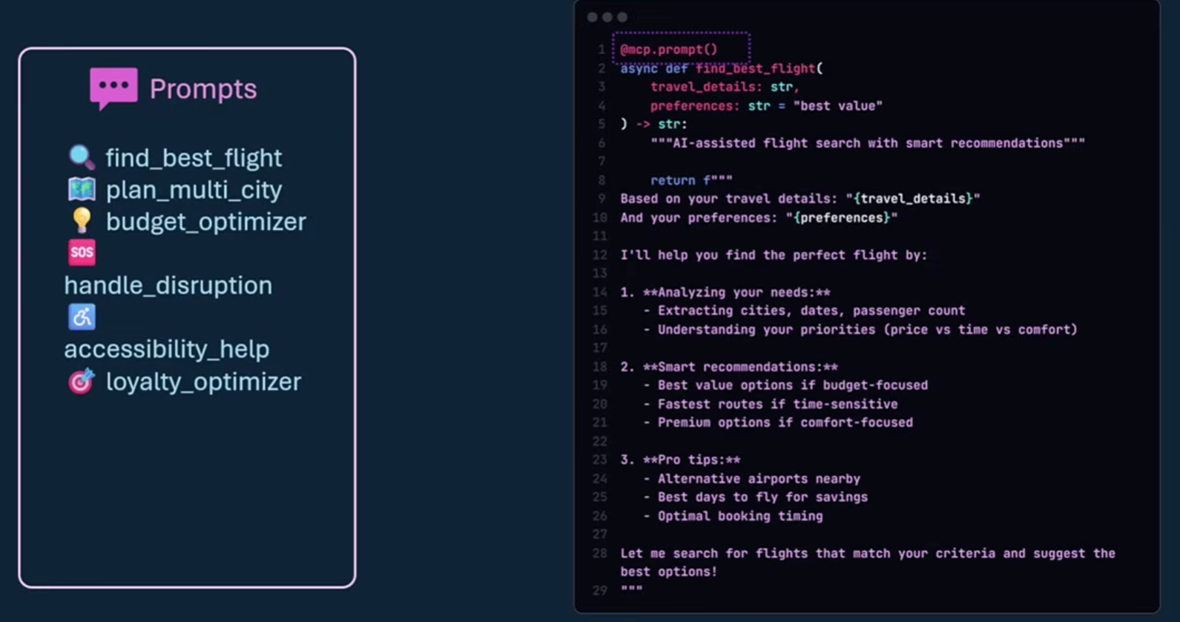
Model Context Protocol ( MCP )
Building MCP Server – Tools / Resources/ Prompts

Slide 23
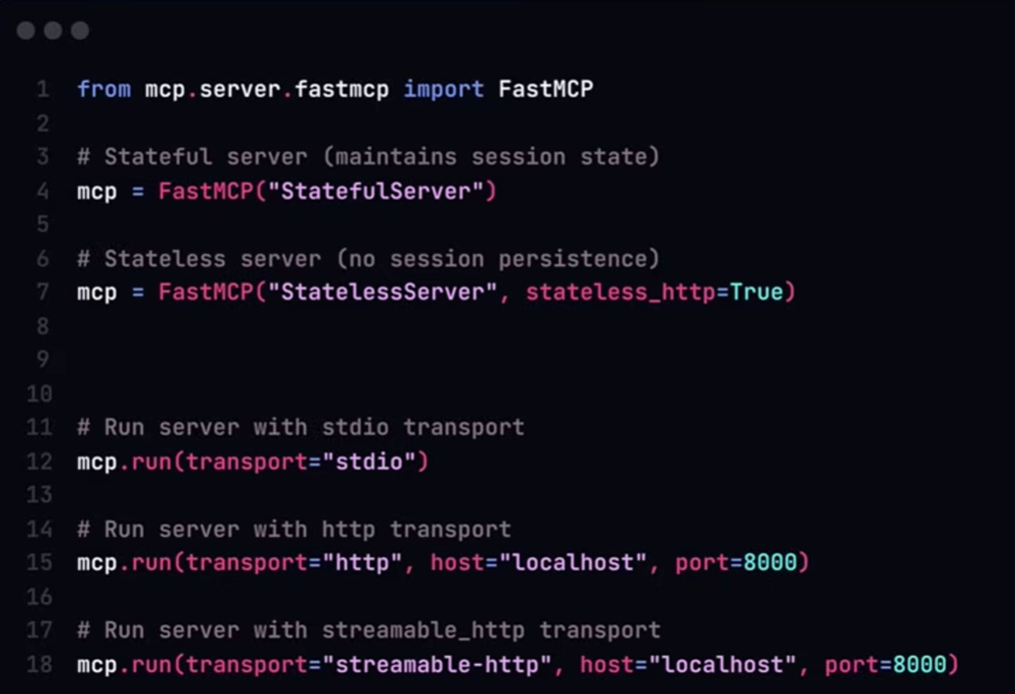
Model Context Protocol ( MCP )
Executing the MCP Server

Slide 24
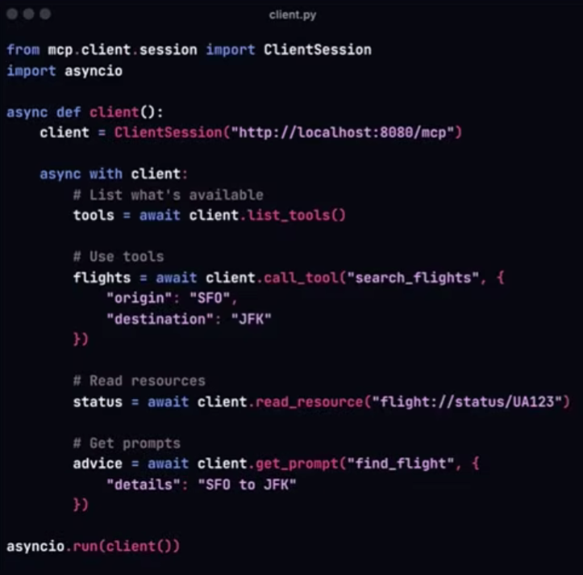
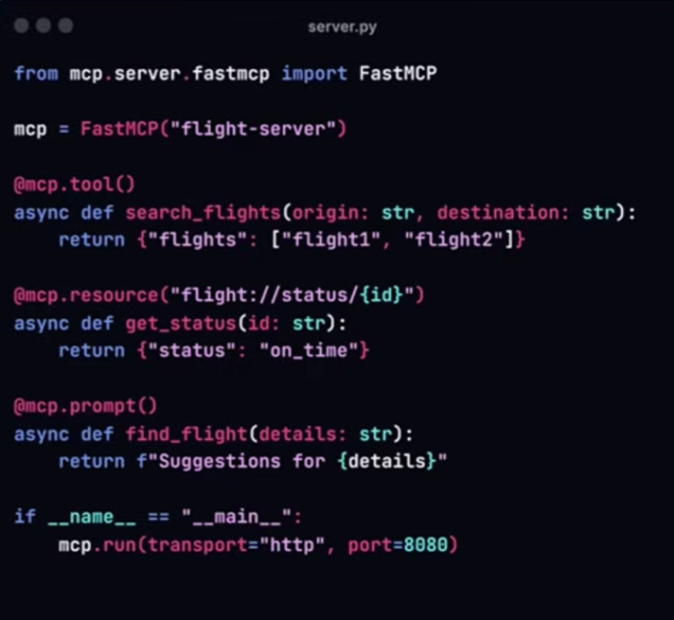
Model Context Protocol ( MCP )
Building MCP Client

Slide 25
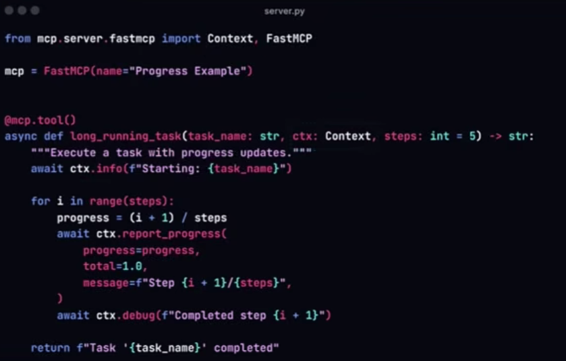
Model Context Protocol ( MCP )
MCP Client – Context - Allows the server to send status/debug messages back to the client

Slide 26
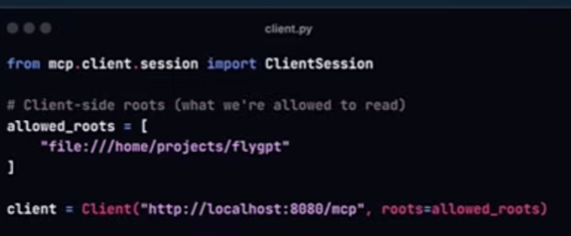
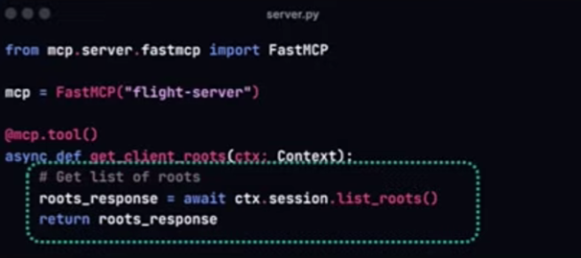
Model Context Protocol ( MCP )
MCP Client – Roots - Defines “safe” folders the client allows the server to see

Slide 27
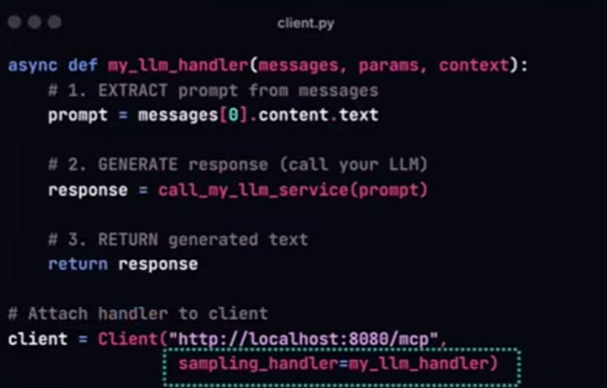

Model Context Protocol ( MCP )
MCP Client – Sampling - Allows server to ask Client to perform LLM call on its behalf, keeping server decoupled from LLM

Slide 28


Model Context Protocol ( MCP )
MCP Client – Elicitation - Enables server to ask end-user more information through the client

Slide 29
Next Step - Module 5 Self Learning
Arize AI Phoenix: Open-Source Tracing & Evaluation for AI (LLM/RAG/Agent) | Arize AI Product Overview Demo-20250703_093526-Meeting Recording.mp4
Note – Reference hands-on Python code will be made available via a personal Google Drive. Please avoid bringing that to Wells Fargo Network

