Slide 1
Agentic AI – Module 5 - Review
Wells Fargo Premier logo
Updated February 2026
© 2026 Wells Fargo Bank, N.A.

Slide 2
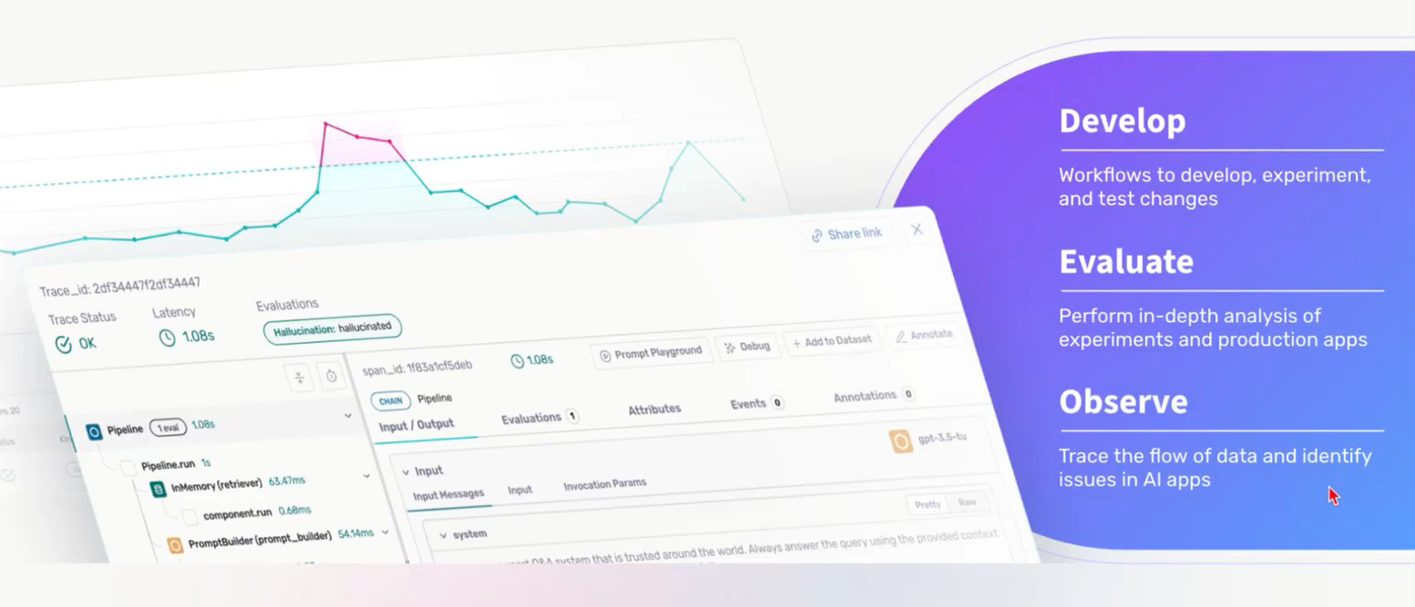
Arize
Challenges in building agents
No centralized place to track data, prompts, experiments
Hard to include non-technical stakeholders or delegate to SME
Slow & hard to iterate
While going into production, shipping agents is harder
No visibility into agent behavior
Lack of ability to quantify application performance
Hard to iterate & experiment in production

Slide 3
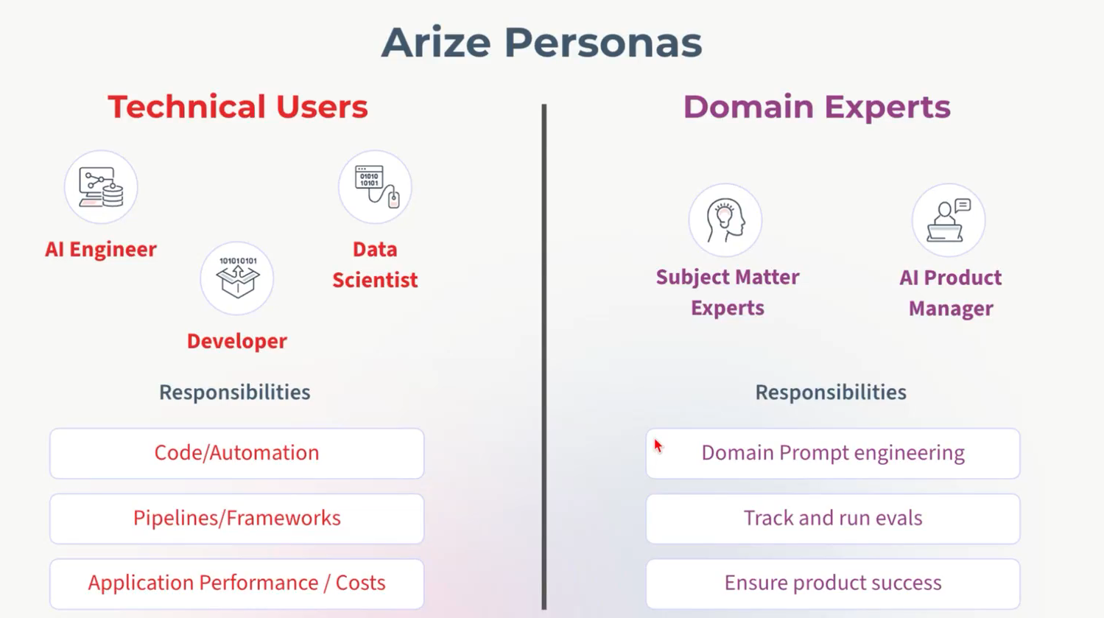
Arize

Slide 4
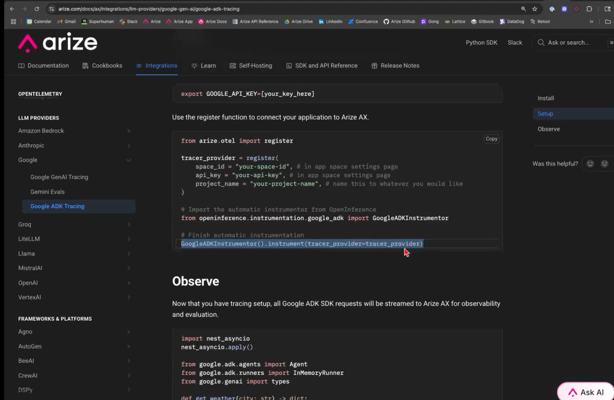
Arize
Use SDK to integrate with Arize

Slide 5
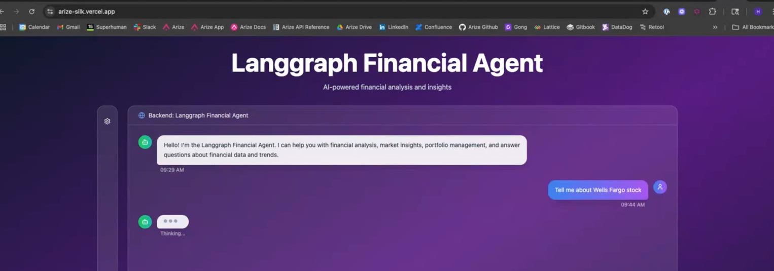
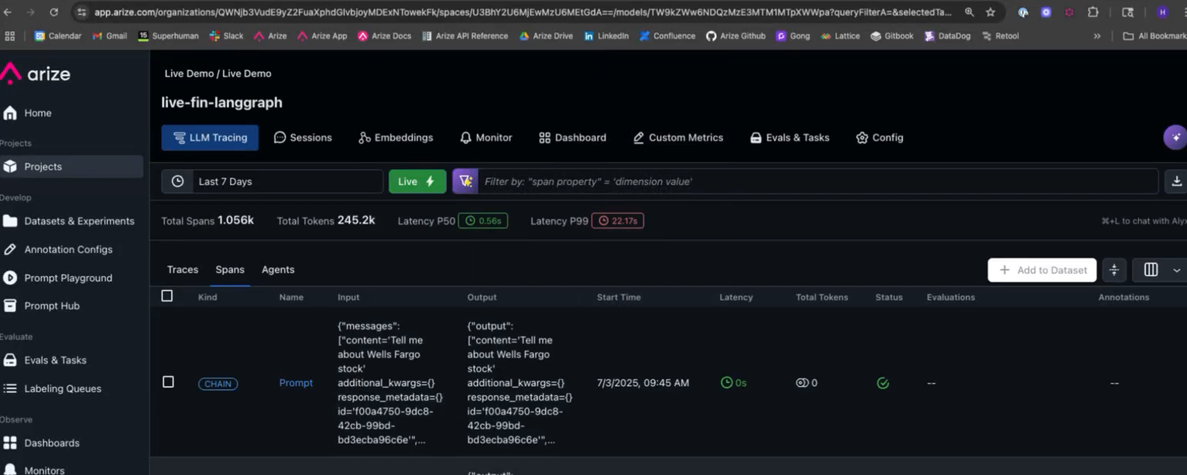
Arize
Example – Langgraph financial agent with prompt “Tell me about wellsfargo stock” – is traced in Arize if integrated:

Slide 6
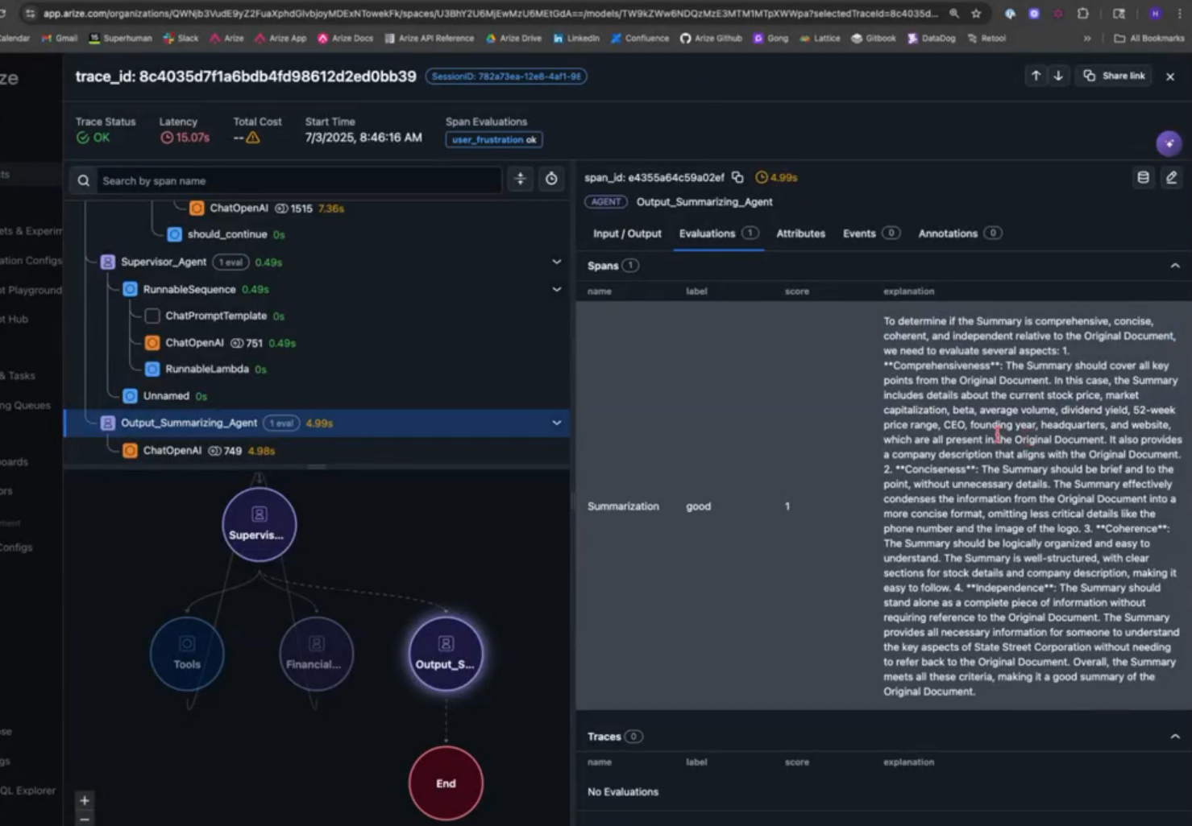
Arize
Agent flow – integrated with Arize. ; Provides Evaluations

Slide 7
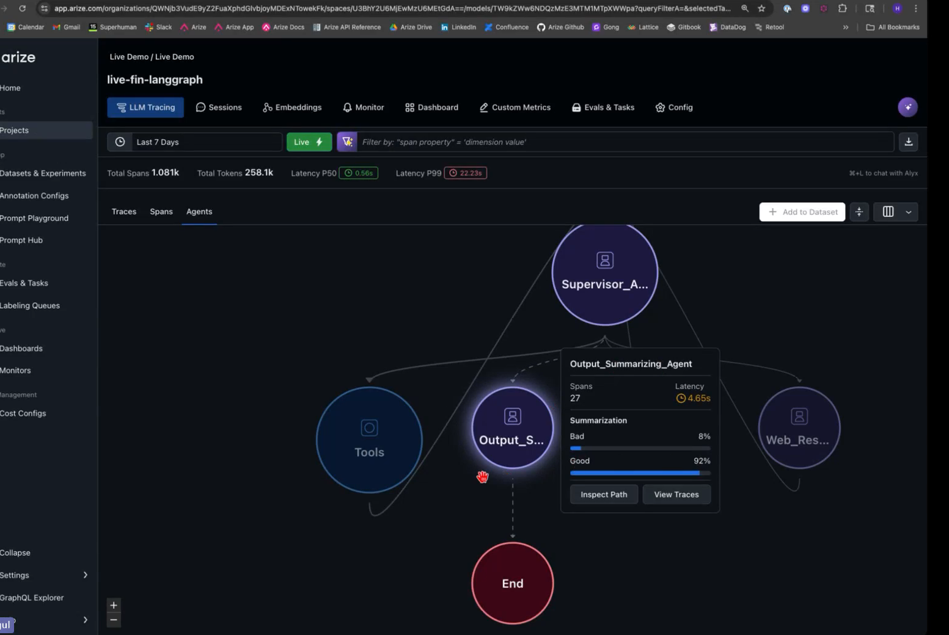
Arize
Ability to track Agent level correctness

Slide 8
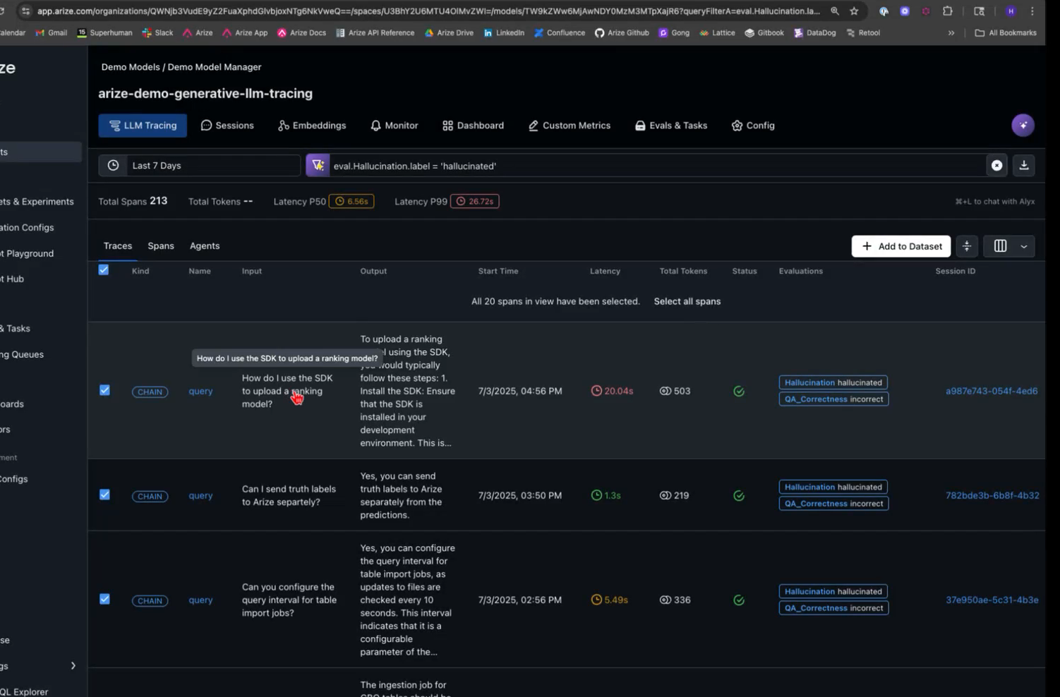
Arize
Saving hallucinated data for further analysis

Slide 9
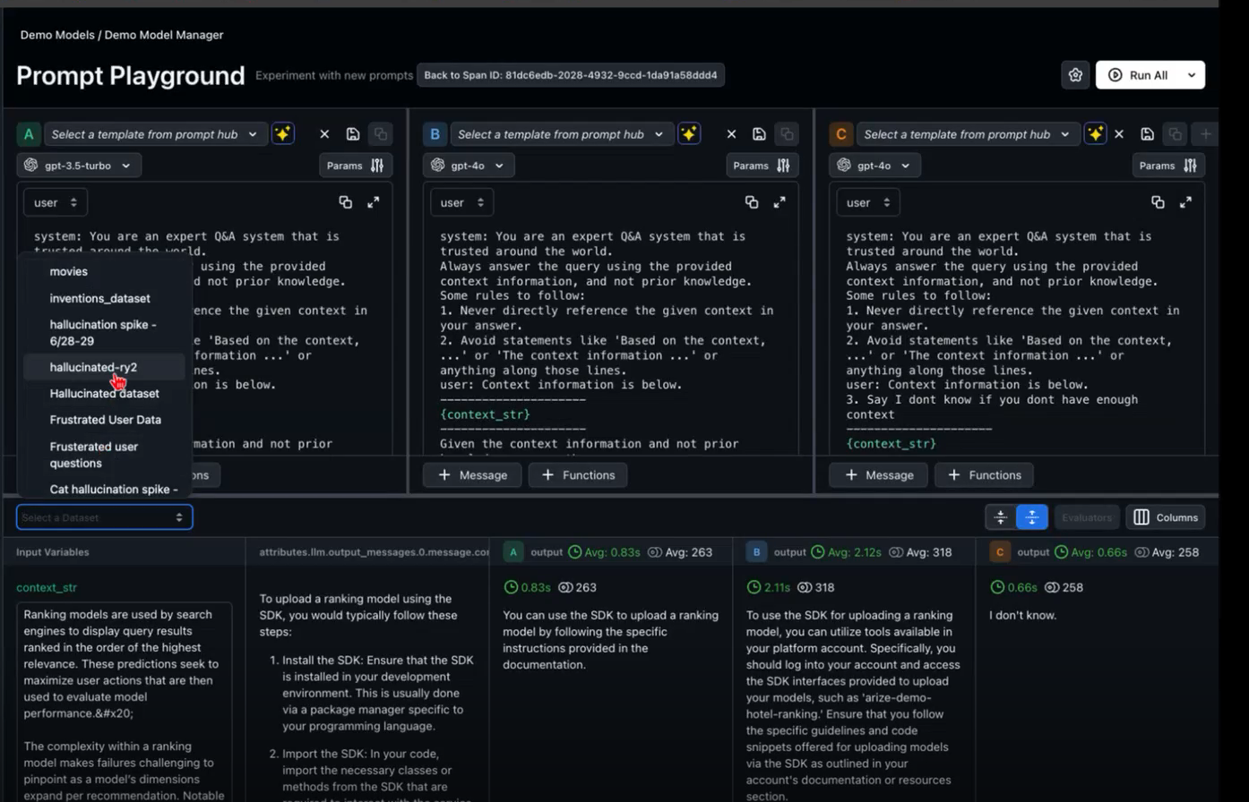
Arize
Refine Prompts in Playground, by selecting from Prompt Hub

Slide 10
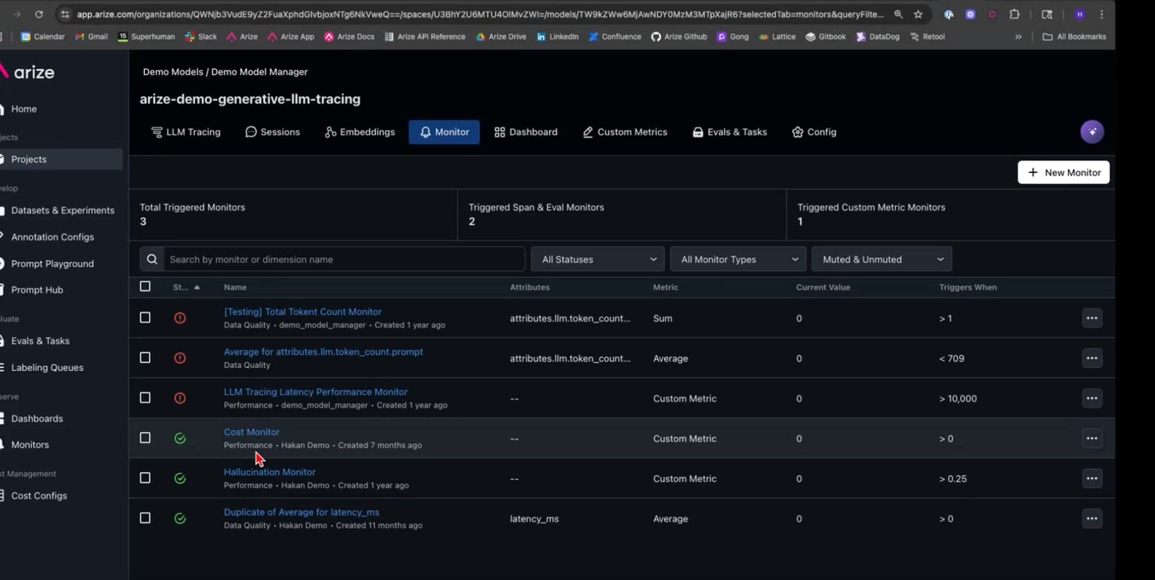
Arize
Metrics monitoring – Eg, Hallucination, bias, cost, toxicity etc

Slide 11
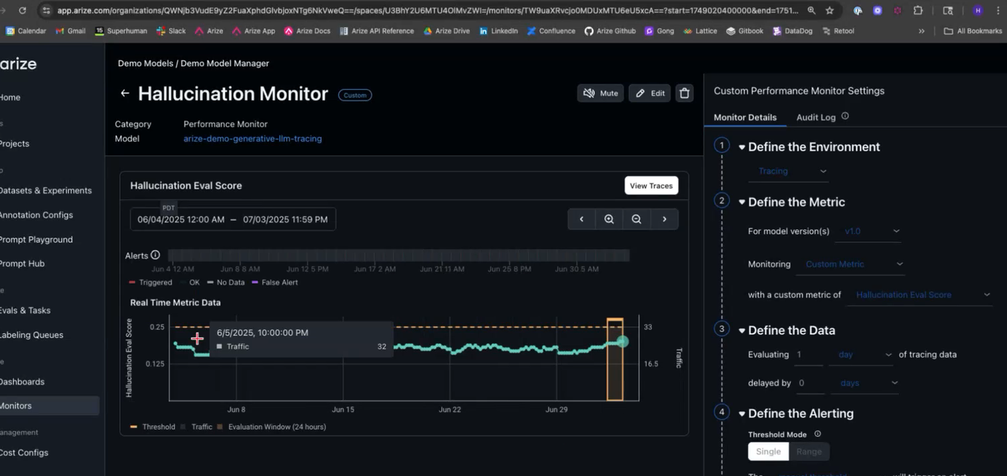
Arize
Hallucination Monitor

Slide 12
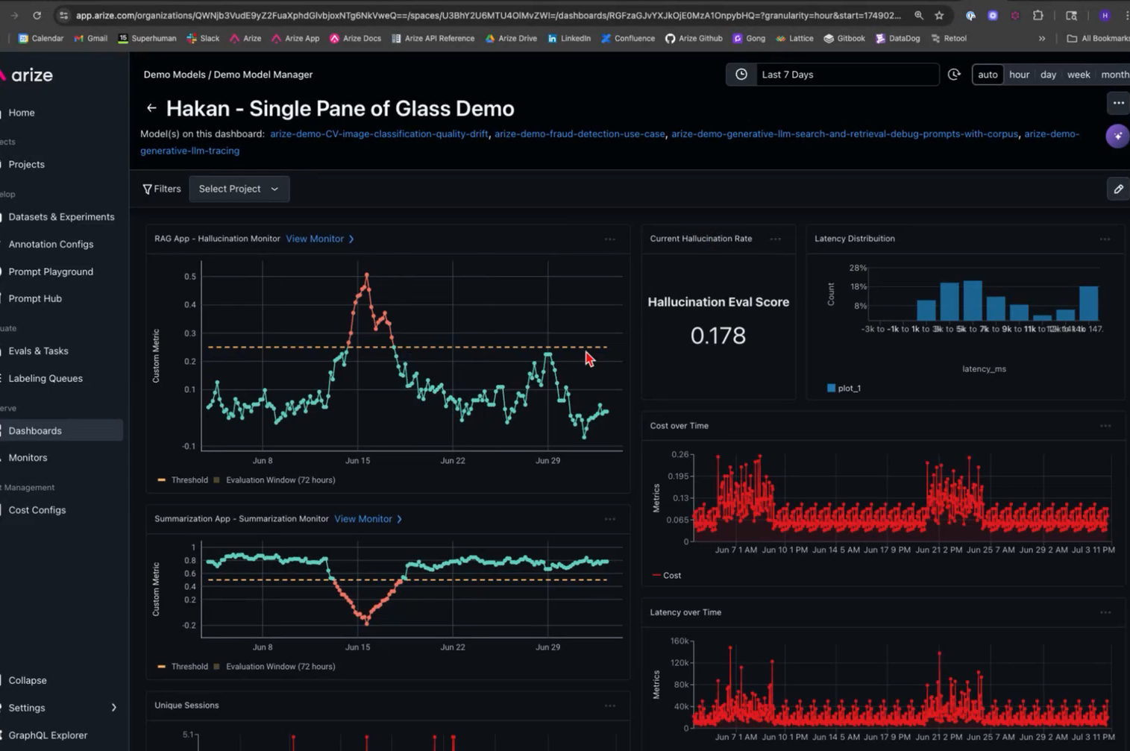
Arize
Single dashboard covering all agents

Slide 13
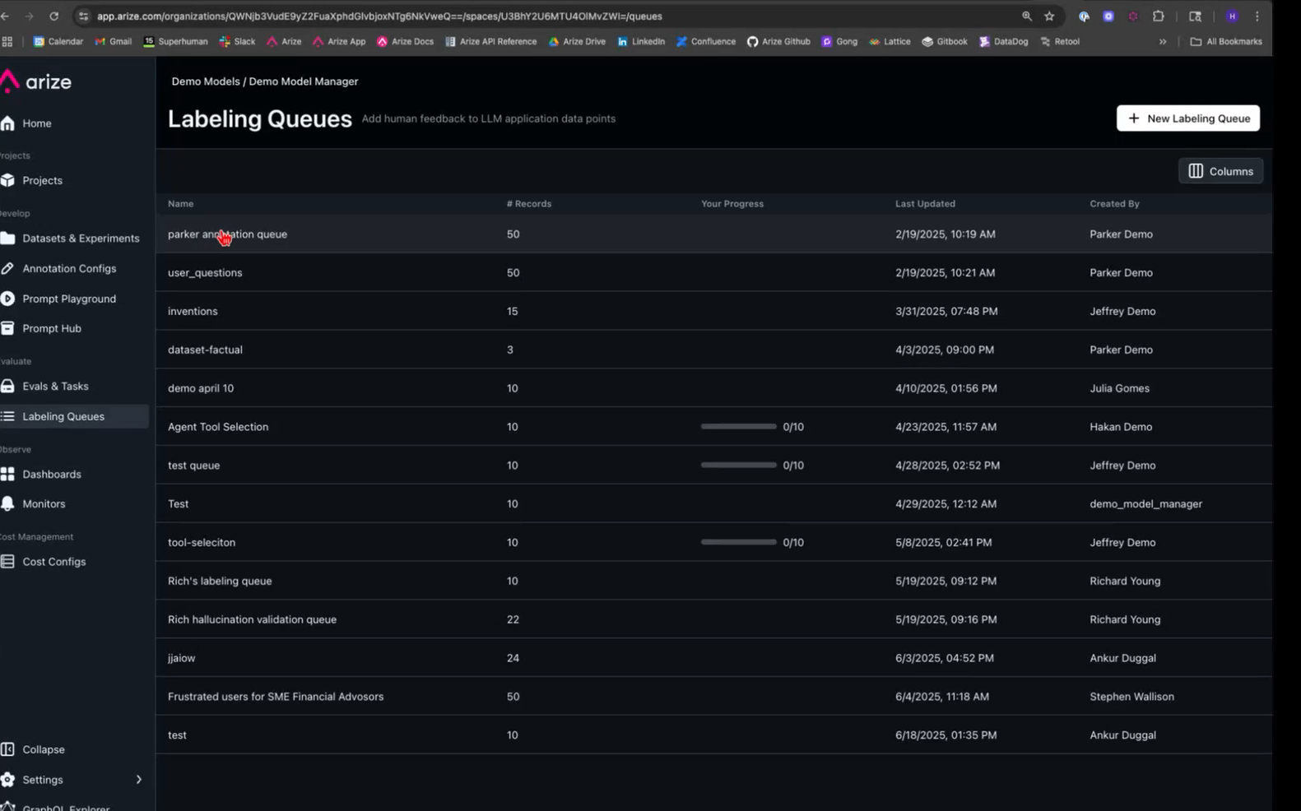
Arize
Traces of interest can be saved into separate datasets & Labelling queues for SME to look into

Slide 14
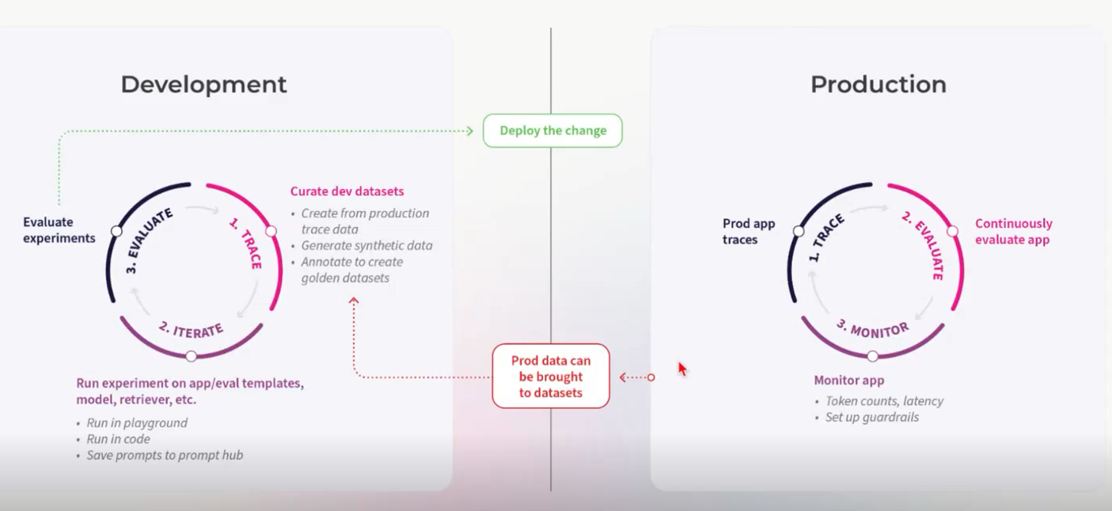
Arize
Development vs Production with Arize

Slide 15
Next Step – Handson – Tool Use Pattern
Banking Insights Agent - given a user request (Example - “What’s my available balance? “) – llm_tool_banking_agent.ipynb
Note – Reference hands-on Python code will be made available via a personal Google Drive. Please avoid bringing that to Wells Fargo Network

