Slide 1
Junit 5
Introduction to Spring MVC

Slide 2

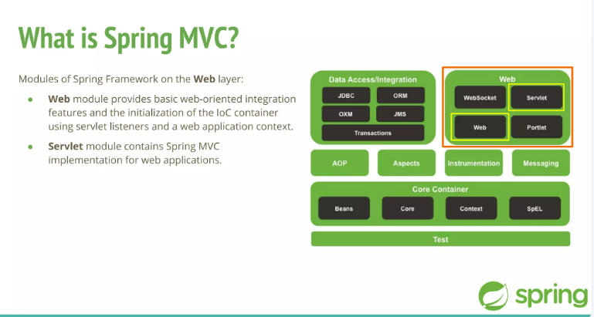
Learning Objectives

Slide 3
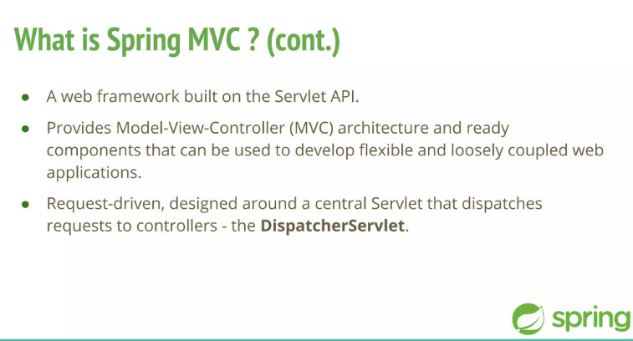
Learning Objectives

Slide 4

Learning Objectives

Slide 5
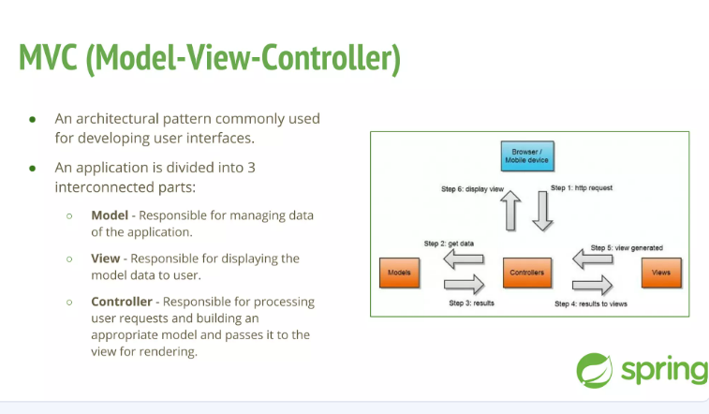
Learning Objectives

Slide 6

Learning Objectives

Slide 7
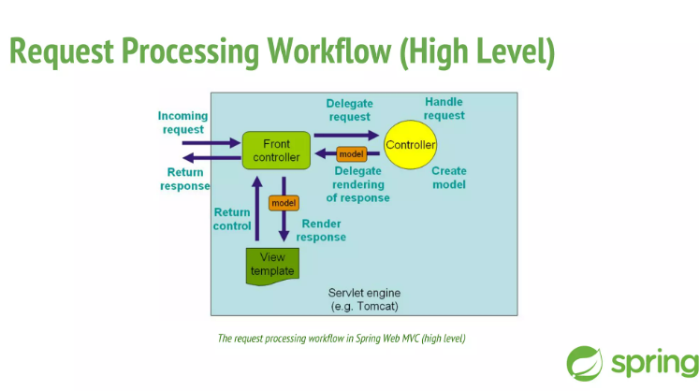
Learning Objectives

Slide 8
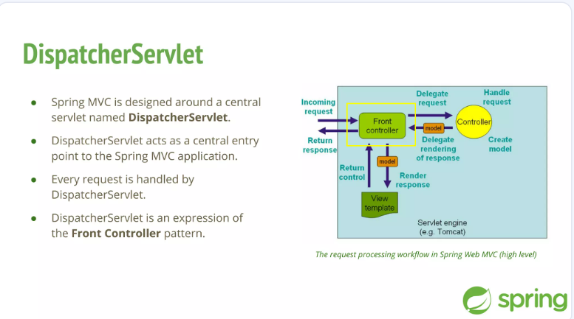
Learning Objectives

Slide 9
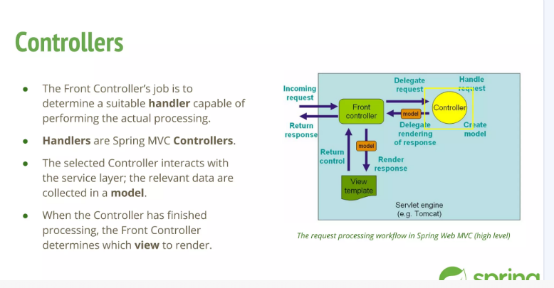
Learning Objectives

Slide 10
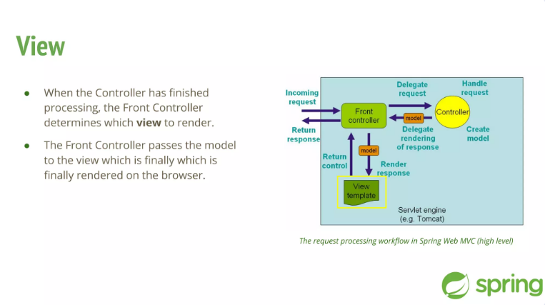
Learning Objectives

Slide 11
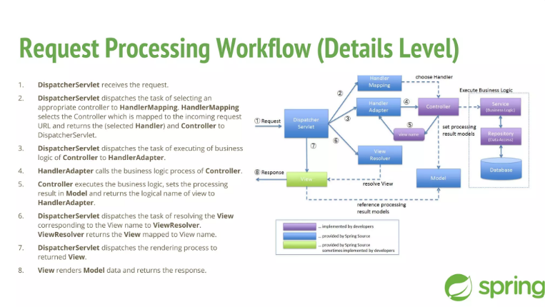
Learning Objectives

Slide 12
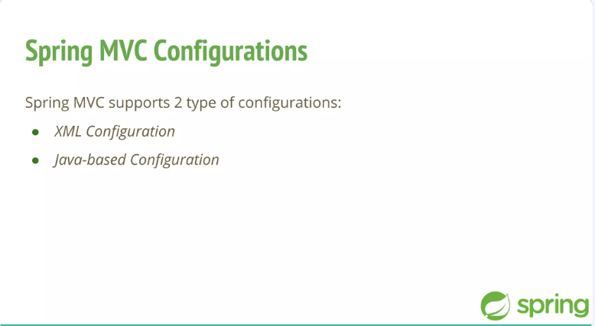
Learning Objectives

Slide 13
Learning Objectives

Slide 14
Learning Objectives

Slide 15
Learning Objectives

Slide 16
Learning Objectives

Slide 17
Learning Objectives

Slide 18
Learning Objectives

Slide 19
Learning Objectives

