Slide 1
Spring Core
Overview of Spring Framework

Slide 2

Learning Objectives
At the end of this session,
Understand the need of framework and structure of Spring Framework.
Understand Injecting dependencies.
Illustrate the usage of autowired concept.

Slide 3
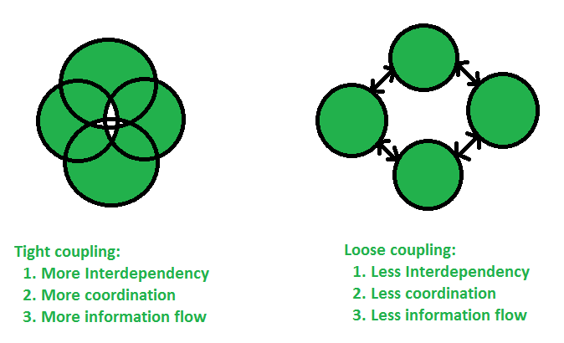
Loosely Coupling and its Benefits
Tight Coupling
1.More Interdependency
2.More Co-ordination
3.More Information Flow
Loose Coupling
1.Less Interdependency
2.Less Co-ordination
3.Less Information Flow

Slide 4

Spring Framework Overview
Spring is a lightweight framework. It can be thought of as a framework of frameworks because it provides support to various frameworks such as Struts, Hibernate, Tapestry, EJB, JSF, etc.
It was developed by Rod Johnson in 2003.
Notes:
"write once, run anywhere" (WORA) : means that compiled Java code can run on all platforms that support Java without the need for recompilation. Java applications are typically compiled to bytecode that can run on any Java virtual machine (JVM) regardless of computer architecture.

Slide 5
Introduction to Spring Framework
Spring Framework is a method for product development comes with criteria like
The need for dependency Injection (DI)
Lightweight structure for the product, with POJO or plain old java object
AOP or aspect oriented programming
An option for unit testing
Modular development options.
Notes:
"write once, run anywhere" (WORA) : means that compiled Java code can run on all platforms that support Java without the need for recompilation. Java applications are typically compiled to bytecode that can run on any Java virtual machine (JVM) regardless of computer architecture.

Slide 6
Benefits of Spring Framework
Predefined Templates
Loosely Couples
Easy to Test
Lightweight
Fast Development
Powerful abstraction
Declarative Support
Notes:
"write once, run anywhere" (WORA) : means that compiled Java code can run on all platforms that support Java without the need for recompilation. Java applications are typically compiled to bytecode that can run on any Java virtual machine (JVM) regardless of computer architecture.

Slide 7
Spring Modules
The Spring framework comprises of many modules such as core, beans, context, expression language, AOP, Aspects, Instrumentation, JDBC, ORM, OXM, JMS, Transaction, Web, Servlet, Struts etc.
These modules are grouped into Test, Core Container, AOP, Aspects, Instrumentation, Data Access / Integration, Web (MVC / Remoting).
Notes:
"write once, run anywhere" (WORA) : means that compiled Java code can run on all platforms that support Java without the need for recompilation. Java applications are typically compiled to bytecode that can run on any Java virtual machine (JVM) regardless of computer architecture.

Slide 8
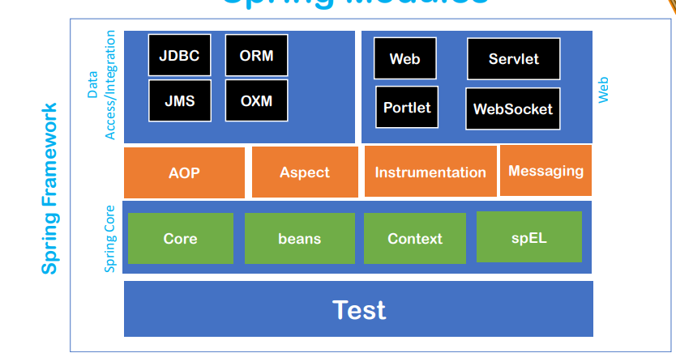
Spring modules –Contd-1
Notes:
"write once, run anywhere" (WORA) : means that compiled Java code can run on all platforms that support Java without the need for recompilation. Java applications are typically compiled to bytecode that can run on any Java virtual machine (JVM) regardless of computer architecture.

Slide 9
Spring modules –Contd-2
The Core module provides the fundamental parts of the framework, including the IoC and Dependency Injection features
The Beans module provides BeanFactory, which is a sophisticated implementation of the factory pattern

Slide 10
Spring modules –Contd-2
The Context module builds on the base provided by the Core and Beans modules and it provides access to any objects defined and configured. The ApplicationContext interface is a key part of the Context module.
It is an extension to the EL defined in JSP. It provides support to setting and getting property values, method invocation, accessing collections and indexers, named variables, logical and arithmetic operators, retrieval of objects by name etc

Slide 11
Spring modules
AOP
ASPECTS
The AOP module provides aspect-oriented programming implementation allowing you to define method-interceptors and point cuts to cleanly decouple code that implements functionality, which should be separated
The Aspects module provides integration with AspectJ, which is a powerful and mature aspect oriented programming (AOP) framework

Slide 12
Spring modules
The JDBC module provides a JDBC-abstraction layer that removes the need to do laborious JDBC related coding
The ORM module provides integration layers for popular object-relational mapping APIs, including JPA, JDO, Hibernate, and so on.
The Transaction module supports programmatic and declarative transaction management for classes that implement special interfaces and for POJOs.
.
The Web module provides basic web-oriented integration features, such as multipart file-upload functionality and the initialization of the IoC container using servlet listeners and a web-oriented application context.

Slide 13
IOC Container
Spring IoC Container is mainly responsible for implementing the objects & injecting themInversion of Control (IoC) i.e., to achieve loose coupling between the classes by creating dynamically during the run time.
Spring IoC Containers helps,
Instantiating the class & creating the object
Configuring the object
Assembling and managing the dependencies between the objects.
Notes:
"write once, run anywhere" (WORA) : means that compiled Java code can run on all platforms that support Java without the need for recompilation. Java applications are typically compiled to bytecode that can run on any Java virtual machine (JVM) regardless of computer architecture.

Slide 14
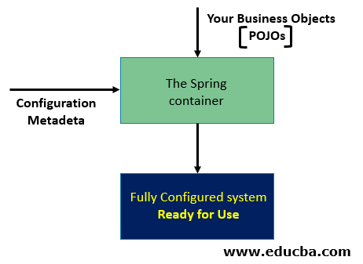
Architecture of IOC Container
Notes:
"write once, run anywhere" (WORA) : means that compiled Java code can run on all platforms that support Java without the need for recompilation. Java applications are typically compiled to bytecode that can run on any Java virtual machine (JVM) regardless of computer architecture.

Slide 15
Architecture of IOC Container
The Spring Container consumes Configuration Metadata which is nothing but the
or Java annotations.
XML file Configuration
This Configuration Metadata contains information which defines:
What are the Objects to be instantiated?
What are the Objects to be configured & how to configure?
How to assemble the Objects?
Notes:
"write once, run anywhere" (WORA) : means that compiled Java code can run on all platforms that support Java without the need for recompilation. Java applications are typically compiled to bytecode that can run on any Java virtual machine (JVM) regardless of computer architecture.

Slide 16
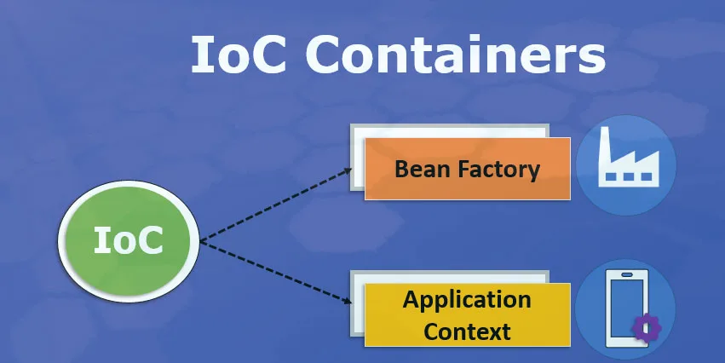
Types of IOC Containers
Notes:
"write once, run anywhere" (WORA) : means that compiled Java code can run on all platforms that support Java without the need for recompilation. Java applications are typically compiled to bytecode that can run on any Java virtual machine (JVM) regardless of computer architecture.

Slide 17
Types of IOC Containers - Contd:1
1.Bean Factory
The Bean Factory, the root interface of the IoC container provides basic support for achieving loose coupling between the classes using Dependency Injection It is defined under org.springframework.beans.factory.
BeanFactory Interface. As the name suggests, Bean Factory is a place where the beans are manufactured & injected into the classes.
Notes:
"write once, run anywhere" (WORA) : means that compiled Java code can run on all platforms that support Java without the need for recompilation. Java applications are typically compiled to bytecode that can run on any Java virtual machine (JVM) regardless of computer architecture.

Slide 18
Types of IOC Containers - Contd:2
Scopes of Beans:
Singleton: This is the default scope. As the name suggests, only one instance of the bean will be created for each container.
Prototype: For each request, a new bean will be created.
Request: It will be used in Web Application For each HTTP request from the client, a new bean will be created.
Session: For each HTTP Session, a new bean will be created.
Notes:
"write once, run anywhere" (WORA) : means that compiled Java code can run on all platforms that support Java without the need for recompilation. Java applications are typically compiled to bytecode that can run on any Java virtual machine (JVM) regardless of computer architecture.

Slide 19
Types of IOC Containers – Contd :3
2. Application Context
Application Context is the same as Bean Factory as it is built upon BeanFactory Interface only, but it provides a few more extra functionalities such as:
Simple Integration with Spring Framework’s AOP.
Message resource handling in Internationalization (i18N).
Event propagation.
Most importantly WebApplicationContext for Web Applications.
It is defined under org.springframework.context.ApplicationContext Interface.
Notes:
"write once, run anywhere" (WORA) : means that compiled Java code can run on all platforms that support Java without the need for recompilation. Java applications are typically compiled to bytecode that can run on any Java virtual machine (JVM) regardless of computer architecture.

Slide 20
Types of IOC Containers - Contd:4
Student.java
package com.springcore;
import org.springframework.context.ApplicationContext;
import org.springframework.context.support.ClassPathXmlApplicationContext;
public class App
{
public static void main( String[] args )
{
System.out.println( "Hello World!" );
ApplicationContext context=new ClassPathXmlApplicationContext("config.xml");
Student student1=(Student) context.getBean("student1");
Student student2=(Student) context.getBean("student2");
System.out.println(student1);
System.out.println(student2);
}
}
Notes:
"write once, run anywhere" (WORA) : means that compiled Java code can run on all platforms that support Java without the need for recompilation. Java applications are typically compiled to bytecode that can run on any Java virtual machine (JVM) regardless of computer architecture.

Slide 21
Types of IOC Containers - Contd:5
Types of Application Context
There are three different types of Application Contexts.
FileSystemXmlApplicationContext
ClassPathXmlApplicationContext
WebXmlApplicationContext
Notes:
"write once, run anywhere" (WORA) : means that compiled Java code can run on all platforms that support Java without the need for recompilation. Java applications are typically compiled to bytecode that can run on any Java virtual machine (JVM) regardless of computer architecture.

Slide 22
Dependency Injection
Dependency Injection (DI) is a design pattern that removes the dependency from the programming code so that it can be easy to manage and test the application.
Dependency Injection makes our programming code loosely coupled.
Notes:
"write once, run anywhere" (WORA) : means that compiled Java code can run on all platforms that support Java without the need for recompilation. Java applications are typically compiled to bytecode that can run on any Java virtual machine (JVM) regardless of computer architecture.

Slide 23
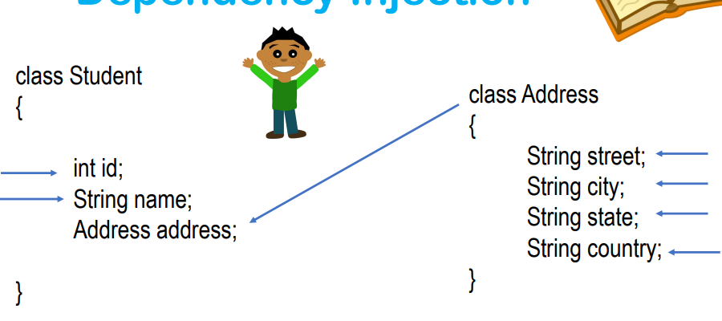
Dependency Injection- Contd -1
Notes:
"write once, run anywhere" (WORA) : means that compiled Java code can run on all platforms that support Java without the need for recompilation. Java applications are typically compiled to bytecode that can run on any Java virtual machine (JVM) regardless of computer architecture.

Slide 24
Dependency Injection
Dependency Injection can be done in 2 ways
Setter Injection
Constructor Injection
Notes:
"write once, run anywhere" (WORA) : means that compiled Java code can run on all platforms that support Java without the need for recompilation. Java applications are typically compiled to bytecode that can run on any Java virtual machine (JVM) regardless of computer architecture.

Slide 25
Dependency Injection –Data Types
1) Primitive DataTypes:( Dependencies)
Byte , short , char , int , float , double , long , Boolean
2) Collection Type Data Types List , Set , Map and Properties
3) Reference Types

Slide 26
Dependency Injection –Primitive Types
Primitive Types:
<property name="">
<value>value</value>
</property>
<property name="" value="" />
<bean p:property:Value />

Slide 27
Dependency Injection –Collection types
List
<bean>
<property name="">
<list>
<value>10</value>
<value>1023</value>
<value>12350</value>
<value>1052</value>
<null/>
</list>
</property>
<bean>
Set
<bean>
<property name="">
<set>
<value>10</value>
<value>1023</value>
<value>12350</value>
<value>1052</value>
</set>
</property>
</bean>

Slide 28
Dependency Injection –Data Types
Map
<bean>
<property name="">
<map>
<entry key="java" value="2month" />
<entry key="python" value="1month" />
</map>
</property>
</bean>

Slide 29
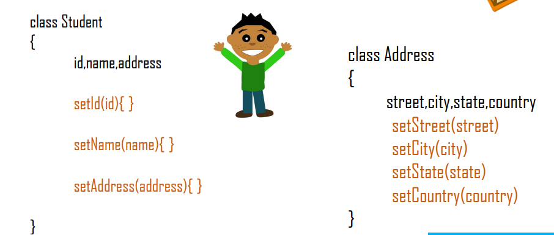
Dependency Injection –Setter Injection
<bean class="com.springcore.Student" name="student3" >
<property name=“id" value="123" />
<property name=“name" value=“Rohan" />
<property name=“address“ value="Bengaluru" />
</bean>

Slide 30
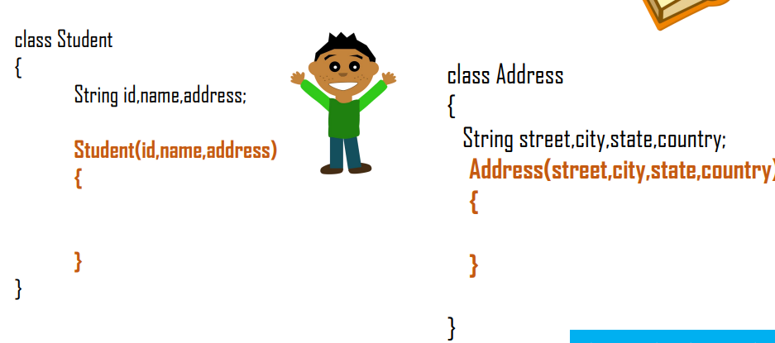
Dependency Injection –Constructor Injection
<bean class="com.springcore.constructotinjection.student" name="person1" >
<constructor-arg value=“Rohan" />
<constructor-arg value="321" />
<constructor-arg value=“Bengaluru” />
</bean>

Slide 31
Bean Life Cycle Methods
Spring provide two important methods to every bean
public void Init()
Initialization Code Loading Config
public void Destroy()
Clean up code
Connecting db,Webservices etc.

Slide 32
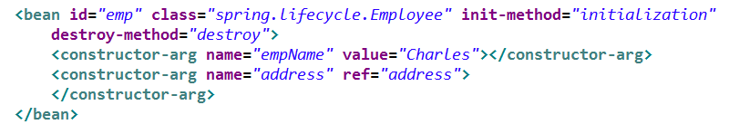
LifeCycle CallBacks
The Spring container manager the lifecycle of the Bean
The container instantiates the beans, Populates the properties and puts the bean in a ready state
Once the bean is no more required, the Container destroys the bean
Container provides opportunity to the programmer to do custom initialization/Destruction through lifecycle CallBack methods

Slide 33
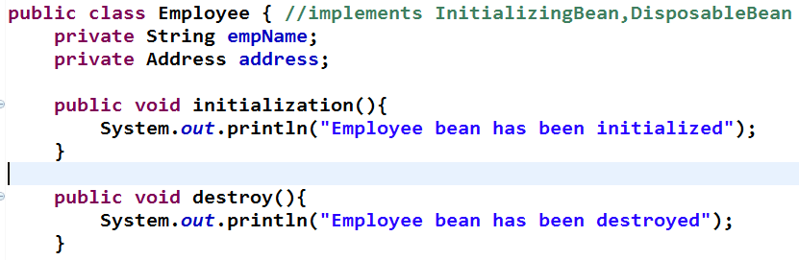
LifeCycle CallBack

Slide 34
BeanPostProcessor
This interface defines callback methods that can be implemented to install custom instantiation and resolution logic
ApplicationContext automatically detects such beans and register them as post processors
It operates on bean instances once they are instantiated by Spring Container

Slide 35
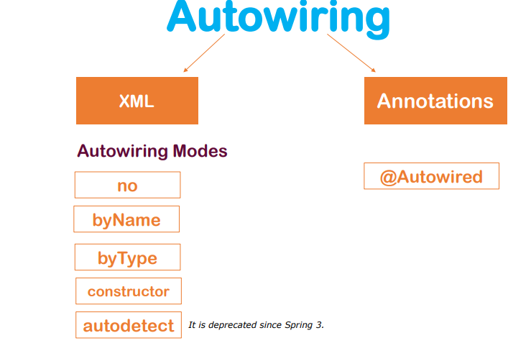
AutoWiring
Spring can automatically detect and inject the dependencies using Autowiring.
Autowiring can't be used to inject primitive and string values. It works with reference only
Autowiring

Slide 36
Spring AutoWiring Modes
No
No wiring at all. Bean References must be defined via a ref element
byName
Autowiring by property name will look for a bean named exactly the same as the property which needs to be auotwired
byType
constructor
Allows a property to be autowired if there is exactly one bean of the property type in the container.if there is more than one ,a fatl exception is thrown
This is analogus to byType,but applies to constructor arguments

Slide 37
AutoWiring Contd
Autowiring Advantages
• Automatic
• less code
Autowiring Disadvantages
• No control of programmer.
• It can't be used for primitive and string values

Slide 38
Annotations
Spring Based
@Autowired
@Qualifier
@Scope
@Value
Java Based
@Inject
@Resource

Slide 39
Stereotypes Annotations
Spring Framework provides us with some special annotations. These annotations are used to create Spring beans automatically in the application context.
@Component annotation is the main Stereotype Annotation.
There are some Stereotype meta-annotations which is derived from @Component those are
@Service
@Repository
@Controller

Slide 40
QUIZ QUESTION
What are the different types of Injections supported by spring?
Setter Injection
Constructor Injection
Interface Injection
Both Setter and Constructor Injection

Slide 41
QUIZ QUESTION
What is the other name of Dependency Injection?
Aspect Oriented Programming
Polymorphism
Inversion of Control
Container

Slide 42


