Slide 1

Team Number :7 Mentor: Sai Anirudh
Team Members:
Aryan Gupta 2022202028
Mohit Sharma 2022201060
Bhagyashree Barhate 2022201033
Chegu sai poorna chandu 2022201062

Slide 2
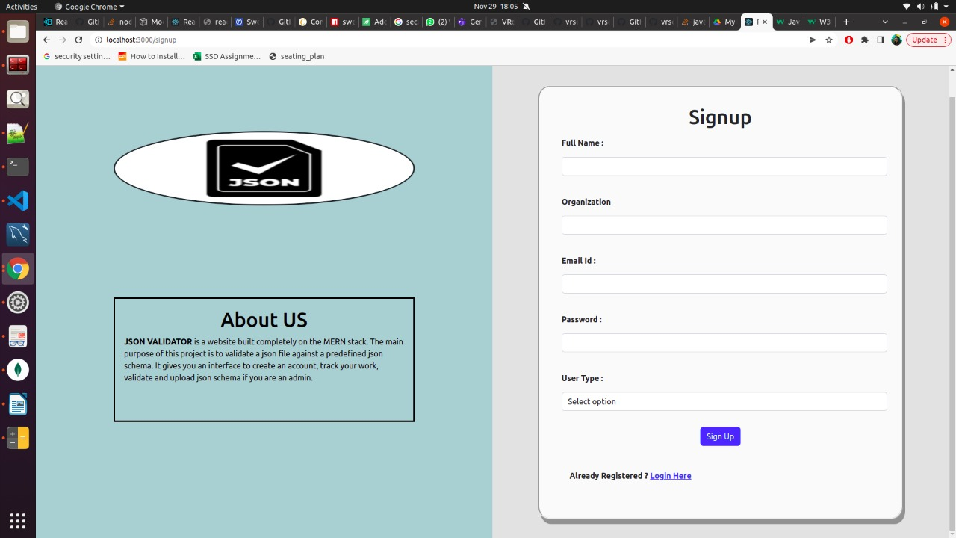
SIGNUP

Slide 3
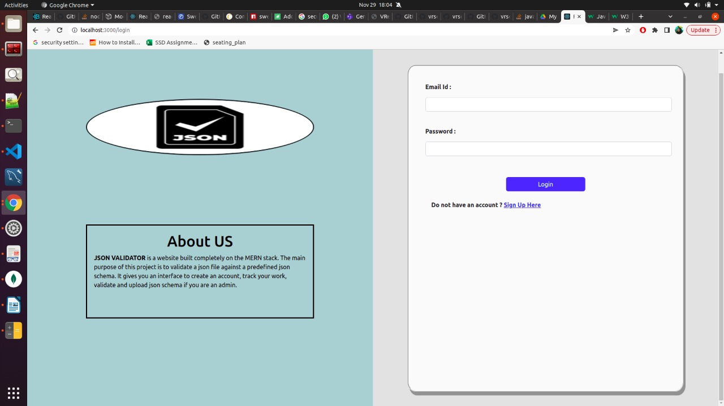
LOGIN

Slide 4
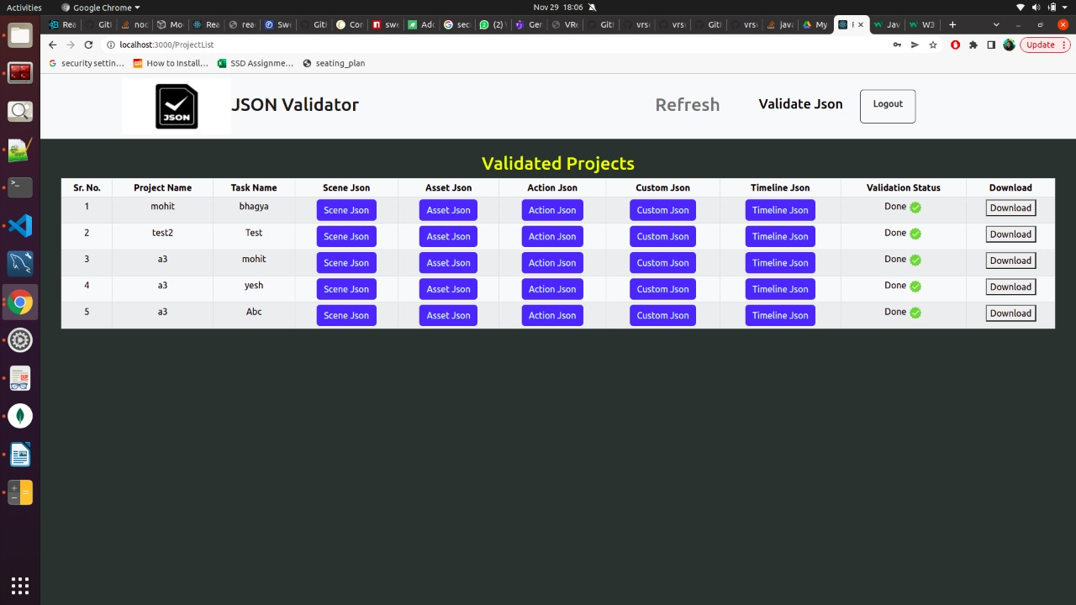
END USER LANDING PAGE

Slide 5
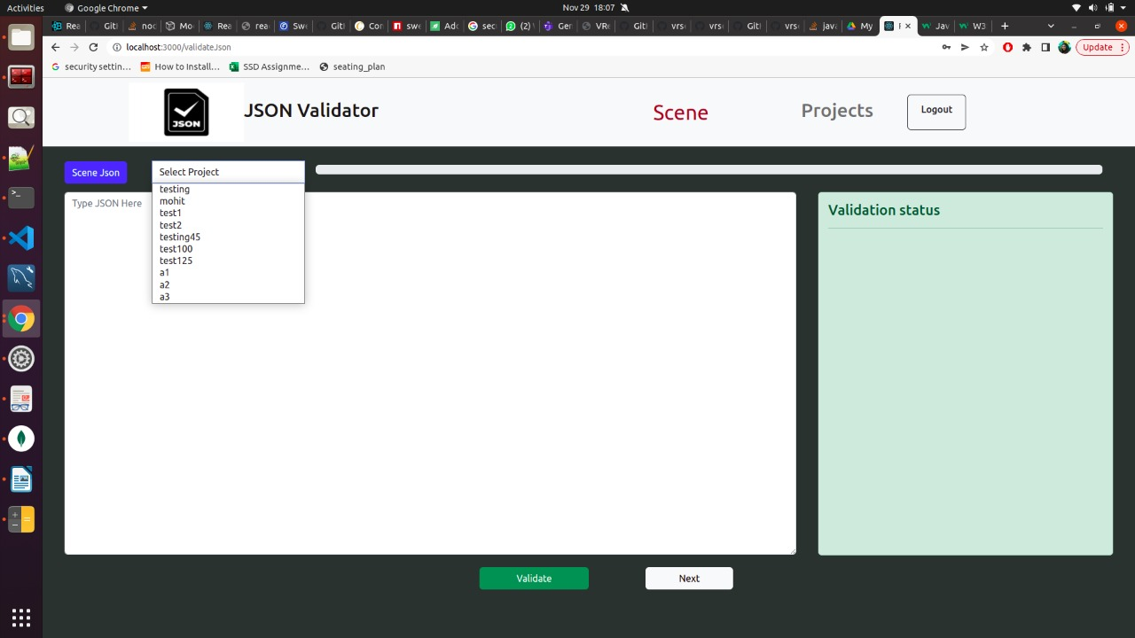
VALIDATION PAGE FOR 5 SCHEMAS

Slide 6
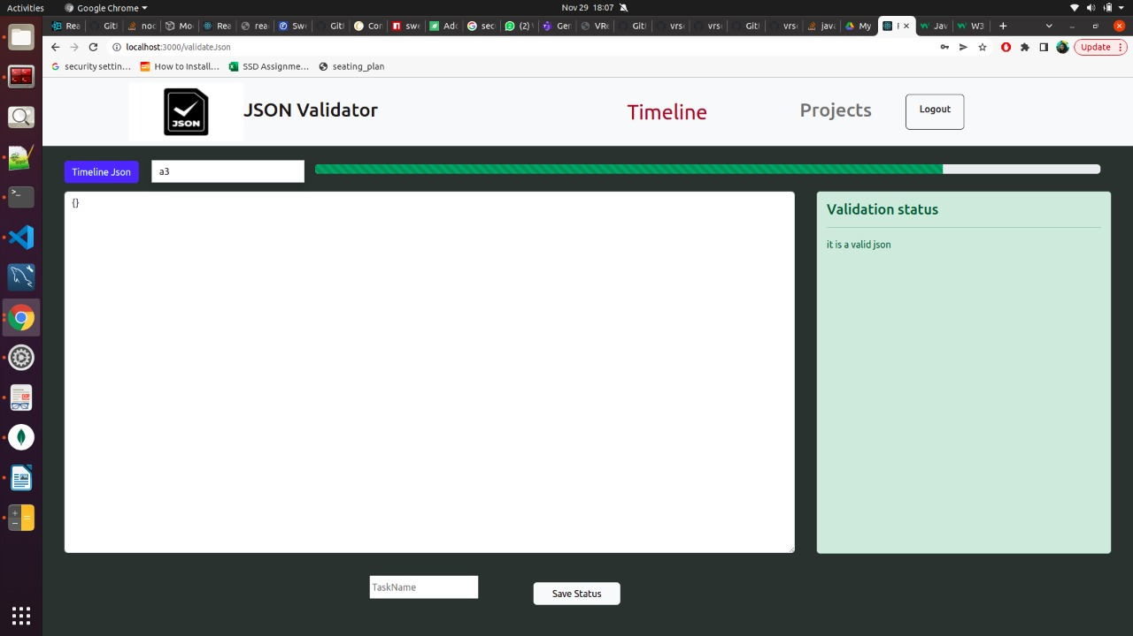
TO STORE VALIDATED DATA

Slide 7
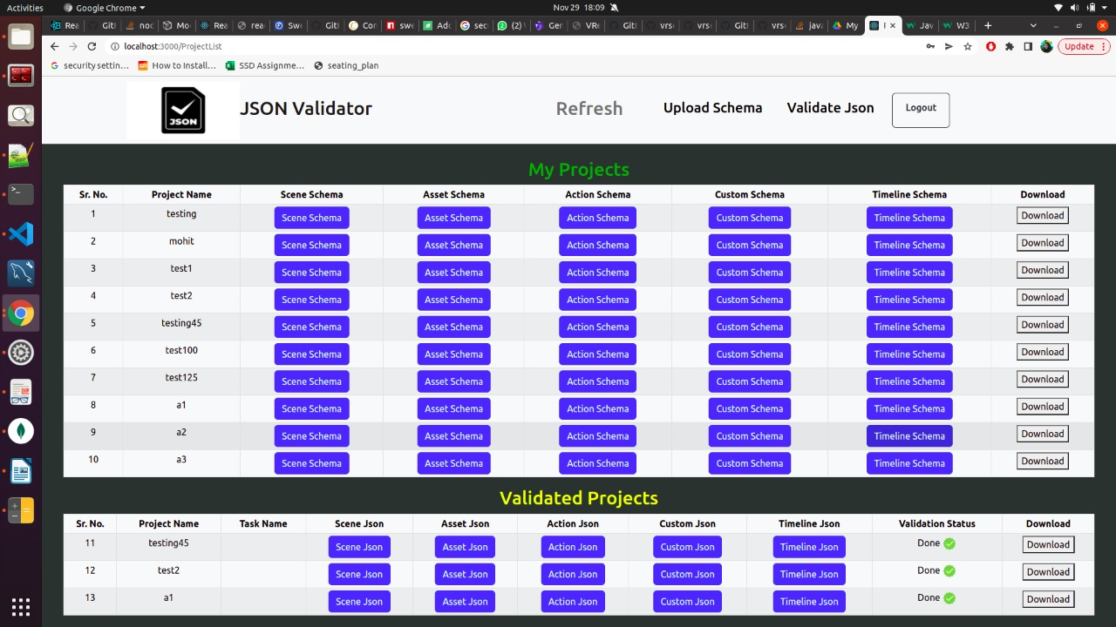
ADMIN LANDING PAGE

Slide 8
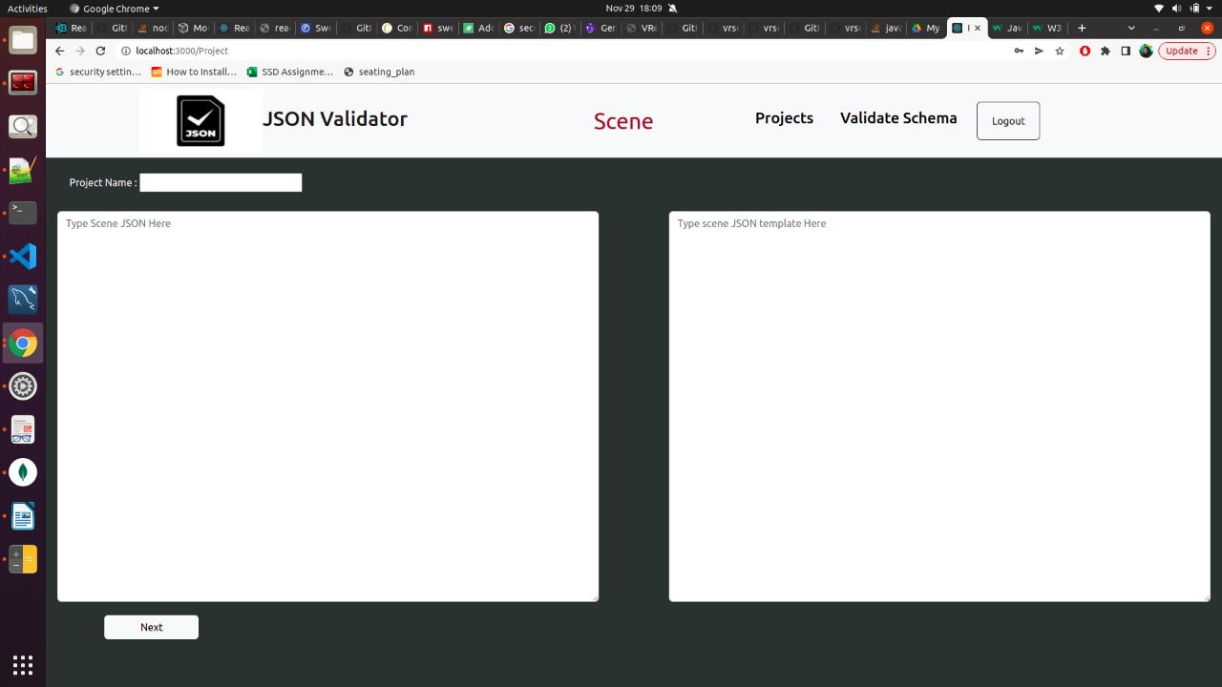
ADMIN UPLOADING 5 SCHEMAS AND TEMPLATES

Slide 9
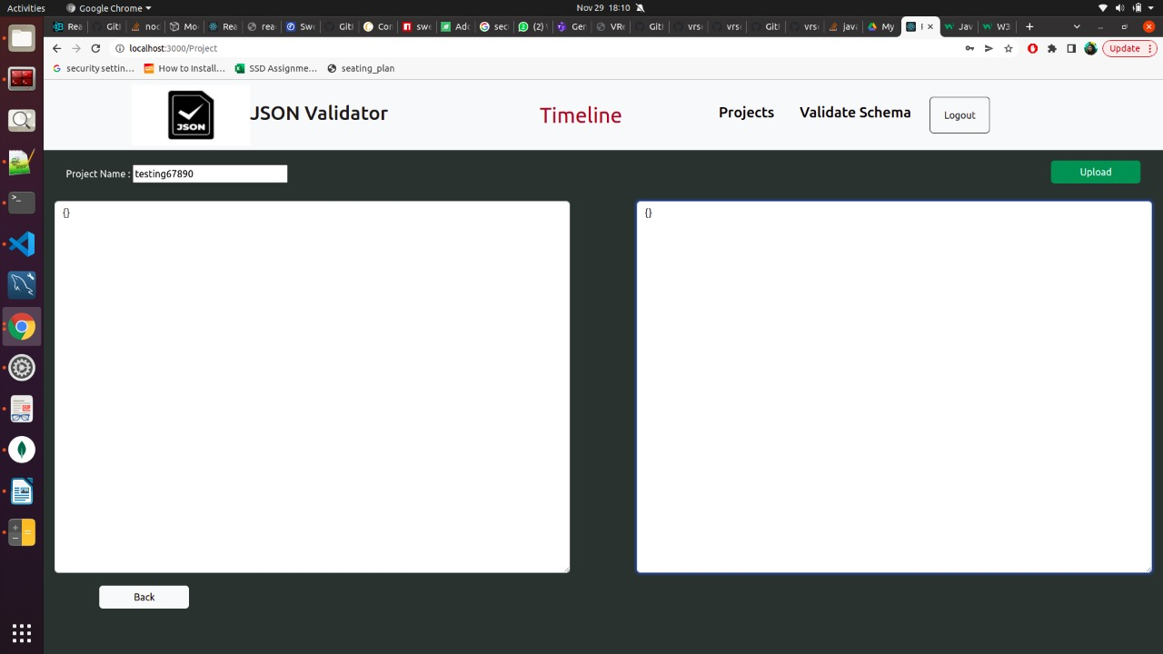
ADMIN CAN UPLOADS THE PROJECT AFTER 5 VALIDATIONS

Slide 10
THANK YOU

