Slide 1


Click Prediction
Team 4
Team Members
Arade Harshad
Borate Bhagyashree
P. Karthish
Notes:
Section 3:

Slide 2
Problem Statement
Presented by a set of advertisements under a particular display_id, predict the advertisement among the set that is most likely to be clicked by the user.
Cleaning of the large dataset and finding correlation between the data to select the most influential features.
Feature formatting and model optimization to achieve required results.

Slide 3
Dataset
File Name | File Size
page_views_sample.csv | 454.35MB
documents_meta.csv | 89.38MB
documents_categories.csv | 118.02MB
events.csv | 1208.55MB
clicks_test.csv | 506.95MB
promoted_content.csv | 13.89MB
documents_topics.csv | 339.47MB
documents_entities.csv | 324.1MB
sample_submission.csv | 273.14MB
clicks_train.csv | 1486.73MB
We are using dataset provided by Kaggle (https://www.kaggle.com/c/outbrain-click-prediction/data).
The dataset for this challenge contains a sample of users’ page views and clicks, as observed on multiple publisher sites in the United States between 14-June-2016 and 28-June-2016.

Slide 4
Performance Matrices
Accuracy measure between the predicted and actual value is not efficient.
AUC will be the metrics to measure the performance along with precision and recall.

Slide 5
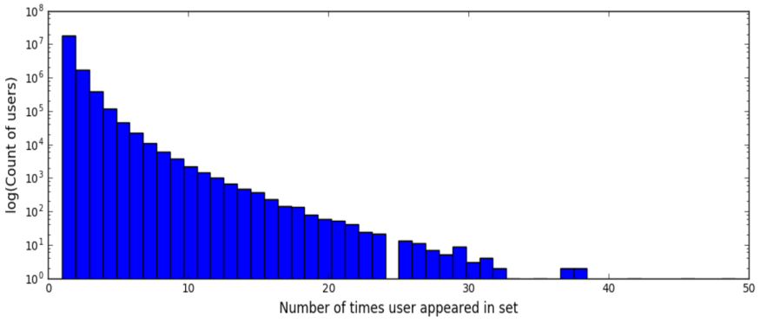
Feature Selection
Clicks_train
Display_id
Ad_id
Clicked (1:clicked, 0: not clicked)
Page_view_samples
Uuid
Document_id
Timestamp
Platform
Geo_location
Traffic_source
Events
Display_id
Uuid
Document_id
Timestamp
Platform
Geo_location
Histogram of users
Promoted_contents
Ad_id
Document_id
Campaign_id
Advertizer_is
Documents_meta
Document_id
Source_id
Publisher_id
Document_topics
Document_categories
Document_topics
Document_entities

Slide 6
Data preparation
Remove data which do not hold a significant influence on the output.
Join the datasets with their relations to get the relevant details from other tables
Reshaping and slicing of the dataframes to select features.
Format the features to be passed to the model

Slide 7
Learning Algorithms
Supervised Learning
Considered Naïve Bayes and SVM supervised Machine Learning algorithms for binary classification.
Naïve Bayes
Independent Features
SVM
Features are not Linearly separable.
Logistic Regression
Works efficiently with dependent features
Binary Classifier for predicting feature is of given class or not (1: Clicked| 0: Not clicked)

Slide 8
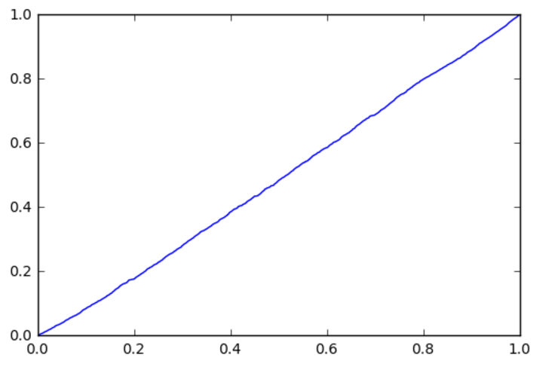
Performance
Accuracy score: 0.80628439843250532
AUC score: 0.51273345711488016
ROC plot

Slide 9
Tools Utilized
Tools
Python and Anacondas
Python Packages
NumPy, Pandas, Matplotlib, SkLearn and SciPy
Data Preparation
Pandas: Organize and query the data(features)
NumPy: Slicing and formatting the data for feature selection.
SciPy: Generating sparse matrix for Learning Algorithm
Machine Learning
SkLearn : Logistic Regression
Visualization
Matplotlib : Plotting Histogram and Scatter plot.

Slide 10
Baseline and Results
The baseline AUC for this model was considered at 0.61
Unexpected challenges in beating the baseline:
Diplay_id is categorical (i.e add_ids are classified under specific diplay_ids) which cannot be taken directly as a feature for the model.
Possible solution tried: pandas.dummies() (failed due to memory constraints with large number of display_ids to be considered)

Slide 11
Baseline and Results
Mapping the features display_ids to other related features from different tables creating a multi dimensional dataset
String Datatypes to be converted into unique integer or float values before training the model
Features with unexpected mixed datatypes:
In the case of Platform used( 0: mobile, 1: tabulet , 2:Laptops)
The above data is not only categorical but also contains the same data with different datatypes (int and string)
Platform.unique() would return: {0, 1, 2, ’0’, ’1’, ’2’, ‘\\N’.

Slide 12
Conclusion
Learning Curve
Choosing the correct model for the Problem Statement
Selection of features to optimize the MC Model
Formatting the features to fit the model
Irregular and unexpected influences of certain features on the results.
Model tuning
Relevant metrics for performance measure
Possible solutions to the fix
Eliminate the display_id from the feature set.
Consider sklearn.preprocessing.LabelEncoder() for categorical data with lesser classifications.
Additional feature selections (Document_id & time)

Slide 13
Thank you.

