Slide 1
HEART DISEASE PREDICTION
Using Machine learning

Slide 2
PROJECT 1
Title : Heart Disease Prediction
Semester : 5
Class : TY BTech
Branch : CSE-AIML

Slide 3
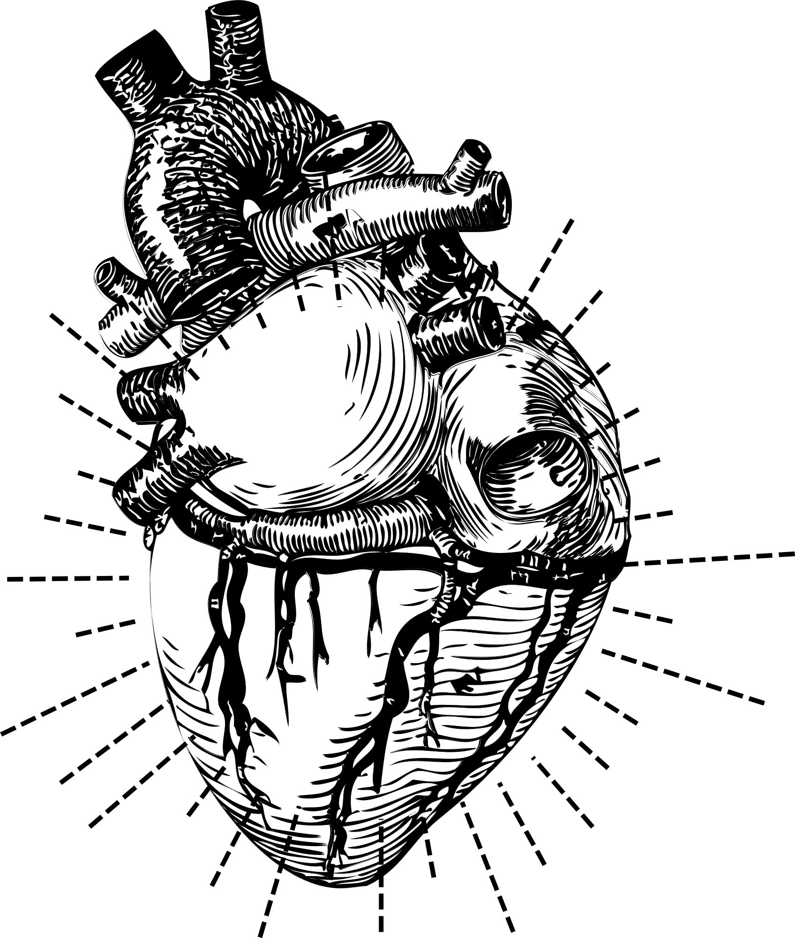
WHAT WE'LL DISCUSS TODAY
Heart Disease Guide
Company Profile
Introduction
Objective of study
Dataset Details
Tools & methods
Proposed system
Algorithm
Advantages
System Architecture
Requirements
Conclusion

Slide 4
LET'S GET
STARTED

Slide 5
Problem Statement
The problem statement involves developing a real-time heart disease prediction model for timely identification of cardiovascular risks. This entails creating an accurate and scalable machine learning system that analyzes diverse health data, prioritizes relevant features, and integrates seamlessly into healthcare workflows. The goal is to provide healthcare professionals with a reliable tool for early detection and intervention in cardiovascular diseases.

Slide 6

OBJECTIVES
Objective Of Study
1. Early Detection
2. Preventive Interventions
3. Reduced Burden on Healthcare System
4. Personalized Medicine
5. Improved Patient Outcomes
6. Real-time Prediction and Deployment
7. Research and Insights

Slide 7
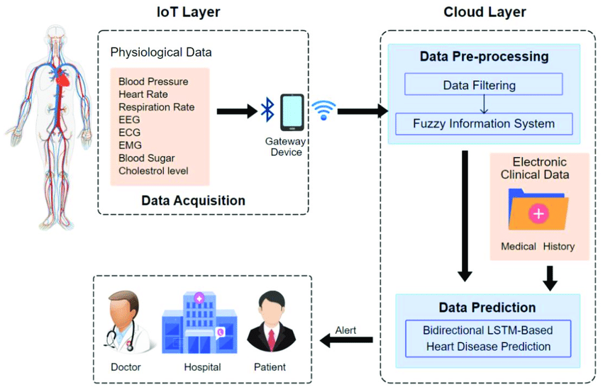
Designed System Architecture / Flow Chart

Slide 8
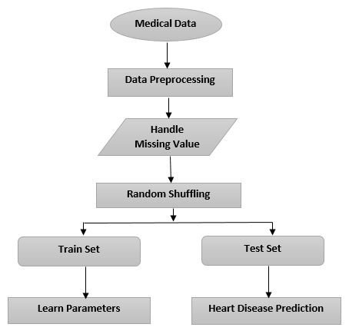
SYSTEM ARCHITECTURE

Slide 9
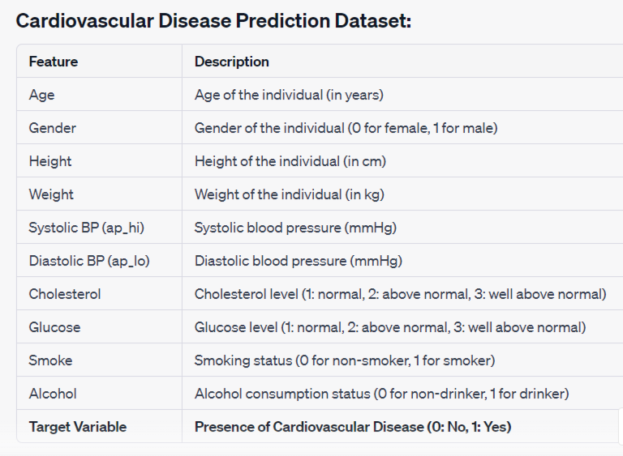
DATASET DETAILS
Heart Disease Prediction Model’s Dataset
Target : Heart Disease Is present or Not (Yes:1 , No: 0)

Slide 10

TOOLS & METHODS
Tools
Programming Languages:
Python
Machine Learning Libraries:
Scikit-Learn
Data Visualization:
Matplotlib
Seaborn

Slide 11

TOOLS & METHODS
Methods
1. Data Preprocessing
Data Cleaning
Data Wrangling
2.Feature Selection
3.Machine Learning Algorithms:
Logistic Regression
Random Forests
Support Vector Machines (SVM)
K-Nearest Neighbors (KNN)
Decision Tree
4.Model Evaluation

Slide 12
ADVANTAGES
1. Early Detection
2. Preventive Interventions
3. Cost-Effectiveness
4. Personalized Medicine
5. Improved Patient Outcomes
6. Population Health Management
7. Reduced Burden on Healthcare System
8. Encourages Healthier Lifestyles
9. Research and Insights
10. Data-Driven Decision Making

Slide 13
REQUIREMENTS
H/W Requirements
S/W Requirements
Processor: Intel core i5
RAM: 8 GB
ROM: 256 GB
OS: Windows OS
Programming Lang: Python
Jupyter notebook

Slide 14
CONCLUSION
In conclusion, learning machine learning techniques for Heart disease prediction represents a significant advancement in healthcare. Through the analysis of diverse datasets and the application of sophisticated algorithms, these predictive models offer valuable insights and numerous benefits.
Machine learning models provide valuable feedback loops for continuous improvement. By analyzing outcomes and refining algorithms, researchers and healthcare providers can enhance the accuracy and effectiveness of predictive models over time. This iterative process drives.

Slide 15
THANKS !!
FOR YOUR KIND ATTENTION !!

