Slide 1
LLMaven
AI Usage Pipeline
University of Washington | eScience Institute
LiteLLM | Azure | Pulumi | Streamlit

Slide 2
Current Pipeline Architecture
Pull-based batch pipeline | runs daily at midnight
LLMaven Server
Azure Functions
Azure Data Lake
Streamlit Dashboard
LiteLLM + PostgreSQL
Extract + Clean daily
Raw JSONL + Parquet
Container Apps
Pulumi IaC
ADLS Gen2
Parquet Format
Container Apps
All Azure resources defined as Python code. One command to deploy everything.
Hierarchical data lake. ~$0.018/GB/month. Partitioned by date for fast queries.
85% smaller than CSV. 10x faster to query. Columnar compression.
Scales to zero when idle. ~$2-5/month. Public shareable URL.
Total estimated cost: ~$2-5 / month

Slide 3
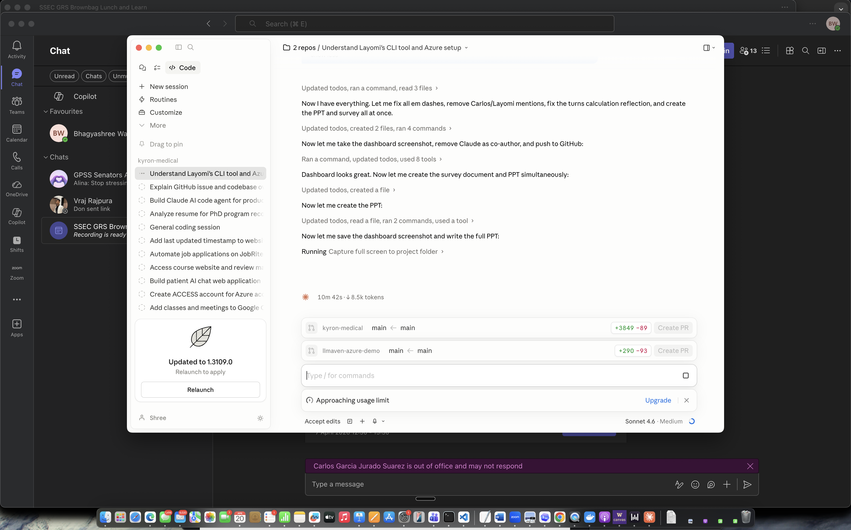
Live Dashboard
Built with Streamlit + Plotly | Hosted on Azure Container Apps
Live demo: http://localhost:8501 (Azure: coming soon)
Model usage breakdown
Daily cost over time
Token distribution (input vs output)
Turns per session histogram
Source filter (isolate coding activity)
Top users by spend

Slide 4
GitHub Repository
github.com/bhagyashreewagh/llmaven-azure-demo
pulumi/
function_app/
Pulumi Python IaC - all Azure resources in one file. Run 'pulumi up' to deploy.
Azure Function - daily timer trigger. Extracts JSONL, cleans to Parquet, uploads to Data Lake.
dashboard/
azure_pipeline_resources.md
Streamlit app + Dockerfile. Charts for model usage, cost, tokens, sessions, source breakdown.
Full resource comparison guide with cost estimates per GB for every Azure service considered.
research_survey.md
End-to-end researcher survey to understand how teams use AI coding assistants.

Slide 5
Research Questions
What do we want to learn from the data?
Q1
How long are conversations? Do they vary by researcher type?
Are RSE conversations longer and more iterative than student conversations? Do certain research domains produce deeper sessions? Understanding session depth helps us tailor onboarding and training by role.
Q2
Prompt vs Code Ratio -- Is the interaction efficient?
10,000 in
If 10,000 tokens go in as context and prompting, but only 50 tokens of real code come out -- is that efficient? What is the ratio of useful output to input effort, and how does it vary by task type?
50 out
Q3
Which RSE-Plugin skills get triggered most? How much rework follows?
Track /research, /plan, /implement, /validate usage frequency and follow-up iteration rate as a quasi-evaluation of skill effectiveness in a given research context.

Slide 6
Researcher Survey
Before building more features -- understand what researchers actually want answered
About You
How You Use It
Role (RSE, grad student, faculty...)
Experience with AI coding tools
Frequency of use
Main use cases (debugging, writing, docs...)
Typical conversation style (1-turn vs iterative)
How often you rework the output
Prompting
What Would Help
Confidence in writing prompts
Have you asked the same thing 5 different ways?
What would help you prompt better?
Rank: guides, workshops, community, plugins...
Where AI gets it wrong for your work
One thing you wish AI could do better
Full survey: github.com/bhagyashreewagh/llmaven-azure-demo/blob/main/research_survey.md
5 minutes to complete | No right or wrong answers | Fully anonymous

Slide 7
The Bigger Goal
The way we teach researchers GitHub and CI/CD -- we want to teach effective AI use.
How do we partner with researchers to show how to use AI coding assistants correctly and effectively?
1
2
3
Learn from the Data
Build Better Tools
Teach and Scale
Use LLMaven logs to understand usage patterns, session depth, model preferences, and where researchers struggle.
RSE-Plugins, custom skills, and domain-specific agents that help researchers work more effectively with AI.
Train researchers how to prompt effectively, just as we teach version control, testing, and reproducibility.

Slide 8
Potential Next Step: Push-Based Architecture
Replace scheduled pull with a real-time LiteLLM callback -- data arrives within seconds, not 24 hours later
CURRENT (Pull)
UPDATED (Push Callback)
LLMaven logs to PostgreSQL
User request processed by LiteLLM
Azure Function wakes up nightly
LiteLLM fires Python callback instantly
Pulls yesterdays data via extract
Callback pushes JSON to Azure endpoint
Uploads to Data Lake
Data in lake within seconds
Up to 24 hour data delay
Real-time -- seconds not hours
No scheduled jobs to maintain
Always up to date -- no 24hr lag
One less moving part (no Azure Function)
Requires LLMaven admin to point callback at our Azure endpoint

