Slide 1
OOPS Concepts

Slide 2
List of Oops Concepts
Constructor.
Instance Member and Static Member.
Inheritance.
Types of Inheritance.
Polymorphism.
Method Overloading.
Method Overriding.

Slide 3
Constructor
constructor is a special method which is invoked automatically at the time of object creation.
It is used to initialize the data members of new object generally.
The constructor in C# has the same name as class or struct.
There can be two types of constructors in C#
1)Default Constructor
2)Parameterized Constructor

Slide 4
Instance Member and Static Member
Instance Member:-An instance variable is a variable defined in a class (i.e. a member variable ), for which each instantiated object of the class has a separate copy, or instance.
An instance variable is similar to a class variable.
Static Members:- The static member is callable on a class even when no instance of the class has been created.
The static member is always accessed by the class name, not the instance name.

Slide 5
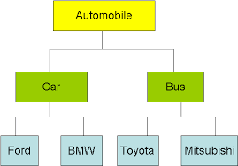
Inheritance
Inheritance:- Is the ability to create a class that inherits attributes and behaviors from an existing class.
The newly created class is the derived (or child) class and the existing class is the base (or parent) class.
Inheritance is one of the key features of object-oriented programming.

Slide 6
Types of inheritance
1)Single Inheritance:-When one class inherits another class, it is known as single level inheritance.
2)Multilevel Inheritance:-When one class inherits another class which is further inherited by another class, it is known as multi level inheritance.

Slide 7
Polymorphism
The word polymorphism means having many forms. In object-oriented programming paradigm, polymorphism is often expressed as 'one interface, multiple functions'.
Polymorphism can be static or dynamic.
In static polymorphism, the response to a function is determined at the compile time.
In dynamic polymorphism, it is decided at run-time.

Slide 8
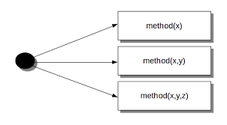
Method overloading
Overloaded methods are differentiated based on the number and type of the parameters passed as arguments to the methods.
You can not define more than one method with the same name, Order and the type of the arguments. ...
The compiler does not consider the return type while differentiating the overloaded method.

Slide 9
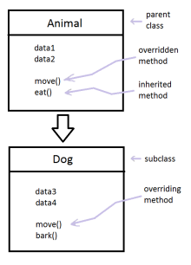
Method overriding
If derived class defines same method as defined in its base class, it is known as method overriding in C#.
It is used to achieve runtime polymorphism. It enables you to provide specific implementation of the method which is already provided by its base class.
To perform method overriding in C#,
you need to use virtual keyword with
base class method and override
keyword with derived class method.

