Slide 1
🚑 RoadSoS AI-Powered Emergency Response & Roadside Assistance System
👩‍💻 Bhagyashri Bhattarki

Slide 2
Problem Statement
Challenges During Emergencies
❌ Delayed emergency response
❌ Difficulty sharing live location
❌ Slow communication with hospitals
❌ No centralized emergency platform
❌ Difficulty notifying family members
Impact
🚨 Increased risk to victims
🚨 Delayed medical assistance
🚨 Higher accident severity

Slide 3
Our Solution
RoadSoS
An intelligent emergency response platform that provides:
📍 Live GPS Tracking
🚨 SOS Emergency Alerts
🏥 Nearby Hospitals
🚓 Nearby Police Stations
👨‍👩‍👧 Emergency Contact Management
📞 One-Tap Emergency Calling
🎤 Voice Assistant
☁️ Cloud-Based Infrastructure

Slide 4
Objectives
Project Objectives
✅ Reduce emergency response time
✅ Improve road safety
✅ Enable automatic location sharing
✅ Improve communication
✅ Provide instant emergency assistance
✅ Build a scalable cloud solution

Slide 5
Key Features
Core Features
🚨 SOS Alert System
📍 Real-Time GPS Tracking
📧 Email-Based Emergency Alerts
👨‍👩‍👧 Emergency Contact Storage
🔐 Firebase Authentication
🎤 Voice Emergency Assistant
📄 Emergency Report Generation
☁️ Cloud Database Integration

Slide 6
Highlight Feature – One-Tap Calling
📞 One-Tap Emergency Calling
Emergency Numbers Available:
🚑 Ambulance – 108
👮 Police – 100
🔥 Fire Brigade – 101
🚨 National Emergency – 112
Benefits
✔ Faster communication
✔ Reduced response time
✔ Easy access during emergencies

Slide 7
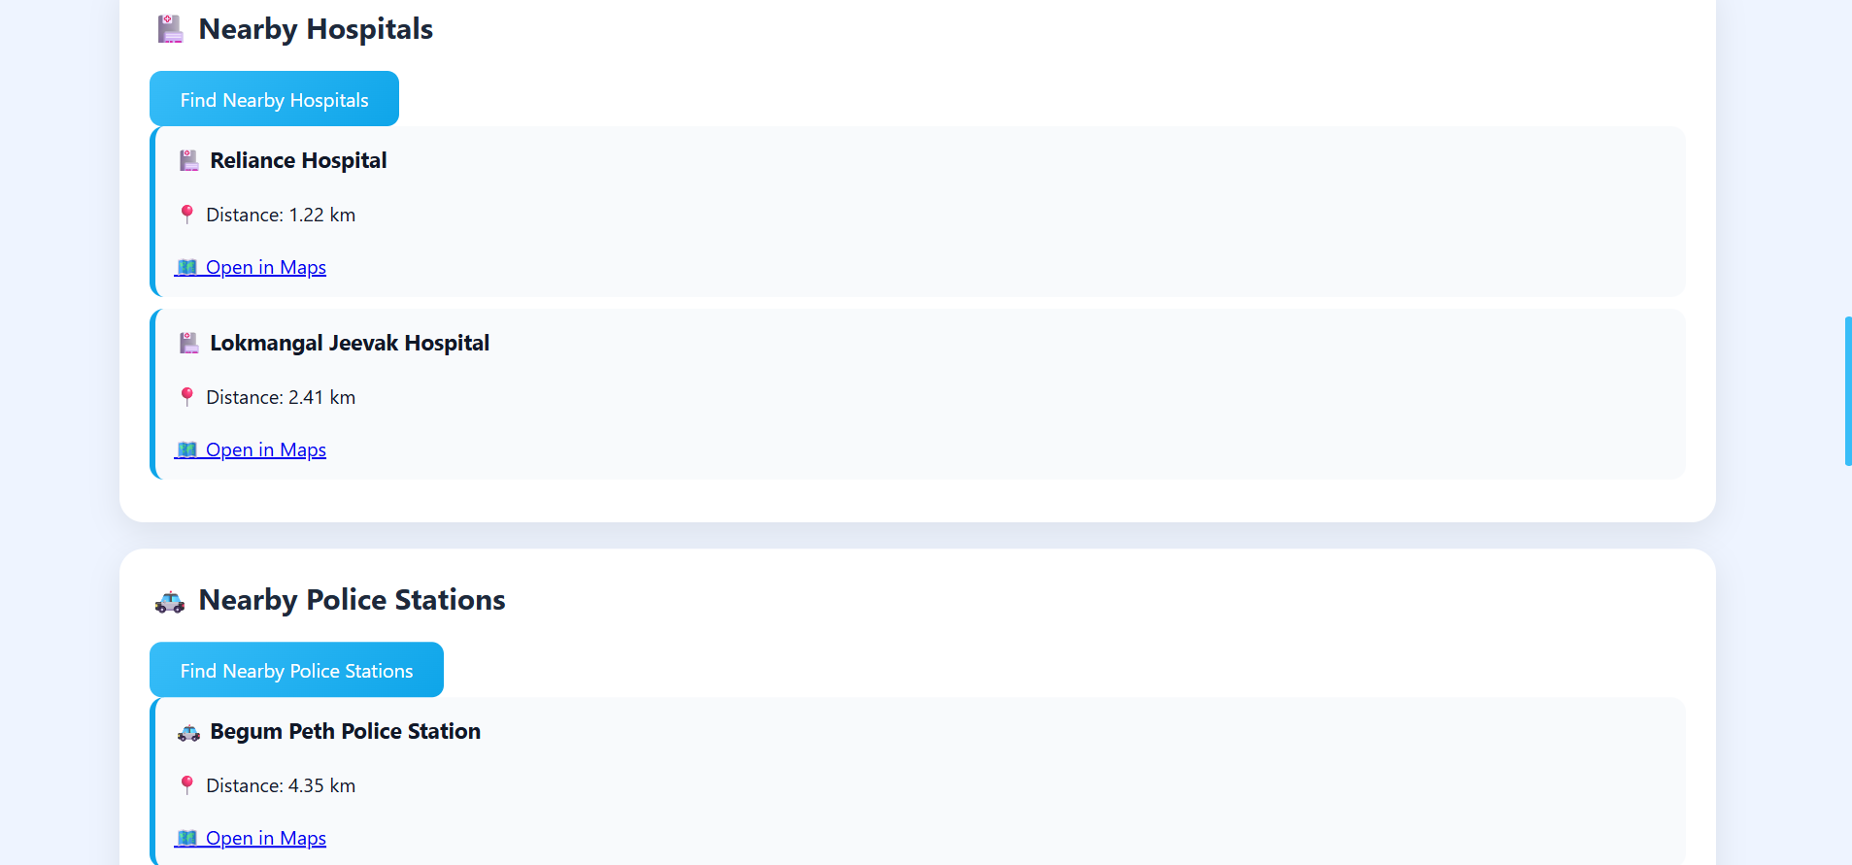
Highlight Feature – Nearby Hospital Finder
🏥 Nearby Hospital Locator
Functionality
📍 Uses user's live GPS location
🏥 Finds nearby hospitals
🗺️ Opens location on map
Benefits
✔ Faster medical assistance
✔ Better accessibility
✔ Improved emergency response

Slide 8
Highlight Feature – Nearby Police Locator
🚓 Nearby Police Station Finder
Functionality
📍 Detects current location
🚓 Displays nearby police stations
🗺️ Navigation support
Benefits
✔ Enhanced safety
✔ Faster reporting
✔ Immediate support access

Slide 9
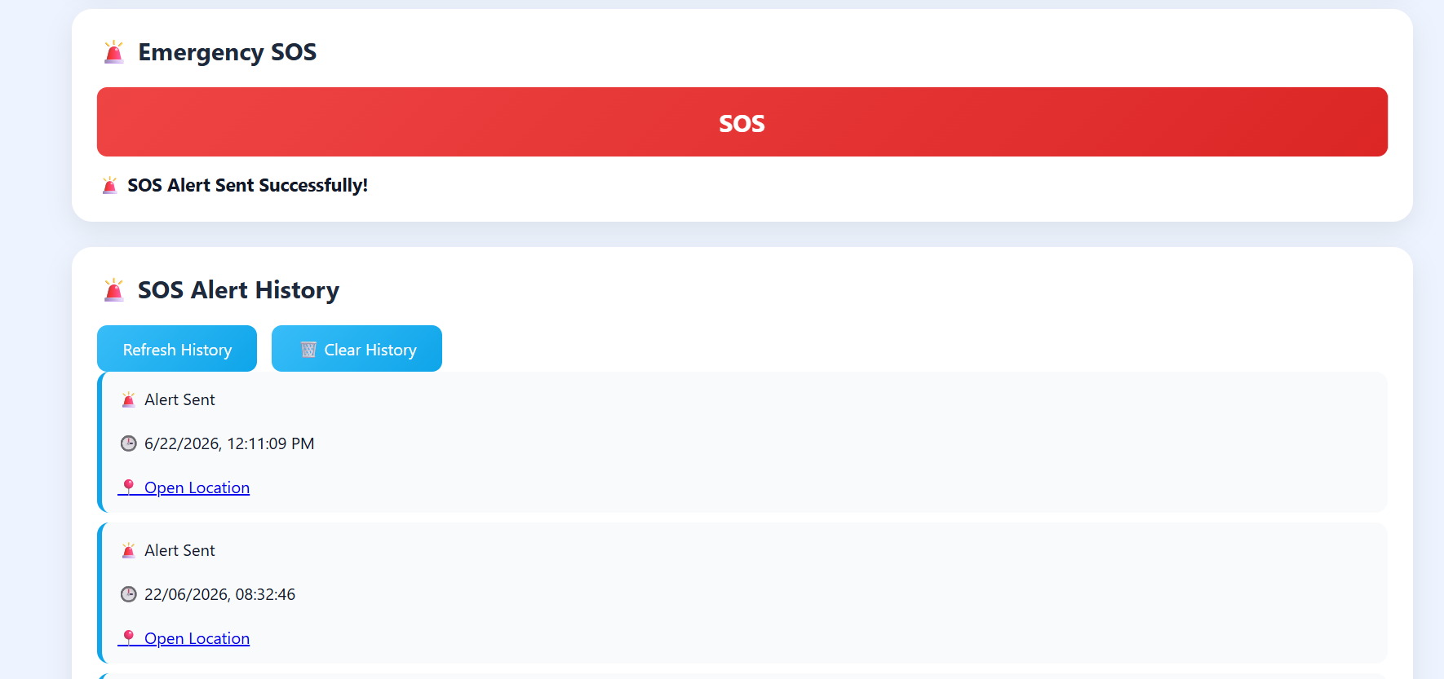
SOS Alert System
🚨 Smart SOS Alert Workflow
User Presses SOS ↓ GPS Location Captured ↓ Google Maps Link Generated ↓ Email Alert Sent ↓ Emergency Contact Receives Alert
Result
⚡ Immediate emergency notification
⚡ Live location sharing

Slide 10
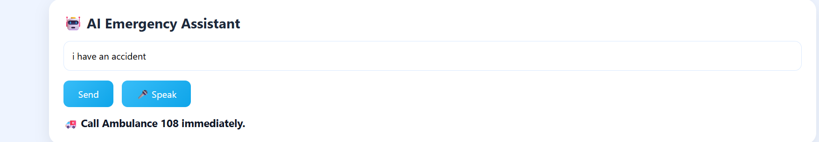
Voice Emergency Assistant
🎤 Voice-Based Assistance
Features
🎙️ Voice Input
🤖 Emergency Guidance
⚡ Hands-Free Operation
Benefits
✔ Useful during critical situations
✔ Improves accessibility
✔ Faster interaction

Slide 11
System Architecture
Architecture Overview
User
↓
Frontend
(HTML, CSS, JavaScript)
↓
Firebase Authentication
↓
Firestore Database
↓
EmailJS Service
↓
Emergency Contacts

Slide 12
Technology Stack
Technologies Used
Frontend
🌐 HTML5
🎨 CSS3
⚡ JavaScript
Cloud Services
🔥 Firebase Authentication
🔥 Firestore Database
🔥 Firebase Hosting
APIs & Services
📍 Geolocation API
📧 EmailJS
🗺️ OpenStreetMap

Slide 13
Testing & Results
Test Case | Result
User Signup | ✅ Pass
User Login | ✅ Pass
GPS Location | ✅ Pass
SOS Alert | ✅ Pass
Save Contact | ✅ Pass
Voice Assistant | ✅ Pass
Testing Results
Overall Success Rate
✅ 100%

Slide 14
Future Scope
Future Enhancements
🚑 Real-Time Ambulance Tracking
📱 Mobile Application
📨 SMS Emergency Alerts
🤖 AI Accident Detection
🔔 Push Notifications
🌍 Multi-Language Support
📊 Analytics Dashboard

Slide 15
Impact & Conclusion
Impact
✅ Faster Emergency Response
✅ Improved Road Safety
✅ Instant Communication
✅ Location-Based Assistance
✅ Better Accessibility
Conclusion
RoadSoS demonstrates how AI, Cloud Computing, and Location Services can be integrated to provide a reliable and scalable emergency response solution.

Slide 16
🌐 Deployment
Live Application
RoadSoS Live URL
https://roadsos-b7e23.web.app
Deployment Platform
🔥 Firebase Hosting
Benefits
✅ Secure HTTPS Website
✅ Fast Global Access
✅ Cloud-Based Infrastructure
✅ Highly Scalable
✅ Always Available
Current Status
🟢 MVP Successfully Deployed
🟢 Ready for Public Access
🟢 Functional Prototype Ready for Evaluation

Slide 17
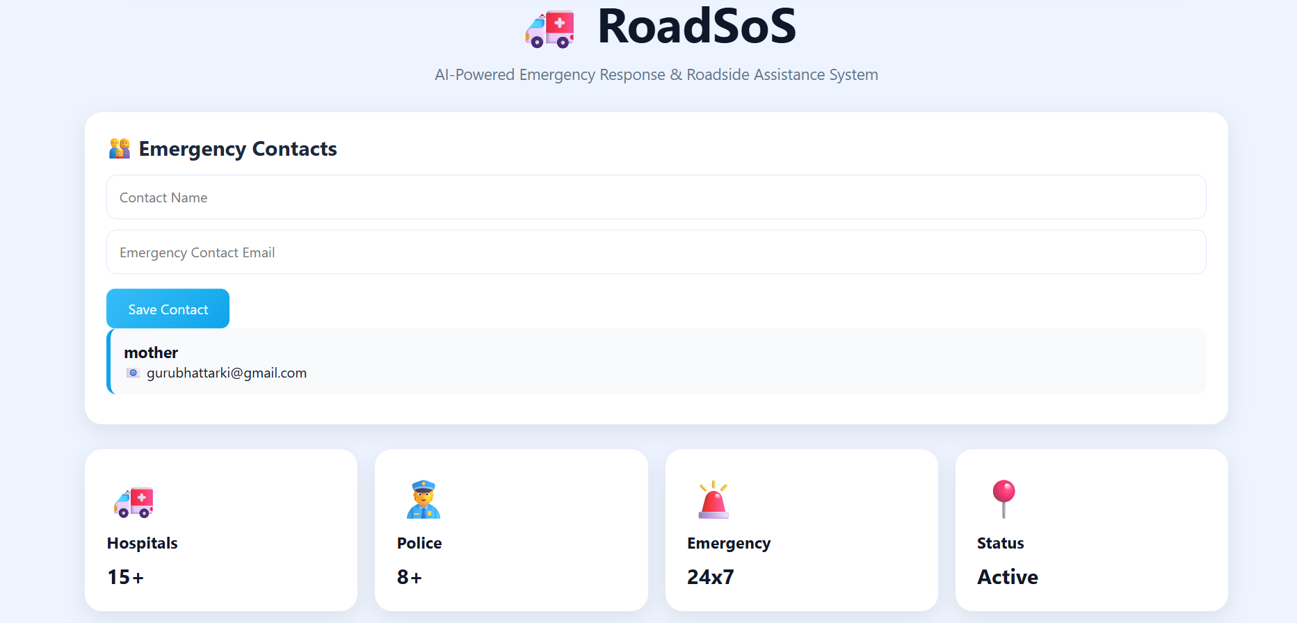
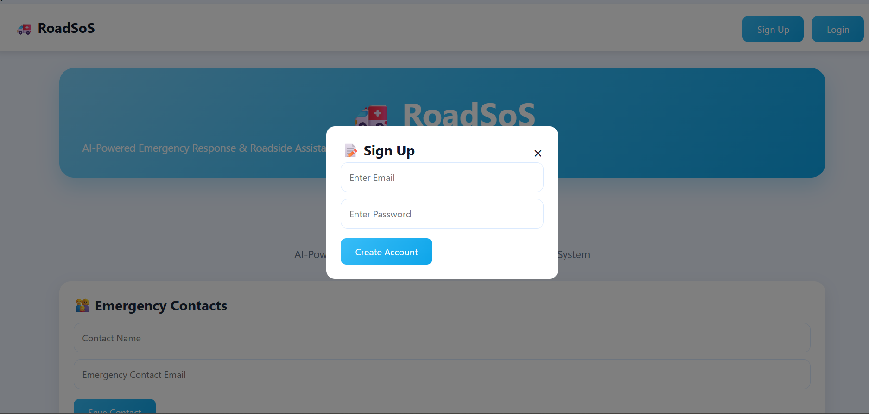
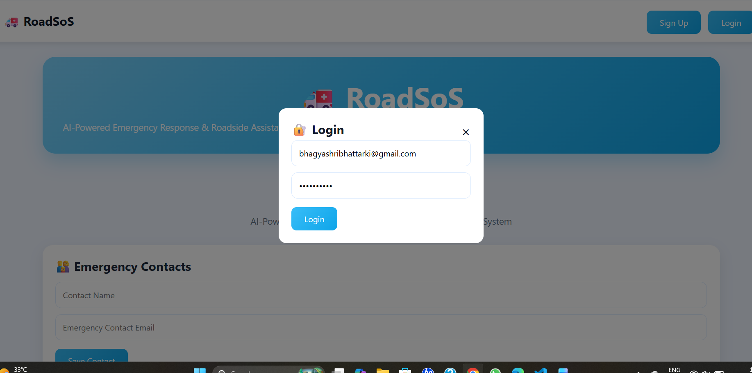
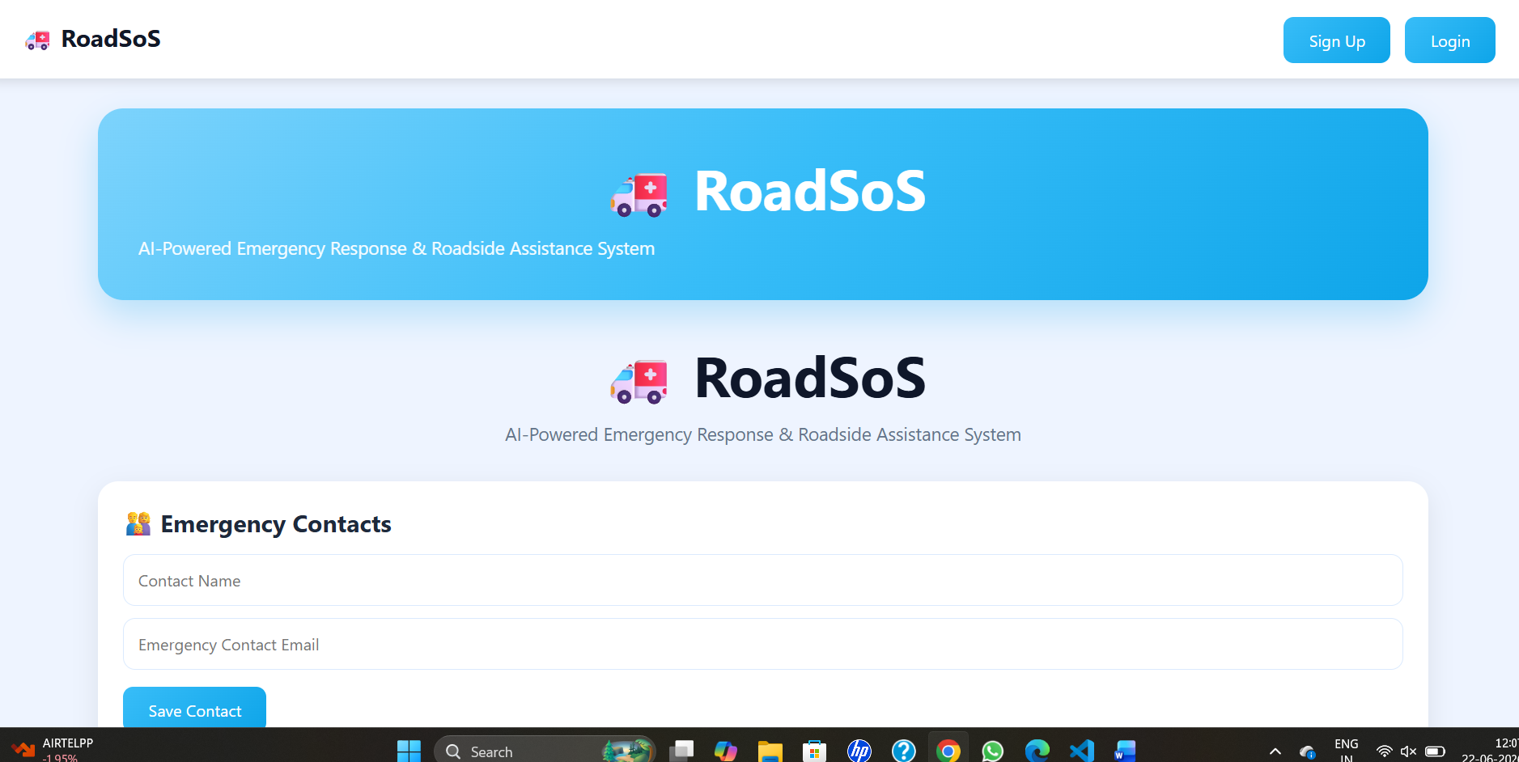

Slide 18
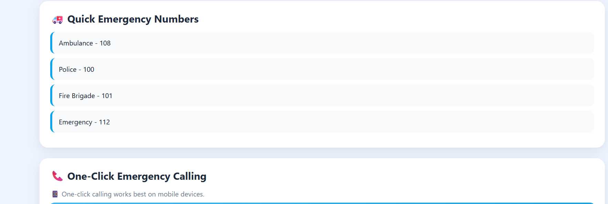
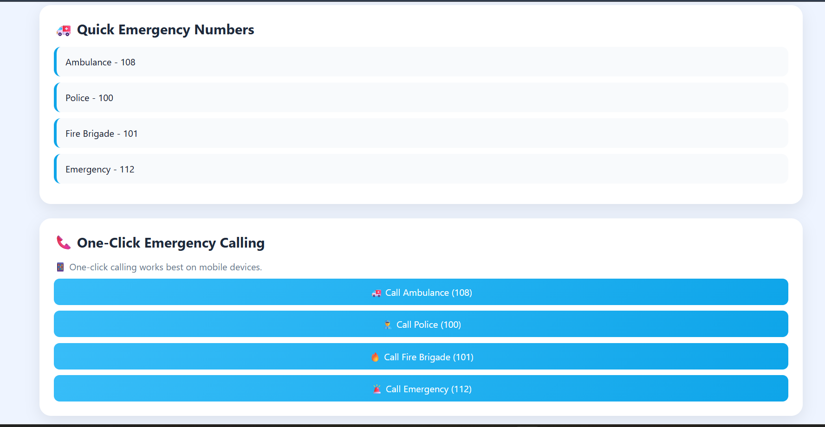
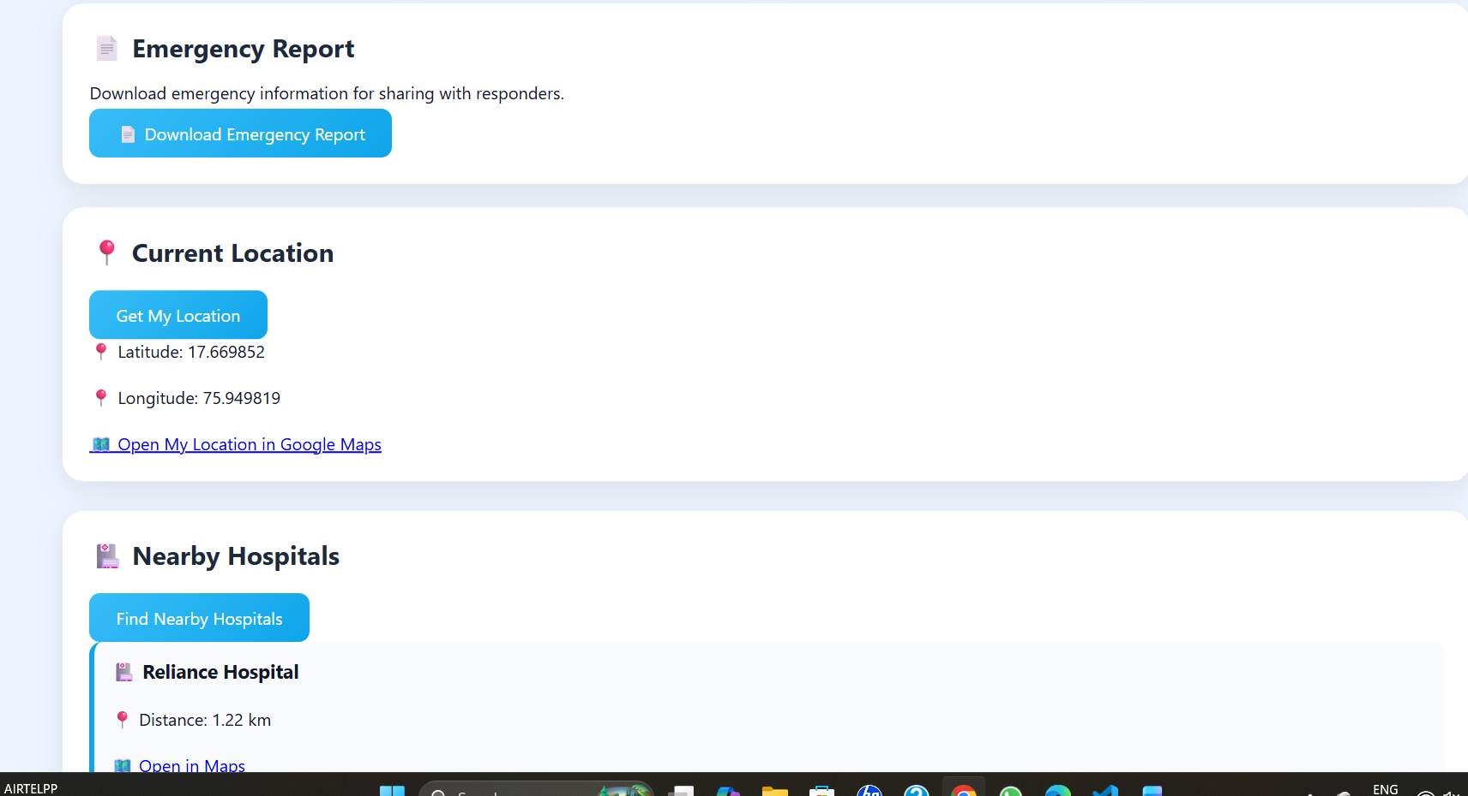

Slide 19
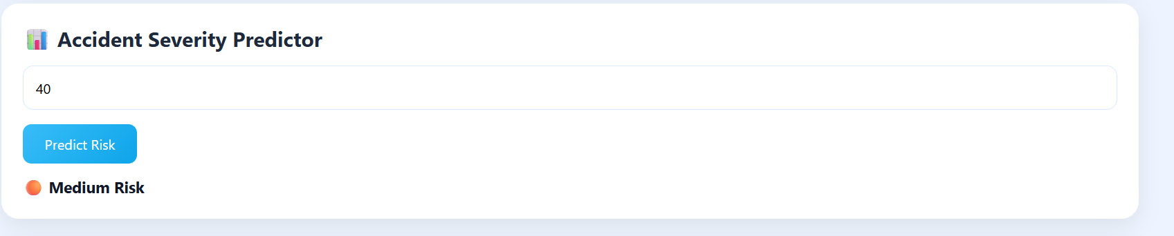
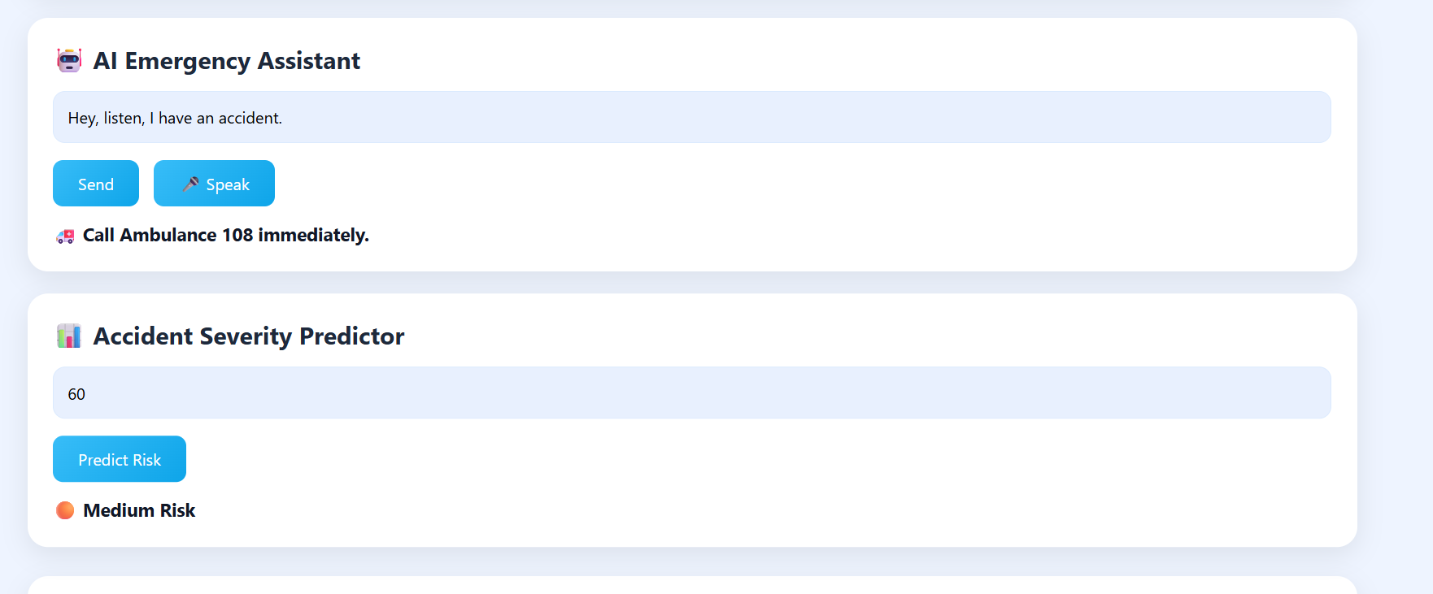

Slide 20
Thank You
🚑 RoadSoS
Saving Lives Through Technology
📍 Live Location Sharing
🚨 Emergency Alerts
🏥 Quick Access to Help
Questions & Feedback?
🙏 Thank You

