Slide 1

Disaster Management
Organization name : Tech stacks
Client Name: Dr. Mark Corson
Department Chair of Natural Sciences
Garett Strong Building
Northwest Missouri State University
Ganesh Siripuram

Slide 2


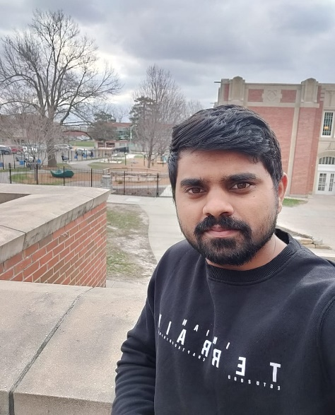
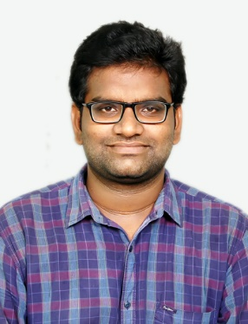

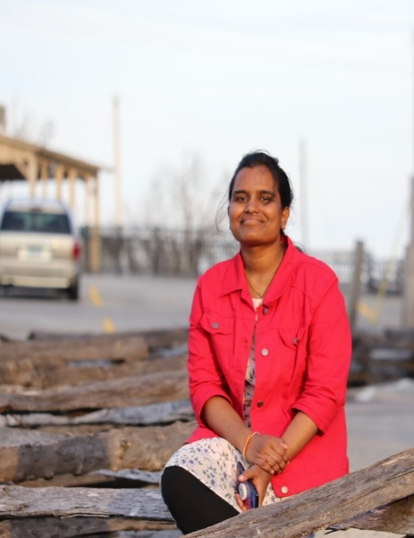
Sunil Mundru
UI Developer
Ganesh Siripuram
Application Developer
GunasekharKoppula
API Developer
Koteswara Harshith Gudapati
Database Engineer
Bhagya Sree Chanda
Team Lead
Chaitra Vemula
Tester
Ganesh Siripuram

Slide 3
Problem
When there is a disaster a cert member should communicate with the authorities and in return they should be given instructions in an asynchronous process.

Slide 4
Background
Community Emergency Response Team (CERT) developed in 1985.
Prepare for, respond to and recover from disasters.
Disaster Preparedness, Fire Suppression, Medical Operations
Ganesh Siripuram

Slide 5
Goals
The main aim of the project is to have a fast data flow between the cert member and the Emergency operation center.
This data will help the official to take quicker steps and allocate required resources to the location.
Chaitra Vemula

Slide 6
Objectives
This application’s main objective is to act as the first basic report for any kind of situation.
To take appropriate measures for helping people who are affected by reporting current location to the Disaster Management official.
Chaitra Vemula

Slide 7
Our Approach
To design a mobile Application where a CERT member will communicate with Authorities and report the issues using an API built on node JS and mongo DB
Chaitra Vemula

Slide 8
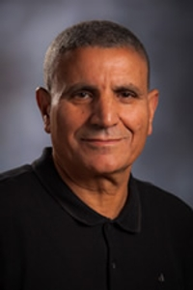
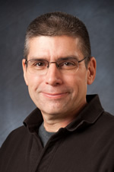
Dr . Aziz Fellah
Assistant Professor
Northwest Missouri State University
Dr. Mark Corson
Department Chair of Natural Sciences
Northwest Missouri State University
Chaitra Vemula

Slide 9
Users
A CERT member who reaches the disaster location will be using our app to send the reports regarding the situation like damage and triage details.
Gunashekar

Slide 10
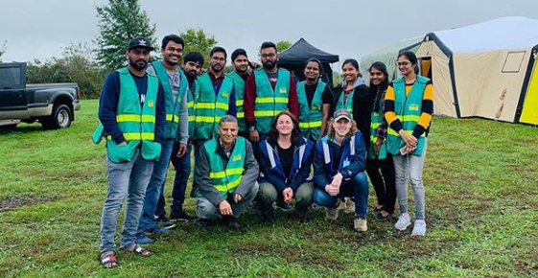
Gunashekar

Slide 11
Functionalities
Login and registration
Generating incident and general reports
Developing a profile page
Developing a map functionality
Gunashekar

Slide 12
Methodology
Agile Methodology.
A team manages a project’s requirements by breaking it up into several stages.
Involving constant collaboration with client.
Developing the product according to the requirement of client.
Artifacts- Client template
Gunashekar

Slide 13
Tools
Android Studio
Visual Studio
Genymotion
Workplace
Sunil Mundru

Slide 14
Discussion of Team Work
Scrum Presentations: Every Friday Morning During class 8:00 AM to 8:50 AM
Group Meetings: Monday and Wednesday 2:00 PM – 3:30 PM at library
Client Meetings: Every Friday 2:30 PM – 3:30 PM
Individual/group reports: Every Friday we will submit individual and group Reports
Sunil Mundru

Slide 15
Database
Mongo DB : MongoDB is an open-source document database and leading NoSQL database.
Sunil Mundru

Slide 16
Login and registration
First time users will have to register using mobile application.
Once users finish their registration the web application team will verify and validate whether they are certified CERT members or not.
If they are authorized, user would be able to login.
Sunil Mundru

Slide 17
Generating Reports
Submitting report for the assigned incident
Getting list of incidents assigned
Selecting date and time from dialog box
Capturing and uploading images
Entering TRIAGE details
Selecting impact level using dropdown menu
Sunil Mundru

Slide 18
Maps Implementation
Plotting different incidents on map using address provided by web team.
Getting current location for submitting report.
Using unique marker icons based on disaster type.
User would be able to navigate to the incident report either by clicking on the list or pointer on map.
Sunil Mundru

Slide 19
Profile Activity
Retrieving user details dynamically such as Name, phone, email, capabilities.
Status – In progress
Sunil Mundru

Slide 20
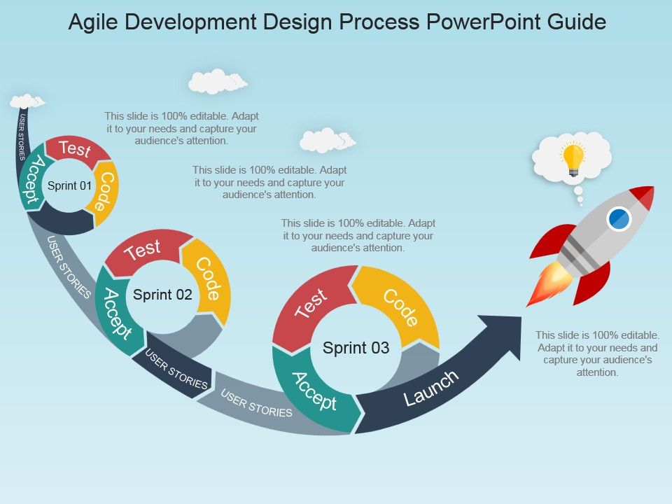
Modelling
Harshith

Slide 21
Work Done
Login and Registration
List of incidents
Incident report
Activity page for General Report for unassigned users
Developed Maps Functionality
Profile page
Harshith

Slide 22
Challenges
Developing, connecting to the API
Maps – getting current location
Authentication of user.
Bhagya Sree Chanda

Slide 23
References
https://www.slideteam.net/agile-development-design-process-powerpoint-guide.html
Bhagya Sree Chanda

Slide 24
Thank You ☺
Bhagya Sree Chanda

