Slide 1
C语言程序设计
C programming
主讲：邓小亚
Speech: Deng Xiaoya

Slide 2
个人信息(Personal Information)
Telephone：15881866287
QQ: 48834055
E-mail: dxy1234@163.com
讲授课程(Lecture Courses)：
C语言程序设计、C#程序设计、 Web程序设计
(C Programming、C# Programming 、Web Programming)
面向对象分析与设计
(Object oriented analysis and design)
软件项目管理(software project management)

Slide 3
Ground Rules
基本要求
按时上课，不迟到，不旷课；
Classes on time, not late or absent;
上课时认真听课，不做与课堂教学无关的事情；
Listen carefully during the class and do not do anything unrelated to the teaching;
积极参与课堂讨论，认真完成布置的作业。
Actively participate in class discussions and carefully complete homework。

Slide 4
什么是计算机语言？
（What is computer language?）
计算机语言：人和计算机交流信息的、计算机和人都能识别的语言。
（Computer Language: Language that people and computers can communicate information, and that computers and people can recognize.）

Slide 5
什么是C语言？
What is C language？
C语言是一种计算机程序设计语言，它既具有高级语言的特点，又具有汇编语言的特点。
C language is a computer programming language, which has the characteristics of both high-level language and assembly language.
它由美国贝尔研究所在1972年推出。它既可以编写系统程序，也可以编写应用程序。
It was launched by the Bell Institute in 1972. It can write both system programs and application programs.

Slide 6
学习C语言有用吗?
Is learning C useful?
C语言对于一个程序设计人员是非常重要的，而且C语言也是一个非常好入门的语言，虽然它是一门高级语言，但我们通常把它称作中间语言，介于汇编语句和高级语言（Java、C#）之间。
C language is very important for a programmer, and C language is also a very good entry language. Although it is a high-level language, we usually call it an intermediate language, which is between assembly language and high-level language (Java , C #).

Slide 7
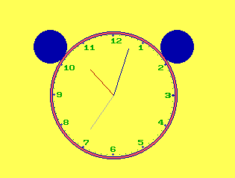
用C语言开发的程序-时钟
Programs Developed in C Language-clock

Slide 8
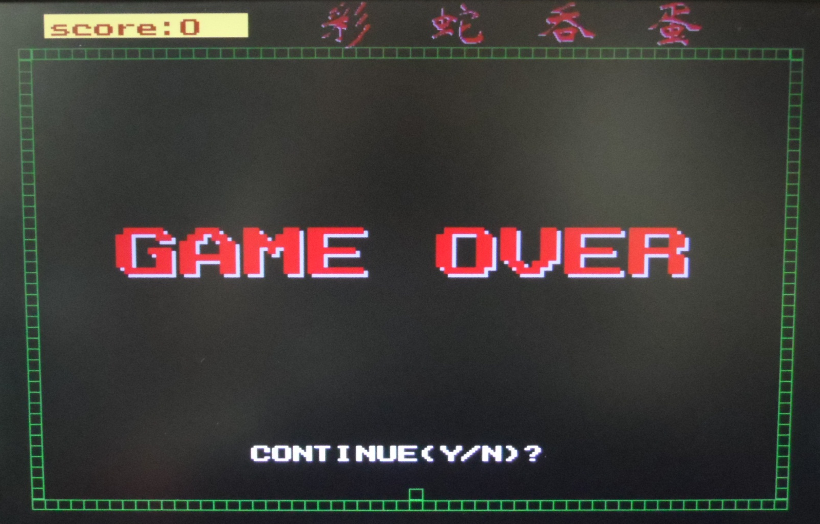
用C语言开发的程序-贪吃蛇游戏
Programs Developed in C Language-Snake Game

Slide 9
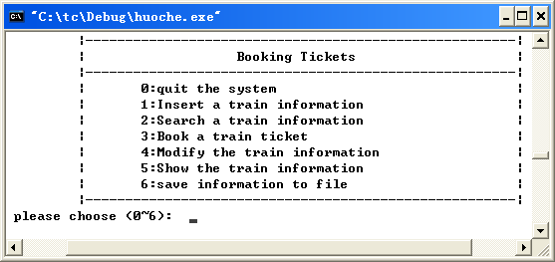
用C语言开发的程序-火车订票系统
Programs Developed in C Language-Train booking system

Slide 10
怎样才能学好C语言呢?
How can we learn C well?
读程序是学习C语言入门最快，也是最好的方法。
Reading programs is the fastest and best way to learn C.
多上机
Practice more on the computer

Slide 11
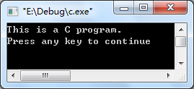
最简单的C程序
The simplest C program
例1.1 要求在屏幕上输出以下一行信息。
Example 1.1 Require the following line of information to be output on the screen.
This is a C program.

Slide 12
最简单的C程序
The simplest C program
这是C程序的基本结构
This is the basic structure
of a C program
#include <stdio.h>
int main( )
{
return 0;
}
printf (”This is a C program.\n”);

Slide 13

最简单的C程序
The simplest C program
#include <stdio.h>
int main( )
{
printf (”This is a C program.\n”);
return 0;
}
换行符
Newline

Slide 14
最简单的C程序
The simplest C program
#include <stdio.h>
int main( )
{
printf (”This is a C program.\n”);
return 0;
}
每句结束加分号
Add ； at the end of each line in { }

Slide 15
练习(Practice)：
要求在屏幕上显示以下信息：
（Require the following line of information to be output on the screen）
*
***
*****
*******
#include <stdio.h>
int main( )
{
return 0;
}
printf(“ *\n”);
printf(“ ***\n”);
printf(“ ******\n”);
printf(“*******\n”);

Slide 16
例1.2 求两个整数之和。
Example 1.2 Find the sum of two integers
such as:10 + 20=30 (ten add twenty equals thirty)
Calculation by program
10+20 (calculate ten add twenty)
  a=10 (Use variable a to store 10)
  b=20 (Use variable b to store 20)
  sum=a+b (Use variable sum to store the result of ten add twenty)

Slide 17
解题思路Problem-solving ideas:
定义3个整型变量（变量用于存放数据，必须先定义，然后才能使用）(Define 3 integer variables (variables are used to store data and must be defined before used))
a和b用来存放两个整数，sum用来存放和(a and b are used to store two integers, and sum is used to store the result of a add b,sum=a+b)
输出sum(output sum)

Slide 18
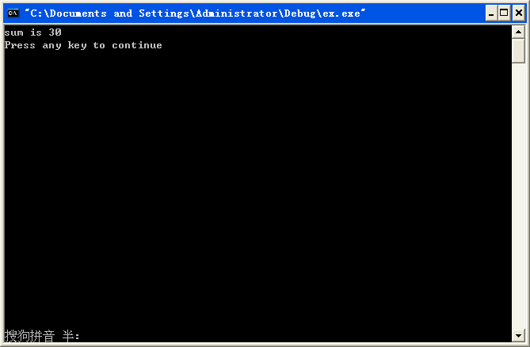
这个是注释，注释是对程序的解释说明。
This is an annotation.
Annotation is an explanations of the program.
程序如下(code)：
#include <stdio.h>
int main( )
{
return 0;
}
int a,b,sum;
//Defining integer variables a,b,sum
a = 10;
//Assign initial values to variables a and b
b = 20;
sum = a + b;
/*Assign the sum of a and b to sum*/
printf(”sum is %d\n”,sum);

Slide 19
#include <stdio.h>
int main( )
{
int a,b,sum;
a = 10;
b = 20;
sum = a + b;
printf(”sum is %d\n”,sum);
return 0;
}
Output sum in %d (decimal integer) format
The character you want to output

Slide 20
C语言的注释(Annotation of C Language)
注释是对程序的解释说明。
Annotation is an explanations of the program.
//：单行注释
Single-Line Comment
/*……*/：多行注释
multiline comments

Slide 21
例1.3求两个整数中的较大者。
Example 1.3 Find the larger of two integers.
1. 分析问题（Analysis problem）
  已知两个整数，求较大者（Given two integers, find the larger one）
  只需将两个整数比较大小就可得到较大者。
  （Just compare two integers to get the larger one）

Slide 22
解题思路Problem-solving ideas:
定义3个整型变量a,b,max（Define 3 integer variables a, b, max）
a和b用来存放两个整数，max用来存放较大者（a and b are used to store two integers, and max is used to store the larger one）
如果a>b,max=a，否则max=b；
( if （a>b） max=a;
else max=b; )
输出max（output max）

Slide 23
练习：写出源代码
Exercise: Write the source code
#include <stdio.h>
int main( )
{
int a,b,max; // Declaration of variables
a=5;
b=10; //Initial data
if (a>b) max=a;
else max=b; //Data processing
printf(“max=%d\n”,max); //Output result
return 0;
}
scanf(“%d%d”,&a,&b);
//Enter initial data from the keyboard

Slide 24
思考：如何求三个数中的最大者?
Think: How to find the largest of the three numbers?
提示Ideas：
定义4个整型变量a,b,c,max（Define 4 integer variables a, b, c, max）
先找出前两个数的较大者放入max中（First find the larger of the first two numbers and put it in max）
然后找出max与第三个数的较大者放入max中（Then find out the larger of max and the third number and put it in max）
max即为三个数的最大者,输出max(max is the largest of the three numbers,Output max )

Slide 25
练习：写出源代码
Exercise: Write the source code
#include <stdio.h>
int main( )
{
int a,b,c,max; // Declaration of variables
a=5;
b=10;
c=15; //Initial data
if (a>b) max=a;
else max=b;
if (c>max) max=c;
else max=max; //Data processing
printf(“max=%d\n”,max); //Output result
return 0;
}
scanf(“%d%d%d”,&a,&b,&c);
//Enter initial data from the keyboard

Slide 26
C程序的上机平台
C program computer system
1.Dev-Cpp（中英文版）
2.C/C++程序设计学习与实验系统(中文版)
3.Visual C++ 6.0（中英文版）

Slide 27
C程序的上机步骤
C program steps on the computer
1.输入和编辑源程序（.c文件）
Enter and edit source programs
2.对源程序进行编译
Compile the source program
3.运行可执行程序，(有时需要输入数据)得到运行结果
Run the executable program (sometimes you need to enter data) to get the results.

