Slide 1
HTML Introduction
Day-5

Slide 2
Html tags:-
<I frame>(inline frame tag):-An Inline frame is a html element that loads another html page within the document.
Ex:-<iframe src=www.image.com title=“image”;></iframe>
background image tag:-If you want to add background image in html using background attribute.
Ex:-<p style=“background –image : url (‘www.image.com’);>

Slide 3
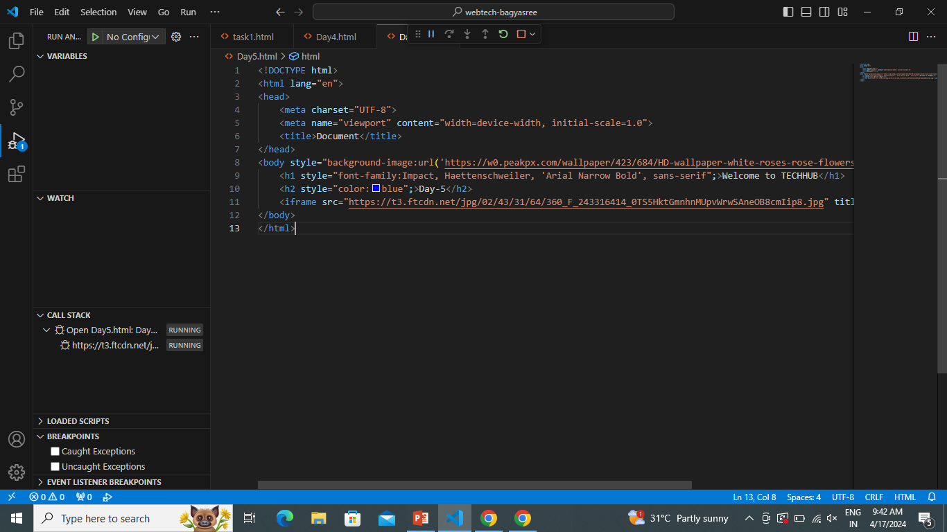

Slide 4
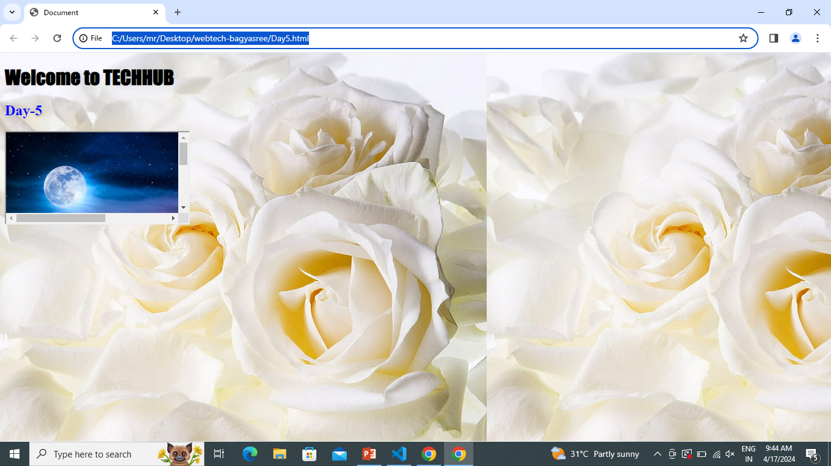

Slide 5
CSS(Cascading Style Sheets):-
CSS:-CSS stands for cascading style sheets.it can control the layout of multiple web pages all at once. Mainly CSS are three types:
1.Inline style sheet
2.internal style sheet
3.external style sheet

Slide 6
Inline CSS:-
An Inline CSS is used to apply a unique style to a single HTML element.
An Inline CSS uses the style attribute of an element.

Slide 7
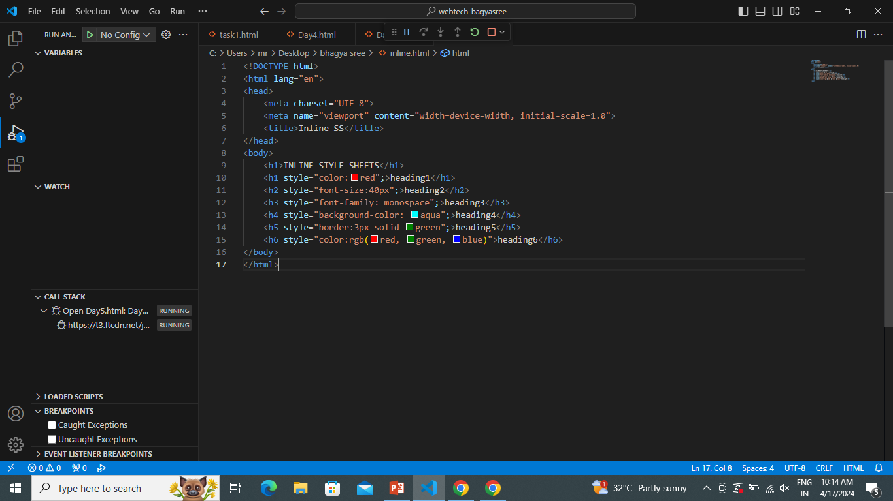

Slide 8
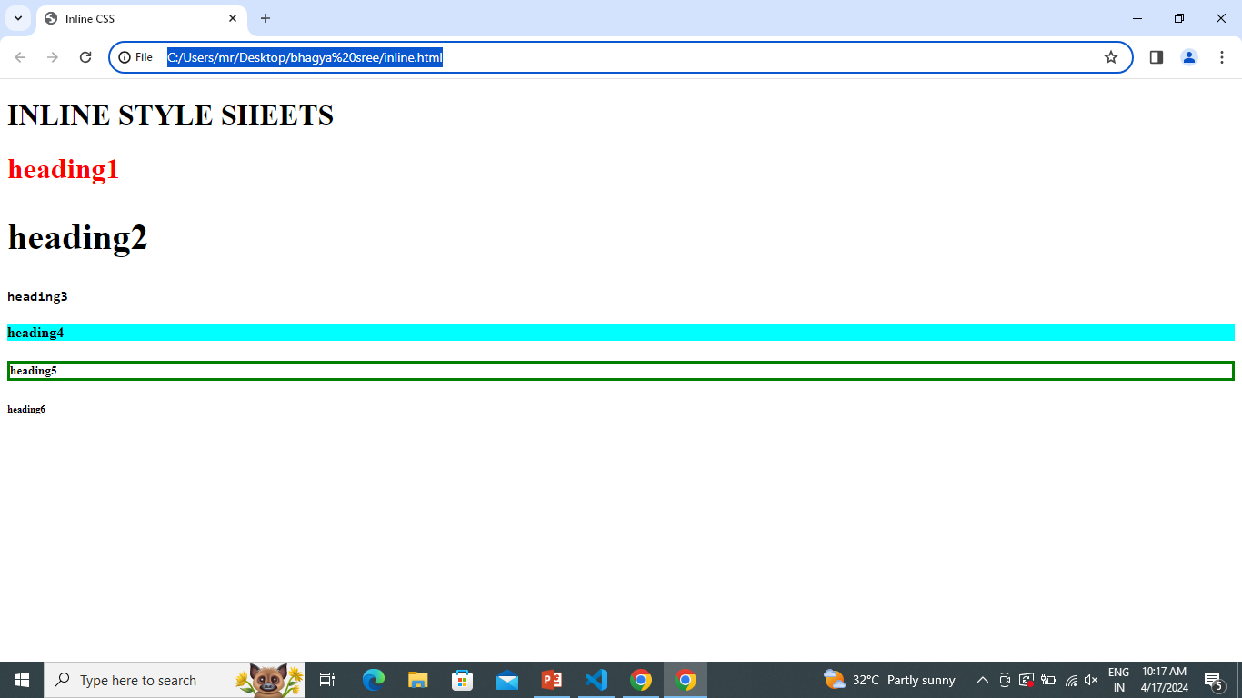

Slide 9
Internal CSS:-
An internal CSS is used to define a style for a single html page.
An internal CSS is defined in the <head> section of an html page , within a <style> attribute.

Slide 10
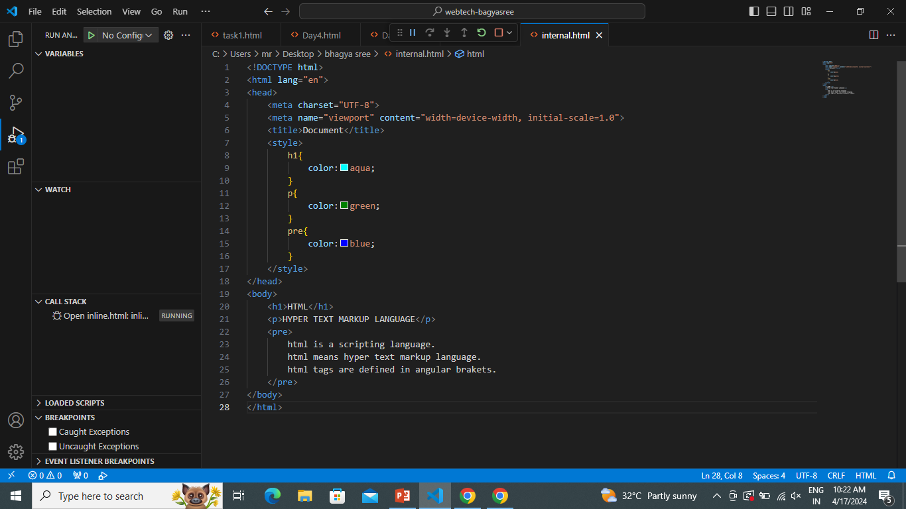

Slide 11
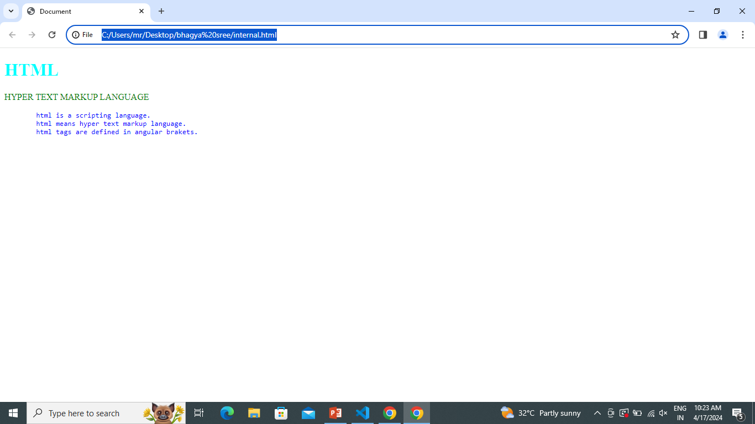

Slide 12
External CSS:-
External CSS is a form of CSS which is used to add styling to multiple html pages at a time.
It helps to design the layout of many html web pages simultaneously.
This file always saved with the extension “.CSS”.

Slide 13
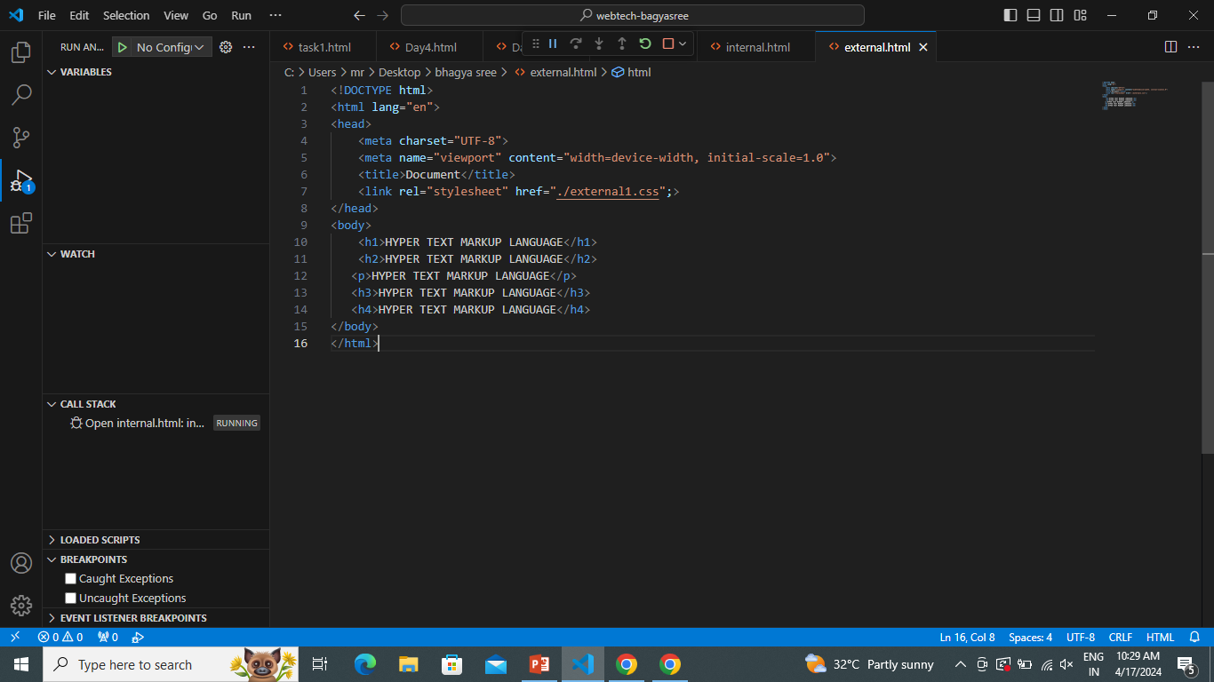

Slide 14
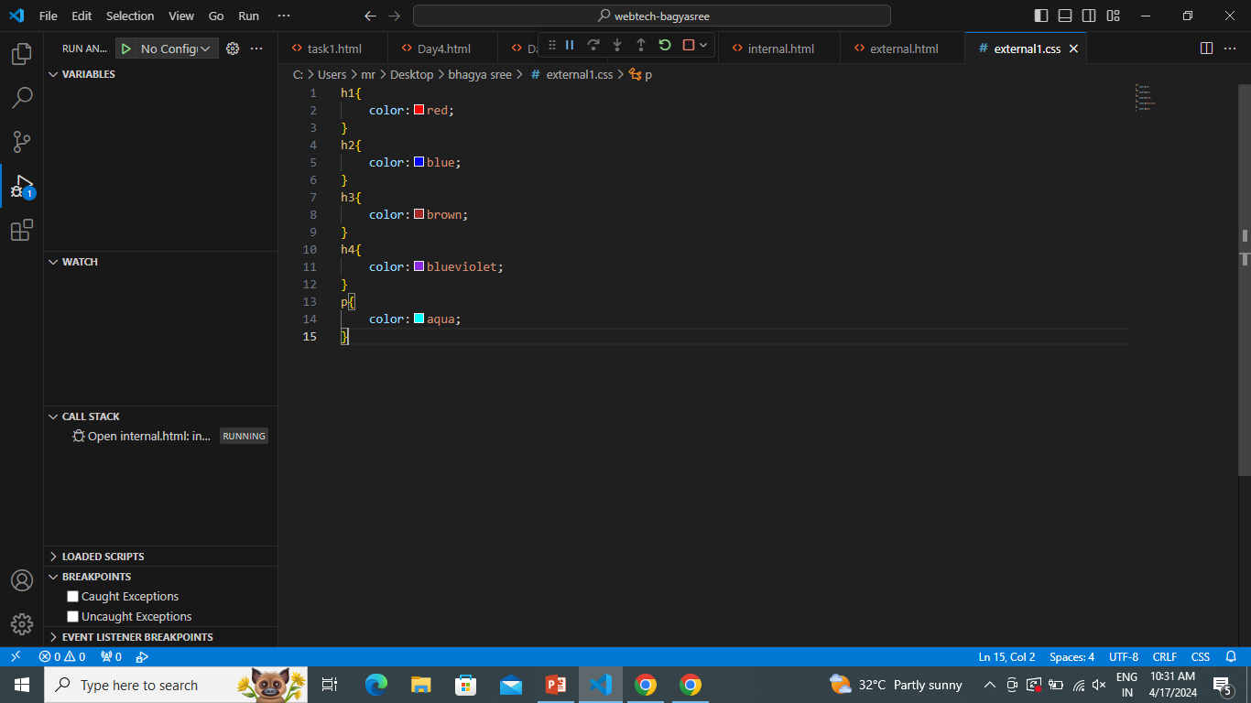

Slide 15
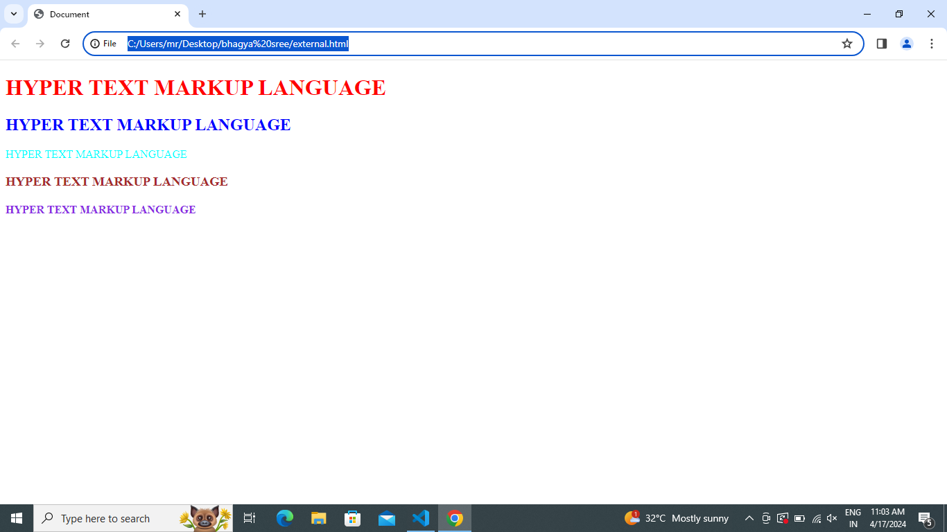

Slide 16
Tables in html:-
In html table tag is used to displays the data in tabular form
(row*column).
which includes the table elements , such as TR(table row),TH(table header) and TD(table data).
ex:-<table> ex:- <table>
<tr> <tr>
<th>name</th> <td> TECHHUB</td>
<th>city</th> <td> NARSAPUR </td>
</table> </table>

Slide 17
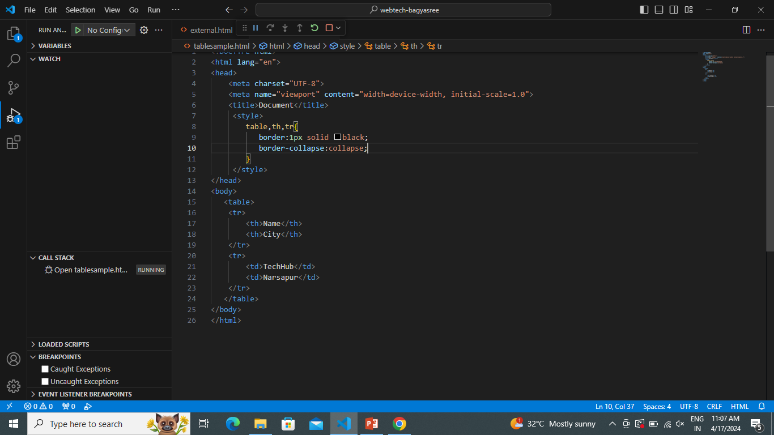

Slide 18
