Slide 1
CSS
Cascading style sheets

Slide 2
CSS selectors:-
Simple selectors
Combination selectors
Pseudo-class selectors
Pseudo-element selectors
Attribute selectors

Slide 3
Simple selectors:-
Id
class

Slide 4
Combinations selectors:-
Descendent selector
Child selector
Adjacent selector
General selector

Slide 5
Pseudo-class selectors
Link
Visited
Active
Hover

Slide 6
Pseudo-element selectors
First-line
First-letter
Multiple
Selection
Marker

Slide 7
Attribute selectors
Class
Title
Src
Href
Target

Slide 8
Flex-property:-
Syntax: justify-content
Flex-start
Flex-end
Center
Space-between
Space-around

Slide 9
Align-items:-
Syntax: align-items
Base-line
Center
Stretch
Flex-start
Flex-end

Slide 10
Flex-directions:-
Syntax: flex-direction
Row
Row-reverse
Column
Column-reverse

Slide 11
Transform:-
Syntax: transform
Translate
Rotate
Skew
scale

Slide 12
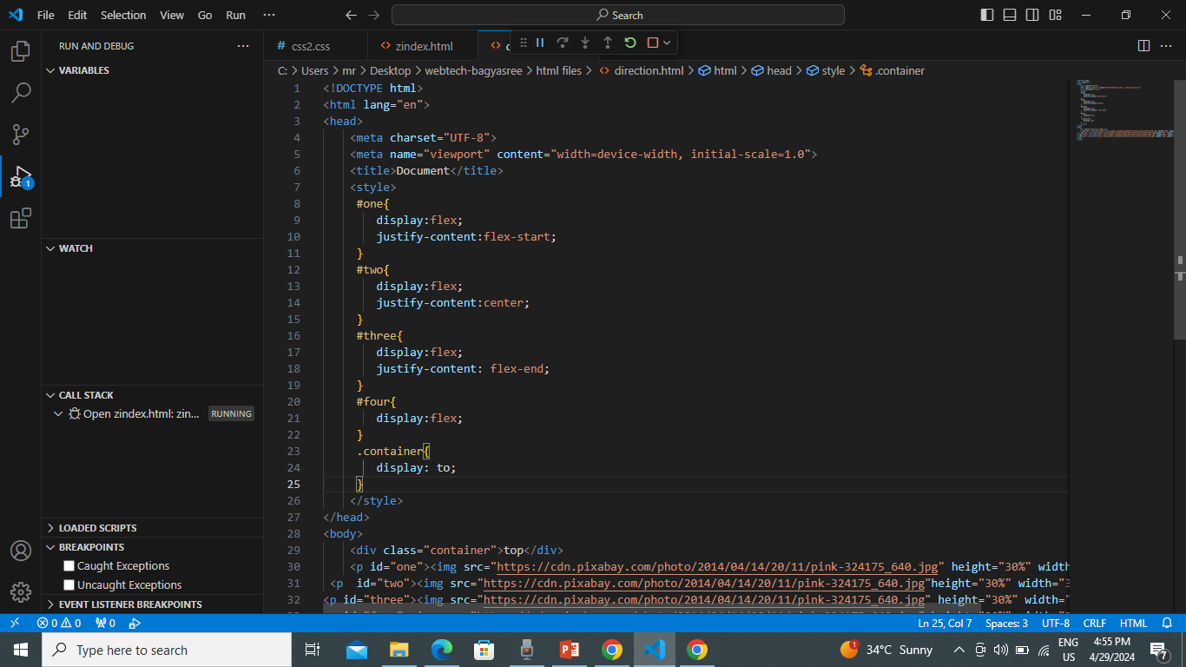

Slide 13
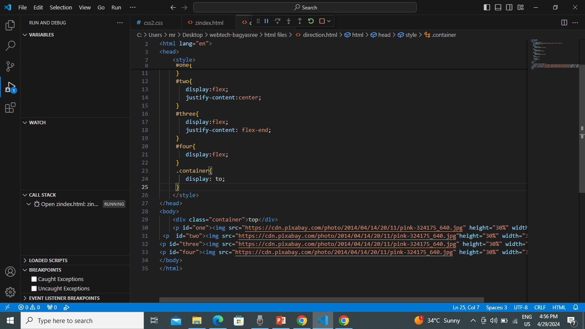

Slide 14
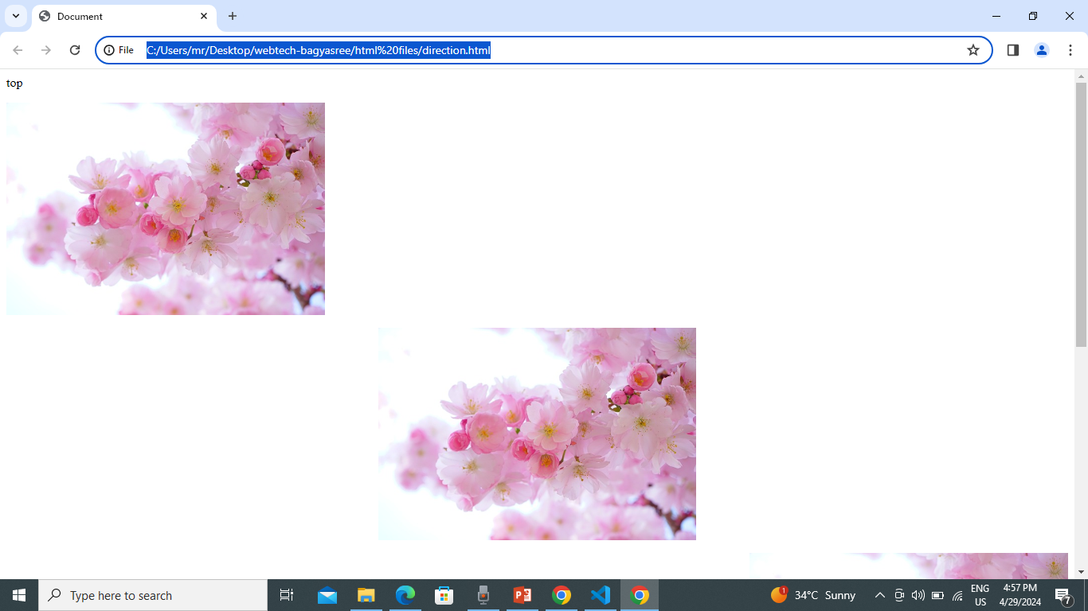

Slide 15
Box model:-
Margin:- clears an area outside the border. The margin is transparent.
Border:- a border that goes around the padding and content.
Padding:- clears an area around the content. The padding is transparent.
Content:- the content of the box, where text and images appear.

Slide 16
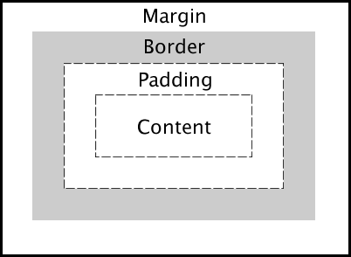

Slide 17
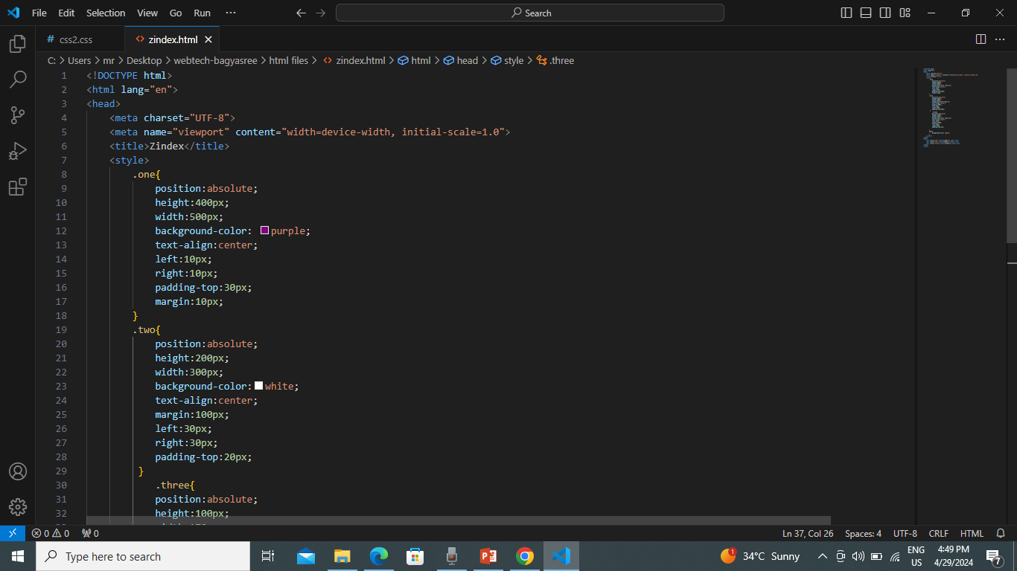

Slide 18
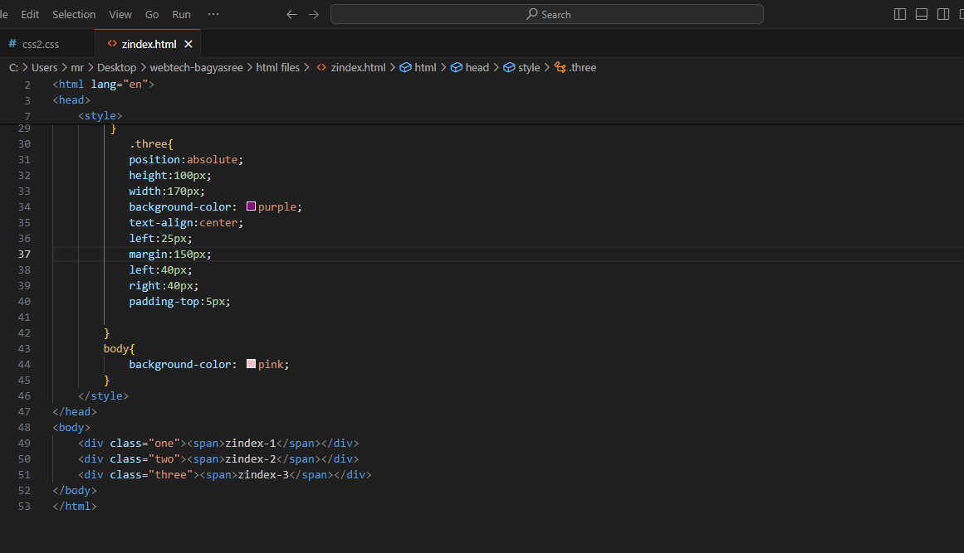

Slide 19
