Slide 1
HTML5
HYPER TEXT MARKUP LANGUAGE

Slide 2
HTML(Hypertext Markup Language):-
HTML stands for Hyper text markup language. It is a language for World Wide Web. It is a standard text formatting language which is used to create and display pages on the Web. It makes the text more interactive and dynamic.
The HTML is proposed by Tim Berners Lee in 1993.

Slide 3
Web Technology:-
Web technology means by which computers communicate with each other using markup languages and multimedia packages.
It gives us a way to interact with hosted information , like websites.
Web technology involves the use of hypertext markup language and CSS .

Slide 4
World Wide Web(WWW):-
The world wide web commonly referred to as www,w3 or the web is a system of interconnected public webpages accessible through the internet.
The www is proposed by TIM BERNERS LEE.

Slide 5
Web Server:-
A web server is software and hardware that uses HTTP and other protocols to respond to client requests made over the world wide web.
The main job of a web server is to display website content through storing , processing and delivering webpages to users.

Slide 6
Web Pages:-
A web page is a document in html that you can see online , using a web browser .
Most web pages include text ,images , videos and links.

Slide 7
Web Browser:-
A web browser is an application for accessing websites.

Slide 8
Structure of HTML :-
<!DOCTYPE html>
<html>
<head>
<title>TECHHUB</title>
</head>
<body>
<h1>Heading 1</h1>
</body>
</html>

Slide 9
Formatting tags:-
<STRONG> - strong tag
<B> - bold tag
<I > - italic tag
< EM > - emphasized
<MARK> - marked
<INS> - insert
<DELETE> - delete/strike through
<SUB> - subset
<SUP> - superset
<P> - paragraph tag
<PRE> - preformatted tag
<CITE> - citation tag
<BDO> - bi-directional override
<ADDRESS> - address tag
<q>-Quotation tag

Slide 10
Html Attributes:-
Property : Value(key-value pair):-
Style=“color : black”;
Style=“font-size : 30px”;
Style=“background-color : blue”;
Example:- <p style=“color : blue“;> BHAGYA SRI</p>
property : value
Style=“font-family : ’Cursive’ ”;
Style=“border: 2px Solid Blue”;
Style=“color : rgb(255,255,255)”;

Slide 11
Html tags:-
<A HREF=“www.google.com” target=“_blank”;>
<I frame>(inline frame tag):-An Inline frame is a html element that loads another html page within the document.
Ex:-<iframe src=www.image.com title=“image”;></iframe>
background image tag:-If you want to add background image in html using background attribute.
Ex:-<p style=“background –image : url (‘www.image.com’);>
<IMG SRC=“www.google.com” alt=“mangoes images”;>

Slide 12
Lists in HTML:-
1.Ordered list:-in html ordered list are defined in <OL>.
Ex:- <ol>
<li>list1 here</li>
<li>list 2 here</li>
</ol>
2.unordered list:-in html unordered list are defined in<UL>.
Ex:- <ul>
<li>unordered list 1 here</li>
<li>unordered list 2 here</li>
</ul>
3.Definition list:-
Ex:- <dl>
<dt>Coffee</dt>
<dd>Black hot drink</dd>
<dt>Milk</dt>
<dd>White cold drink</dd>
</dl>

Slide 13
Tables in html:-
In html table tag is used to displays the data in tabular form
(row*column).
which includes the table elements , such as TR(table row),TH(table header) and TD(table data).
ex:-<table> ex:- <table>
<tr> <tr>
<th>name</th> <td> TECHHUB</td>
<th>city</th> <td> NARSAPUR </td>
</table> </table>

Slide 14
Query selector & query selector all:-
Query selector:-
document.queryselector(“p”).style.backgroundColor = “red”;
Query selector all:-
document.queryselectorall(“.example”);

Slide 15
Semantics in HTML:-
A semantic element clearly describes it’s meaning to both the browser and the developer. These are two types:-
Non semantic elements:- <div>, <span>.
Semantic elements:- <form>, <table> and <article>.

Slide 16
CSS3
CASCADING STYLE SHEETS

Slide 17
CSS(Cascading Style Sheets):-
CSS stands for cascading style sheets. It is a popular styling language which is used with HTML to design webpages. It can also be used with XML documents including plain XML, SVG and XVL.
The CSS is proposed by Hakon Wiumlie and Bert Bos in 1994.

Slide 18
CSS Selectors:-
Simple selectors
Combination selectors
Pseudo-class selectors
Pseudo-element selectors
Attribute selectors

Slide 19
Simple selectors:-
Id
class

Slide 20
Combinations selectors:-
Descendent selector
Child selector
Adjacent selector
General selector

Slide 21
Pseudo-class selectors:-
Link
Visited
Active
Hover

Slide 22
Pseudo-element selectors:-
First-line
First-letter
Multiple
Selection
Marker

Slide 23
Attribute selectors:-
Class
Title
Src
Href
Target

Slide 24
Flex-property:-
Syntax: justify-content
Flex-start
Flex-end
Center
Space-between
Space-around

Slide 25
Align-items:-
Syntax: align-items
Base-line
Center
Stretch
Flex-start
Flex-end

Slide 26
Flex-directions:-
Syntax: flex-direction
Row
Row-reverse
Column
Column-reverse

Slide 27
Transform:-
Syntax: transform
Translate
Rotate
Skew
scale

Slide 28
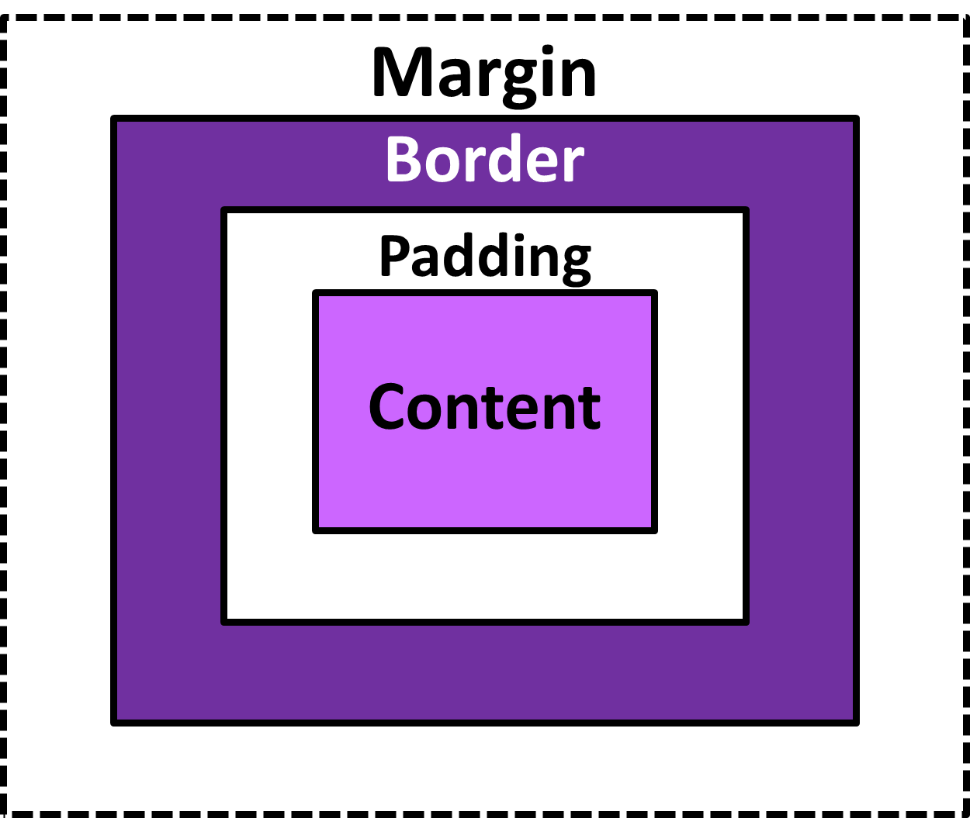
Box model:-
Margin:- clears an area outside the border. The margin is transparent.
Border:- a border that goes around the padding and content.
Padding:- clears an area around the content. The padding is transparent.
Content:- the content of the box, where text and images appear.

Slide 29
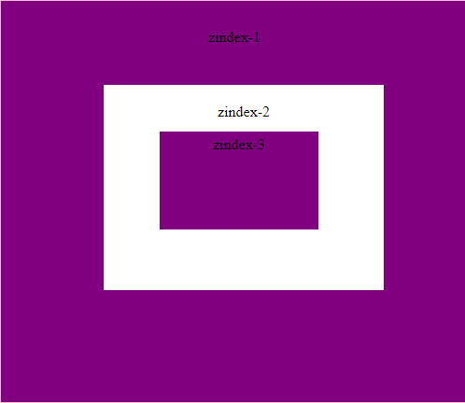
Z-index:-
The z-index property specifies the stack order of an element.
An element with greater stack order is always in front of an element with a lower stack order.

Slide 30
Block level & Inline elements:-
Block level elements:-
A block level elements always starts on a new line and the browser automatically add some space before and after the element.
Ex:- <address>,
<form>,
<table>,
<div>.
Inline elements:-
An inline element does not start on a new line. An inline element only takes up as much width as necessary.
Ex:- <strong>,
<br>,
<img>,
<span>

Slide 31
JAVA SCRIPT

Slide 32
Java Script:-
JavaScript is a scripting language. It is different from java language. It is an object-based and lightweight language. It is widely used for client-side validation. The javascript translator is responsible for translating the javascript code for the web browser.
The javascript is proposed by Brendan Eich in 1995.

Slide 33
JavaScript display possibilities:-
document.getElementById(“id name”).innerhtml
document.write( )
console.log( )

Slide 34
JavaScript variables:-
Javascript variales can be declared in 4ways:
=> automatically
=> var
=> let
=> const

Slide 35
Automatically:-
The undeclared variables are automatically declared.
Ex:- x = 5;
y = 7;
z = x + y;

Slide 36
Var:-
The values are declared as variables. We can re-declare variables.
Ex:- var x = 5;
var y = 7;
var z = x + y;

Slide 37
Let:-
The values are defined with let keyword. We cannot re-declare let variables.
Ex:- let x = 5;
let y = 7;
let z = x + y;

Slide 38
Const:-
The values are stored as constant variables. These variables cannot be re-declare.
Ex:- const x = 5;
const y = 7;
const z = x + y;

Slide 39
Datatypes:-
JavaScript has 8 datatypes:
1.string
2.number
3.boolean
4.bigint
5.undefined
6.null
7.symbol
8.object

Slide 40
Operators:-
JavaScript operators are used to perform different types operations. there are different types of operators:
=> Arithmetic operators
=> Assignment operators
=> Comparison operators
=> String operators
=> Logical operators
=> Bitwise operators
=> Ternary operators
=> Type operators

Slide 41
Function:-
The JavaScript function is a block of code designed to perform a particular task. It is executed when calls it.
Ex:- function add(a,b) {
return a + b
}
let answer = add(3,5);
document.write(answer);

Slide 42
Event handlers
Event Handlers are JavaScript methods, i.e. functions of objects, that allow us to control what happens when events occur.
onAbort
onBlur
onClick
onChange
onError
onFocus
onLoad
onMouseout
onMouseover
onReset
onSelect
onSubmit
onUnload

Slide 43
Array methods:-
Push( )
Pop( )
Shift( )
Unshift( )
Splice( )
Slice( )
Includes( )
Indexof( )
Lastindexof( )
Concat( )
Reverse( )
Join( )
Sort( )
Foreach( )
Filter( )

Slide 44
String methods:-
toUppercase( )
toLowercase( )
Slice( )
Split( )
Substr( )
Substring( )
Startswith( )
Endswith( )
Repeat( )
Replace( )
Charat( )
Charcode( )

Slide 45
CRUD operators:-
CRUD operations:-
Create : adds new data
Read : retrieves data
Update: modifies existing data
Delete: removes data

Slide 46
Conditionals:-
If
Else
Else if
switch

Slide 47
If:-
The if statement specify a block of code to be executed if a condition is true.
Ex:- if (time < 18) {
document.write(“Good day”);
}

Slide 48
else:-
The else statement specify a block of code to be executed if the condition is false.
Ex:- if (time < 18) {
document.write(“Good morning”);
}
else {
document.write(“Good evening”);
}

Slide 49
Else if:-
The else if statement specify a new condition if the first condition is false.
Ex:-if (time < 10) {
document.write(“Good morning”);
}
else if (time<20) {
document.write(“Good afternoon”);
else {
document.write(“Good evening”);
}

Slide 50
Switch:-
The switch statement is used to perform different actions based on different conditions.
Ex:- switch(time) { case0 :
time = morning;
case1 :
time = afternoon;
case2 :
time = evening;

Slide 51
loops:-
For loop
While loop

Slide 52
For loop:-
The for loop through a block of code a number of times.
Ex:- for ( let i = 0; i < 5; i ++) {
text += “the number is “ + i + “<br>”;
}
document.write(text);

Slide 53
While loop:-
The while loop loops through a block of code as long as a specified condition is true.
Ex: while ( i <10 ){
text += “<br> the number is” + i
i ++;
}

Slide 54
Regular Expressions:-
The regular expression is built in javascript which is used to match the parents.
Ex:- function valid() {
var input=document.getElementsById(“inp”);
var reg = /^[6-9][0-9]{9}$/g;
var res = reg.test(input.value);
if (res==True) {
alert (“Mobile number accepted”);
return True; }
else {
alert (“Mobile number not accepted”);
return False; }

