Slide 1
CSE7302 - INTERNSHIP
Review-1 Presentation
Student Details
Name | BHAGYAVARDHAN
Roll No | 20231CSE3038
Section | 8CSE09
Under the Supervision of,
Mr.Bikram Sarkar & Ms.Chinmayi G V
Assistant Professor
School of Computer Science and Engineering
Presidency University
Name of the Program: Internship-CSE7302
Name of the HoD: Dr. Asif Mohammed
Name of the Program Internship Coordinator: Dr. Balakrishnan
Name of the School Internship Coordinator: Dr. Md Ziaur Rahman

Slide 2
Content
About Company or Organization
Working domain or the technology
About your team and reporting Manager
Challenges Faced in Internship
Objectives of the work
Internship Roadmap
Github Link

Slide 3
About Company or Organization
Ankit Automations is a trusted name in the field of security and automation solutions.
With a focus on innovation, quality, and customer satisfaction, we provide a wide range of products designed to make spaces smarter, safer, and more efficient.
Join the growing number of clients who trust us to automate their world.

Slide 4
Product Offerings
Our offerings include boom barriers, sliding gates, automatic doors, garage door, gate motors, flap barriers, swing barriers, turnstiles, CCTV cameras, walkie-talkies, metal detectors, and handheld detectors & etc.
Whether it’s residential, commercial, or industrial, our automation solutions are tailored to meet the unique needs of each client.

Slide 5
Commitment & Support
Backed by years of experience and a dedicated team, we ensure professional installation, reliable support, and prompt after-sales service.
At Ankit Automations, we don’t just sell products—we deliver peace of mind and convenience.

Slide 6
Working domain or the technology
As a Data Analyst at Ankit Automations, you’ll collect and process data from security systems like CCTV cameras and access control devices to identify patterns in usage and potential vulnerabilities.
Analyzing Sales data for products such as boom barriers and sliding gates to forecast demand and optimize inventory management for residential, commercial, and industrial clients.
This domain emphasizes predictive analytics on sales and inventory data for products like sliding gates and garage doors, helping forecast demand and improve customer satisfaction.

Slide 7
Data Analyst Responsibilities
Evaluating data from metal detectors and walkie-talkies to assess efficiency in security operations and recommend upgrades for better safety.
Collaborate with the dedicated team to interpret client-specific data, ensuring tailored automation solutions meet unique needs in smarter and safer spaces.
Extend to monitoring system logs from gate motors and turnstiles to detect anomalies, contributing to reliable support and peace of mind for clients.
Generating reports on overall company performance, using insights to drive quality improvements and expand the growing number of trusting clients in automation.

Slide 8
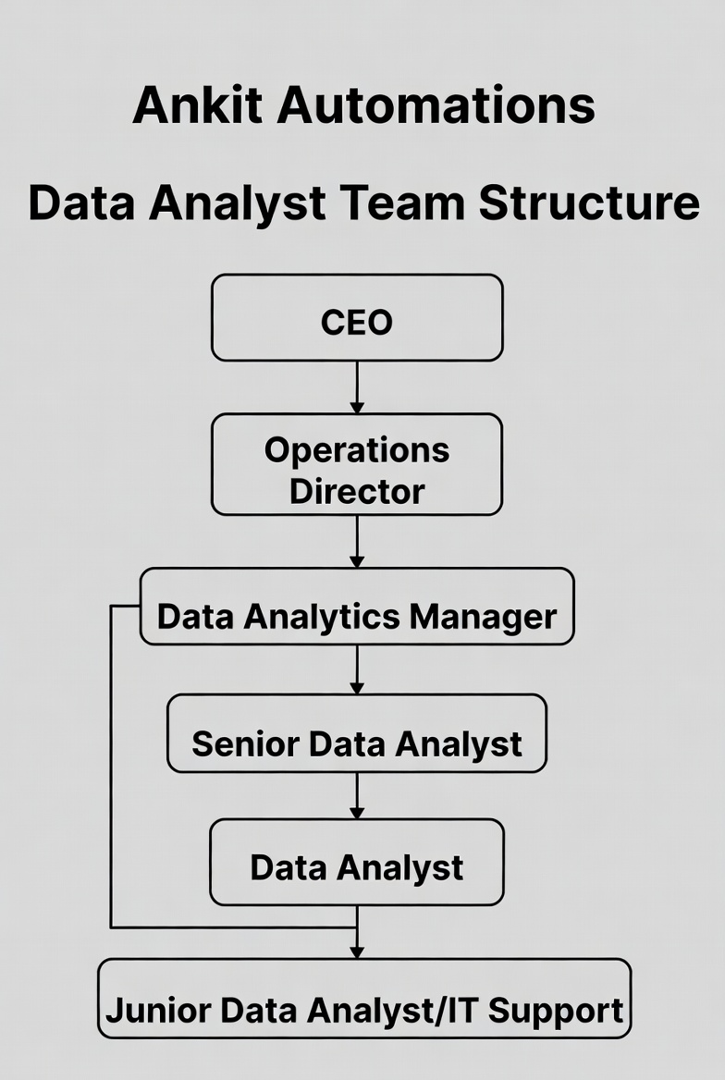
About your team and reporting Manager

Slide 9
Project for Data Analyst
Sales & Inventory Optimization Project — Analyzing historical sales data, client inquiries, and product performance (e.g., boom barriers and walkie-talkies) across residential/commercial sectors to forecast demand, manage stock levels, and support business growth.
After-Sales Service Enhancement Project — Evaluating service tickets, installation feedback, and system uptime data to identify improvement areas, ensure prompt support, and contribute to overall customer satisfaction and peace of mind.

Slide 10
Challenges Faced in Internship
Adjusting to cross-functional team dynamics.
Adapting to ambiguous, unstructured real-world data.
Communicating insights to non-technical teams.
Dealing with time-zone or hybrid work confusion.

Slide 11
Objectives of the work
Support data-driven decision-making for clients by generating insights from installed systems, helping tailor solutions that meet unique residential, commercial, or industrial needs.
Improve after-sales service efficiency through trend analysis of service tickets, installation feedback, and system uptime data to ensure prompt support and higher customer satisfaction.
Drive client peace of mind by delivering reliable, evidence-based insights that demonstrate the value of installed systems and build long-term trust.

Slide 12
Continue….
Transform raw device data into strategic assets overall, turning logs from IoT-connected products into meaningful intelligence that aligns with the company's mission of innovation, quality, and customer-focused automation.
Support business expansion by analyzing market and usage data to identify high-demand sectors (e.g., industrial vs. commercial) and inform strategic decisions.

Slide 13
Internship Road Map
Note: Write in the below table what u will be achieving in each review
Review 1
Learning domain basics for security & automation: Understand boom barriers, turnstiles, flap barriers, CCTV metadata, access patterns (domain knowledge, physical security systems, access control devices)
Review 2
Review 3
Review 4
Review 5

Slide 14
Github Link
https://github.com/bhagyavardhanIntern08

Slide 15
Q&A

Slide 16
Thank you !!

