Slide 1
CSE7302 - INTERNSHIP
Review-2 Presentation
Student Details
Name | BHAGYAVARDHAN
Roll No | 20231CSE3038
Section | 8CSE09
Under the Supervision of,
Mr.Bikram Sarkar & Ms.Chinmayi G V
Assistant Professor
School of Computer Science and Engineering
Presidency University
Name of the Program: Internship-CSE7302
Name of the HoD: Dr. Asif Mohammed
Name of the Program Internship Coordinator: Dr. Balakrishnan
Name of the School Internship Coordinator: Dr. Md Ziaur Rahman

Slide 2
Content
About Company or Organization
Working domain or the technology
About your team and reporting Manager
Challenges Faced in Internship
Objectives of the work
Literature Review
Proposed System
Problem Statement
System Requirements
Advantages of Proposed System/Work

Slide 3
About Company or Organization
Ankit Automations is a trusted name in the field of security and automation solutions.
With a focus on innovation, quality, and customer satisfaction, we provide a wide range of products designed to make spaces smarter, safer, and more efficient.
Join the growing number of clients who trust us to automate their world.

Slide 4
Product Offerings
Our offerings include boom barriers, sliding gates, automatic doors, garage door, gate motors, flap barriers, swing barriers, turnstiles, CCTV cameras, walkie-talkies, metal detectors, and handheld detectors & etc.
Whether it’s residential, commercial, or industrial, our automation solutions are tailored to meet the unique needs of each client.

Slide 5
Commitment & Support
Backed by years of experience and a dedicated team, we ensure professional installation, reliable support, and prompt after-sales service.
At Ankit Automations, we don’t just sell products—we deliver peace of mind and convenience.

Slide 6
Working domain or the technology
As a Data Analyst at Ankit Automations, you’ll collect and process data from security systems like CCTV cameras and access control devices to identify patterns in usage and potential vulnerabilities.
IoT sensors are used to continuously monitor operational parameters like temperature, voltage, uptime, and error frequency.
Security automation systems such as CCTV cameras, boom barriers, turnstiles, and access control systems form the core application area.

Slide 7
Continue…
The project operates in the domain of IoT-enabled smart security automation, where physical security devices are interconnected through the internet.
It focuses on predictive maintenance analytics, which uses historical and real-time data to forecast failures before they occur.
Automation analytics enables proactive decision-making rather than reactive maintenance.

Slide 8
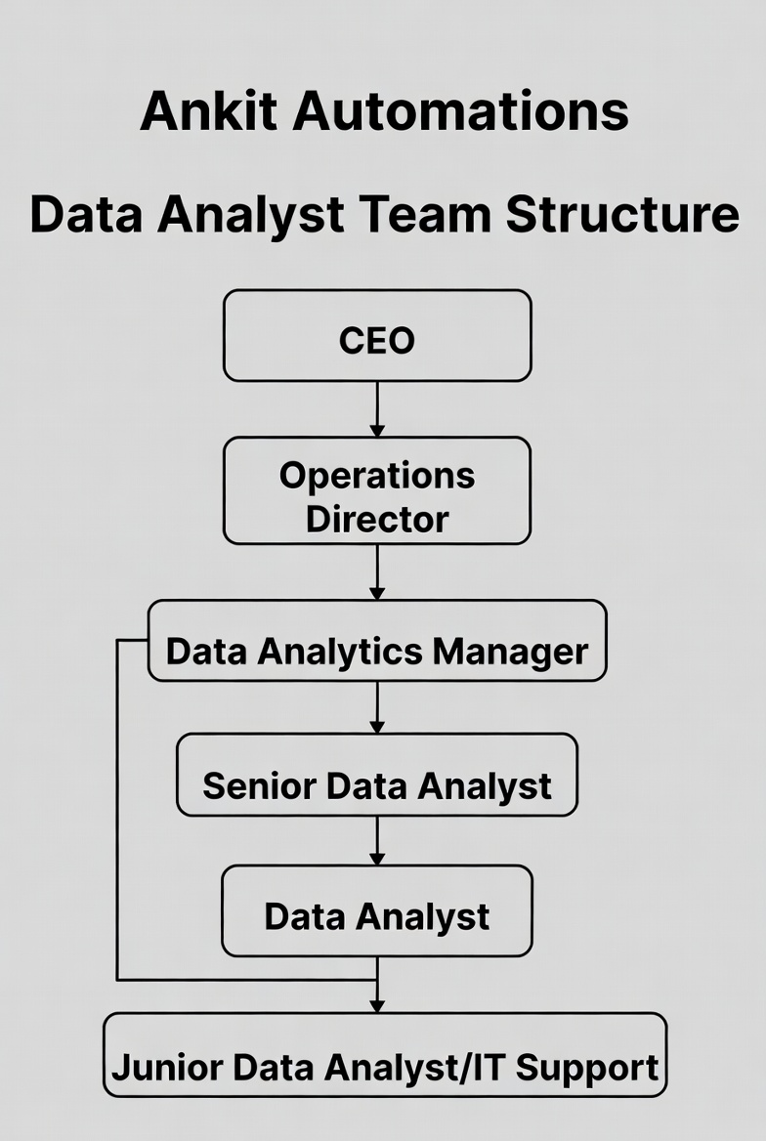
About your team and reporting Manager

Slide 9
Continue…
The internship was conducted at Ankit Automations, a company specializing in security and automation solutions.
The team includes automation engineers responsible for hardware deployment.
The reporting structure helps interns understand real-world organizational workflows.
The team follows professional communication and reporting standards.

Slide 10
Challenges Faced in Internship
Adjusting to cross-functional team dynamics.
Adapting to ambiguous, unstructured real-world data.
Communicating insights to non-technical teams.
Dealing with time-zone or hybrid work confusion.
Data preprocessing consumed significant time and effort.

Slide 11
Objectives of the work
To analyze device behavior using analytics techniques.
To understand maintenance challenges faced in security infrastructures.
To apply predictive maintenance concepts in a real-world scenario.
To collect real-time operational and environmental data.

Slide 12
Continue….
Transform raw device data into strategic assets overall, turning logs from IoT-connected products into meaningful intelligence that aligns with the company's mission of innovation, quality, and customer-focused automation.
Support business expansion by analyzing market and usage data to identify high-demand sectors (e.g., industrial vs. commercial) and inform strategic decisions.

Slide 13
Literature Review
Research studies highlight predictive maintenance as superior to reactive methods.
Literature shows IoT as a key enabler for smart monitoring systems.
Existing systems lack integration between IoT and analytics.
Research identifies data quality as a major challenge.

Slide 14
Proposed System
The proposed system integrates IoT sensors with security devices.
Data is transmitted securely to cloud servers.
Machine learning models analyze trends and anomalies.
Maintenance schedules are optimized using analytics.
The solution improves system reliability and uptime.

Slide 15
Problem Statement
Existing maintenance methods are reactive.
Manual monitoring is inefficient and error-prone.
Maintenance costs increase due to emergency repairs.
Security automation systems face unexpected operational failures.
Maintenance schedules are not data-driven.

Slide 16
Hardware and Software Details
Laptops/Workstations: Development team using Windows 10/11 laptops with 16GB RAM, Intel i7 processors, and dual monitors for productivity.
Development Tools: Visual Studio Code for coding, GitHub for version control and collaboration, Docker for containerization ensuring consistent environments, and Postman for API testing.
ETL Tools: Apache Airflow for workflow orchestration and scheduling, custom Python scripts using SQLAlchemy for database connectivity, and Pandas for data transformation logic.

Slide 17
Continue….
Communication Tools: Slack for team collaboration, Microsoft Teams for meetings, and JIRA for project task tracking and sprint planning.
Monitoring Tools: AWS CloudWatch for infrastructure monitoring, Grafana for custom metrics dashboards, and PagerDuty for incident alerting and escalation management.
Backup Systems: AWS S3 with versioning enabled, automated backup scripts, and tested disaster recovery procedures with quarterly restoration drills.

Slide 18
Advantages of Proposed System/Work
Enables early fault detection.
Reduces manual intervention.
Extends equipment lifespan.
Optimizes maintenance scheduling.
Enhances customer satisfaction.

Slide 19
Internship Road Map
Note: Write in the below table what u will be achieving in each review
Review 1
Learning domain basics for security & automation: Understand boom barriers, turnstiles, flap barriers, CCTV metadata, access patterns (domain knowledge, physical security systems, access control devices)
Review 2
Review 3
Review 4
Review 5
Building an foundational knowledge in time-series & IoT data concepts: sensor logs, anomaly detection, predictive maintenance basics (time-series analysis, IoT sensor data detection.

Slide 20
Github Link
https://github.com/bhagyavardhanIntern08

Slide 21
Q&A

Slide 22
Thank you !!

